Slide 1
What do the different front covers of the novel suggest about the story?
Weeks/ Lessons | Topic/Unit | Objectives/Activities
Week 1 Noticing | Introduction to IGCSE course Focus on Prose Text | To introduce the prose section of the IGCSE literature course. To compare front covers, and make predictions about the novel.

Slide 3
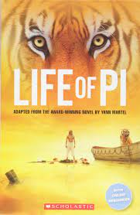
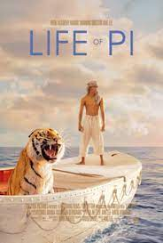

Slide 4
Question
What would someone who knows nothing about this book, and has only seen THIS front cover, think this book is going to be about and why?

Slide 5
Question
What would someone who knows nothing about this book, and has only seen THIS front cover, think this book is going to be about and why?

Slide 6
Question
What would someone who knows nothing about this book, and has only seen THESE front covers, think this book is going to be about and why?

Slide 7
Learning Objectives: To introduce the prose section of the IGCSE literature course. To compare front covers, and make predictions about the novel
Starter:
What do you think the book is going to be about?
What do you think the deeper meanings might be?

Slide 8
Why are we studying this?
English Literature IGCSE exam:
Component 1 (45 minutes)
Choose from two questions to answer in the exam (one is passage-based and the other is an umbrella question).
25% of your final Literature grade.
AO1: UNDERSTAND THE CONTENT OF THE TEXT.
You demonstrate your knowledge of what the novel is about and its deeper meanings. You use TEXTUAL REFERENCES, including QUOTATIONS, to support and illustrate your interpretations.
AO2: Understanding of characters, relationships and themes.
AO3: UNDERSTANDING OF THE author’s INTENTIONS AND METHODS.
You demonstrate an understanding of WHY the write wrote the novel and HOW he uses language to achieve his intentions. You ANALYSE language and structure closely.
AO4: YOU OFFER A PERSONAL RESPONSE TO THE novel.
You engage with the text and OFFER AN OPINION on it sometimes directly (answering questions such as ‘What do you think?’, ‘What are
your feelings about…?’) and sometimes by implication (answering questions such as ‘Explore the ways in which…’)

Slide 9
Main Task: Compare these front covers and explain how they are all similar and then how they are all different.

Slide 10
.
Draw your own front cover.
Create a good front cover for the novel (with colour).
You can magpie ideas from the ones we have looked at.
Consider whether you want your front cover to give away the whole story.
Consider how you could make someone want to buy the book who is walking past it in a book shop.

Slide 11
Look at the list below – do you not know what any of these mean?
Structural:
Foreshadowing
Pathetic fallacy
Types of narrative- 1st person, 3rd person. Flashback. Past tense, present tense.
Different paragraph lengths for effect.
Sentence types- rhetorical questions, complex, compound, simple sentences, lists.
Motifs- repeated symbols.
Language:
Adjectives
Adverbs
Verbs
Similes
Metaphors
Personification
Anthropomorphism
Semantic fields
Alliteration- plosives, fricatives, sibilance.
Symbolism.
Sensory imagery.

