Slide 1
Your Name
GCSE English
Mr Andy

Slide 2
Intro to GCSE English
Thursday 1st September 2022

Slide 3
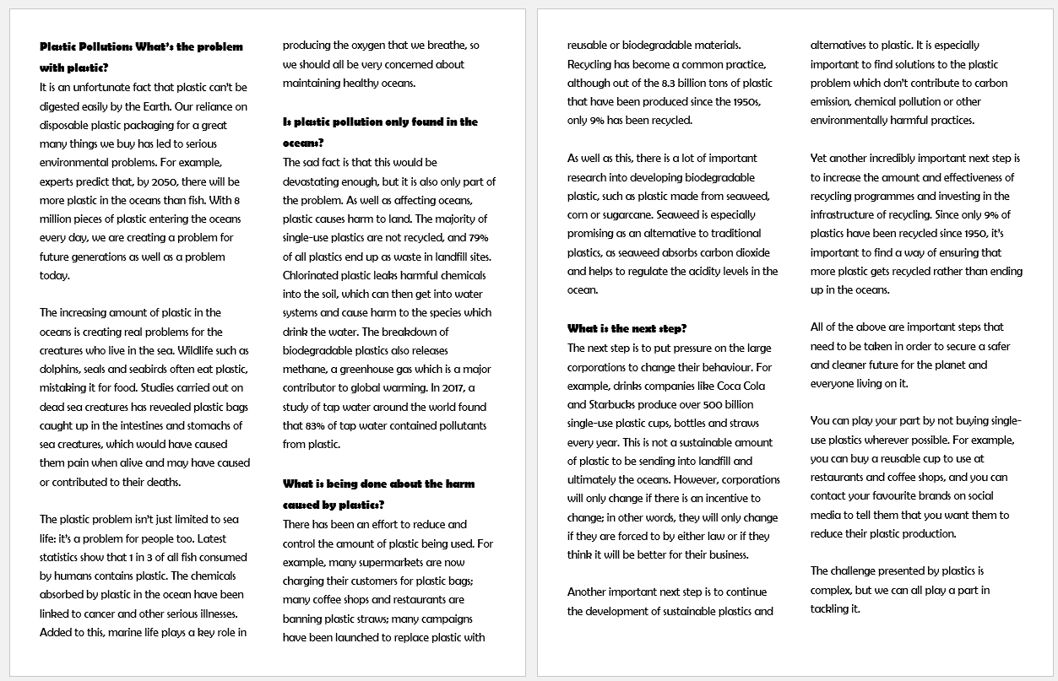

Slide 4
Challenging
1. Define pollution in a sentence.
2. Name TWO reasons why plastic pollution is a problem
3. Describe two examples of the harm done by humans.
Mega Challenging
1. Evaluating the entire article, what are the writer’s opinions on the state of the oceans? How do you know? (1 paragraph)
2. Is this article completely unbiased? How can you tell?
3. What kind of tone does the writer establish in the article and why? Provide examples.
4.. Write a paragraph that summarises your own opinion on plastic pollution. Your sentence should include a semi-colon.
More Challenging
1. Write out TWO sentences from this article which show the writer’s opinion.
2. Describe the next steps in tackling pollution, in your own words.
3. Write out a sentence from the text which contains adjectives. What effect do these adjectives create on the reader? Why?

Slide 5
Writing to persuade
Include:
A rhetorical question
A simile
Imagine you are the CEO of Coca Cola.
You make 500 billion plastic straws and cups every year.
People buy your products and you make A LOT of money.
Write a letter to the author of our last article (on plastic pollution), attempting to persuade them that they are wrong.
(This might be difficult because you might not believe in what you’re writing – THAT’S the skill…)

Slide 6
Writing to persuade
Include:
A rhetorical question
A simile
Imagine you are writing to the CEO of Coca Cola.
You are angry about the 500 billion plastic straws and cups every year.
They are making a lot of money at the expense of the planet.
In your letter you’re trying to persuade the CEO of Coca Cola to cut down on the amount of plastic it produces.
Remember to keep it polite – people don’t respond well to being threatened!

Slide 7
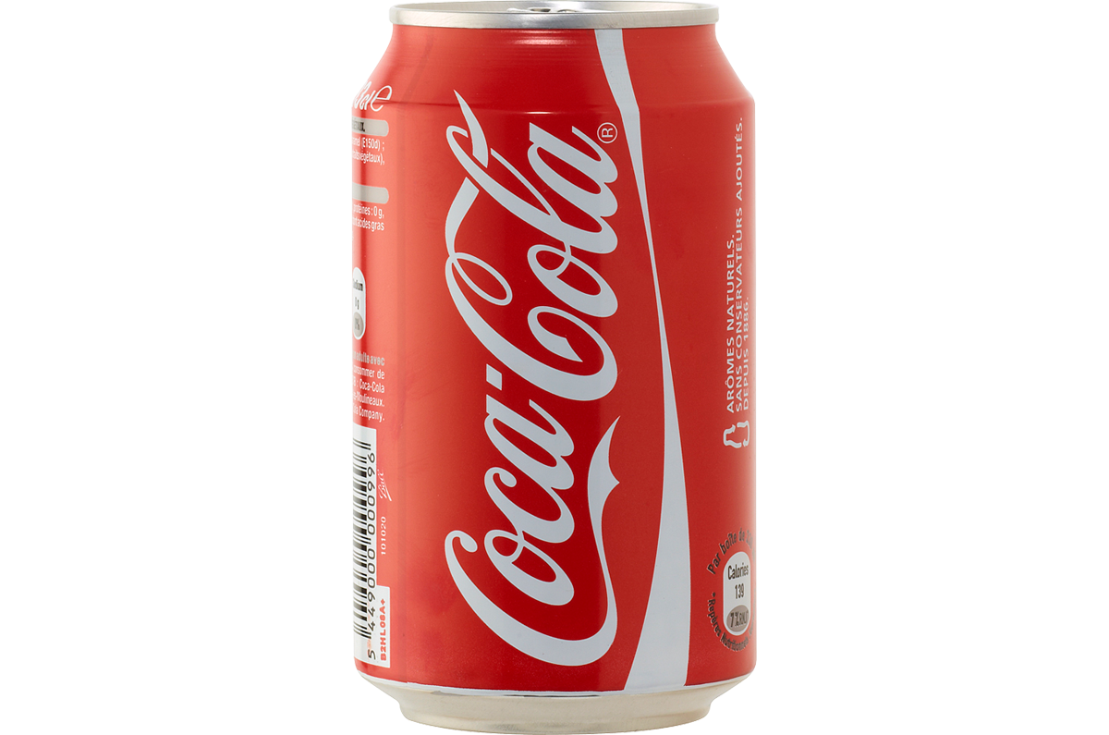
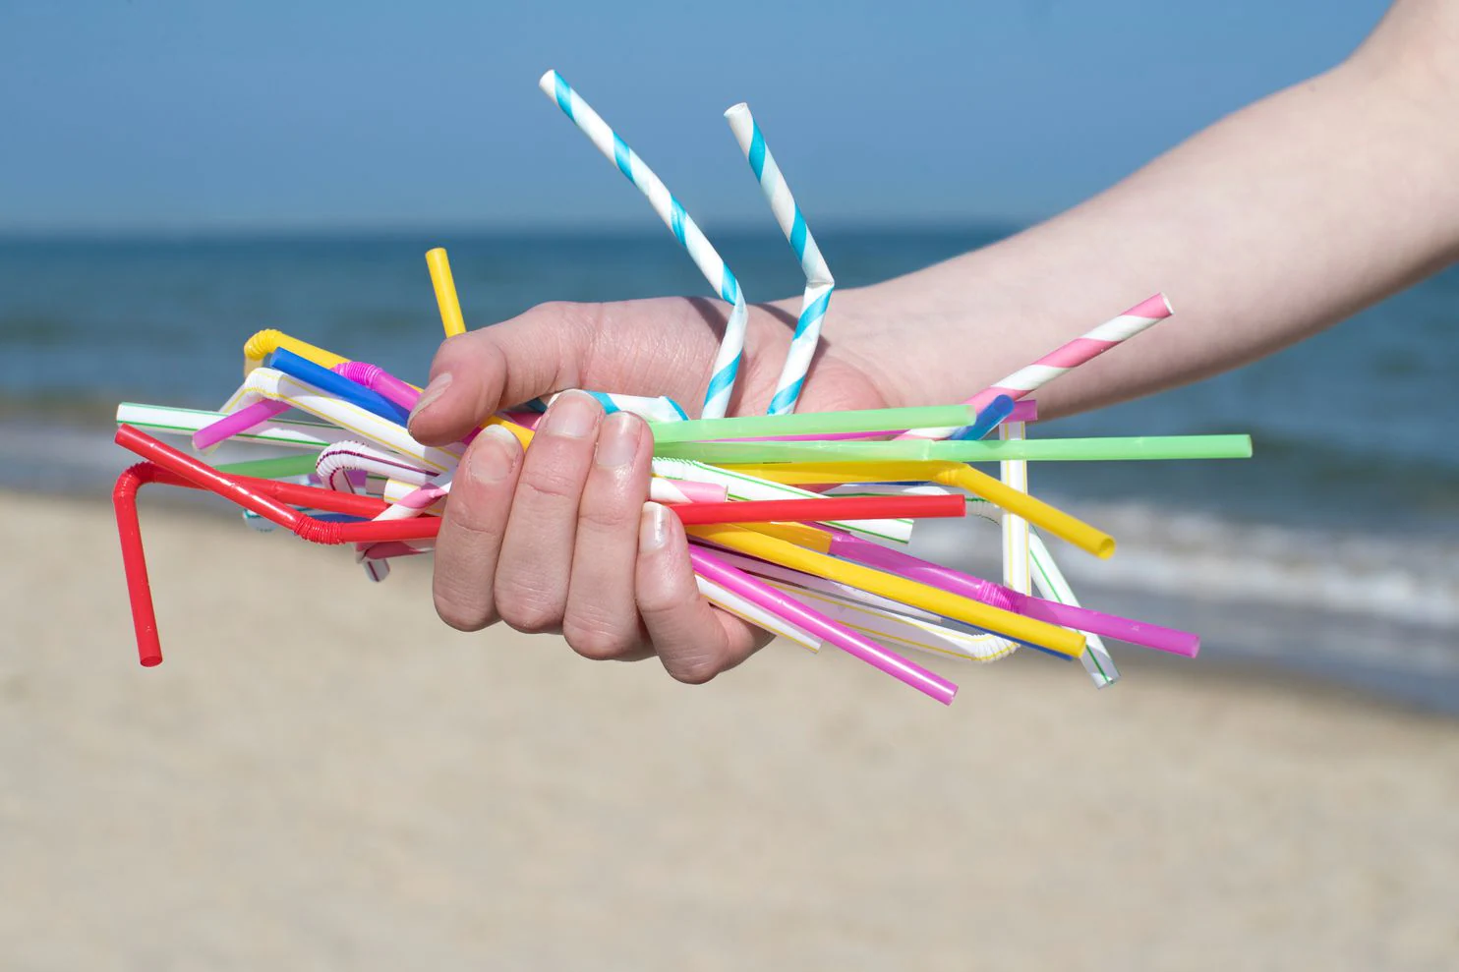
1
2

