Slide 1
Why do we still study William Shakespeare?
Saturday, September 3, 2022

Slide 2
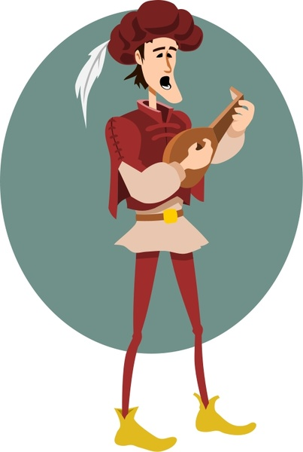
Why do we have to study William Shakespeare?
Shakespeare is considered the greatest playwright in the world.
This includes not just English-speaking countries, but everywhere.
There are a number of reasons for this, and these explain why we keep studying "the bard."

Slide 3
Characterization
Creating ‘believable’ characters that we feel we ‘know’ so much about.
Shakespeare seemed to intensely feel what his characters felt, whether they were good or evil.
He created characters that are powerful because they seem so alive. Their struggles and emotions are completely heartfelt.
They behave consistently, as if they are real people. They draw us in with their deeply felt desires.
Shakespeare’s characterization is so good because he…

Slide 4
Language
Shakespeare doesn't simply put boring, ordinary words into his character's mouths.
The words he uses are so memorable that they stick with us.
He's never afraid of a pun (a play on words) or a metaphor.
Juliet, for example, is not simply beautiful: she sparkles like a jewel against an ear.
Shakespeare’s use of language is so good because…

Slide 5
Range of plays
Not every play Shakespeare wrote was a masterpiece, but he wrote a large number of plays, and very many of them are masterpieces.
He excelled at both comedy and tragedy and did so numerous times.
The consistency of his excellence is stunning.
Shakespeare is also impressive because…

Slide 6
Influence on later authors
References to Shakespeare show up everywhere because so many writers are inspired by him.
So many writers have since tried to emulate him and claim to be inspired by him.
Shakespeare is also impressive because…

Slide 7
Exciting Plots
Shakespeare’s storylines are actually very rarely boring.
He writes about witches, ghosts, fairies, laughter, fights, horror, romance, and bloodshed.
Shakespeare is also impressive because…

Slide 8
Shakespeare’s works are timeless. After four hundred years, people still read, study, and perform his plays and poetry.
Almost anyone can quote from several of his works. The reason that people know them is because they have been a part of our culture constantly since they were published.
It is important to study Shakespeare because it is a part of popular culture. Popular culture refers to movies, television, and songs.
If you don’t study Shakespeare, you will miss all the references that pop up everywhere. You’ll feel left out when other people understand them.
However, the greatest reason to study Shakespeare is that there is a reason his plays are still so popular. The stories’ themes are timeless.
These are tales of young love, madness, family drama, aging, ambition, murder, and intrigue and his poetry is both clever and beautiful.
His plays cover multiple genres. When you read and study the plays, you have a greater appreciation for them. There are so many works, and they have so much to offer.
Why do we still study Shakespeare?
The study of Shakespeare is still important for many reasons. One reason is that Shakespeare has had a vast influence on the English language and is the source of many idioms and metaphors that are still widely used today, such as "all that glitters is not gold" from The Merchant of Venice.
To hear idioms such as this one in its original context is to understand something about the development and evolution of English.
The themes of Shakespeare's plays still resonate today because they speak to the human condition.
For example, if we read Hamlet as a meditation on manhood or Macbeth as a look at the risks of unchecked ambition, it enables us to look at the modern world and perhaps better understand ourselves, others, and our shared humanity.
Love relationships today are often as complicated as those in The Taming of the Shrew, Twelfth Night, and Romeo and Juliet.
Some families are dysfunctional as they are in King Lear. Many people struggle with uncertainty about life, death, and the afterlife as Hamlet does.
The fact that Shakespeare's works are still performed all over the world, both translated into dozens of world languages and in English, is evidence that his work is of global interest, and therefore an art form worthy of study in schools.

Slide 9
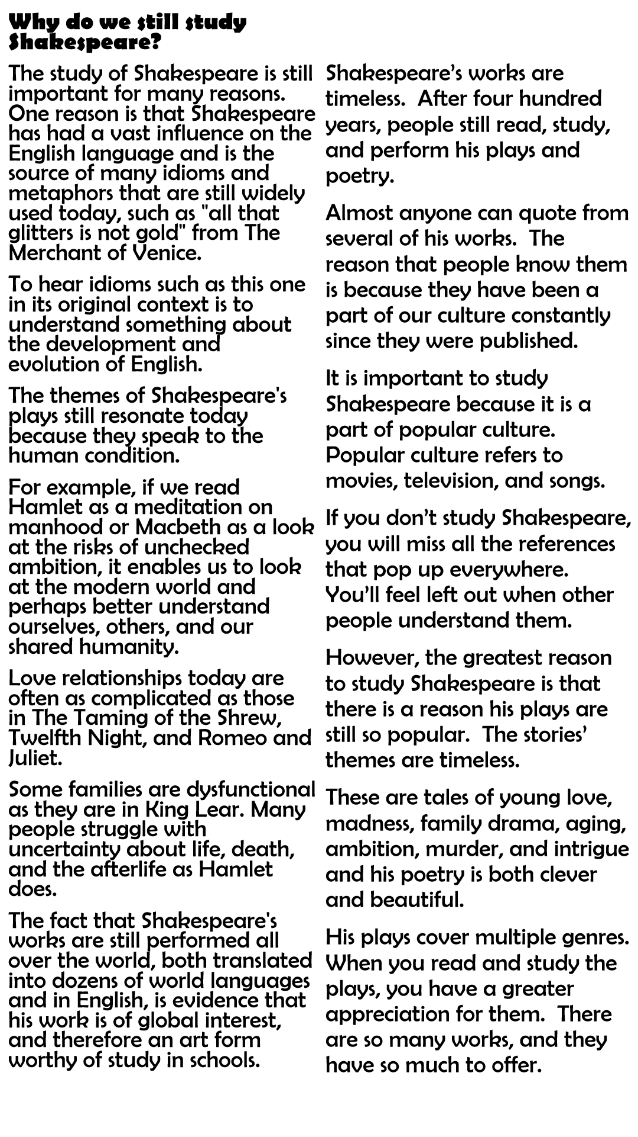
Stick in your handout
We will it through together and highlight certain words.
When we highlight the word, we write the definition in the margin.
Put together all the information we have learnt about Shakespeare today together in your head and write a paragraph in answer to the following question:
Why do we still study Shakespeare?
EXT: a) Tell me the outline of the story of Macbeth
b) Tell me two things you enjoyed about it and why
c) Tell me two things you didn’t enjoy about it and why.

