Slide 1
Digging deeper into Act 1 of Othello
Tuesday, September 20, 2022
Good Progress | Outstanding Progress
Explain the meaning of Quotes within Act 1 in the context of the play as a whole. | Analyse these quotes within an exam-style setting

Slide 2
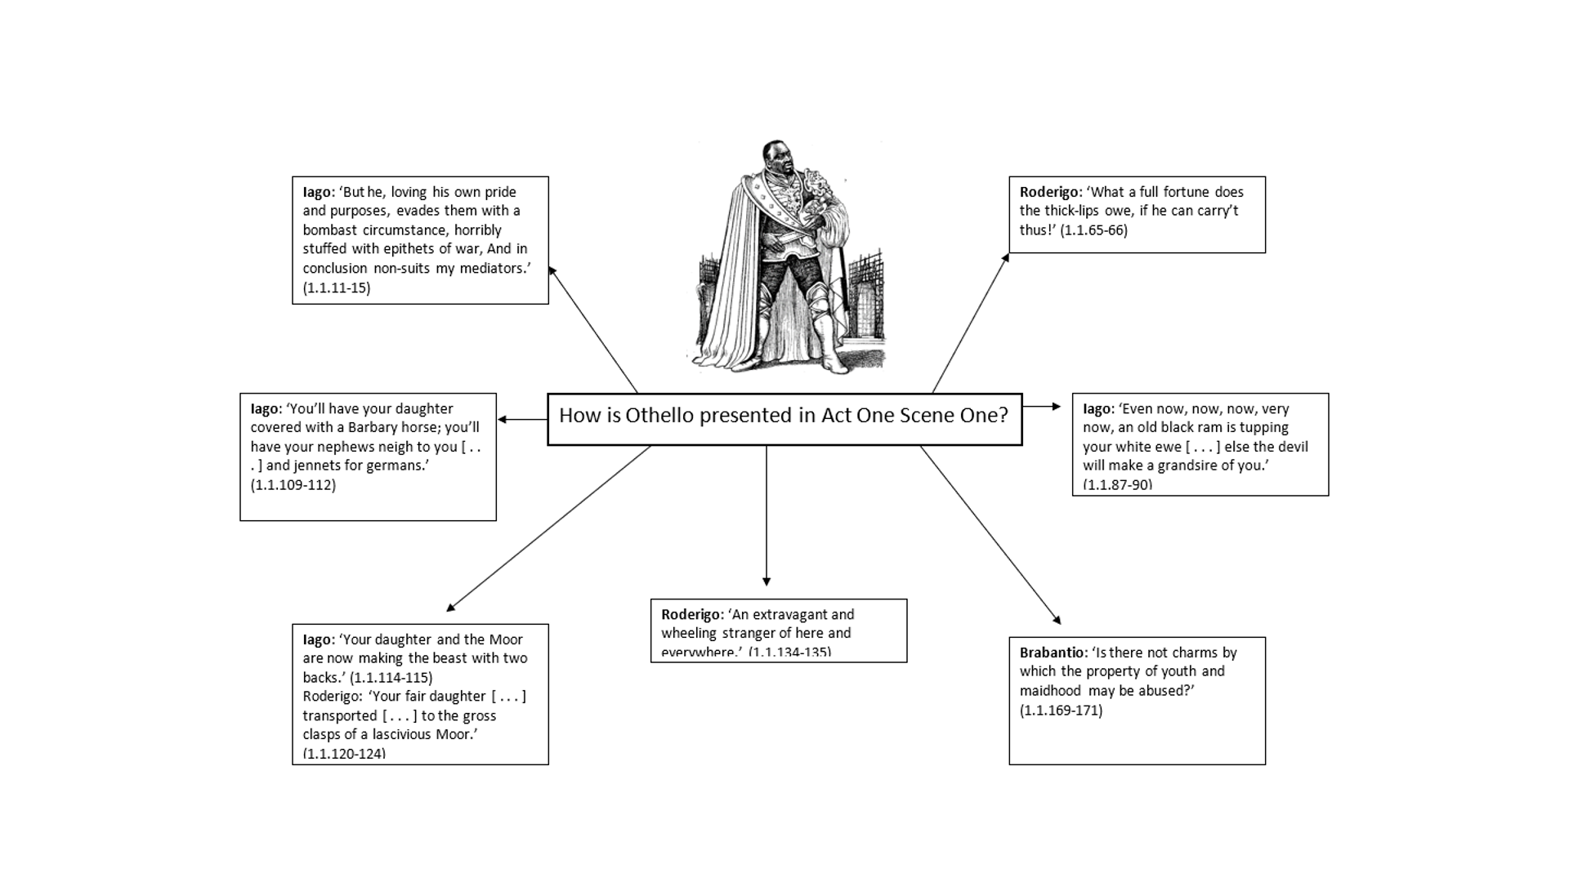
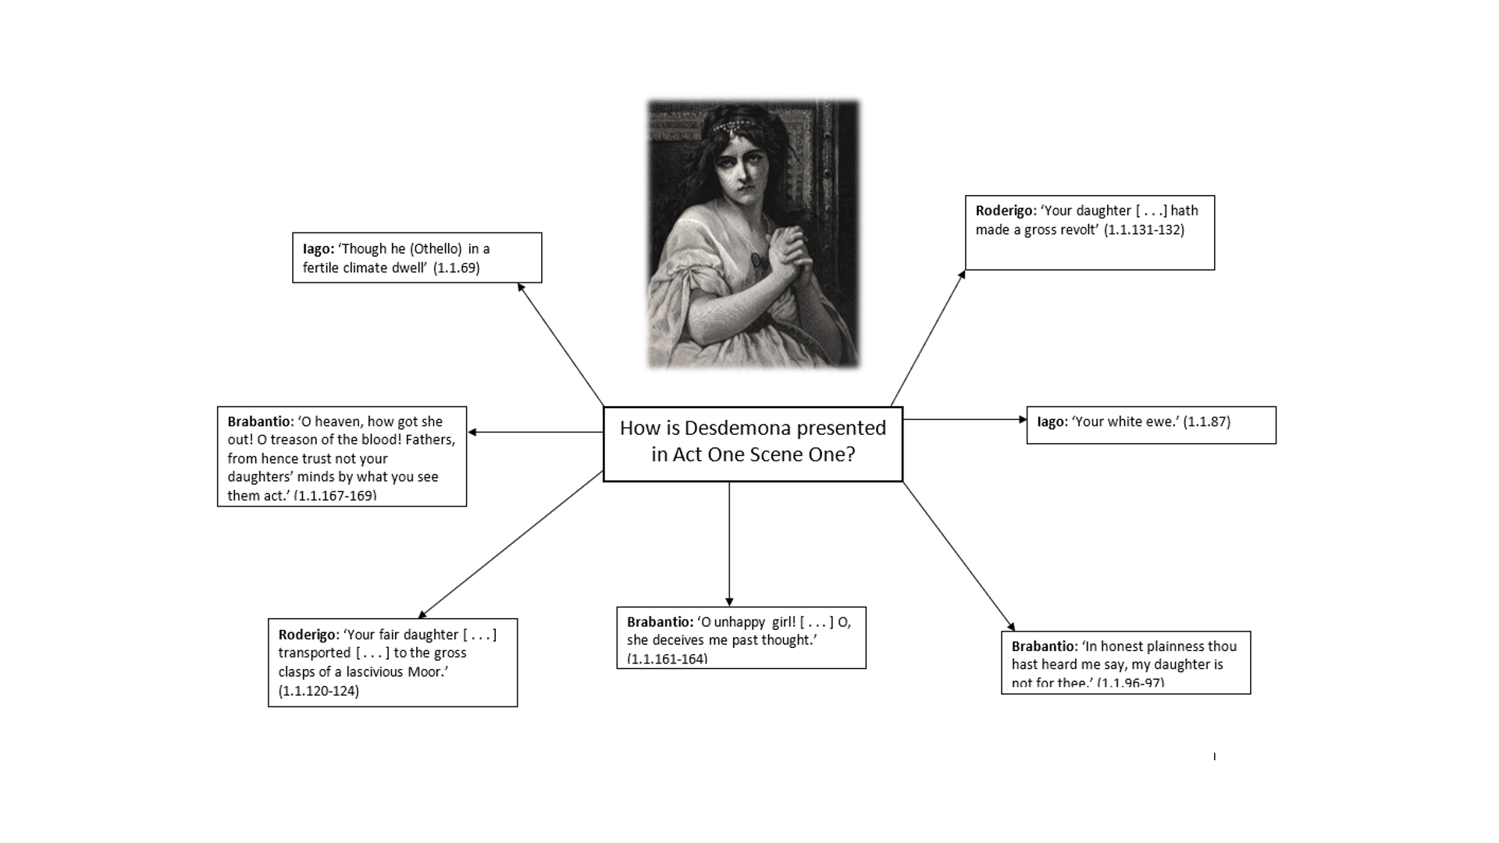
Explain why each quote is significant.
This quote is showing that…
This quote demonstrates…
This quote is suggesting that…
This quote makes me think…
This quote is a good example of…

Slide 5
How is Othello portrayed in Act 1, Scene 1?
Othello is portrayed as….
A quote that supports this is…
This quote shows Othello is… because…
Desdemona is portrayed as…
A quote that supports this is…
This quote shows Desdemona is…. because…
How is Desdemona portrayed in Act 1, Scene 1?

Slide 6
Digging deeper into Act 1 of Othello
Wednesday, September 21, 2022
Good Progress | Outstanding Progress
Explain the meaning of Quotes within Act 1 in the context of the play as a whole. | Analyse these quotes within an exam-style setting.

