Slide 1
Investigating key parts and themes of Act 1 of Othello
Tuesday, September 20, 2022
Good Progress | Outstanding Progress
Explain the significance of different events throughout Act 1 | Analyse and evaluate the significant events of Act 1.

Slide 3
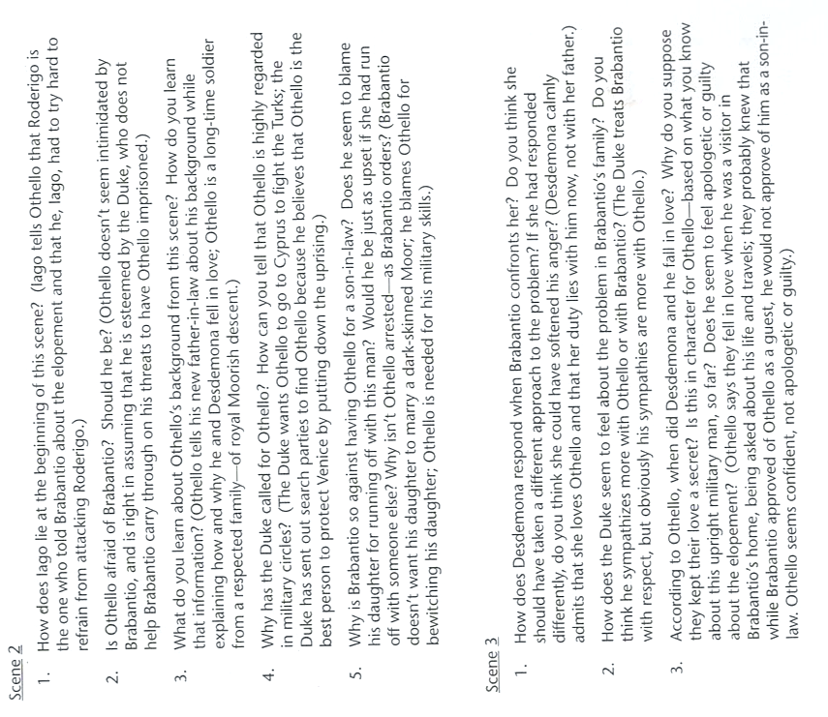

Slide 5
Digging deeper into Act 1 of Othello
Wednesday, September 21, 2022
Good Progress | Outstanding Progress
Explain the meaning of Quotes within Act 1 in the context of the play as a whole. | Analyse these quotes within an exam-style setting.

