Slide 1
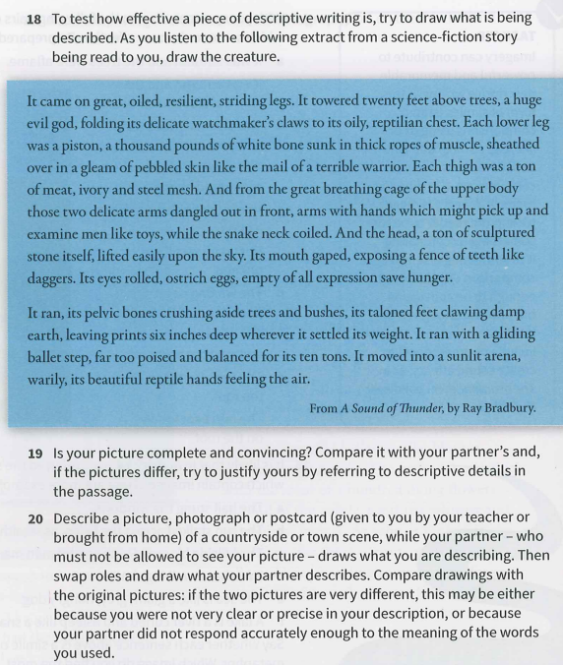
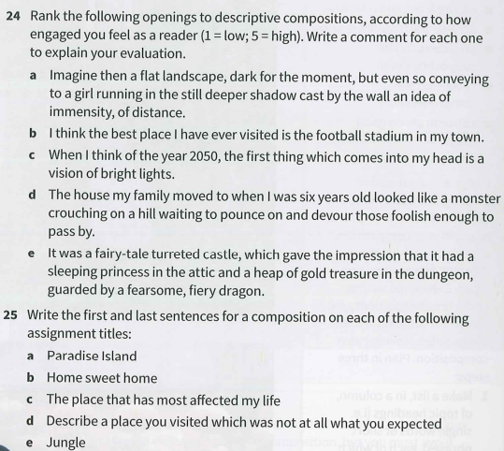
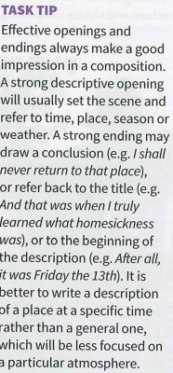
1. Read the below passage and highlight information about the creature.
2. Draw the creature based on the description below.
4.
5.
3.
6.
7. Read and highlight the Task Tip box.

Slide 2
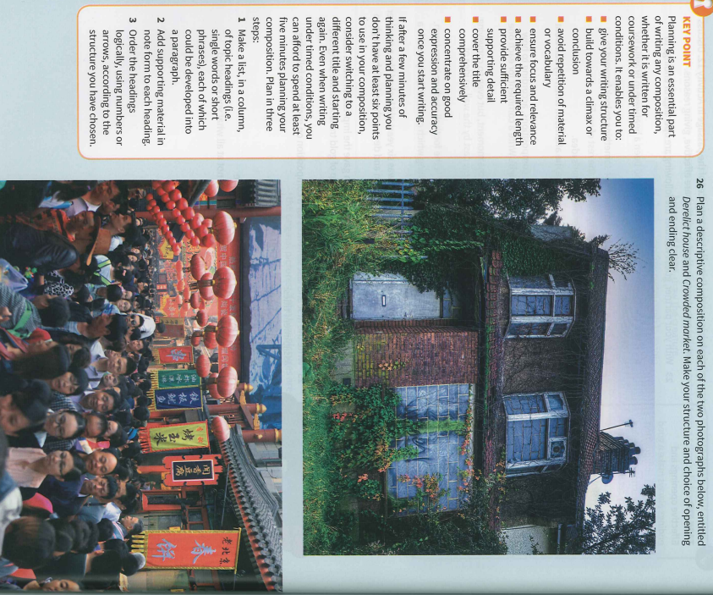
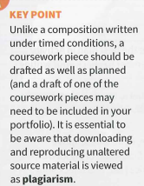
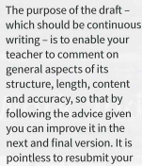
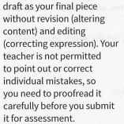
10.
9.
26b. Read and highlight the Key point above.
8. Read and highlight the first Key Point box

