Slide 1
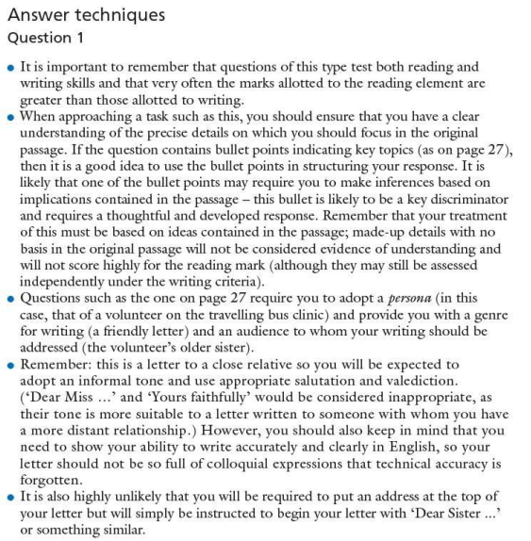
1. Read and highlight the key information on this sheet.
2. What is the most important thing to remember when answering Question 1 type questions on the English Language paper, in your opinion?
3. What do you think is the most important thing to remember when answering Question 2 type questions on the English Language paper?

Slide 2
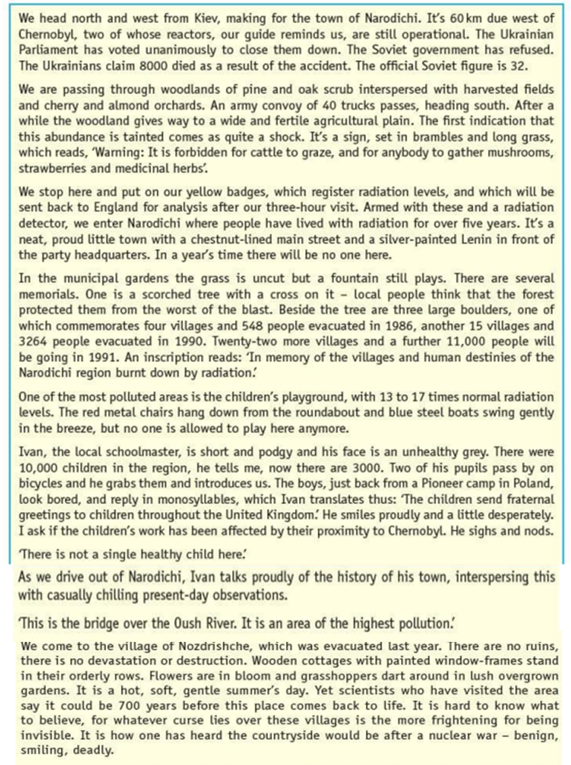
A Trip to Ukraine

Slide 3
