Slide 1
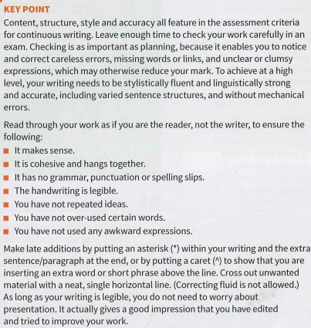
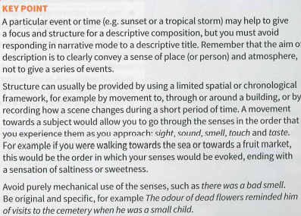
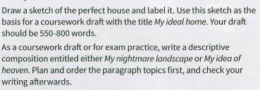
1. Read and highlight they key information in both Key Points.
2. Complete task below:
Write a composition
based on this sketch
3. Complete the following task:

Slide 2
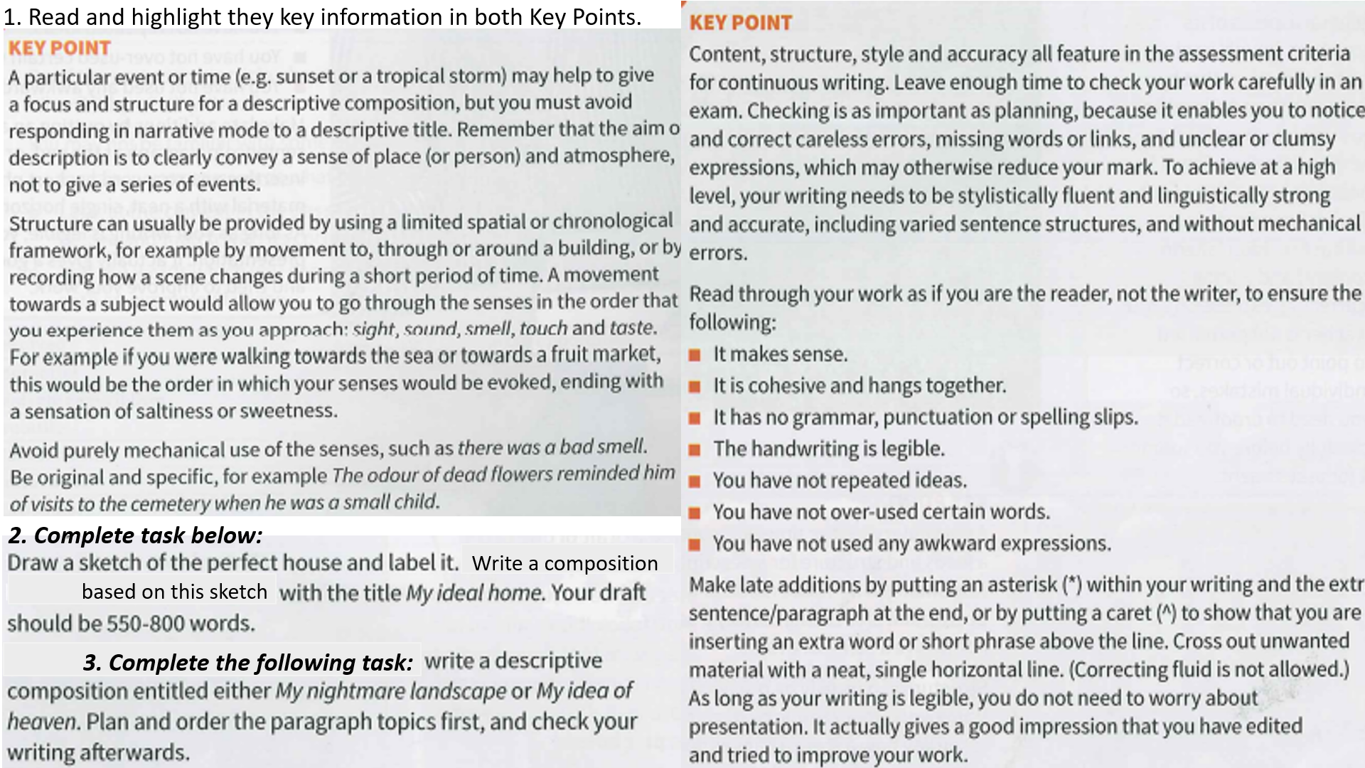
a

Slide 3
