Slide 1
How do we approach extended writing when studying Othello?
Friday, October 7, 2022
Good Progress | Outstanding Progress
Select and attempt an extended-response question | Use success criteria to evaluate your own performance.

Slide 2
Extended writing in GCSE English
Othello
Purple Hibiscus
Short essay based on a passage from the play.
Essay question based on your knowledge of the play
Short essay based on a passage from the book.
Essay question based on your knowledge of the book.

Slide 3
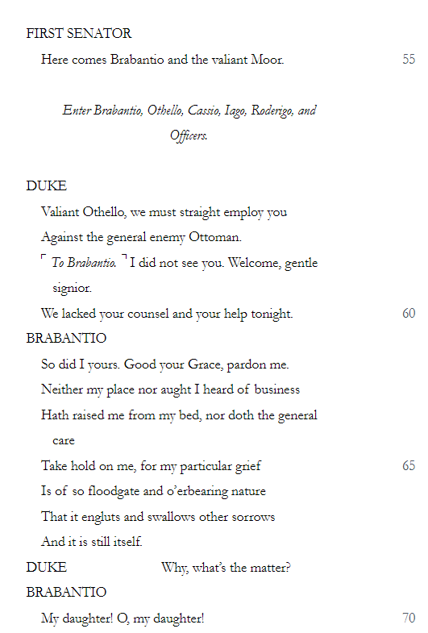
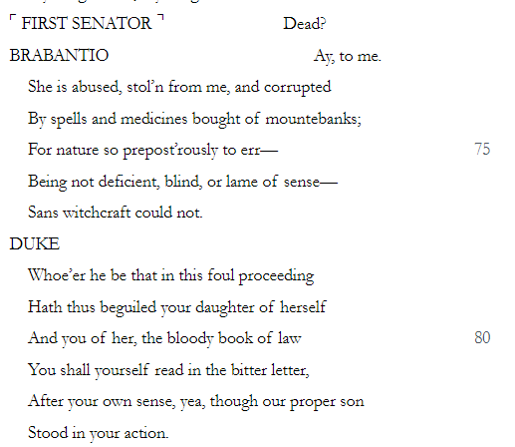
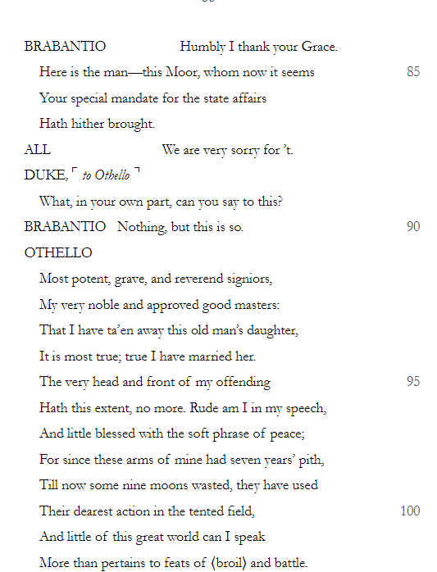
Q. How does Shakespeare make this such a memorable moment in the play?
Shakespeare makes this a very memorable moment in the play by…
For example, in the passage…
This makes it a memorable moment for the audience because….
Another way Shakespeare makes this a memorable part of the play is…
For example, in the passage…
This makes it a moment that sticks in the audience’s mind because…
A final way that Shakespeare makes this a memorable moment is…
For example, in the passage…
This makes it such a memorable moment because…
Writing a third paragraph is challenging because of: a) the time it takes, b) how tired your hand gets, and c) you might think you can’t find anything else in the passage to talk about.

Slide 4
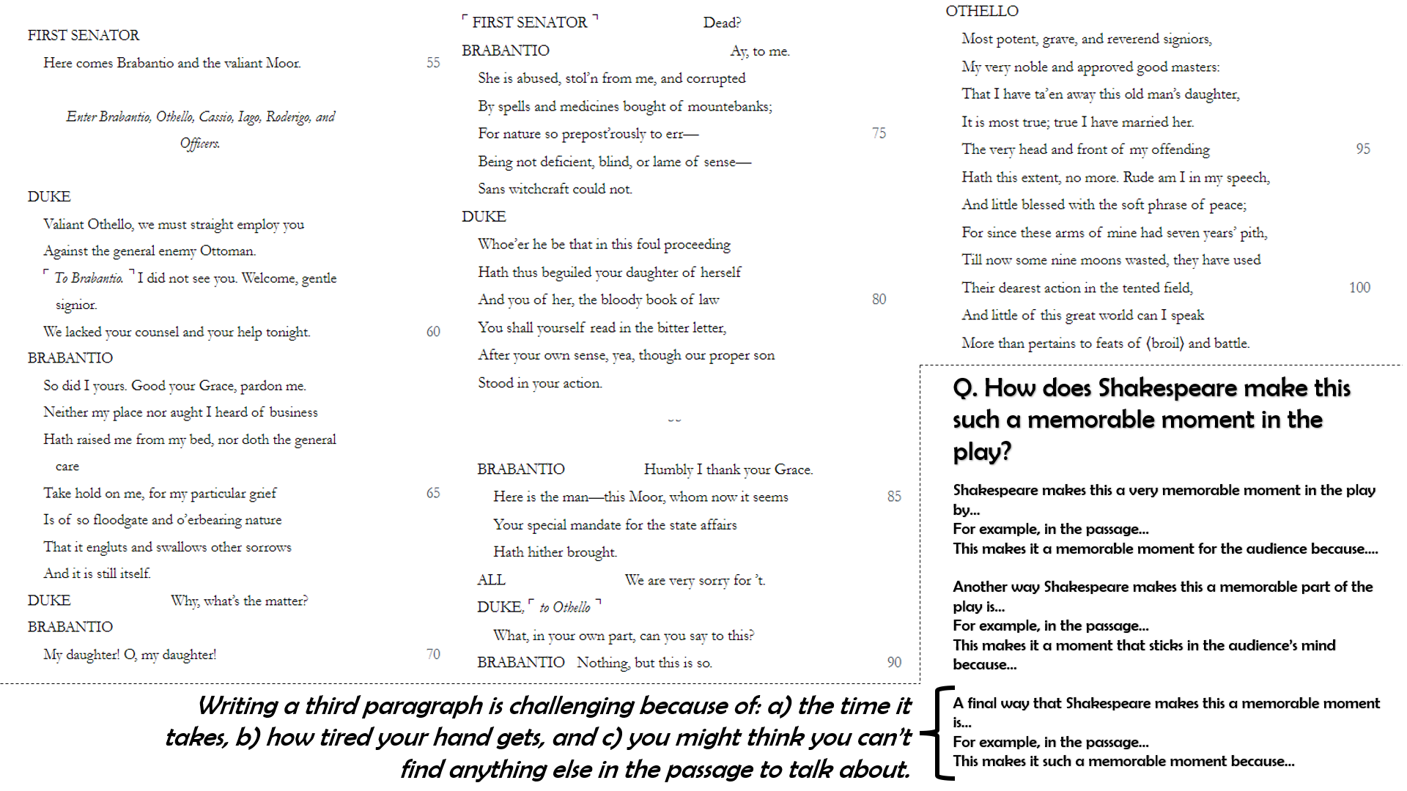
or
To what extent do you think Shakespeare portrays Iago as a jealous subordinate?

Slide 5
To what extent do you think Shakespeare portrays Iago as a jealous subordinate?
I believe that Shakespeare portrays Iago as a jealous subordinate to a large extent.
For example…
This shows Iago is jealous because…
Another example of Iago’s jealousy becoming evident to the audience in the play is when….
This shows he is jealous because…
He is not just jealous though; he is also very much a subordinate to Othello. This is evident on numerous occasions when…
This shows his subordination to Othello because…
It is therefore clear then that Iago’s subordination to Othello is actually the cause of his jealousy. This is because…
Difficult because you need to be careful not to repeat yourself. Don’t re-write what you’ve already written above.
Difficult because you need to be careful not to repeat yourself AND you’ve got to link two separate concepts: jealousy and subordination.

Slide 7
How do I know if I’ve done well?
Now, in green pen, given the above info, make your answer better ☺
EXT: Attempt the other question

Slide 8
Extended writing in GCSE English
Othello
Purple Hibiscus
Short essay based on a passage from the play.
Essay question based on your knowledge of the play
Short essay based on a passage from the book.
Essay question based on your knowledge of the book.

Slide 9
Plenary
Tell me where these themes are evident so far in the play?
Race
Pride
Magic
Order vs. Chaos
Self-Knowledge
Good vs. Evil
Appearance vs. Reality

Slide 10
Which question am I going to answer?
Friday, October 7, 2022
Good Progress | Outstanding Progress
Select and attempt an extended-response question | Use success criteria to evaluate your own performance.

