Slide 1
What’s going on in Act 2 Scene 2&3?
Monday, October 10, 2022
Good Progress | Outstanding Progress
Describe the key features of Act 2 Scene 2&3 | Explain how Act 2 Scene 2 fits into the play in terms of the plot, structure and its wider themes.

Slide 2
Extended writing in GCSE English
Othello
Purple Hibiscus
Short essay based on a passage from the play.
Essay question based on your knowledge of the play
Short essay based on a passage from the book.
Essay question based on your knowledge of the book.

Slide 3
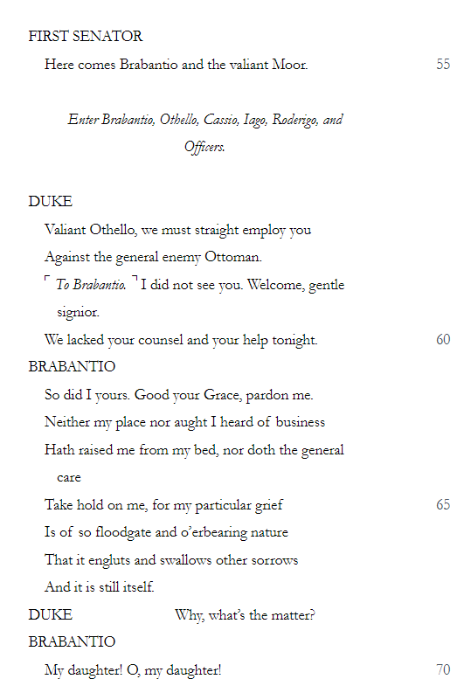
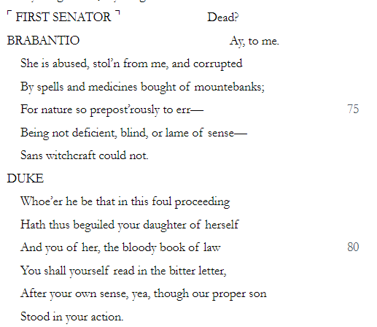
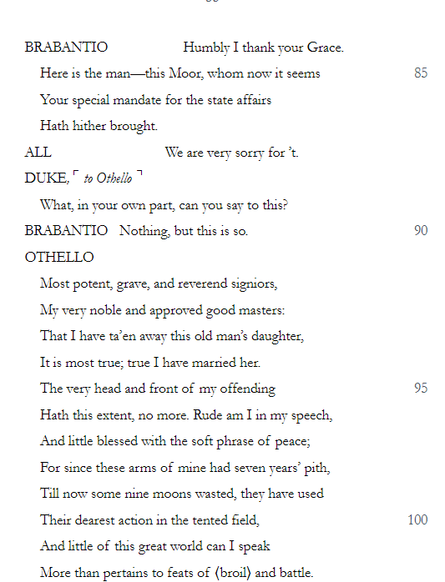
Q. How does Shakespeare make this such a memorable moment in the play?
Shakespeare makes this a very memorable moment in the play by…
For example, in the passage…
This makes it a memorable moment for the audience because….
Another way Shakespeare makes this a memorable part of the play is…
For example, in the passage…
This makes it a moment that sticks in the audience’s mind because…
A final way that Shakespeare makes this a memorable moment is…
For example, in the passage…
This makes it such a memorable moment because…
Writing a third paragraph is challenging because of: a) the time it takes, b) how tired your hand gets, and c) you might think you can’t find anything else in the passage to talk about.

Slide 4
To what extent do you think Shakespeare portrays Iago as a jealous subordinate?
I believe that Shakespeare portrays Iago as a jealous subordinate to a large extent.
For example…
This shows Iago is jealous because…
Another example of Iago’s jealousy becoming evident to the audience in the play is when….
This shows he is jealous because…
He is not just jealous though; he is also very much a subordinate to Othello. This is evident on numerous occasions when…
This shows his subordination to Othello because…
It is therefore clear then that Iago’s subordination to Othello is actually the cause of his jealousy. This is because…
Difficult because you need to be careful not to repeat yourself. Don’t re-write what you’ve already written above.
Difficult because you need to be careful not to repeat yourself AND you’ve got to link two separate concepts: jealousy and subordination.

Slide 5
How do I know if I’ve done well?

Slide 6
Othello: Act 2, Scene 3
A Herald proclaims that Othello has announced a celebration to mark the destruction of the Turks and his marriage to Desdemona. He ordered that the people of Cyprus should eat and drink and indulge in any other celebratory pleasures that took their fancy, from the hour of five until the bell rang the hour of eleven.
Othello: Act 2, Scene 3, Part 1 of 2
Othello ended his meeting with Cassio by reminding him about the behaviour expected of a visiting army, particularly on an evening when there were going to be revellers on the streets. ‘Good Michael,’ he said. ‘Keep your eye on the guard tonight, We must set an example and not overdo it.’ ‘Iago knows what to do,’ said Cassio. ‘But I’ll keep an eye on it personally.’
‘Iago is most honest,’ said Othello. ‘We’ll goodnight, Michael. I need to talk to you first thing in the morning.’ He smiled at the waiting Desdemona. ‘Come, my dear love,’ he said. ‘We’ve made the purchase; the fruits are to follow. The profit’s yet to come between me and you.’ He turned and smiled at Cassio and the other officers. ‘Goodnight.’ Iago was already in the guardroom when Cassio arrived.
‘We must attend to the guard,’ said Cassio. ‘Not yet,’ said Iago. ‘It’s not ten o’clock yet. Our general got rid of us early for the love of his Desdemona, and I don’t blame him. He hasn’t done it with her yet; and she’s sport for the gods.’
‘She’s a most exquisite lady,’ said Cassio. ‘And full of game, I’ll bet.’ ‘She’s certainly a lovely, delicate creature.’ ‘What an eye she has: a real come and get it look.’ ‘A welcoming eye,’ said Cassio, ‘and yet very modest, I think.’ ‘And when she speaks, isn’t it a signal for love?’ ‘She’s certainly perfection.’ ‘O well, let them enjoy it.’ Iago clapped Cassio on the back. ‘Come Lieutenant,’ he said. ‘I’ve got a jar of wine, and there is a brace of Cyprus lads outside who want to drink to the health of black Othello.’
‘Not tonight, Iago. I can’t take too much drink. I really wish society would invent some other form of entertainment.’ Iago sighed. ‘They’re our friends. Just one glass. I’ll do your drinking for you.’ ‘I’ve already had one glass tonight,’ said Cassio, ‘and that was cunningly diluted as well; and look at the effect it’s had on me. I’m unlucky in that defect and daren’t push it with more drinking.’ Iago clapped his hands in front of Cassio’s face. ‘Come on, man, it’s a night of partying. The lads want it.’ ‘Where are they?’ ‘There, at the door. Go on, invite them in.’ ‘I’ll do it,’ said Cassio, ‘but I don’t like it.’
Iago couldn’t believe his luck. Now if he could just make him have one glass, that, together with what he had already drunk, would make him as quarrelsome and offensive as a lapdog. And the sick fool, Roderigo, who had been turned inside out with love had drunk himself silly in toasts to Desdemona, was out there too. It was all coming together. He had made three other men of Cyprus drunk – men of high rank, the backbone of Cyprus. He would put Cassio among this flock of drunkards and induce him to commit some act that would offend the people of Cyprus. It was all going smoothly, like a boat sailing freely with favourable winds and currents.
Cassio came back into the guardroom with Montano and some other men of Cyprus. They’d all been drinking and Cassio was holding a mug. ‘Before God, they’ve given me enough already,’ he said. Montano, in a celebratory mood, laughed. ‘As I am a soldier, it’s a small one. Not much more than a pint.’ Iago beckoned the servants. ‘Hey, some wine here,’ he said. They served everyone and Iago started tapping his foot, creating a rhythmic beat, then he began to sing.
‘And let me the canakin clink, clink.’ banging his mug against those of the others’ who, stamping their feet to the rhythm, put their mugs forward to him as he moved among them. ‘A soldier’s a man Oh, man’s life but a span; Why, then, let a soldier drink. Some wine, boys.’ Cassio was tapping and clinking and drinking with the others. His voice was slurred as he praised Iago’s singing. ‘Fore God, that’s an excellent song,’ he said.
‘I learnt it in England where they’re great boozers,’ said Iago. ‘Your Dane, your German, and your swag-bellied Hollander… Hey, more wine!… are nothing to your English.’ ‘Is your Englishman so expert in his drinking?’ said Cassio. Iago beamed at him. ‘Why, he easily drinks your Dane under the table. He defeats your German without breaking sweat and he outdrinks your Hollander into vomiting before the next jug can be produced.’ Cassio raised his mug. ‘To the health of our General!’ he shouted and they all drank. ‘I’m in favour, Lieutenant,’ said Montano, ‘and I’ll match you.’ Iago raised his mug again.
‘O sweet England,’ he said, and began singing.
‘King Stephen was and-a worthy peer
His breeches cost him but a crown;
He held them sixpence all too dear;
With that he called the tailor lown.
He was a wight of high renown,
And thou art but of low degree;
‘Tis pride that pulls the country down;
Then take thine old cloak about thee… More wine here!’
Cassio slapped his thigh. ‘Fore God, this is an even better song than the other!’ He took a long swig. ‘Want to hear it again?’ said Iago. Cassio swayed. ‘No,’ he said. He squinted at Iago. ‘Because I don’t think a king who does those things is worthy of his position.’ He took another swig. ‘Oh well, God’s above everyone. And there are some souls… must be saved and… some souls… must not be saved.’
Iago’s attention was completely focused on Cassio now. ‘It’s true, good Lieutenant,’ he said. ‘For myself!’ Cassio stumbled and righted himself again. ‘No offence to the General…’ swinging round and bowing elaborately to the gentlemen of Cyprus – ‘Nor to any man of quality. I hope to be saved.’
‘And so do I, Lieutenant,’ said Iago. Cassio prodded Iago’s chest. ‘Yes, but if you don’t mind, not before me. The Lieutenant has to be saved before the Ensign.’ He swung round to the guests. ‘Let’s have no more of this,’ he said. ‘Let’s get down to business. God forgive our sins. Gentlemen, let’s take care of our business.’
They were all staring at him. No-one said anything. Cassio drained his drink. ‘Don’t think I’m drunk, gentlemen,’ he said. He planted a heavy hand on Iago’s shoulder. ‘This is my Ensign.’ He raised his hand and stared at it. ‘This is my right hand.’ He raised the other. ‘This is my left hand. I am not drunk. I can stand well enough.’ He tried standing on one leg and gave up. ‘I can speak well enough.’ His speech was slurred.’ They all clapped and laughed and assured him that he could do those things well.
‘Very well, then,’ he said. ‘You mustn’t think, then, that I am drunk.’ He staggered towards the door and went out into the night. Montano handed his mug to a servant. ‘To the platform, gentlemen,’ he said. ‘Come, let’s set the watch.’ Iago walked with Montano.
‘You see that fellow who’s just left? He’s a soldier fit to stand beside Caesar and command Roman legions, and look at his weakness. It’s the exact opposite of his strength, each one as powerful as the other. It’s such a pity. I fear that the trust Othello has put in him, just at the time of his infirmity, will shake this island.’
‘But is he often like this?’ said Montano. ‘He does this more and more before he goes to bed. He’d stay awake around the clock if he didn’t drink himself to sleep.’ ‘I think someone should tell the General. Perhaps he doesn’t know, or perhaps his good nature values the positive things in Cassio and overlooks his weaknesses. Do you think that’s it?’ Roderigo appeared out of the shadows and Iago mouthed to him to go after Cassio.
‘And,’ Montano was saying, ‘it’s a great pity that the noble Moor should risk putting someone with such a failing in the position of second in command. It would be an act of honesty to tell the Moor.’ ‘Not I!’ Iago seemed shocked. ‘Not for this fair island! I’m very fond of Cassio and would do anything to cure him of this fault.’ They were interrupted by a commotion that was coming nearer. Someone was shouting … ‘help! help!’ Roderigo ran past them with Cassio, his sword out and raised, hot in pursuit. ‘You rogue! You rascal!’ Cassio shouted as he chased Roderigo.
Montano ran towards him and stopped him in his tracks. ‘What’s the matter, Lieutenant?’ he said. Cassio’s face was red and he was out of breath. ‘A rogue like that teaching me my duty,’ he gasped. ‘I’ll beat the rascal till he looks like wicker-work. Roderigo, emboldened by the presence of Iago and Montano squared up to Cassio. ‘Beat me?’ he said. Cassio was beside himself. ‘Are you babbling, rogue?’ and he lunged at him, striking at his face. Montano came between them. ‘No, good Lieutenant,’ he said. ‘Stop this.’
Cassio lunged again and Montano took him in a head grip. Cassio struggled hard. ‘Let me go, Sir,’ he shouted, ‘or I’ll knock your head off.’ ‘Come, come,’ said Montano, gently releasing him. ‘You’re drunk.’ ‘Drunk!’ Cassio punched Montano in the face. Iago gestured to Roderigo. ‘Get out of here,’ he hissed. ‘Make as much noise as you can. Cry mutiny.’ Roderigo ran off. Cassio and Montano were fighting and Iago tried to pull them apart. ‘’No, good Lieutenant!’ he shouted. ‘For God’s sake, gentlemen! Someone help us! Lieutenant! Sir! Montano! Sir! Help, please! This is a fine watch.’
A bell rang out. ‘Who’s ringing the bell?’ said Iago. He tried to stop the fighting again but the lieutenant and the governor were clinging to each other, each one trying to get the upper hand. ‘You’re disturbing the town. For God’s sake, Lieutenant, stop! You’ll be shamed forever!’ He was suddenly aware that Othello was there. ‘What’s going on here?’ said the General.
Montano pulled himself away from Cassio’s grasp. ‘God’s wounds,’ he cried. ‘I’m bleeding profusely. I’m badly hurt.’ He hit Cassio again. ‘Stop, for the sake of your lives!’ said Othello. The pair took no notice of him and Iago started pulling at Cassio. ‘Stop! Lieutenant. Sir! Montano,! Gentlemen! Have you forgotten where you are? The General is talking to you. Stop, for shame!’ When they saw Othello they stepped back and stared at him. Othello’s face showed his shock.
‘Well,’ he said. ‘How did this start? Have we become Turks that we are doing what the Ottomites’ religion has forbidden even them? For Christian shame, stop this barbarous brawl.

Slide 7
Othello: Act 2, Scene 3, Part 2 of 2
Whichever of you moves again has no regard for his soul: he dies instantly.’ He turned to one of his attendants. ‘Silence that dreadful bell. It’s disturbing the people of the island.’ The two fighters stood, ashamed, before him. ‘What’s the matter, gentlemen?’ he said. ‘Honest Iago, you look dead with grief. Tell me. Who began this? Iago shifted from one foot to the other, avoiding Othello’s glare. ’I order you,’ said Othello. Iago shrugged. ‘I don’t know,’ he said. ‘They were friends until now, until just a minute ago. In the guardroom they were like bride and groom preparing themselves for bed: and then, just a moment ago, as though some planet had taken possession of them – swords out, and tilting at each other’s chests in bloody opposition. I can’t tell you how this animosity began. I wish that I had lost the legs that have brought me here to see it in some glorious battle.’
Othello stepped forward and looked Cassio in the eyes. ‘How have you forgotten yourself like this Michael?’ Cassio avoided the General’s eyes. ‘I’m sorry,’ he said. ‘I can’t speak.’ Othello turned to Montano. ‘Worthy Montano,’ he said. ‘You are usually so civil. Everyone knows how mature and calm you are for your age, and you are highly thought of by the wisest men. What’s the matter that you could unravel your reputation like this to be seen as a night brawler? Answer me.’
Montano was wincing with the pain of his wounds. ‘Worthy Othello,’ he said. ‘Your officer, Iago, will tell you. I don’t want to talk, I don’t want to make trouble. I don’t know of anything that I’ve said or done wrong tonight, unless self protection is a failing and to defend ourselves is a sin when we’re victims of violence.’
Othello’s patience had come to its end. No-one was prepared to tell him how this had happened. He drew himself up. ‘Now, by heaven,’ he said, ‘I’m getting angry, and I’m about to lose my temper. By God’s wounds, I’m tempted to lift this arm, and if I do, even the best of you will suffer. Tell me right now how this disgraceful fight started and who started it, and whoever it was, even if he were my twin, I will condemn him. What! In a town beset by war, still unsettled, the people living in fear, to indulge in a private and domestic quarrel, at night and in the place from which the people are being guarded! It’s monstrous. Iago, who started it? Montano gripped Iago’s arm. ‘If out of bias you tell anything less than the truth you are no soldier.’
All eyes were on Iago. He had to choose his words carefully. ‘Don’t think that,’ he said. ‘I would rather have my tongue cut out than that it should utter anything offensive to Michael Cassio. But I’m telling myself that the truth won’t harm him. Here it is, General. Montano and I were chatting and this fellow appeared, crying out for help, and Cassio was chasing him with his sword raised. Sir, this gentleman, Montano, steps in and begs Cassio to stop. I pursued this shouting fellow because I thought the noise would wake the town – as it did. He, running fast, got away and I went back and there was the clink and fall of swords, and Cassio was swearing, which I had never heard from him before.
Then I saw them close together in combat, thrusting and hitting each other, just as they were doing when you yourself parted them. I can’t tell you any more about it. But men are what they are. Even the best sometimes forget themselves. Although Cassio did some wrong to Montano, as men in a rage sometimes strike those who wish them no harm… I suppose Cassio was insulted by the fellow who ran away – in a way that he couldn’t tolerate.’ ‘I know, Iago,’ said Othello, ‘your honesty makes you mince this matter, putting a better light on Cassio.’ He went and stood in front of Cassio and looked sternly at him. ‘Cassio, I love you, but you can’t be my officer any more.’
Desdemona arrived just then, attended by some soldiers and a group of women. Othello stretched his hand out to her. ‘Look, you’ve even disturbed my gentle love,’ he told Casssio. ‘I’m going to make an example of you.’ ‘What’s the matter, dear?’ she said. ‘All is well now, Sweetheart,’ he said. ‘Come, let’s go to bed.’ He turned to Montano. ‘Sir, I will do everything I can to make amends.’ Montano groaned and clutched his head. His friends led him away. Othello took Desdemona’s hand. ‘Iago,’ he said. ‘Go and sort it out with the citizens. Calm those who have been disturbed. Come Desdemona, this is the life of a soldier – being woken up because of trouble.’ When they had gone only Iago and Cassio were left. Cassio sank his head into his hands and sat, unmoving. Iago touched his shoulder but there was no response.
‘What! Are you hurt, Lieutenant?’ ‘Yes,’ said Cassio. ‘Past all surgery.’ ‘No! God forbid!’ said Iago. Cassio didn’t look up. His head moved slowly from side to side. ‘Reputation, reputation, reputation,’ he said. ‘Oh, I have lost my reputation. I have lost my soul and what I’m left with is bestial.’ He looked up at Iago. His eyes were wet. ‘My reputation, Iago, my reputation,’ he said mournfully.
Iago affected a sigh of relief. ‘As I am an honest man I thought you had received some physical wound,’ he said. ‘That would be far more serious than a wounded reputation. Reputation is a useless and false concept, often gained without merit and lost without deserving. You haven’t lost your reputation – it’s all in your mind.’ He lifted Cassio’s face and looked into his eyes. ‘Come on man, there are ways of re-establishing yourself with the General. You’re a victim of the moment – it’s more of a diplomatic punishment, to set an example, than a permanent one, like beating an inoffensive dog to intimidate a fierce lion. Go to him and he’ll forgive you.’
‘I would rather beg him to despise me than to impose such a pathetic, drunken, indiscreet officer on such a good commander. Drunk! And talk nonsense! And fight! Swagger! Swear! And talk rubbish to myself! Oh, you invisible evil of wine. If there was no other name to call you we could call you devil.’ ‘Who was that man you chased with your sword?’ said Iago. What did he do to you?’ ‘I don’t know. I can remember lots of this, but nothing clearly: a quarrel but not the cause of it. Oh God, that men should put such an enemy in their mouths to steal their brains! That we should with happiness, pleasure, partying and celebration transform ourselves into beasts!’ ‘But you’re sober now,’ said Iago. ‘How did you make such a good recovery?’
‘Drunkenness has given way to anger. One imperfection leads to another to make me despise myself. ‘Come, you’re too hard on yourself. Given the time and the place I heartily wish this hadn’t happened, but since things are as they are, make the best of it in your own interest.’ Cassio’s shoulders slumped even further. ‘Oh yes, I’ll ask him for my place again: he’ll tell me I’m a drunkard. Even if I had as many mouths as Hydra such an answer would shut them all. To be a sensible man at one moment, and then a fool, and eventually a beast! Oh, strange! Every ill-advised cup is cursed and the contents are a devil!’ Iago laughed. ‘Come, come; good wine is a good friend if it isn’t abused. Don’t run it down.’ Cassio shook his head in misery.
‘Good Lieutenant, I think you know I’m your friend.’ ‘I know that,’ said Cassio. ‘Me! Drunk!’ ‘You, like any man, may be drunk from time to time. I’ll tell you what we’ll do. Our General’s wife is now the General. I say that because he’s besotted with her, given himself over to his fantasies about her body and her charms. Speak openly to her. Beg her to help you get your post back. She is so liberal, so kind, so competent, of such a blessed nature that she would consider it a sin not to do that for you. This breach between you and her husband – beg her to heal it. And I will bet everything I have that your relationship with him will become even stronger than it was before.’
‘You’re giving me good advice,’ said Cassio. ‘I have faith in the sincerity of love and honest kindness.’
‘I wholeheartedly agree, and in the morning I’ll ask the virtuous Desdemona to act for me.’ Iago took Cassio’s arm and helped him to his feet. ‘I’m desperately worried about my future if my career were to be stopped here,’ said Cassio. ‘You’re doing the right thing. Good night Lieutenant. I must go and attend to the watch.’
‘Good night, honest Iago.’ Iago left him and walked slowly to the battlements. Who could say that he was playing the villain? This was open and honest advice he had given. It was wise and logical and absolutely the right course to win the Moor over, because it would be easy to commit the kind-hearted Desdemona to any good cause. She had the most generous nature. And then, for her to persuade the Moor, even if it were to renounce his baptism – that very symbol of his redemption from sin – would be easy. He was so in love with her that she could make him, break him, do as she liked with him. He was completely under her spell.
How could he then be called a villain when he was giving Cassio such good advice? He laughed out loud. It was the divinity of hell. When devils want to do their worst evil they seduce their victims with displays of good actions, as he had just been doing. While that honest fool plied Desdemona to help him, and while she was in turn begging the Moor, he would pour poison into Othello’s ear. He would suggest to the Moor that she was doing it out of lust for Cassio so that the more she pestered the Moor about it the more damage she would be doing to herself. In that way he would turn her virtue into pitch and use her very goodness to weave the net that would enmesh them all. Someone was following him. He turned. It was Roderigo, fuming. Iago smiled. ‘Well hello Roderigo.’
‘I’m doing this for nothing!’ said Roderigo. ‘Following the chase, not like a hound, involved in it, but like one of the onlookers. I’ve spent my money; I’ve been badly beaten tonight, and I know that it will turn out that I’ll have nothing for my pains. And so, with no money at all and no brains either, I’ll go back to Venice.’
Iago sneered. ‘How poor those without patience are. What wound didn’t heal in stages? You know we’re working with our brains, not by witchcraft, and that means it takes time.’ Roderigo looked doubtful. ‘Don’t you think it’s going well?’ said Iago. ‘Cassio’s beaten you and by that small hurt you’ve destroyed him. Although all plants grow differently, the fruits that blossom first will ripen first. Be patient for a while.’
The sun was peeping up over the horizon. ‘My, my,’ said Iago. ‘It’s morning. Time flies when one’s having pleasure and action. Go to bed; go to your lodgings.’ Roderigo was about to say something but Iago waved him away. ‘Go now, I’ll keep you informed.’ Roderigo opened his mouth. ‘No,’ said Iago. ‘Be gone.’ Iago watched him as he slunk away. There were two things that had to be done. His wife had to petition Desdemona on Cassio’s behalf and he had to draw Othello aside and arrange for him to be in the right place to see Cassio soliciting Desdemona. Yes, that was the way. He mustn’t lose this by letting it go cold.

Slide 8
Plenary
Find evidence of the following in Act 2 Scene 2&3
Race
Pride
Magic
Order vs. Chaos
Self-Knowledge
Good vs. Evil
Appearance vs. Reality

Slide 9
What’s going on in Act 2 Scene 2&3?
Monday, October 10, 2022
Good Progress | Outstanding Progress
Describe the key features of Act 2 Scene 2&3 | Explain how Act 2 Scene 2 fits into the play in terms of the plot, structure and its wider themes.

