Slide 1
What are the key features of Act 3, Scene 1?

Slide 2
Act 3 Scene 1
The troupe of musicians followed Michael Cassio to the little square overlooked by the castle’s living quarters. He stopped. ‘Gentlemen,’ he said. ‘Right here. I’ll pay you for your trouble. Play something short, and sing “Good morning General”.’
They began, but they had hardly warmed to their tune when the old man whose job it was to sweep the courtyard came out and held his hands up. ‘What’s this, gentlemen? Have your instruments been in Naples that they have such a terrible, nasal sound? They sound like they have the pox.’
‘What do you mean?’ said the musician’s leader.
‘I ask you’, said the old man, ‘are these wind instruments?’
‘Yes, they are, of course,’ said the minstrel.
The old man nodded wisely. ‘Oh, I see. Thereby hangs a tail.’
‘Whereby hangs a tale?’
‘Indeed, Sir,’ the old man said. ‘By many wind instruments that I know of. He handed the musician a purse. ‘But gentlemen, here’s money for you. The General likes your music so much that he wishes you for the sake of love to stop making such a noise with it.’
‘The musicians laughed and their leader took the purse. ‘Well Sir, we won’t then,’ he said.
‘Of course, if you have any music that’s silent, then start again. But, as they say, the General doesn’t particularly like listening to music.’
‘We don’t have any silent music, Sir,’ the minstrel said.
‘Then pack your pipes away,’ the old man said. ‘I’m off now. Go on, vanish into thin air. Go on.’
The musicians packed up and walked away. Cassio called to the old man, who ignored him.
‘Do you hear me, my honest friend?’ said Cassio.
The old man turned to him. ‘No Sir. I don’t hear your honest friend. I hear you.’
Cassio laughed. ‘Keep it up,’ he said. ‘Here’s a small coin for you. If the gentlewoman who attends on the General’s wife is up tell her there’s one Cassio who’s asking to talk to her. Will you do that?’
‘She’s up, and I’ll ask her for you.’
‘Do that, my good friend,’ said Cassio ‘Ah,’ he said, as Iago came round the corner. ‘Good timing, Iago.’
Iago looked puzzled. ‘You haven’t been to bed then?’
‘No, of course not. It was already daylight before we parted. I’ve taken the liberty, Iago, of sending a message to your wife. My suit to her is that she will get me access to the virtuous Desdemona.’
‘I’ll send her to you in a while, and I’ll find a means of taking the Moor out of the way so that you can talk more freely.’
Cassio smiled. ‘I sincerely thank you.’ He had never known even a Florentine as kind and honest as Iago.
He waited no more than five minutes before Emilia came out to him.
Good morning, good Lieutenant,’ she said. I’m sorry to hear about your troubles, but I’m sure it will all turn out well. The General and his wife are talking about it and she’s stoutly defending you. The Moor’s argument is that the man you injured is important here in Cyprus and that he is also a significant ally. He won’t be able to refuse you though. He values you very highly and needs no other suitor than his own desire to bring you back at the first opportunity.’
‘Even so,’ said Cassio. ‘If you think it fitting, and if you can manage it, give me the chance of a brief chat with Desdemona in private.’
‘Come in then,’ she said. ‘I’ll take you somewhere where you can speak freely to her.’
‘I’m very grateful,’ said Cassio and followed her into the castle.

Slide 3
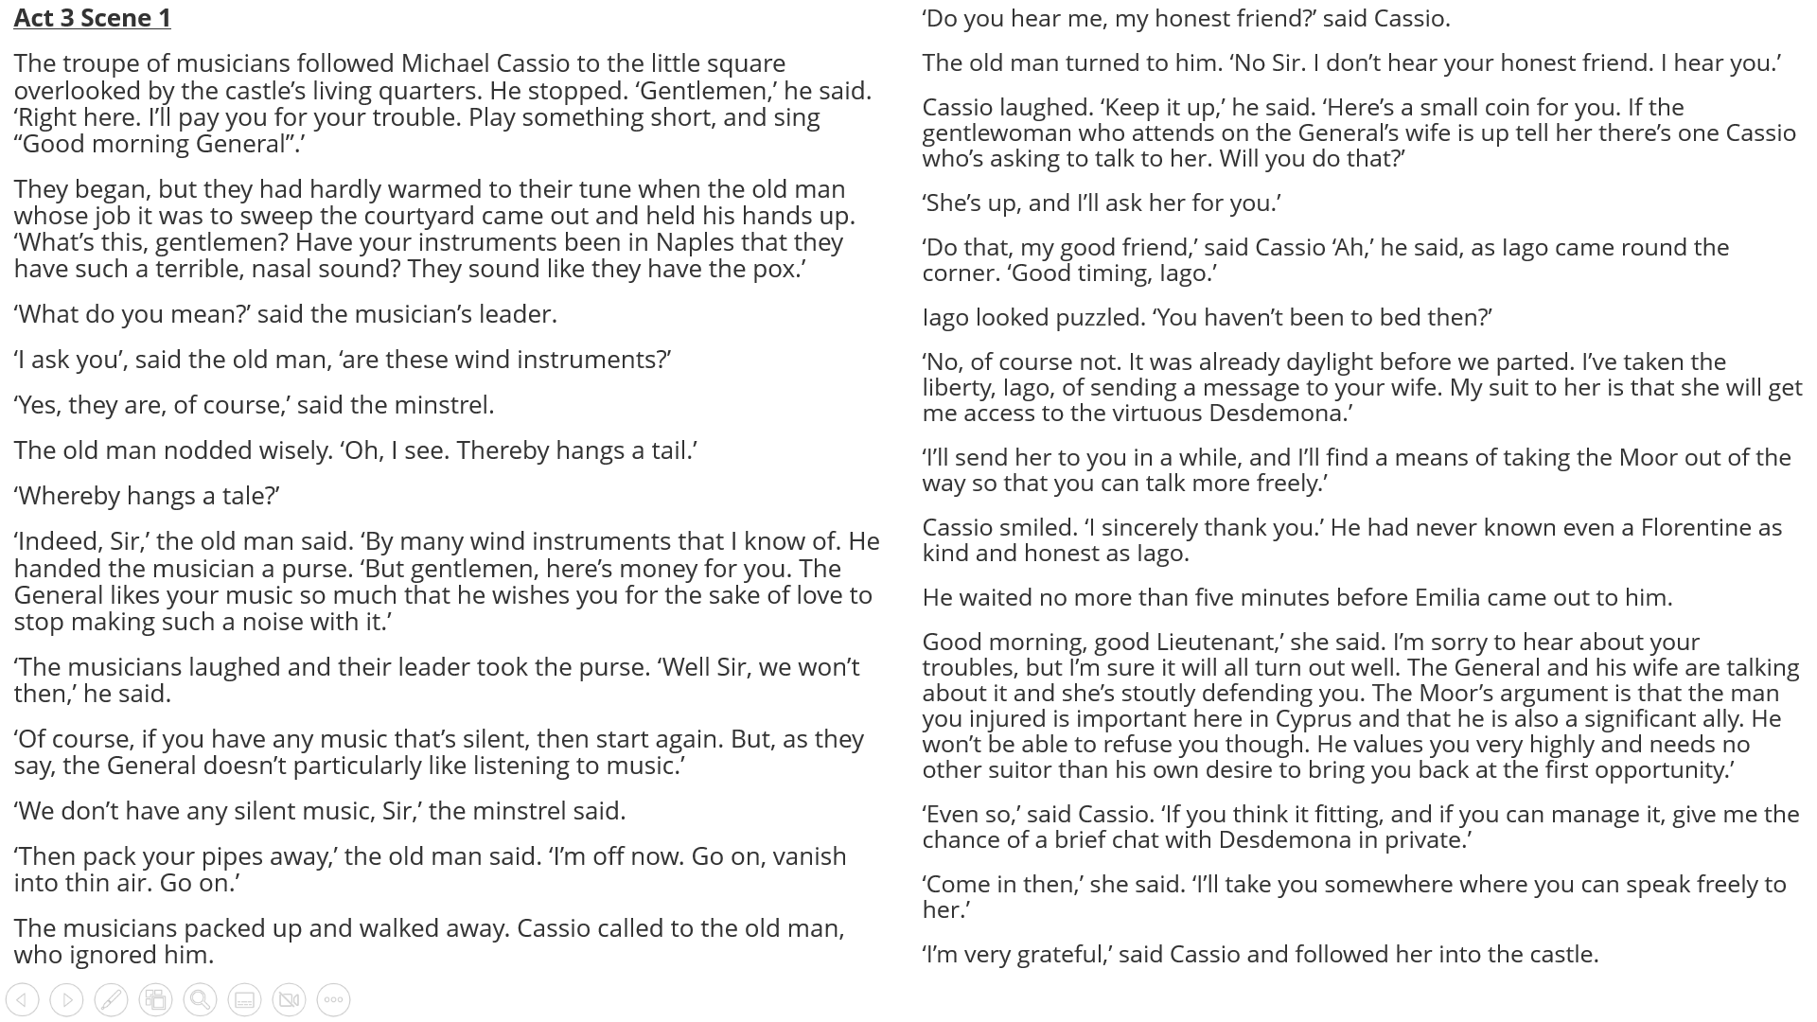

Slide 4
How is Cassio characterised in Act 3 Scene 1?
Cassio is characterised as….
A quote that supports this is…
This quote supports this charaterisation because…
In this scene you could also say Cassio is portrayed as…
A quote that supports this characterisation of Cassio is…
This quote is supportive of my point because…

Slide 5
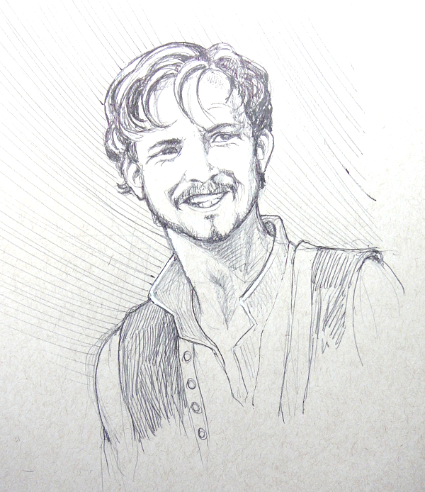
In your opinion, does this artwork depicting Michael Cassio fit with his characterization in Act 3 Scene 1? Why/not?

