Slide 1
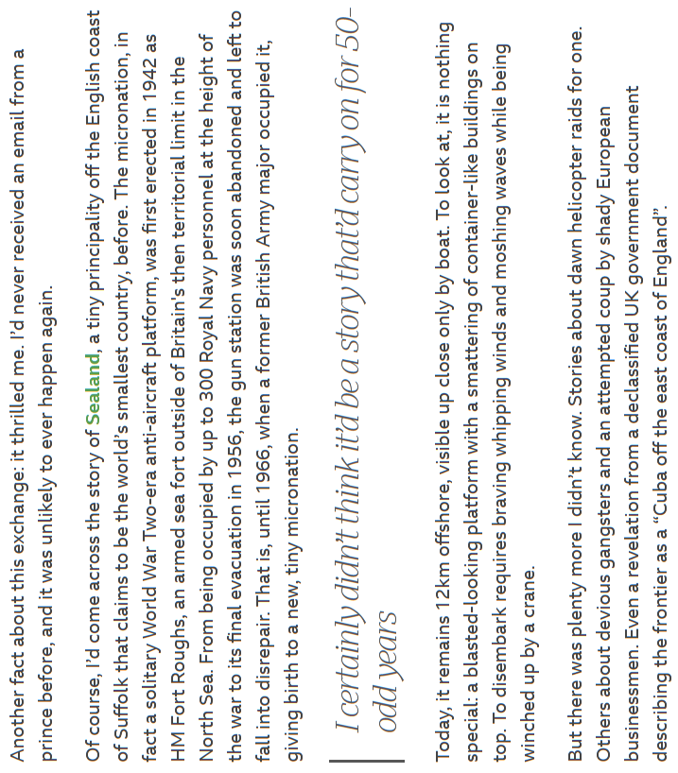
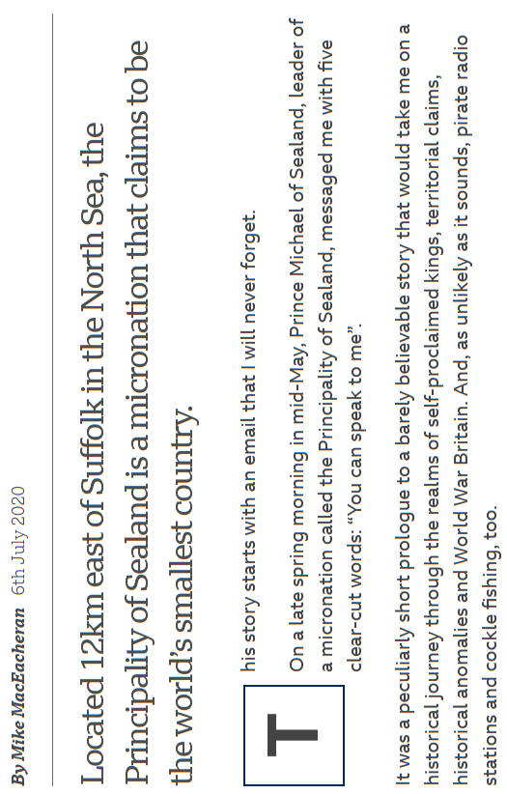

Slide 2
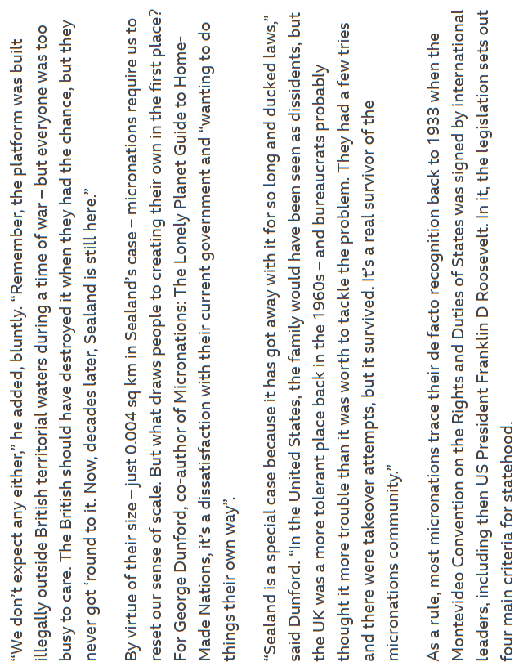
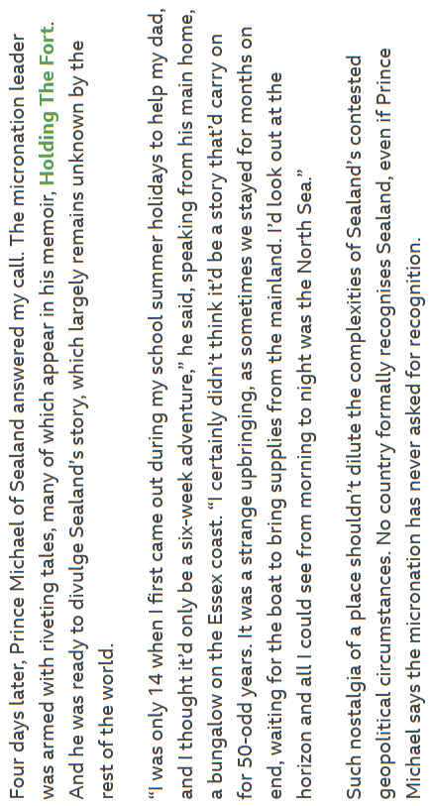

Slide 3
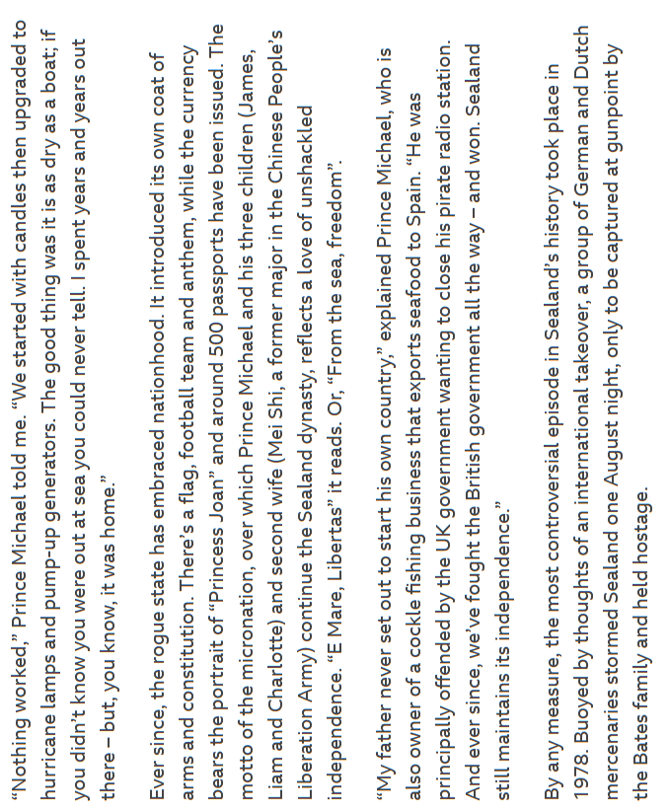
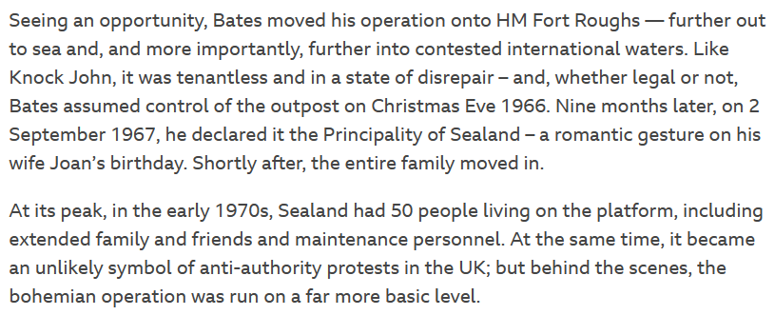
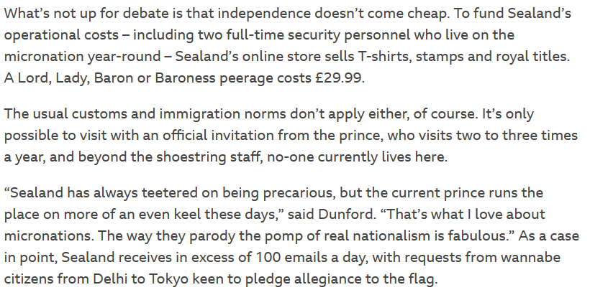

Slide 4
Read the article and highlight the key information, then answer the questions below.
1. How did the exchange between the author and Prince Michael of Sealand occur?
2. What is the current state of Sealand?
3. What was HM Fort Roughs and why was it abandoned?
4. Who occupied HM Fort Roughs in 1966?
5. What type of stories had the author heard about Sealand before speaking with Prince Michael?
6. What is Prince Michael's memoir called?
7. What draws people to creating their own micronations?
8. Why doesn't any country formally recognise Sealand?
9. What is the Montevideo Convention on the Rights and Duties of States?
10. What are the four main criteria for statehood set out by the Montevideo Convention?
11. How does Sealand eschew the Montevideo Convention?
12. What is the size of Sealand?
13. How does the size of a micronation require people to reset their sense of scale?
14. What does George Dunford think of Sealand?
15. What does Prince Michael think about recognition for Sealand?
16. What is the current state of Sealand's geopolitical circumstances?
17. What did the UK government say about Sealand?
18. How is Sealand's story viewed by the author in your opinion? Give two quotes that back up your opinion.
19. Where does Prince Michael live nowadays?
20. Draw Sealand, add colour.
21. Imagine you are the Prince of Sealand. Write a story about the British government trying to take Sealand away from you.

