Slide 1
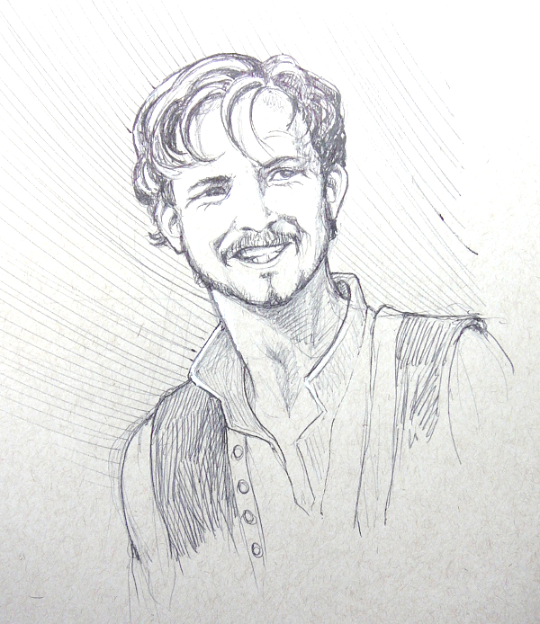
In your opinion, does this artwork depicting Michael Cassio fit with his characterization in Act 3 Scene 1? Why/not?

Slide 2
What’s going on at the beginning of Act 3 Scene 3?

Slide 3
Act 3 Scene 2
Othello was about to inspect Cyprus’ fortifications. He gave Iago some letters. ‘Give these to the ship’s captain, Iago. They’re my reports to the senate. Then come back to me. I’ll be on the battlements.’
‘Very good, my lord,’ said Iago.
‘Come on, then gentlemen, shall we look at these fortifications?’ said Othello.
Act 3 Scene 3 (part 1 of 3)
Emilia, Desdemona and Cassio sat in the state reception room. ‘You can be sure, good Cassio,’ Desdemona was saying, ‘I’ll do everything I can for you.’
‘Please do, good madam,’ said Emilia. ‘I know this has upset my husband as if it were he this has happened to.’
‘Oh, that’s an honest fellow!’ said Desdemona. ‘Don’t worry, Cassio, I’ll make sure that you and my husband are as friendly as you were.’
‘Generous madam,’ said Cassio. ‘Whatever happens to Michael Cassio, he will always be your true servant. ’Desdemona squeezed his hand. ‘I know. Thank you. You love my lord. You’ve known him a long time and it’s certain that he won’t distance himself more than is diplomatically necessary.’
Cassio frowned. ‘Yes, but that diplomacy might last so long, or become so watered down, or be overtaken by events, so that I not being there, and someone else taking my place, my General will forget me.’
‘Don’t think that,’ said Desdemona. ‘In front of Emilia I promise you your place. Be sure that if I say I’ll do something I’ll do it to the last letter. I’ll give him no peace. I’ll keep my eye on it and talk him to death. His bed will be like a school and his dinner table a confessional. I’ll intermingle everything he does with Cassio’s suit. So, cheer up, Cassio, because your advocate will die rather than give up.’
Emilia glanced towards the door. ‘Madam,’ she said, ‘here comes my lord.’ Cassio looked uncomfortable. ‘Madam, I’ll go now,’ he said and stood up. ‘Why?’ Desdemona stretched out her hand. ‘Stay and hear me speak.’
‘Madam,’ he said. ‘Not now. I’m very uneasy – I don’t feel up to it.’
‘Well, if you insist,’ she said, as he left by the other door. Iago stopped Othello at the door. ‘Ha,’ he said. ‘I don’t like that!’
‘What?’ said Othello. Iago shook his head. ‘Oh it’s nothing. Or perhaps … No, I don’t know.’
‘Wasn’t that Cassio just leaving my wife?’
‘Cassio, my lord? No, surely not. I can’t believe Cassio would sneak away so guiltily, seeing you coming.’
‘I really do think it was him.’ Desdemona walked across the room to them. ‘Hello, my lord. I’ve just been talking to a petitioner here – someone who’s languishing in your displeasure.’
Who do you mean?’
‘ ‘Your Lieutenant, Cassio, of course. If I have any power to influence you, accept his apology because if he isn’t a man who truly loves you and only errs in ignorance and not out of malice then I’m no judge of honesty. I beg of you, call him back.’
‘Did he just leave?’
‘Yes. So humiliated that he’s made me sad. Dearest love, call him back.’
Othello kissed her. ‘Not now, sweet Desdemona. Some other time.’
‘But will it be soon?’
‘Very soon, Sweet, just for you.’
‘Tonight, at supper?’
‘No, not tonight.’
‘Tomorrow at dinner?’
‘I won’t be dining at home. I’m meeting the captains at the citadel.’ Desdemona put her arms around his neck. ‘Come on, tomorrow night or Tuesday morning, or Tuesday noon, or night; on Wednesday night. I beg of you, name the time, but don’t let it exceed three days. I’m telling you, he’s penitent, even though his offence can’t be considered something to warrant a serious punishment, although I can understand that because it’s wartime he should set an example.’ She stroked his beard. ‘When can he come, tell me Othello. I wonder what you would ask me that I would deny you, or stand hesitating like this. What! Michael Cassio, who came wooing with you? And so many times, when I have spoken critically of you, has taken your side. To have so much of a to-do to re-instate him?’
Othello laughed and kissed her. ‘Please, no more; he can come whenever he likes. I won’t deny you anything.’
‘Come on, this isn’t a favour to me. It’s as though I would ask you to wear your gloves or eat nourishing food, or keep yourself warm, or ask you to do something in your own interest. No, when there’s something I want out of love it will be more complex and tricky for you and difficult to grant.’
‘I will deny you nothing,’ he said. ‘But I do beg you to give me one thing; that is to give me a little time to myself.’
‘Would I deny you that? No, goodbye, my lord.’
‘Goodbye, my Desdemona, I’ll come to you soon.’
‘Come Emilia.’ Desdemona paused at the door. ‘See? Whatever you want of me I’ll give you.’ Othello watched them go. He muttered, almost to himself. ‘Hell take my soul, but I love you. And when I love you not it will be a return to chaos.’ He stood staring at the closed door. Iago cleared his throat. ‘My noble lord…’
Othello turned. ‘What, Iago?’ Iago spoke slowly, thoughtfully. ‘When you were wooing my lady, did Cassio know of your love?’
‘He did, from beginning to end. Why are you asking?’
‘Just a thought I had. Nothing more.’
‘What thought, Iago?’
‘I didn’t think he knew her.’

Slide 4
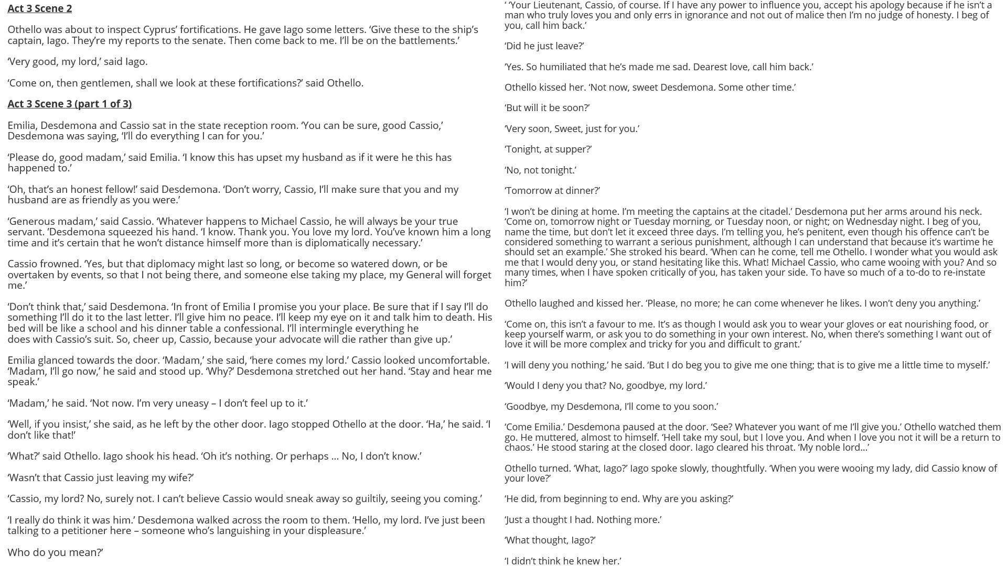

Slide 5
How does Shakespeare make this a memorable moment in the play?
One thing Shakespeare does to make this a memorable moment in the play is…
A quote that supports this would be…
This quote demonstrates my point because…
Another thing Shakespeare does to make this a memorable moment in the play is…
A quote that supports this would be…
This quote supports what I am saying because…

