Slide 1
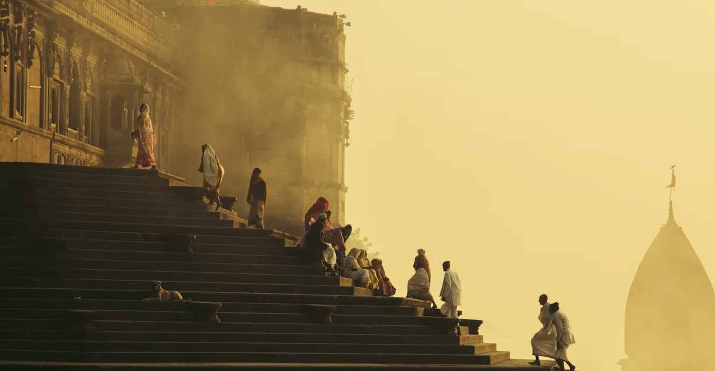
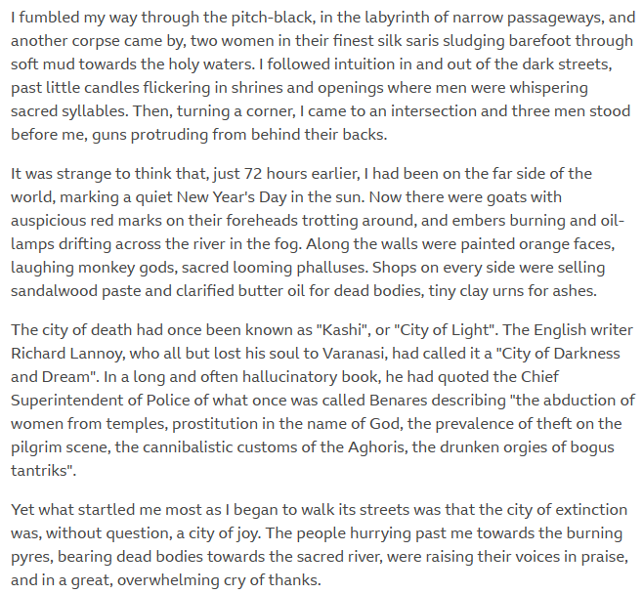

Slide 2
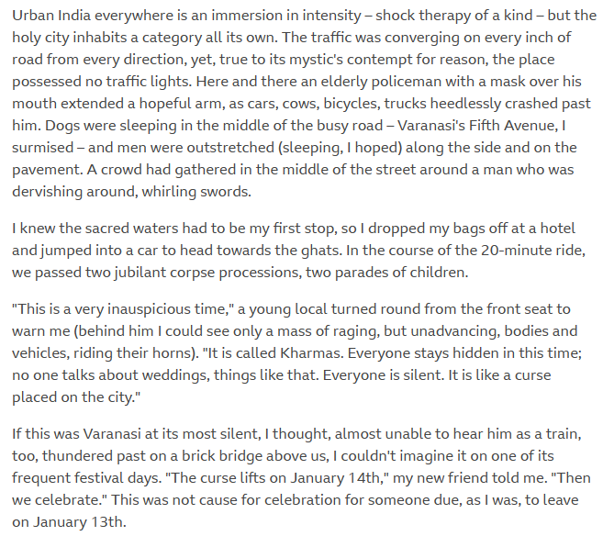

Slide 3
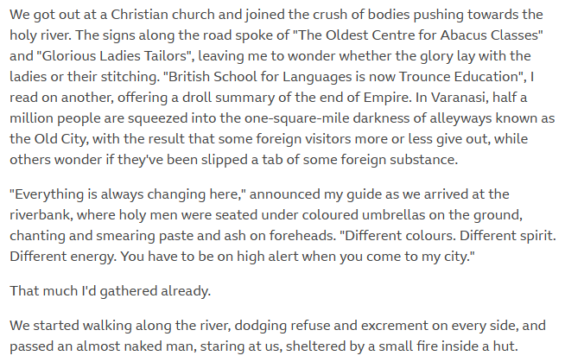
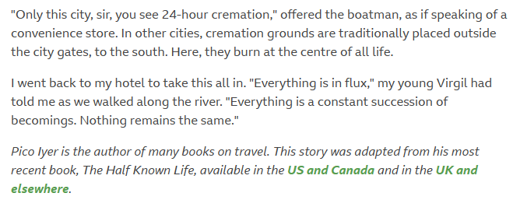
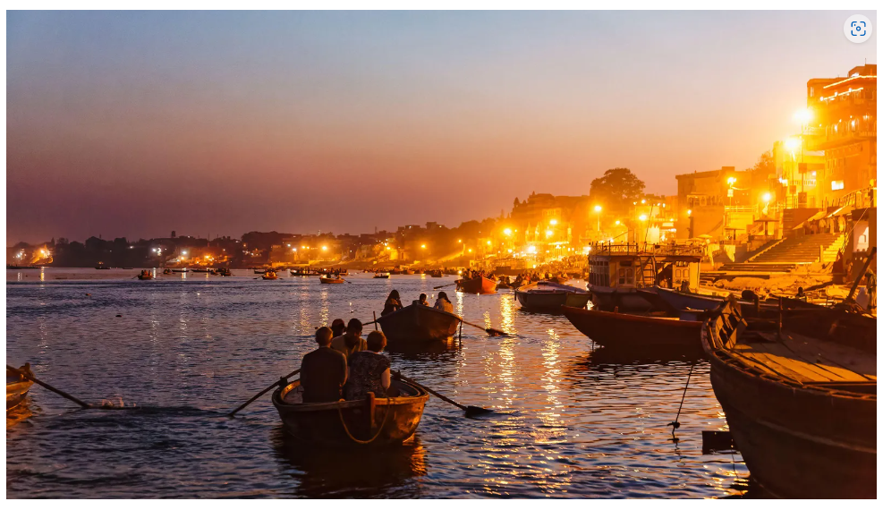

Slide 4
IGCSE English Language Questions
What is the author's purpose in writing this travel article about Varanasi?
How does the author describe the atmosphere in Varanasi?
What is the significance of Varanasi for Hindus and how does it relate to the theme of death?
What are some of the specific cultural and religious practices that take place in Varanasi, according to the article?
How does the author describe the experience of taking a boat ride along the Ganges River in Varanasi?
How does the author suggest that the experience of visiting Varanasi might challenge one's preconceptions or beliefs?
How does the author incorporate quotes and personal anecdotes to support their writing?
How does the author use language to create a vivid sense of place and atmosphere in the article?
What is the tone of the article, and how does the author use tone to convey their message?
How might reading this article impact your own perceptions of India or your understanding of different cultural practices?

