Slide 1
Which cover did you take most inspiration from and why?

Slide 2
Look at the blurb below, what do you think might happen in the story?

Slide 3
Look at the list below – do you not know what any of these mean?
Structural:
Foreshadowing
Pathetic fallacy
Types of narrative- 1st person, 3rd person. Flashback. Past tense, present tense.
Different paragraph lengths for effect.
Sentence types- rhetorical questions, complex, compound, simple sentences, lists.
Motifs- repeated symbols.
Language:
Adjectives
Adverbs
Verbs
Similes
Metaphors
Personification
Anthropomorphism
Semantic fields
Alliteration- plosives, fricatives, sibilance.
Symbolism.
Sensory imagery.

Slide 4
Context matters
Context – the background to the novel.
Yann Martel – the author’s own experiences provide context for the novel.
Hinduism, Islam and Christianity all provide context to the novel.
The theme of Emigration is also a big piece of context.

Slide 5
Draw the table below and get ready to fill it in with information.
It should take up half a page.
Christianity in Life of Pi
Islam in Life of Pi
Hinduism in Life of Pi

Slide 6
Life of Pi and Christianity

Slide 7
Draw the table below and get ready to fill it in with information.
It should take up half a page.
Christianity in Life of Pi
Islam in Life of Pi
Hinduism in Life of Pi

Slide 8
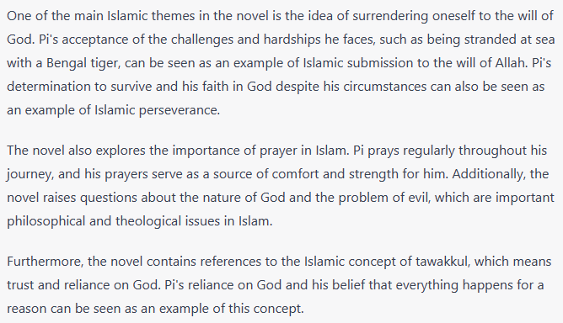
Life of Pi and Islam

Slide 9
Draw the table below and get ready to fill it in with information.
It should take up half a page.
Christianity in Life of Pi
Islam in Life of Pi
Hinduism in Life of Pi

Slide 10
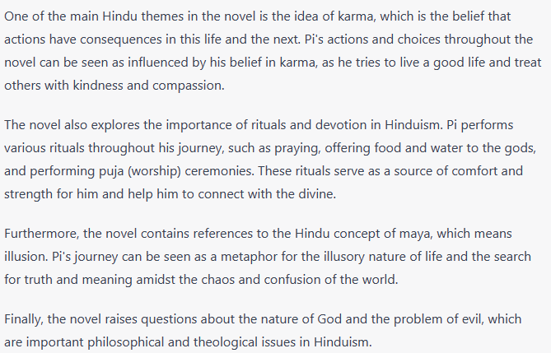
Life of Pi and Hinduism

Slide 11
Draw the table below and get ready to fill it in with information.
It should take up half a page.
Christianity in Life of Pi
Islam in Life of Pi
Hinduism in Life of Pi

Slide 12
How does religion feature in Life of Pi?
How do I write a good paragraph in this situation?
Mention Christianity
Mention Islam
Mention Hinduism
4. Explain how the things you’ve mentioned are important to understanding the novel.

