Slide 3
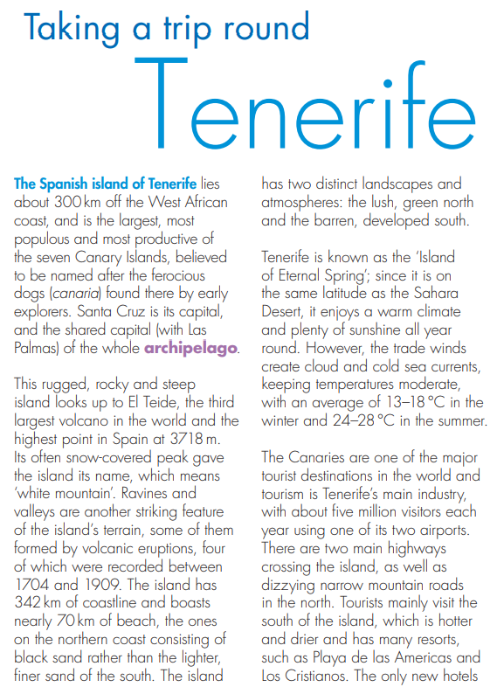
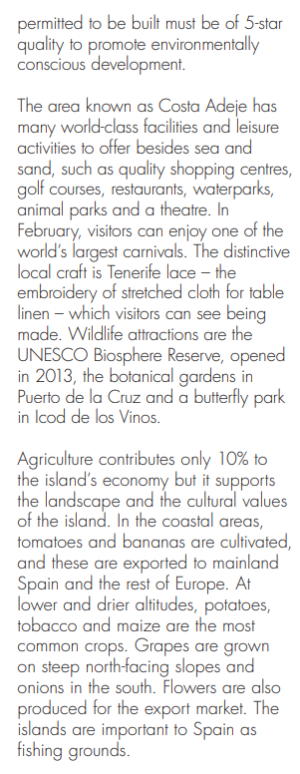
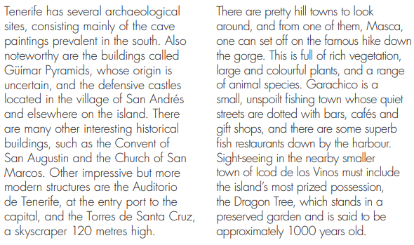
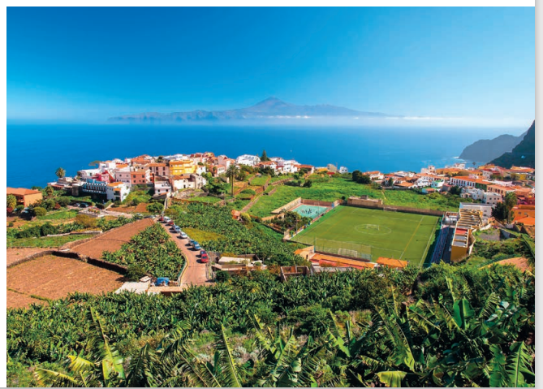

Slide 4
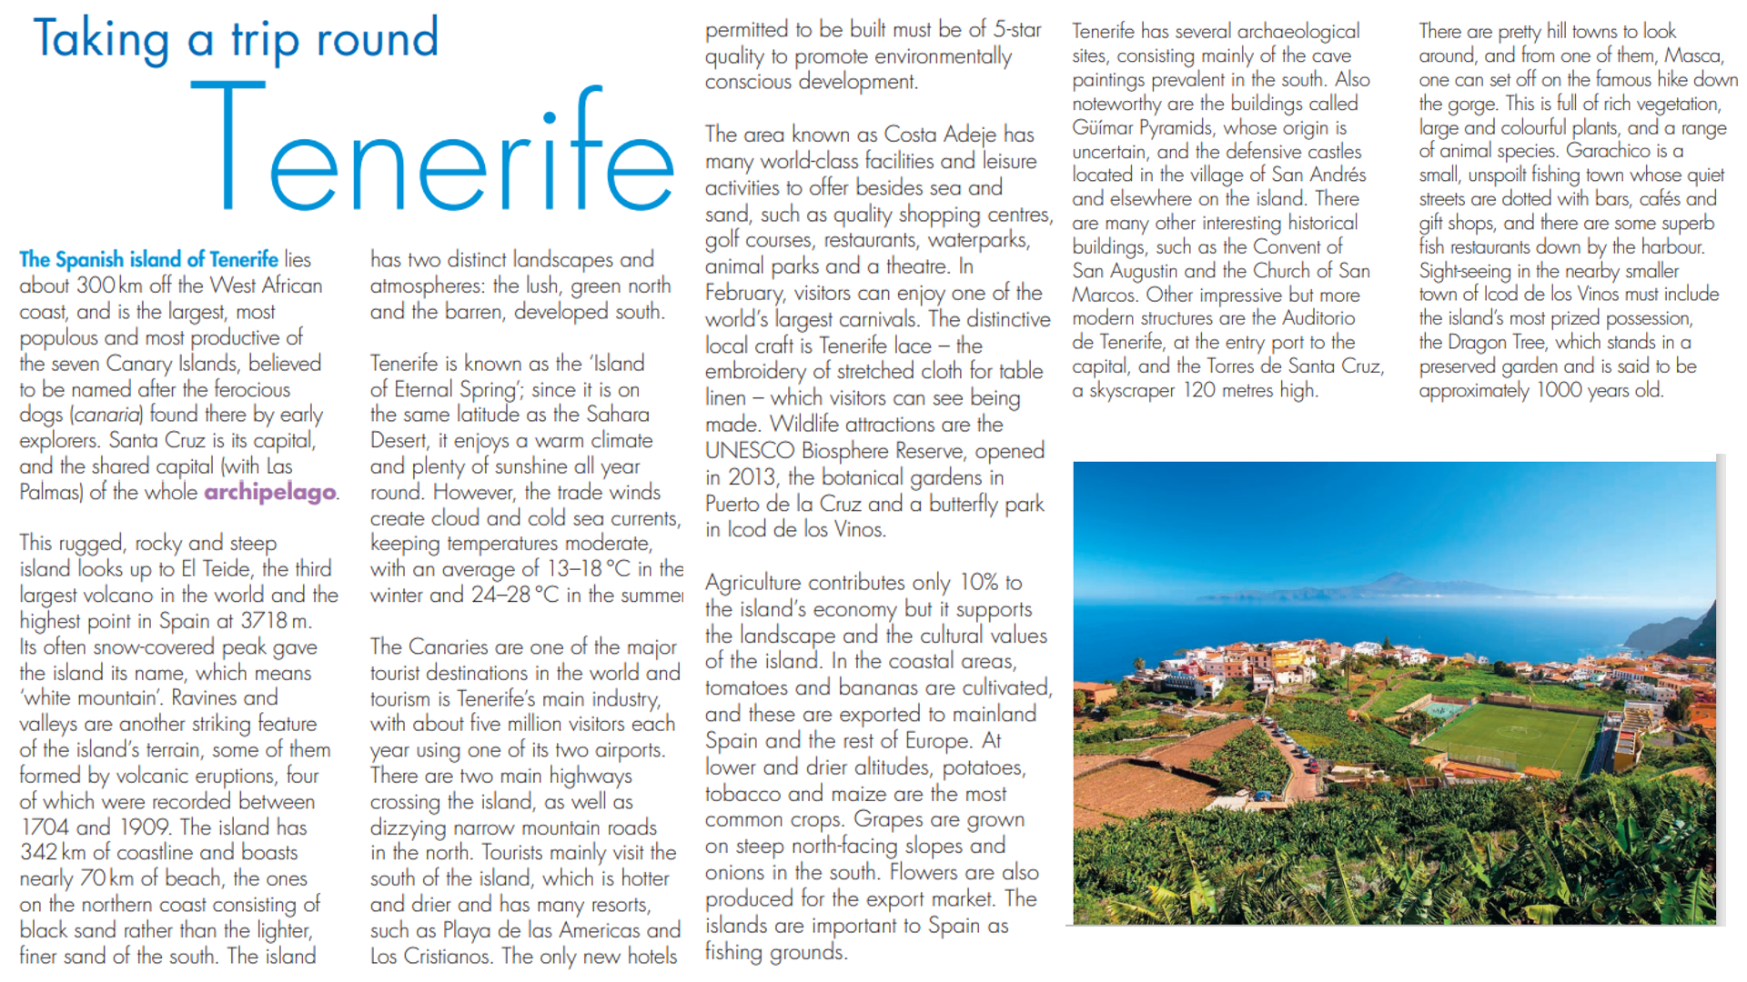
Read the passage, highlighting any words you’re unsure the meaning of.

Slide 5
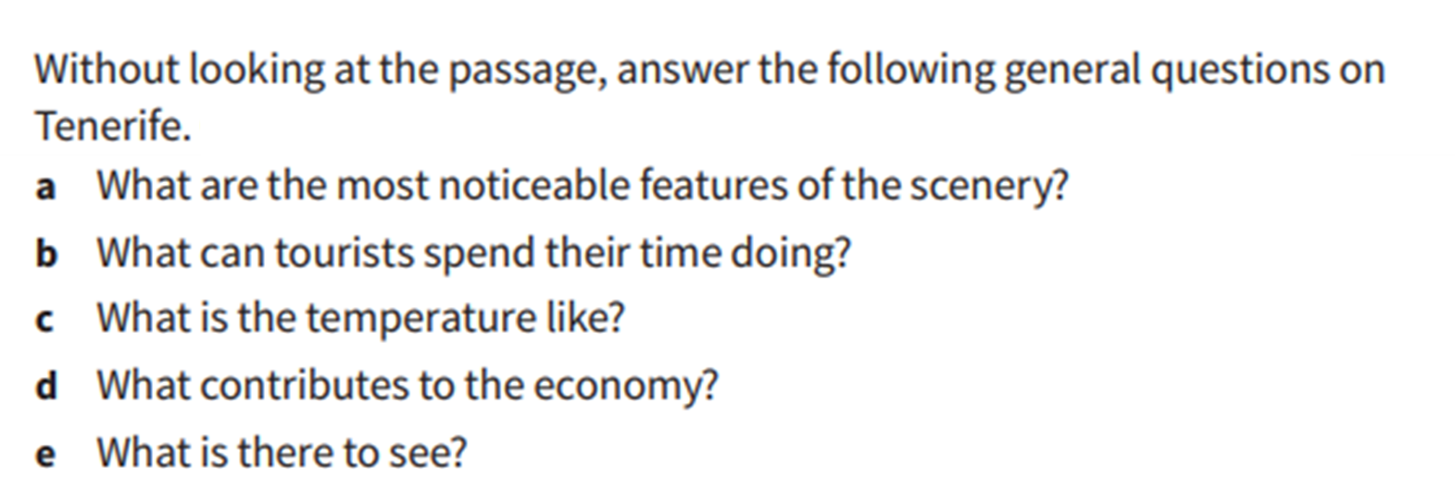
NOW check your answers are right by checking the passage – correct as appropriate.
EXT
SUPER EXT
Put brackets around any info in the text that you definitely wouldn’t use in a summary of Tenerife.
Why wouldn’t you include this sort of information?

