Slide 1
Quick recap
Shakespeare is respected because he is good at the technique known as c_________.
Shakespeare is renowned for how he uses L________ effectively.
Shakespeare wrote 38 plays, across a range of genres, for example: t__________, c__________ and h_________.
Shakespeare is famous for his i_________ on later authors and popular culture nowadays.
Shakespeare actually came up with a lot of the i_____ that people nowadays like to use, for example; “Break the ice” and “Heart of gold”.
Characterization
Language
Tragedies, comedies and histories
influence
idioms

Slide 2
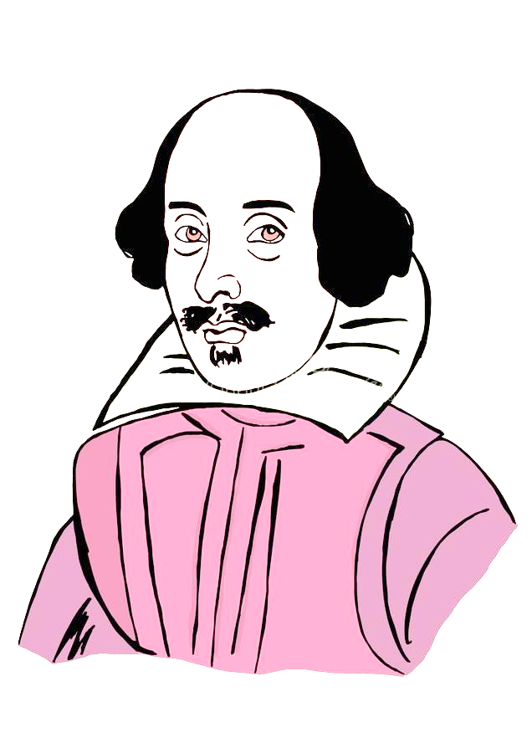
What influence did Shakespeare’s world have on his writing?
Saturday, September 3, 2022
Good Progress | Excellent Progress
Describe the key features of Elizabethan England. | Explain how changes in Elizabethan England affected demand for Shakespeare’s plays.

Slide 3
Handout
You’ll need a highlighter and a pen.
Parts of this are difficult to understand.
We’ll highlight difficult phrases and write out what they mean in this context

Slide 4
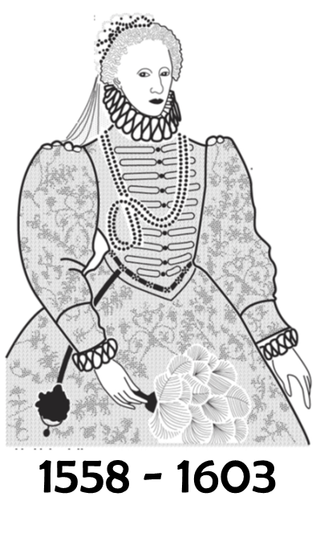
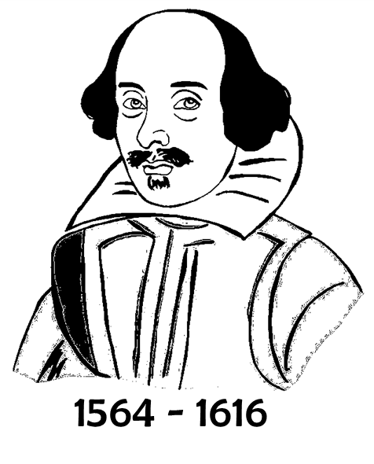
Elizabethan England
Shakespeare was alive, and writing plays, in Elizabethan England.
It was a special time to be alive. England, which had been at war for hundreds of years, with France and Spain, was largely peaceful during the reign of Elizabeth I.

Slide 5
Elizabethan England
Shakespeare was alive, and writing plays, in Elizabethan England.
It was a special time to be alive. England, which had been at war for hundreds of years, with France and Spain, was largely peaceful during the reign of Elizabeth I.
What do you think the effect on culture was, given the fact England was now at peace?

Slide 6
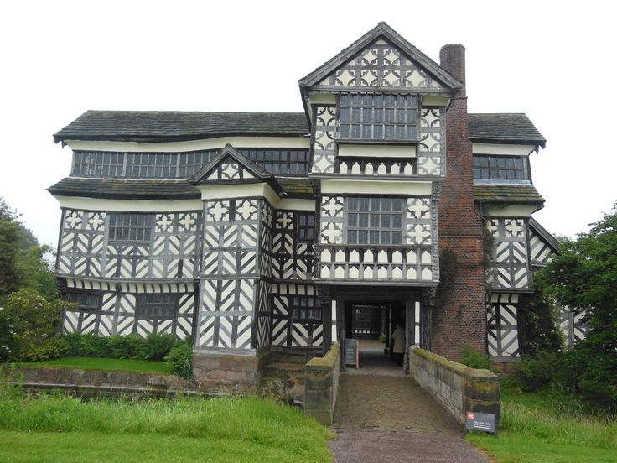
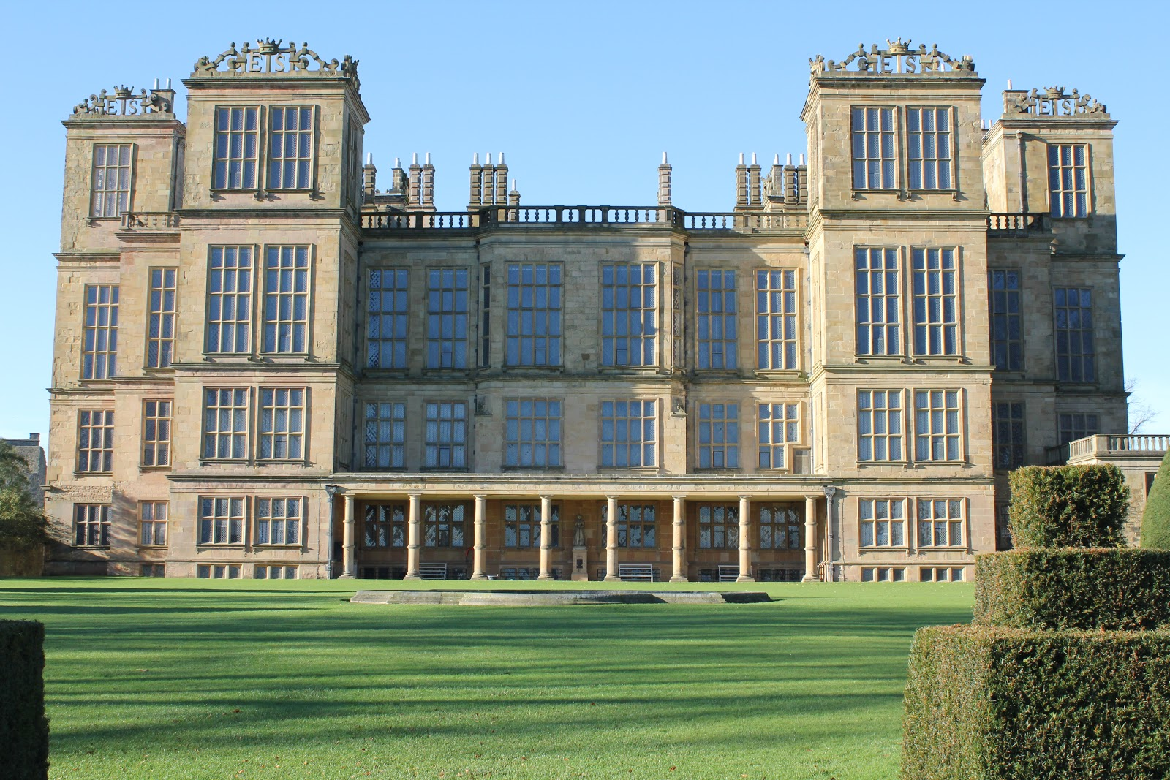
What was happening to housing in Elizabethan England?
Why might may historians claim that Elizabethan times were a time of increased prosperity?
A Noble’s house in the time of Henry VIII (1509)
A Noble’s house in the time of Elizabeth I (1590)

Slide 7
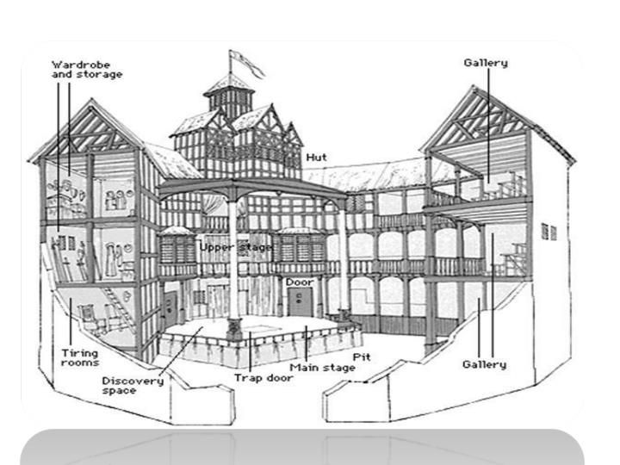
Where would Shakespeare’s plays be performed?
What does this suggest about Elizabethan England, as time went on?
The Burbage Theatre 1576
The Curtain Theatre 1577
The Rose Theatre 1587
The Swan Theatre 1595
The Globe Theatre 1598 (actually the Burbage Theatre that was moved across London piece by piece!)

Slide 8
The new Middle Class
Prior to Elizabethan times, you were either a Noble or a Peasant.
Now, there was a new class… the Merchant class (business owners)… with money to spend and an education under their belts…

Slide 9
Tasks – increasing in difficulty ☺
Explain what Elizabethan England was like.
Explain how Elizabethan England was different to England under Henry VIII.
Explain how the changes that were evident in Elizabethan England led to greater leisure time for ordinary people.
Explain the effects of how the changes that Elizabethan England was undergoing affected the demand for the kinds of play that Shakespeare was producing.

Slide 10
Can you get 5/5?
Shakespeare is respected because he is good at the technique known as c_________.
Shakespeare is renowned for how he uses L________ effectively.
Shakespeare wrote 38 plays, across a range of genres, for example: t__________, c__________ and h_________.
Shakespeare is famous for his i_________ on later authors and popular culture nowadays.
Shakespeare actually came up with a lot of the i_____ that people nowadays like to use, for example; “Break the ice” and “Heart of gold”.
Characterization
Language
Tragedies, comedies and histories
influence
idioms

