Slide 1
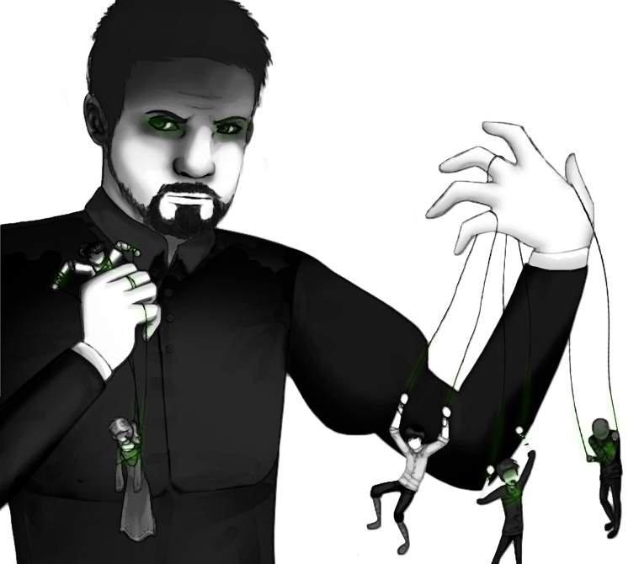
In your opinion, does this artwork depicting Iago fit with his characterization in Act 3 Scene 3 so far? Why/not?

Slide 2
What’s going on at the in the middle of Act 3 Scene 3?

Slide 3
Act 3 Scene 3 part 2 of 3
‘Oh yes, and was often a go-between.’
‘Really!’
‘Really? Yes, really. Is there anything wrong with that? Isn’t he honest?’
‘Honest, my lord?’
‘Honest?’ Othello nodded irritably. ‘Yes, honest.’
‘My lord, for all I know.’
‘What do you think?’
‘Think, my lord?’
‘Think my lord!’ Othello was exasperated. ‘By heaven, he echoes me, as though there were some monster in his thought, too hideous to be revealed.’ Othello took a step towards Iago and looked down at him menacingly. ‘You’re insinuating something. Just now you said you didn’t like that. What didn’t you like? And when I told you he was my confidant all through my wooing you cried ‘Really!’ And you contracted and pursed your brow as if you had some horrible idea in your brain. If you love me tell me your thoughts.’
Iago sighed. ‘My lord, you know I love you.’ Othello stepped back but did not take his eyes off Iago. ‘I think you do. And as far as I know you are full of love and honesty, and you’re weighing your words before you voice them. So your hesitation scares me. Such things are common in a false, disloyal knave, but in a man that’s just they’re sincere, coming from the heart; things he can’t control because of genuine feeling.’ Iago spoke slowly, as though feeling for the right words. ‘Regarding Michael Cassio, I would swear that he is honest.’
‘I think so too.’
‘Men should be what they seem, or those that aren’t, it would be better if they didn’t seem to be anything.’
‘Certainly, men should be what they seem.’ Iago smiled and seemed relieved. ‘Well then, I think Cassio’s an honest man.’ He shrugged and turned to the window. Othello gripped his shoulder. ‘No, there’s more to this. Please tell me what you’re thinking, exactly what’s in your mind, and speak plainly.’
‘My lord,’ said Iago, ‘forgive me. ‘Although I’m bound to you in every act of duty, I’m not bound, as even slaves are not, to utter my thoughts. What if they are vile and false? And whose mind doesn’t sometimes have foul intruders? Who has such a pure heart that some unclean considerations don’t sit alongside lawful ones?’
‘You conspire against your friend, Iago, if you think him wronged and don’t tell him.’ Iago said nothing for a moment, then smiled sadly. ‘I beg of you,’ he said. ‘Although I’m perhaps judging too harshly – and I admit it’s a fault in me, that I’m very sensitive to abuses, and my suspicions make me imagine faults that don’t exist – I’m sure that you’re too wise to take any notice of someone whose judgment is so imperfect. It’s not in the interest of your peace of mind, nor to your advantage, nor in the interest of my humanity, honesty and wisdom, to tell you what I’m thinking.’ Othello took a step towards him and looked him squarely in the eyes. ‘What are you talking about?’ he said. Iago didn’t avert his eyes. ‘Good name in man or woman, my dear lord, is the most precious jewel of their souls. Whoever steals my purse steals trash – it’s something of no value. It was mine, now it’s his, and money has enslaved thousands. But he who steals my good name robs me of something that doesn’t enrich him but makes me very poor.’
Othello stepped even closer. ‘By heaven, I want to know your thoughts,’ he roared. ‘You can’t,’ said Iago, ‘even if you held my heart in your hand. Nor will you as long as it’s in my custody.’ Othello’s eyes widened. He was speechless. He raised his hand then stopped himself. All he could say was ‘Ha!’ Then he turned away.
‘O beware, my lord of jealousy!’ said Iago, and Othello turned back to face him again. ‘It is the green-eyed monster that mocks the meat it feeds on. The cuckold who, knowing he is one and hates his wronger, lives in bliss. But oh, what terrible minutes he who adores, yet doubts, suspects but foolishly continues to love, endures.’ Othello buried his head in his hands. ‘Oh misery!’
‘Being poor and content is to be rich, and rich enough. But unlimited riches are as poor as winter to him who is always afraid that he is going to be poor. Dear God defend the souls of all my tribe from jealousy.’
‘What? What’s this?’ said Othello. ‘Do you think I would live with jealousy; to live through the changes of the moon with new suspicions all the time? No, as soon as I have doubts I do something about it immediately. Turn me into a goat when I allow my soul to suffer as a consequence of your inferences. It doesn’t make me jealous when someone says my wife is beautiful, likes company, speaks freely, sings, plays and dances well. When someone is virtuous these things add to that. Nor because of my own lack of attractiveness will I have the smallest fear or doubt about her fidelity, because she had eyes and chose me. No, Iago, I have to see evidence before I’ll doubt. When I have doubts I’ll try and prove it. And when it’s been proved that’s all there is to it: love and jealousy will be immediately banished.’
‘I’m relieved,’ said Iago. ‘Because now I have reason to show my love and duty with greater frankness. So, because it’s my duty, I’ll tell you. I’m not talking about proof yet, mind, but watch your wife – watch her closely with Cassio. Be objective – neither jealous nor secure. I wouldn’t want your open and noble nature taken advantage of. Watch. I know the nature of the women of our country. In Venice they let God see tricks they get up to that they dare not show their husbands. They would rather keep them secret than not get up to them.’
‘Is that so?’ Othello gave him a disapproving look. Iago shrugged. ‘In marrying you she deceived her father. ‘And when she seemed to tremble and fear the looks you gave her, that’s when she loved you most in reality.’ Othello nodded. ‘Yes, she did.’
‘There you are then,’ said Iago. ‘She who when so young could appear so affected, and to seal her father’s eyes up so soundly that he thought it was witchcraft… But this is all my fault. I humbly beg your pardon for loving you too much.’ Othello put his hand on Iago’s shoulder. ‘I’m grateful to you for ever.’
‘I see this has lowered your spirits,’ said Iago. Othello laughed. ‘Not a bit, not a bit.’
‘Really, I think it has. I hope you will understand that what I have said is because of my love for you.’ Othello tied to laugh again but failed. ‘But I can see it’s affected you,’ said Iago. ‘I’m asking you not to force me to tell you worse things, not to go beyond suspicion.’
‘I won’t,’ said Othello.
‘If you did I would say things I didn’t mean to say. Cassio’s my best friend. My lord. I can see you’re moved.’
‘No.’ Othello shook his head. ‘Not very moved. I’m sure Desdemona’s honest.
‘May she always be. And may you always think so!’
‘And yet.’ Othello was reflective. ‘I’m thinking about how nature is sometimes freakish…’
‘Yes,’ said Iago. ‘That’s the point.. To be quite frank, to reject so many proposed marriages to men of her own country, colour and position, which would be the most natural thing …. Foh! One could interpret that as having too strong a will, foully disproportionate, unnatural thoughts. But forgive me, I’m not talking about her specifically, although I could have cause to fear that her will, giving way to her better judgment may begin to compare you with her own countrymen so that perhaps she will be regretting marrying you.’
Othello was staring at him. ‘Go now, go. And if you notice anything more tell me. Get your wife to watch her. Leave me, Iago.

Slide 4
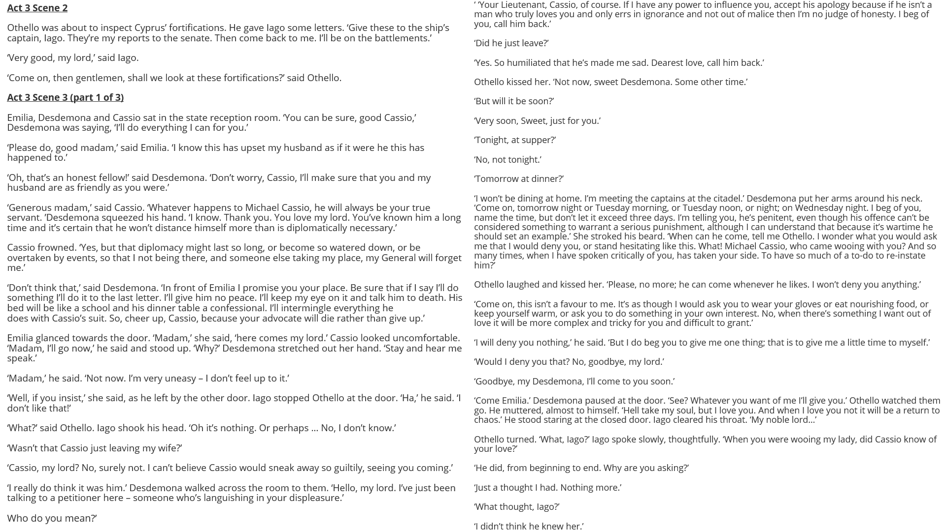

Slide 5
How does Shakespeare make this a memorable moment in the play?
One thing Shakespeare does to make this a memorable moment in the play is…
A quote that supports this would be…
This quote demonstrates my point because…
Another thing Shakespeare does to make this a memorable moment in the play is…
A quote that supports this would be…
This quote supports what I am saying because…

