Slide 1
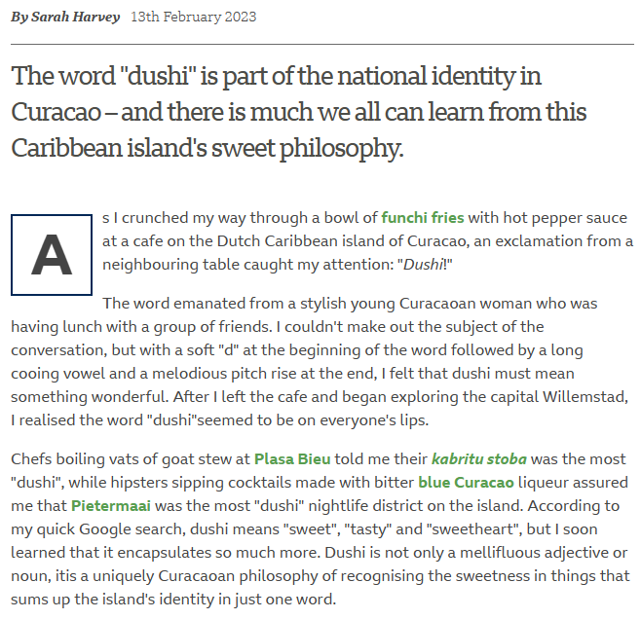
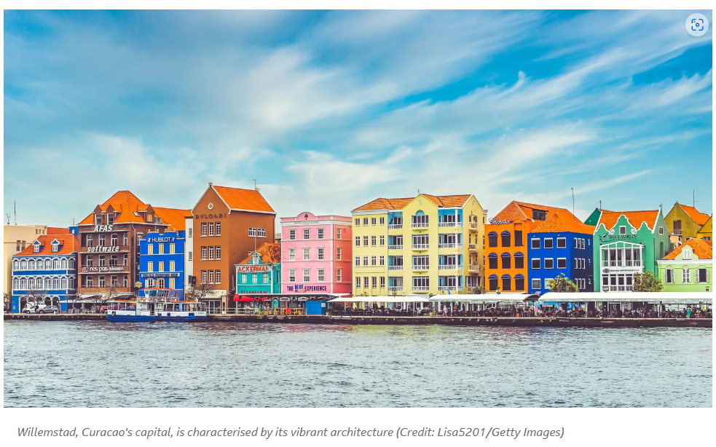
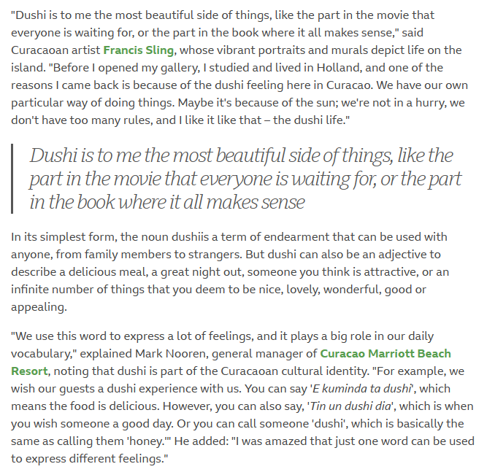

Slide 2
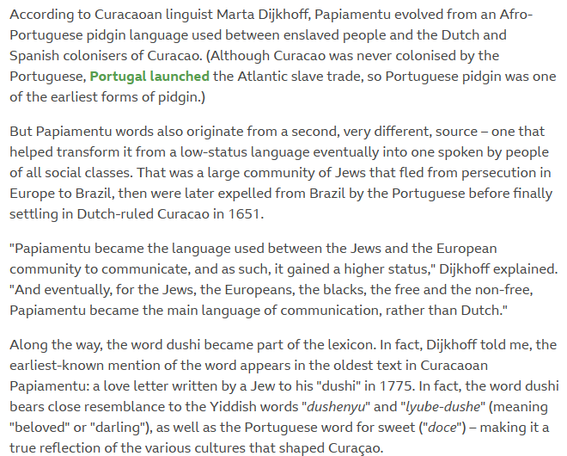
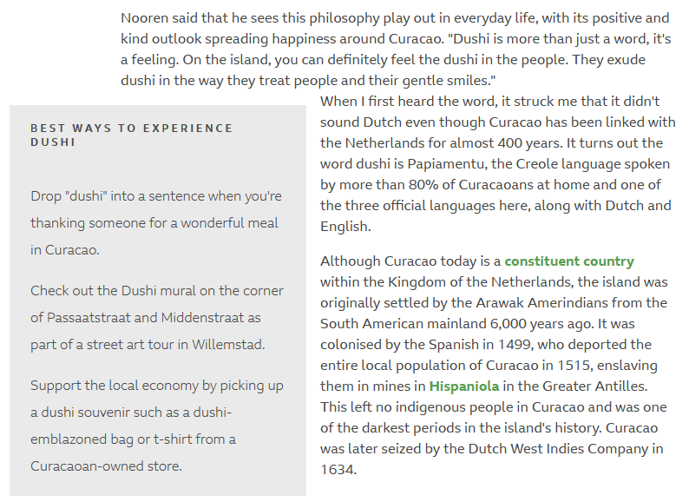
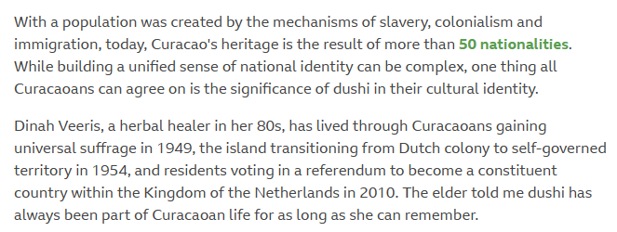

Slide 3
IGCSE English Language Questions
What is the purpose of this travel article about Curaçao?
How does the author describe the island's "live and let live" philosophy?
What are some examples of the cultural diversity that exists on Curaçao, and how do they contribute to the island's unique character?
How does the author describe the local food and drink culture of Curaçao?
What are some of the specific places the author suggests visiting on the island and what makes them interesting or unique?
How does the author use language to create a sense of place and atmosphere in the article?
What is the tone of the article, and how does it contribute to the author's message?
What do you think the author means when she says, "Happiness is a choice on Curaçao"?
How might the author's descriptions of the island's culture and lifestyle be different from what you are used to or what you might expect?
How might this article influence your own perceptions of travel and cultural differences?

