Slide 1
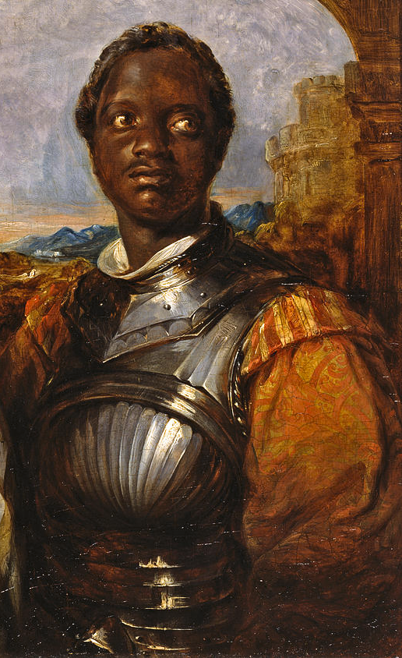
In your opinion, does this artwork depicting Othello fit with his characterization in Act 3 Scene 3 so far? Why/not?

Slide 2
What’s going on at the in the middle of Act 3 Scene 3?

Slide 3
Act 3 Scene 3 part 3 of 3
Iago turned away. ‘My lord, I’m going.’ He went to the door. ‘Why did I marry?’ said Othello. ‘This honest creature no doubt sees and knows much more than he’s telling me.’
‘Iago went back My lord.’ His tone was one of concern. ‘I would ask you not to think about it. Give it time. Although it’s right that Cassio should have his position, because he occupies it with great ability, yet if you were to hold him off for a while, you’ll be able to watch him and see his methods. See if you wife pleads strongly or passionately for his reinstatement. That will tell you a lot. In the meantime, just think of me as too interfering – although in a just cause – and regard her as honest. I beg of you.’
‘Don’t worry about me,’ said Othello. ‘Now I’ll go,’ said Iago. Othello stood alone, gazing out the window. He knew that Iago was an honest man. He also had a lot of knowledge of human behaviour. If Desdemona proved unfaithful he would cast her out and leave her to fortune. Maybe it was because he was black and didn’t have the refined way of speaking that Venetian gentlemen had; or perhaps it was because he was older – although not all that much older …. She was gone, he had been deceived and his only relief would be to loathe her. Marriage was a curse! That men could call these delicate creatures theirs and yet not own their appetites. He would rather be a toad and live in a foul dungeon than keep a woman that he loved for the use of other men, even for a moment. This was the plague of great men, more privileged than the lesser. It was a destiny as unavoidable as death, and fated to them at the moment of their birth. He heard Desdemona and Emily coming into the room behind him. He turned. She was smiling; pleasure at seeing him was in her eyes. If she was unfaithful it would be a case of heaven mocking itself. He wouldn’t believe it. ‘Hello, my dear Othello! she exclaimed. ‘Dinner is ready and the islanders you have invited are waiting for you.’
‘I’m at fault,’ he whispered. She kissed him tenderly. ‘Why are you speaking so faintly? Are you unwell?’
‘I have a headache,’ he said. She stroked his forehead. ‘We’ll have to do something about that. It will go away again. Let me bind it up for you and it will be better.’ She took a handkerchief from her sleeve. ‘That’s too small,’ he said and pushed her hand away. She dropped the handkerchief and when she reached for it he took her arm. ‘Leave it,’ he said. ‘Come, let’s go in.’ They walked to the door, her hand on his arm. She said: ‘I’m so sorry you’re not well.’ Emilia picked up the handkerchief. She was glad she had found it. It was Desdemona’s first gift from the Moor. Her husband had asked her a hundred times to steal it. But Desdemona loved it so much, because he had told her that she should keep it forever, that she always carried it with her to kiss it and talk to it. She would take it now, and unpick the embroidery then give it to Iago. Heaven knew what he would do with it but all she wanted to do was indulge him. And here he was. ‘Well,’ he said. What are you doing here all by yourself?’
‘Don’t reprimand me,’ she said. ‘I’ve got something for you.’… ‘Something for me?’ Iago glared at her. ‘It’s a normal thing to have a stupid wife.’… ‘Oh,’ she said. ‘Is that all?’ She went up close to him, holding her hand behind her back. ‘What will you give me for that handkerchief?’
‘What handkerchief?’ She laughed. ‘What handkerchief! The one the Moor first gave to Desdemona of course. The one you’ve been nagging me to steal.’
‘Have you stolen it from her?’…… Emilia continued: ‘No, I didn’t have to. As luck would have it she dropped it by accident. I happened to be there and picked it up.’ She held the handkerchief up. ‘See? Here it is.’
‘Good girl. Give it to me.’ She thrust it behind her back again. ‘What do you want it for that you’ve been so keen for me to steal it?’ Iago pulled her arm from behind her back and snatched the handkerchief. ‘What’s it got to do with you?’ Emilia tried to snatch it back but he held it tightly. ‘If it’s not something important give it back to me. Poor lady, she’ll be distraught when she misses it.’ Iago fondled the handkerchief. ‘Don’t say anything about it. I have a use for it. Go. Leave me.’ She looked hurt but did as she was told. When she had gone Iago examined the handkerchief. He was very pleased. He would drop it in Cassio’s lodgings and let him find it. Any small thing would be proof to the jealous. This handkerchief could contribute. The Moor was already changing with his poison. Daring ideas are poison by their very nature. They may be dismissed at first but once they take root in the blood they burn like sulphur.
Someone was coming. It was Othello, looking devastated. Iago watched him. It was as he had thought it would be. No drugs, neither poppy nor madragora, nor any drug in the world would ever restore that sweet sleep that he had known as recently as yesterday. Othello stumbled towards him, muttering to himself. ‘Oh, oh,’ he said. ‘Unfaithful to me!’ Iago helped him to his desk and sat him down. ‘Now, now, General,’ he said. ‘Enough of that.’ Othello looked up at him. ‘Get away. Go! You’ve put me on the rack. I swear, it’s better to be terribly abused than to know anything of it at all.’
‘Come on, my lord,’ said Iago. Othello sank his head on to the desk. ‘What intimation did I have of her stolen hours of lust?’ he said, speaking softly. ‘I didn’t see it, didn’t think it, it didn’t affect me. I slept well, I was free and happy. I didn’t sense Cassio’s kisses on her lips. When a man is robbed, if he doesn’t miss the thing that’s stolen, if he doesn’t know, he’s not robbed at all.’ ‘I’m sorry to hear this,’ said Iago solicitously. ‘I would have been happy if the whole regiment, navvies and all, had enjoyed her sweet body,’ said Othello. ‘As long as I hadn’t known.’ He looked up at Iago. There were tears in his eyes. ‘Oh, now, forever, farewell to peace of mind! Farewell contentedness! Farewell to the decorated army and the big wars that make one proud. Oh farewell! Farewell to the neighing horses and the shrill trumpet, the spirit-strirring drum, the ear-piercing fife, the royal banner and all the good things – the pride, pomp and pageantry – of glorious war! And, oh, the shouts of soldiers who imitate Jove’s dread thunders, farewell! Othello’s occupation’s gone.’ Iago shook his head. ‘Is it that bad, my lord?’ Othello
sprang up and bore down on Iago. He grasped the front of his tunic. ‘Villain!’ he exclaimed. ‘Be sure you can prove my love’s a whore. Be sure of it. Give me visual proof or by everything I am it would be better that you had been born a dog than that you should have to answer my awakened wrath!’ Iago looked shocked. ‘Has it come to this?’
‘Let me see it with my own eyes,’ said Othello. ‘Or at the very least, prove it beyond doubt. Your life depends on it!’ he continued. ‘My noble lord…’ Iago tried to interject. Othello went on:‘If you’re slandering her, and torturing me, don’t ever look for mercy again: abandon all hope of redemption. Let horror be piled upon horror for you. You could do any wicked act, deeds to make heaven weep, to amaze the whole world, because you wouldn’t be able to add anything worse to that.’ Iago thrust his hands over his ears and looked up to the ceiling. ‘Oh grace!’ he exclaimed. ‘Oh heaven defend me!’ He shook his head.
‘Are you a man? Do you have a soul? Or any intelligence?’ He turned and began walking away. ‘God be with you then. Take my office away from me.’ He got to the door and paused. Then speaking to himself, but loudly enough for Othello to hear he said: ‘O wretched fool, who loves to make your honesty a vice! Oh cruel world! Take note, take note, oh world: to be straightforward and honest is not safe.’ He turned and looked at Othello with infinite sadness etched on his features. ‘I thank you for doing this. From now on I’ll love no-one since loving acts breed such offence.’ Othello stretched his arm toward him. ‘No, don’t go,’ he said. ‘I’m sure you’re honest.’
‘I should be more wise,’ said Iago, ‘because honesty’s a fool and destroys its good intentions.’ Othello slumped on to a chair. ‘I’m confused. I think my wife is honest and I also think she isn’t. I think you’re just and I also think you’re not. I want some proof. Her name, that was as fresh as Dian’s face, is now soiled and black as my own face. There are ropes and knives, poison, fire, drowning, available. Why should I endure this? I wish I were satisfied.’ Iago hadn’t moved. He went, now, and stood before Othello. ‘I see Sir,’ he said, ‘that you’re eaten up with passion. I’m sorry now, that I said anything. You want to be satisfied?’ Othello sprang up. ‘Want? No, demand!’
‘And you may be. But how? Satisfied in what way, my lord? Would you be a voyeur, crudely watching? See her topped?’ Othello swayed. His eyeballs bulged and he spluttered. ‘Death and damnation! Oh!’ Iago continued with his theme, appearing not to notice Othello’s state. ‘I think it would be incredibly difficult to arrange that. If any mortal eyes were to see them sharing a bed they would be eternally damned. What then? How shall we do this? What can I say? Where can we get satisfaction? It would be impossible to arrange for you to see this, even if they were as lecherous as goats, as hot as monkeys, as lustful as wolves on heat, and if they were such fools, made drunk by ignorance. But still, if inference and circumstantial evidence which would lead directly to the door of truth will give you satisfaction, you could have it.’
‘Give me one reason you have for thinking she’s disloyal.’ Othello challenged. ‘I don’t like doing this,’ said Iago. ‘But since I’ve gone so far, moved to it by my foolish honesty and love, I’ll tell you. I stayed with Cassio recently, and being troubled with a raging toothache, I couldn’t sleep. There are some people who are so unguarded that they expose their private affairs by talking in their sleep. Cassio is one of those. I heard him say, while still asleep: ‘Sweet Desdemona, we must be careful, we must hide our love.’ And then, Sir, he gripped my hand and wrung it, and cried ‘Oh sweet creature!’ and kissed me passionately as though he was pulling up by the roots the kisses that grew on my lips. Then he put his leg over my thigh and sighed and kissed me and then cried ‘Cursed fate, that gave you to the Moor!’’ Othello’s mouth fell open. ‘Oh monstrous!’ he exclaimed. ‘Monstrous!’
‘No, no,’ said Iago. ‘It was only a dream. And Othello replied: ‘But it showed his real thoughts.’ Iago paused and then said, ‘It’s an indication, although it was only a dream, and it may add to other less obvious proofs.’ Othello pulled himself up. ‘I’ll tear her to pieces,’ he said. ‘No,’ said Iago. Be cautious. ‘We haven’t seen him do anything. She may still be honest.’ His brow furrowed. ‘Just tell me something. Have you ever seen your wife with a handkerchief decorated with strawberries?’ Iago said. ‘I gave her one like that. It was my first gift to her,’ Othello replied. ‘I don’t know anything about that,’ said Iago. ‘But it was a handkerchief just like that – I’m sure it was your wife’s – that I saw him wipe his beard with only today.’
‘If it was that one…’ Othello said, before Iago finished his sentence: ‘If it was that one, or any other one that was hers, it adds to the other proofs.’ Othello extracted a handkerchief from his pocket and wiped his brow. ‘Oh, I wish the slave had forty thousand lives! One is not enough, not enough for my revenge. Now I can see that it’s true. Look here, Iago – all my foolish love I hereby blow to heaven. It’s gone.’ He drew in a deep breath. ‘Arise, black vengeance, from your hollow cell! Oh love, give up your crown and hearted throne to tyrannous hate! Swell, bosom, with your pain, it’s full of snakes’ tongues.’ Othello was angry. Calm down,’ said Iago. Othello swayed from side to side. ‘Oh blood, blood, blood!’ he moaned. ‘Calm down, I say,’ said Iago.’ You may change your mind.’
Othello went on: ‘Never, Iago. Just like the Pontic sea, whose icy current and compulsive thrust, never relaxes in a retiring ebb, but keeps pushing on to the Propontic and the Hellespont, just like that, my bloody thoughts with their violent pace, will never look back, never ebb to the calm I felt before until a huge revenge swallows them up. Now, by heaven above, I’m taking a vow.’ He knelt down. Iago placed his hand on Othello’s head. ‘Don’t rise yet,’ he said, and facing him, knelt too. ‘I swear,’ he said, ‘before the lights of heaven and the elements that surround us, I swear that Iago surrenders his mind, hands and heart to the service of wronged Othello. Let him command, and to obey, whatever it may be, will be my goal, however bloody the business is.’ He took Othello’s hands in his and they rose together. ’I accept your love,’ said Othello. ‘Not with a superficial gratitude, but completely. And I’m going to test you immediately. Let me within the next three days hear you say that Cassio’s not alive.’
‘My friend is dead,’ said Iago. ‘It’s done at your request. But let her live.’ Othello looked as though he was going to burst. ‘Damn her, lewd minx! He roared. ‘Damn her, damn her! Come with me. I’m going to go straight away and find a way of killing the beautiful devil. You’re my lieutenant now.’
‘I’m yours forever,’ said Iago.

Slide 4
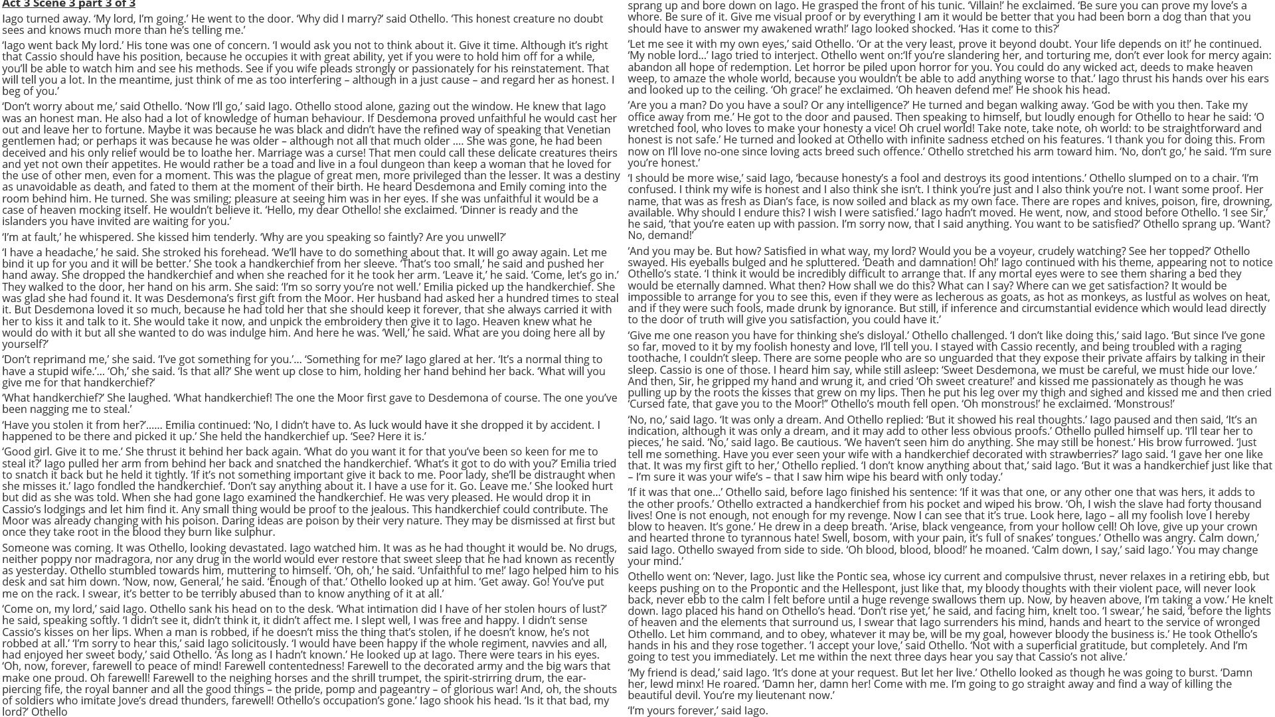

Slide 5
How does Shakespeare make this a memorable moment in the play?
One thing Shakespeare does to make this a memorable moment in the play is…
A quote that supports this would be…
This quote demonstrates my point because…
Another thing Shakespeare does to make this a memorable moment in the play is…
A quote that supports this would be…
This quote supports what I am saying because…

