Slide 1
What’s going on at the beginning of Act 3 Scene 4?

Slide 2
Act 3 Scene 4 Part 1
Desdemona and Emilia went out to the courtyard to enjoy the sunshine. They settled themselves on a bench under a tall shady tree. Desdemona beckoned to the old sweeper.
‘Do you know, my good man, where Lieutenant Cassio lies?’
‘I wouldn’t dare say he lies anywhere,’ the old man said.
‘Why man?’
‘He’s a soldier and for one to say a soldier lies is slander.’
Desdemona and Emilia laughed. ‘Where does he lodge?’ said Desdemona.
‘To tell you where he lodges is to tell you where I lie,’ the old man said.
Desdemona looked at Emilia. ‘Can one make anything of this?’
Emilia shrugged.
‘I don’t know where he lodges,’ said the old man. ‘And for me to invent a lodging and say he lies here or lies there would be to lie in my own throat.’
‘Can you seek him out? And honour us with a report?’
‘I will examine the world for him: that is, compile questions and by them, answer.’ The old man bowed exaggeratedly and they laughed.
‘Look for him,’ said Desdemona. ‘Tell him to come here. Say that I have succeeded with my husband on his behalf and hope all will be well.’
‘To do that is within the possibility of man’s intelligence and therefore I will try doing it.’ The old man bowed again, saluted and set off on his errand.
Desdemona sighed. ‘Where do you think I lost that handkerchief, Emilia?’
Emilia avoided her eyes. ‘I don’t know, Madam,’ she said.
‘Believe me,’ said Desdemona. ‘I would rather have lost my purse, full of gold coins. And if my noble Moor weren’t so straightforward, with none of that unpleasantness that jealous men have, it would be enough to give him negative thoughts.’
‘He’s not a jealous man?’
‘Who? He?’ Desdemona laughed. I think the sun in the country where he was born dried up all those kinds of fluids in him.’
‘And here he comes,’ said Emilia, as Othello strode towards them.
Desdemona spoke softly in Emilia’s ear: ‘I won’t give him any peace now until he sends for Cassio.’ She smiled brightly. ‘How are you, my lord?’
‘I’m well, my good lady,’ said Othello. It was so hard to hide his feelings. ‘And how are you, Desdemona?’
‘Well, my good lord,’ she said.
‘Give me your hand,’ he said. He raised her hand to his lips and kissed her palm. ‘Your hand is moist, my lady.’
‘It hasn’t yet felt age, or known sorrow.’
‘It’s a sign of passion and open-heartedness.’ He stroked her palm. ‘Hot, hot and moist,’ he said ‘This hand of yours requires locking up, fasting, prayer, a lot of penance and religious exercise, because there’s a sweating and rebellious young devil here. It’s a good hand, a frank one.’
She laughed. ‘And so you should say that. It was the hand that gave my heart away.’
‘A free hand!’ he exclaimed. In olden times hands were given with hearts but the modern way is giving hands without hearts.’
‘I know nothing about that,’ she said. ‘Come now. Your promise.’
‘What promise, darling?’
‘I’ve sent to tell Cassio to come and talk to you.’
‘I’m getting a bad cold.’ he said. ‘Lend me your handkerchief.’
She took a handkerchief from her sleeve. ‘Here, my lord.’
He shook his head impatiently. ‘The one I gave you.’
‘I don’t have it with me.’
‘Not?’
‘No I don’t, my lord.’
‘That’s a mistake,’ he said. ‘An Egyptian gave it to my mother. She was a mystic and could almost read people’s thoughts. She told her that as long as she kept it it would make her agreeable and subdue my father completely to her love. But if she lost it or gave it away, my father would loathe the sight of her and he would look for new women. She gave it to me as she was dying and told me that when my turn came to marry I should give it to my wife. I did so, and take note of this: value it as you do your eyesight. To lose it or give it away would be damnation that nothing else could match.’
Desdemona breathed in sharply. ‘Is it possible?’ she said.
Othello nodded vigorously. ‘It’s true – there’s magic in the weave of it. A sibyl, who was two hundred years old, sewed it in a prophetic burst. The worms that made the silk were sacred, and it was dyed in fluid from mummies and the colour fixed with extract of virgins’ hearts.’
‘Really!’ Desdemona was uncertain. ‘Is it true?’
‘Most surely,’ he said. ‘Therefore look after it well.’
‘Then I wish to God I had never set eyes on it!’ she exclaimed.

Slide 3
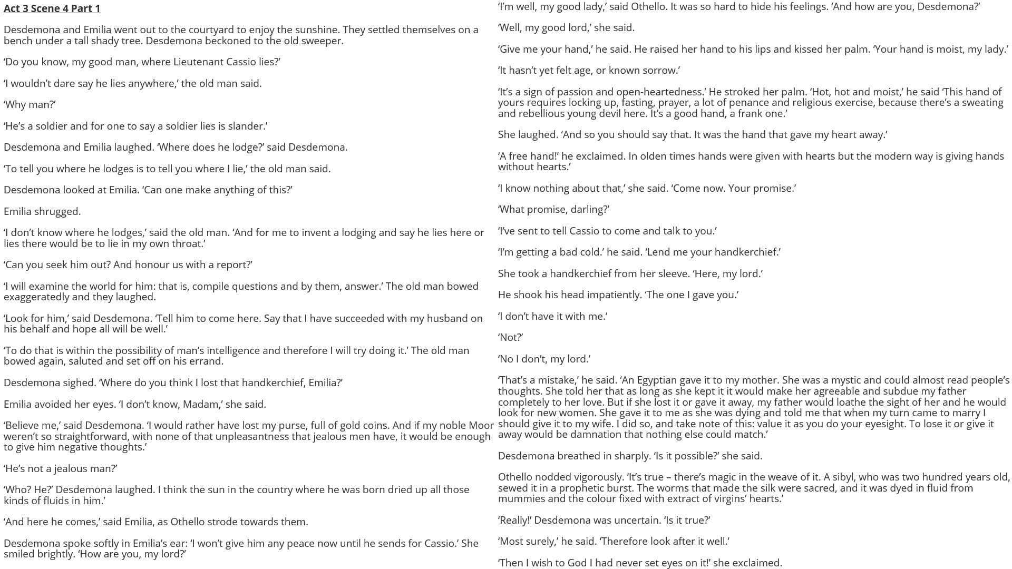

Slide 5
How does Shakespeare make this a memorable moment in the play?
One thing Shakespeare does to make this a memorable moment in the play is…
A quote that supports this would be…
This quote demonstrates my point because…
Another thing Shakespeare does to make this a memorable moment in the play is…
A quote that supports this would be…
This quote supports what I am saying because…

