Slide 1
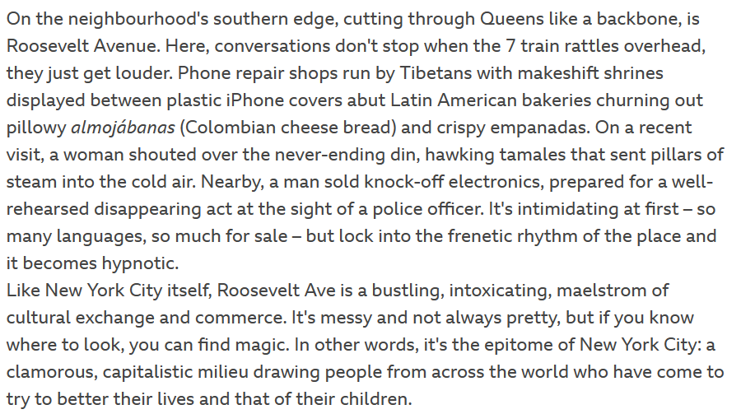
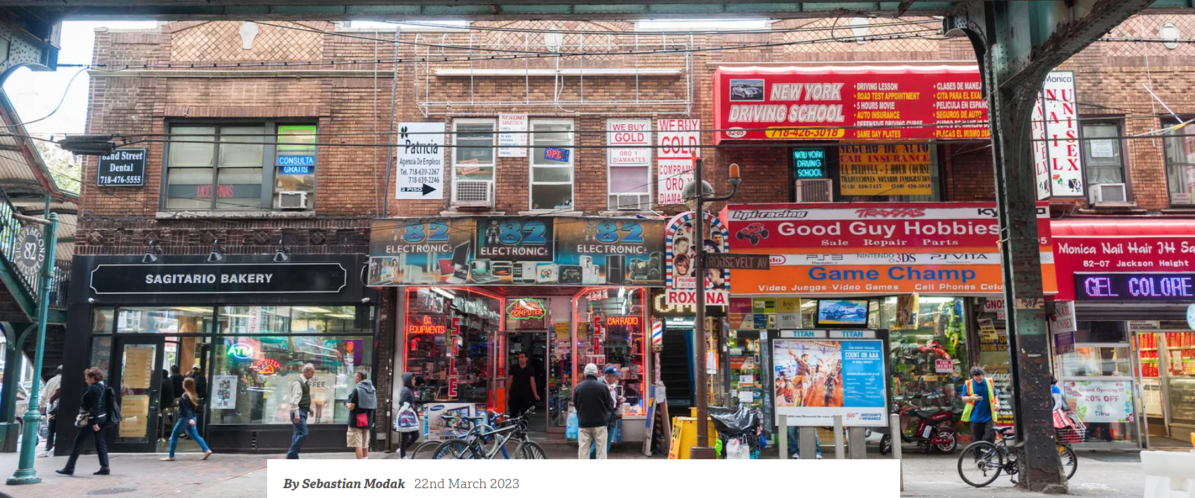
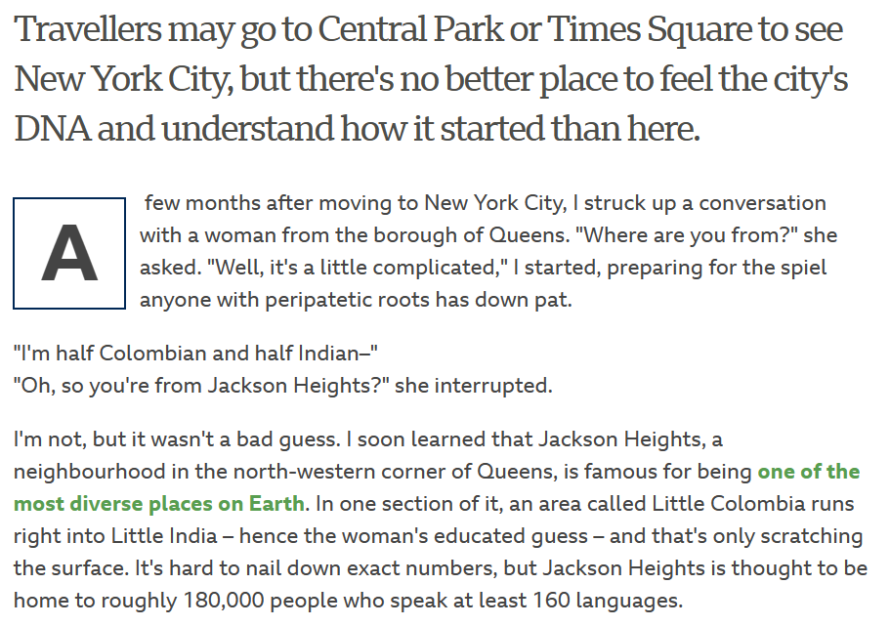
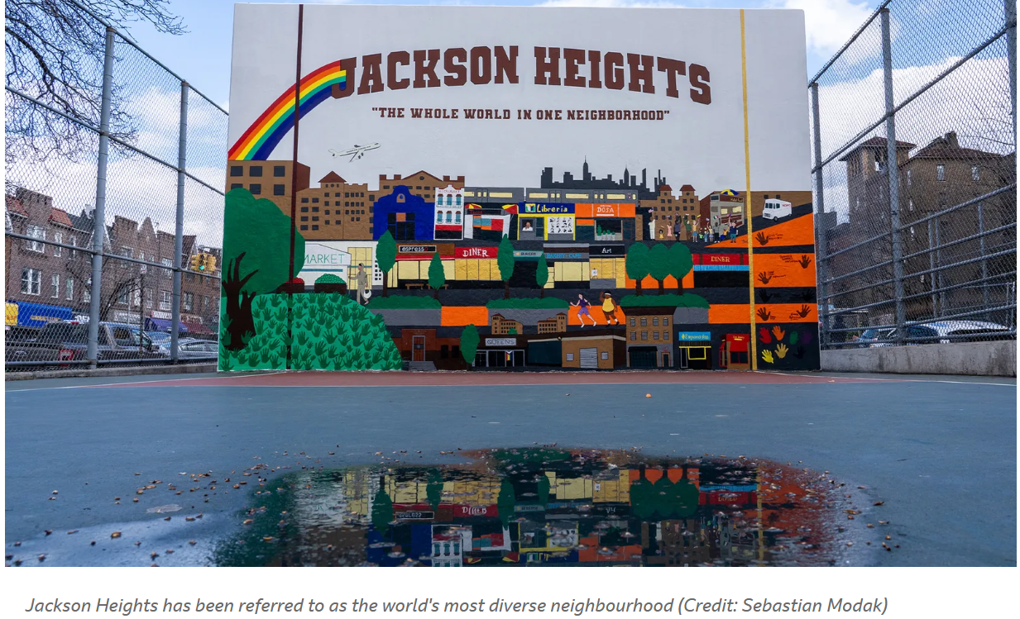

Slide 2
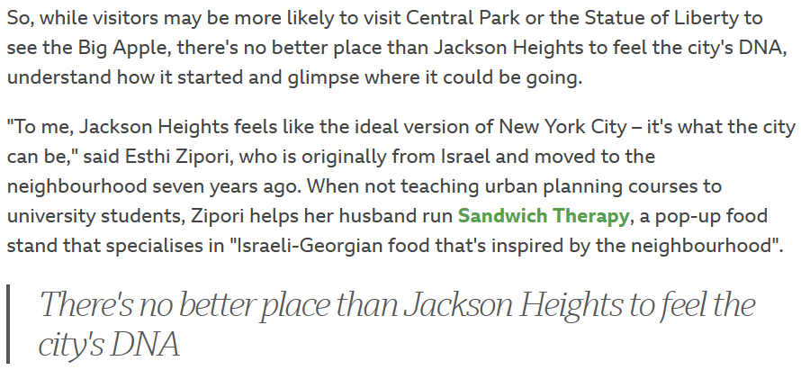
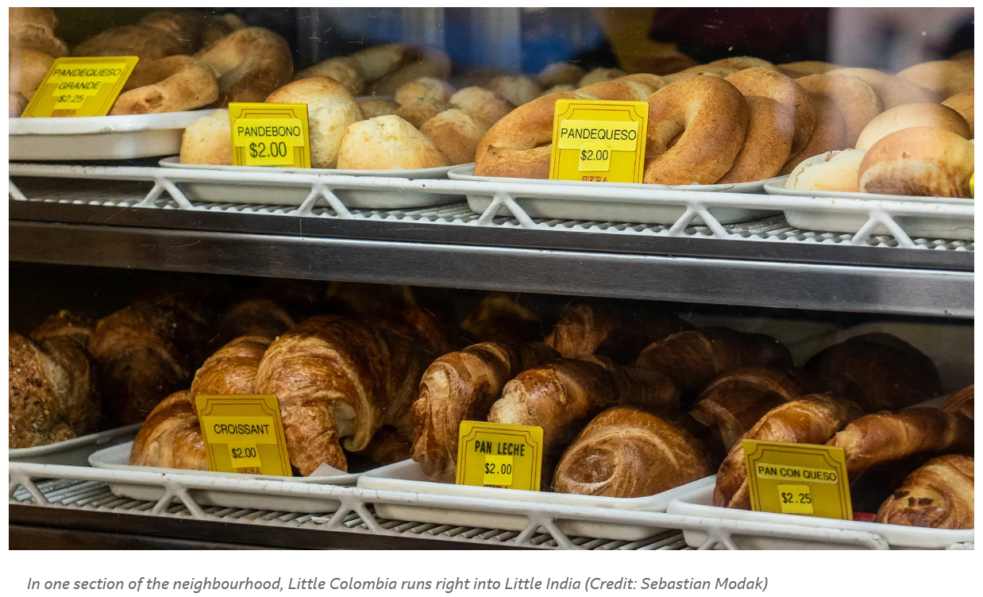
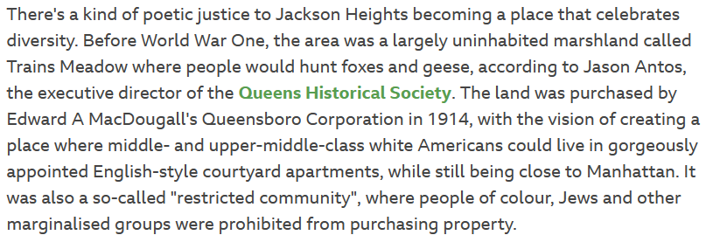

Slide 3
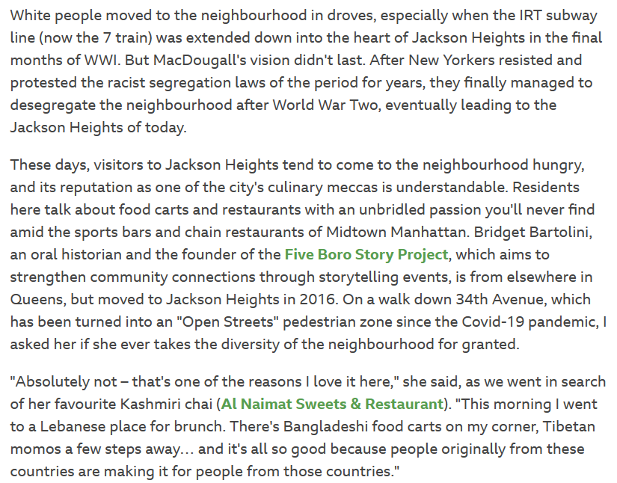
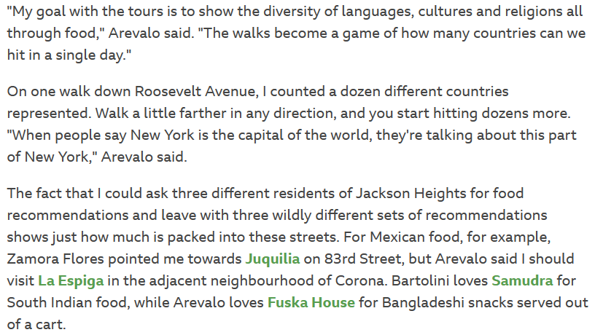
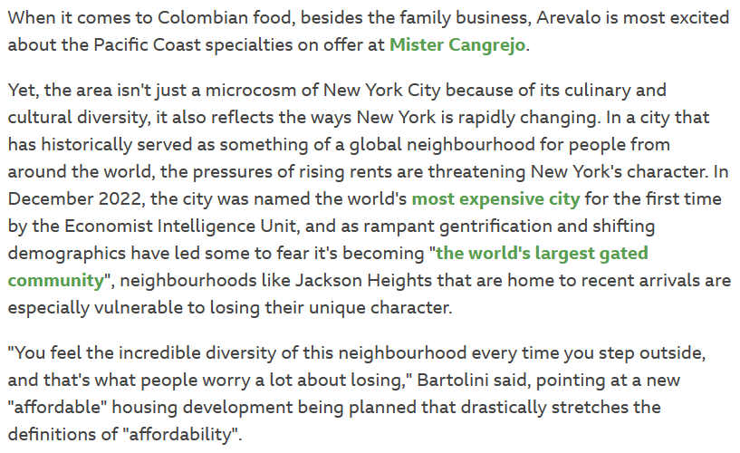

Slide 4
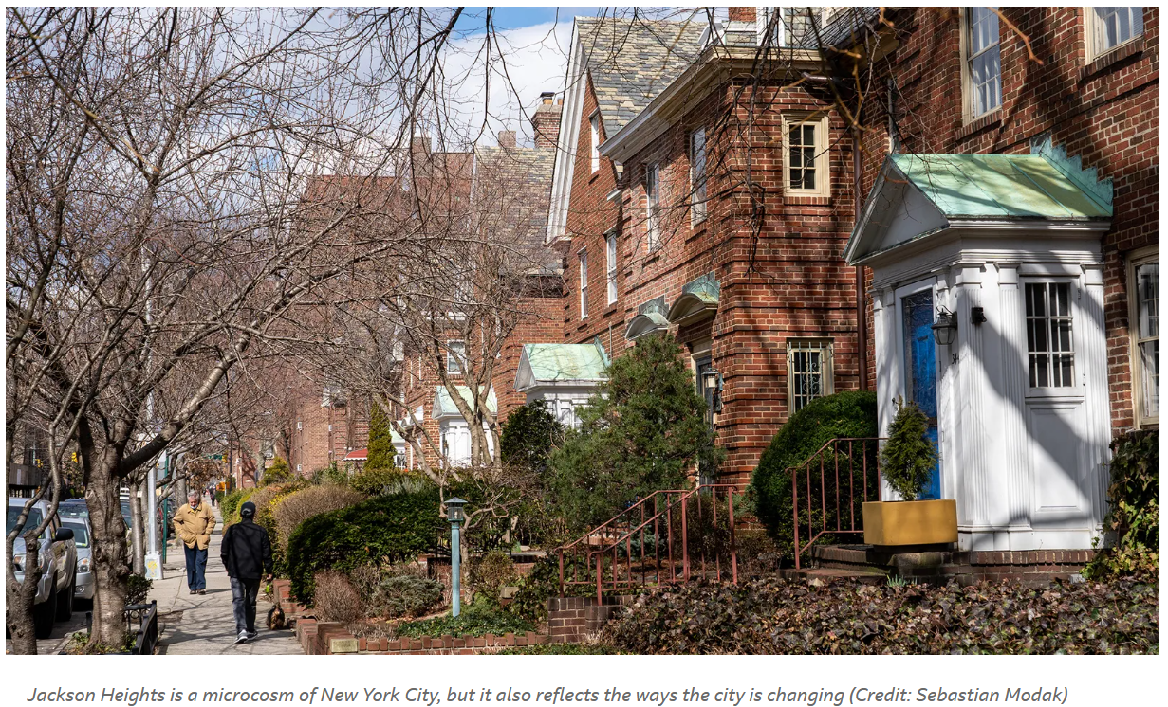
What is the focus of the article?
2. According to the article, what is the cultural and ethnic diversity of Jackson Heights?
3. How has the neighborhood changed over time, according to the article?
4. What is the main form of transportation used by residents of Jackson Heights?
5. What are some notable landmarks in Jackson Heights, mentioned in the article?
6. What is the author's opinion on the food scene in Jackson Heights?
7. According to the article, what are some challenges that residents of Jackson Heights face?
8. What is the historical significance of Jackson Heights, as described in the article?
9. How has Jackson Heights contributed to the overall cultural landscape of New York City?
10. What is the author's overall impression of Jackson Heights?
11. Write a short paragraph or create a visual representation that highlights what you find most interesting about Jackson Heights after reading this article.

