Slide 1
What’s going on at the beginning of Act 3 Scene 4?

Slide 2
Act 3 Scene 4 Part 2 of 2
‘Ha!’ Othello twitched. ‘Why?’
‘Why are you shouting?’
He put his face close to hers and raised his voice even more. ‘Is’t lost? Is’t gone?’
She stepped back.
‘Tell me!’ he shouted. ‘Is it missing?’
Desdemona looked desperately at Emilia. ‘Heaven bless us!’
‘What did you say?’ Othello gripped her arms.
‘It isn’t lost,’ she said. ‘But what if it was?’
‘What!’
‘I said it is not lost.’
‘Get it. Let me see it!’
‘Why, I can, Sir, but I don’t want to now. This is a trick to distract me from my suit. Please, see Cassio again.’
‘Go and get the handkerchief. My mind is uneasy.’
‘Come on now,’ she said. ‘You couldn’t find a more adequate man.’
Othello didn’t take his eyes off her. ‘The handkerchief!’ he bellowed.
‘I beg of you,’ she said. ‘Talk to me about Cassio.’
‘The handkerchief!’
Desdemona refused to give up. She tried again. ‘A man who has been your best friend, shared dangers with you…’
Othello’s eyes bulged. ‘The handkerchief!’
Desdemona turned away. ‘I don’t know what’s wrong with you,’ she said.
Othello threw his hands up. ‘God’s wounds,’ he shouted and strode to the castle entrance.
‘He looks like a jealous man,’ said Emilia as they watched him storm away.
I’ve never seen this before,’ said Desdemona. ‘There must be something special about that handkerchief. I’m dreadfully sorry that I lost it.’
‘It doesn’t take more than a year or two for a man to show his true colours,’ said Emilia. ‘They’re nothing more than stomachs and we’re only food. They eat us hungrily and when they’re full they belch us. Oh look, Cassio and my husband.’
Iago was saying, ‘There’s no other way: she’s the one who has to do it. Go and ask her.’ Desdemona put her hand out to Cassio. ‘Welcome, good Cassio,’ she said. ‘How are you?’
Cassio showed his distress. ‘Madam,’ he said. ‘About my former request. I beg of you, that with your help I may again exist and be a member of his love, whom I honour with all my heart. I can’t bear any delay. If my offence is so bad that nothing I have done to serve him in the past, nor my sorrow, nor my future good intentions, can bring me back into his favour, then I have to know so that I can get used to it and find something else to do with my life.
‘Oh dear, my good friend Cassio,’ she said. ‘This is not the best time for me. My lord is not himself, and I wouldn’t even know him if he had changed in his looks as much he has changed in his mood. I assure you, I have done my best to speak for you and have aroused his displeasure for being so bold. You must be patient for a while. I’ll do what I can, and even more than I really dare to. Let that be enough for you.’ Iago looked surprised. ‘Is my lord angry?’ he said.
‘He’s just left,’ said Emilia, ‘ and was certainly very disturbed.’
‘Could he be angry?’ said Iago. I have seen the cannon blasting his ranks into the air and strike his brother down and not seen anger in him. This is something momentous then. I’ll go and see him. There’s some real substance in this if he’s angry.’
‘Please do so,’ said Desdemona. When he had gone Desdemona shook her head. She appealed to Emilia. ‘It must be some matter of state,’ she said. ‘Either something from Venice or some unhatched plot that’s been revealed to him here in Cyprus has muddied the clarity of his mind. In such cases it’s the nature of men to wrangle about small things when they have important matters on their minds. That must be it. It’s like when a finger aches it makes every part of us feel that it’s in pain. No, we mustn’t make the mistake of thinking that men are gods, nor should we expect them always to behave towards us as they do at the wedding. Forgive me, Emilia, I was, inadequate ‘warrior’ as I am, resenting his unkindness but now I find I was being unjust and accusing him falsely.’
‘Let’s hope it is state matters, as you think it is, and nothing – not any jealousy – concerning you.’ Emilia looked thoughtful. ‘Oh no,’ said Desdemona. ‘I’ve never given him cause for that.’
‘But jealous natures don’t need a cause. They never have a reason for their jealousy. They’re jealous because they’re jealous. Jealousy is a monster, conceived of itself, born of itself.’
‘Heaven keep that monster from Othello’s mind,’ said Desdemona.
‘Amen!’ said Emilia.
‘I’ll go and look for him,’ said Desdemona. ‘Stay in the vicinity, Cassio. If I find him in the right state of mind I’ll ask him again and try my best to bring it about.’
‘I’m most grateful to your ladyship,’ said Cassio.
He went out, past the guard, and stood at the gate, staring down at the sea. A voice startled him. It was Bianca, a young townswoman he had struck up a friendship with. ‘What are you doing here?’ he said. ‘How are you, my beautiful Bianca? I was going to go to your house.’
She smiled coquettishly. ‘And I was on my way to your lodging, Cassio.’ She slipped an arm round his waist. ‘What’s this?’ she said. ‘Keep a week away from me? Seven days and nights? Eight score eight hours? And lovers’ hours away from each other more tedious than the eight score on the clock. So slow.’
‘Forgive me Bianca,’ he said. ‘I’ve been oppressed with a heavy heart these last few days but I’ll be able to make up for this absence soon.’ He pulled a large handkerchief out of his pocket. ‘Sweet Bianca, take this embroidery out for me.’
Bianca looked dismayed. ‘Oh Cassio, where did this come from? This is a gift from a newer friend. Now I understand your absence. So it’s come to this. Well, well.’
‘Go on, woman!’ he exclaimed. Throw your vile guesses back in the devil’s teeth where they came from.’ And when she turned away he caught hold of her. ‘You’re jealous now. You think this is a souvenir from some woman. No, I swear, Bianca.’
‘Well whose is it then?’
‘I have no idea, Sweetheart. I found it in my bedroom. I like the pattern a lot. Before someone claims it, as I’m sure they will, I want it copied. Take it and do it, and leave me for the moment.’
‘Leave you?’ she said. ‘Why?’
‘I’m here to see the General, and I don’t think it will be helpful – nor do I want it – that he should see me with a woman.’
‘Why ever not?’
‘It’s not that I love you not.’
‘But that you do not love me. Come on, walk a little way with me and tell me if I’ll see you tonight.’
‘I can only walk a little way with you because I have to be here, but I’ll see you soon.’
‘Fine,’ she said. ‘I’ll have to make do with that.’

Slide 3
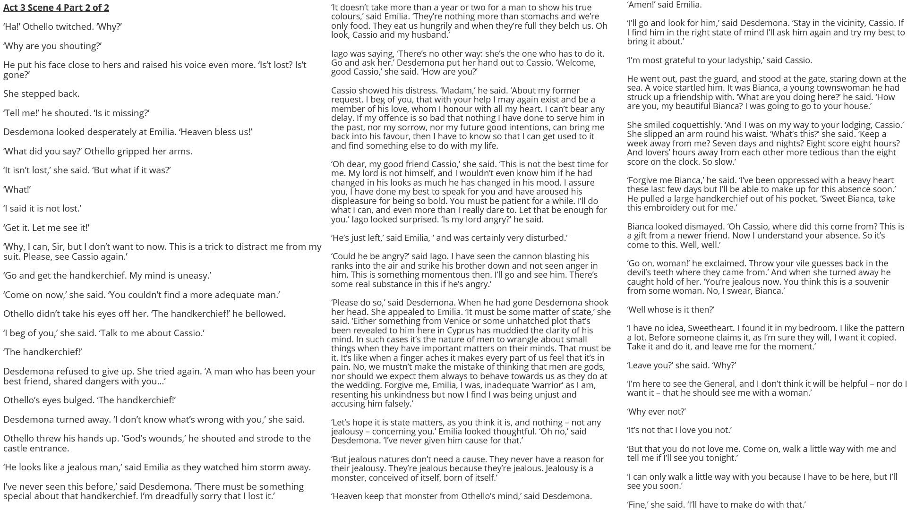

Slide 4
How does Shakespeare make this a memorable moment in the play?
One thing Shakespeare does to make this a memorable moment in the play is…
A quote that supports this would be…
This quote demonstrates my point because…
Another thing Shakespeare does to make this a memorable moment in the play is…
A quote that supports this would be…
This quote supports what I am saying because…

Slide 5
Act 3 Scene 1 part 1
Act 3 Scene 1 part 2
Act 3 Scene 2
Act 3 Scene 3 part 1
Act 3 Scene 3 part 2
Act 3 Scene 3 part 3
Act 3 Scene 4 part 1
Act 3 Scene 4 part 2

