Slide 1
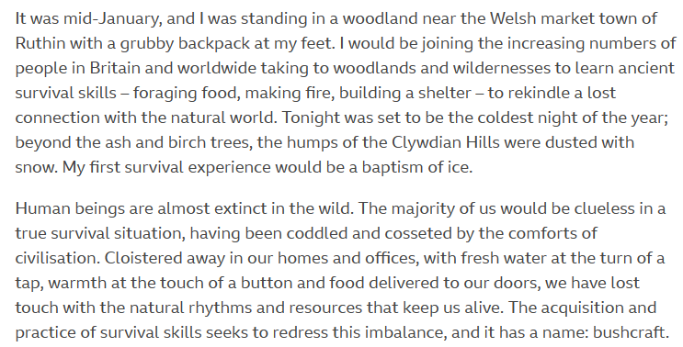
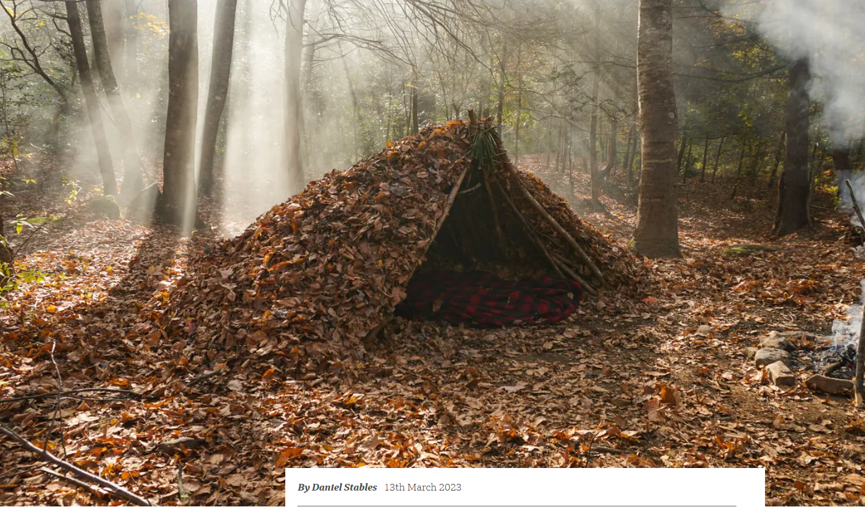
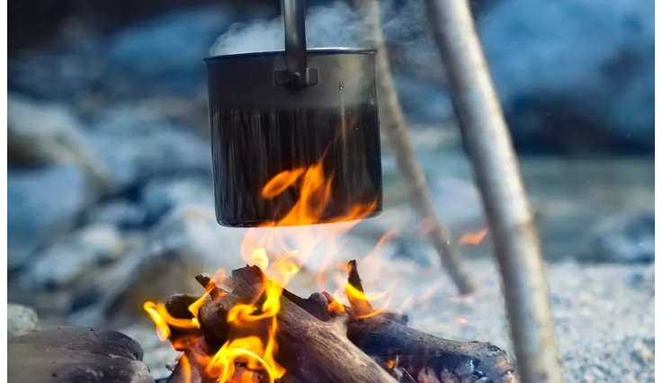

Slide 2
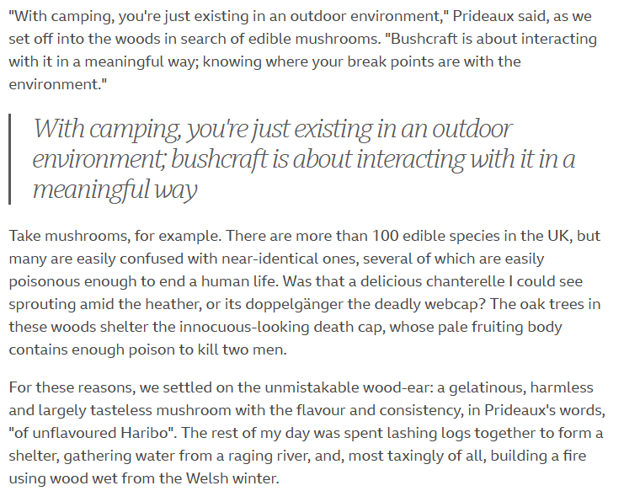
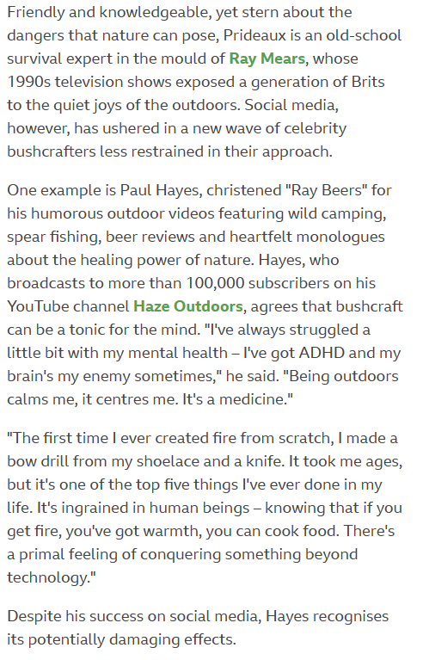

Slide 3
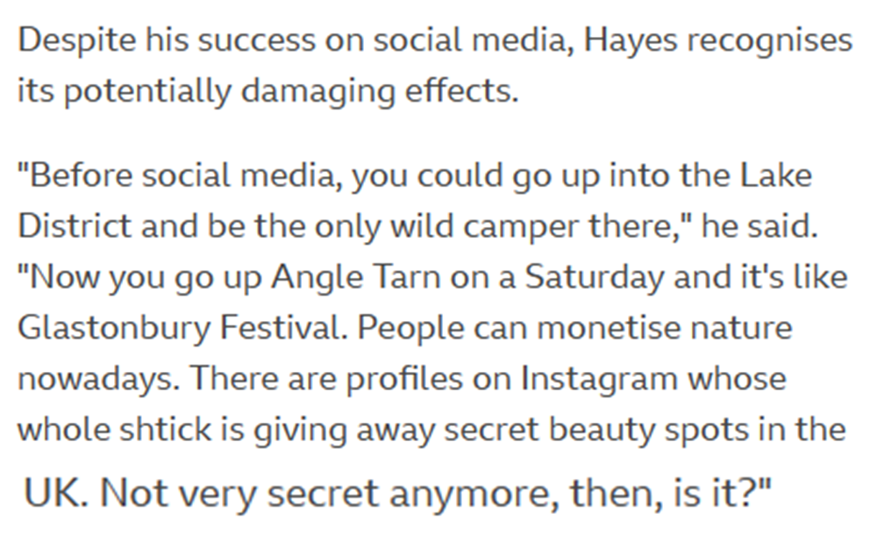
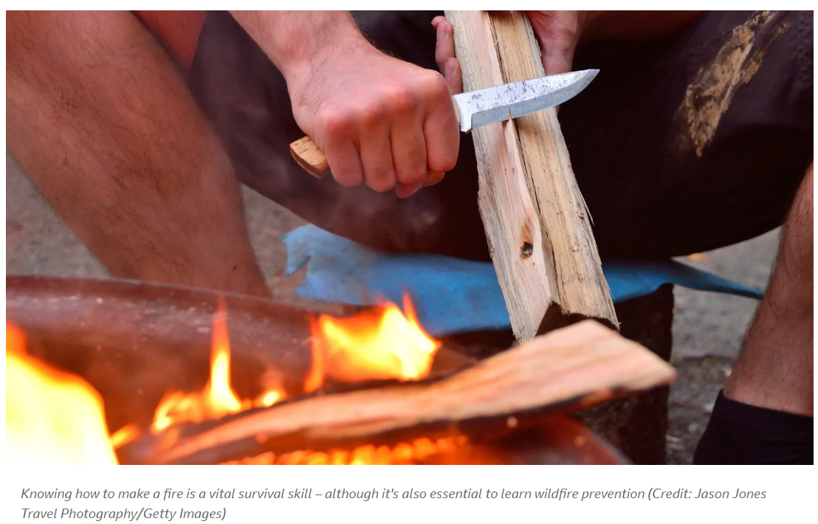
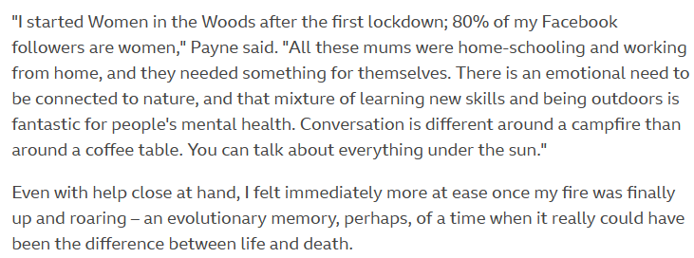
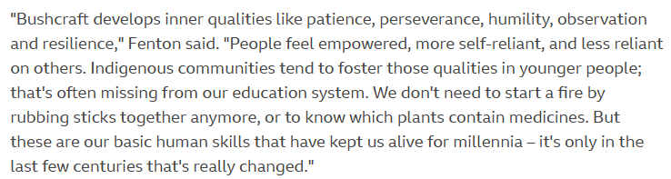

Slide 4
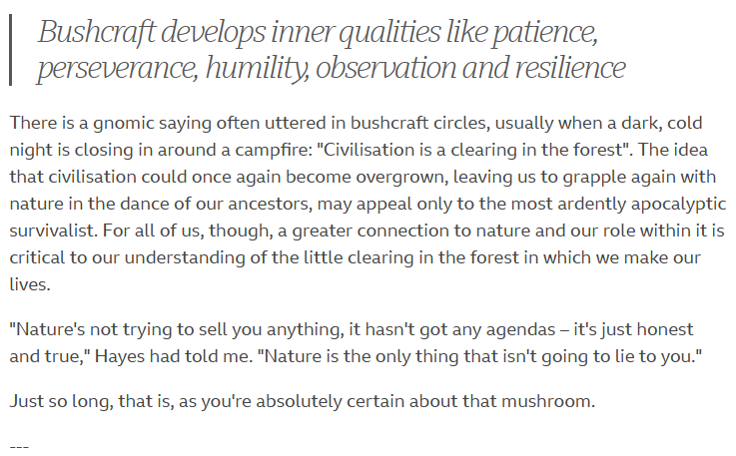
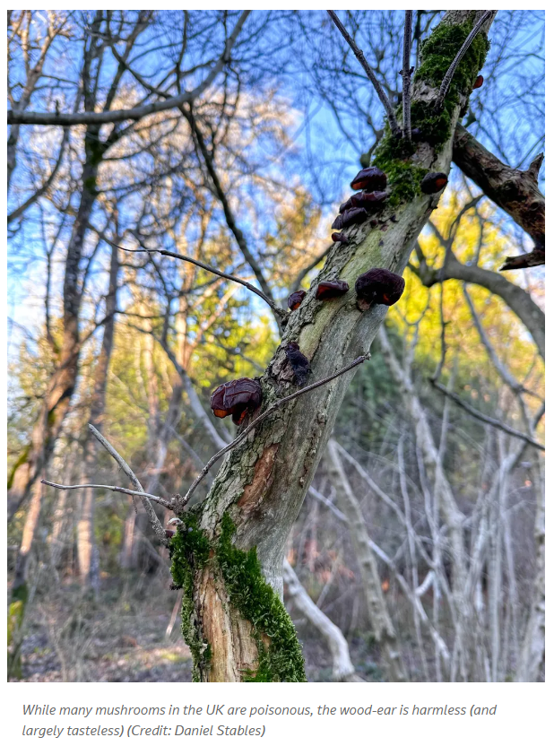
What is the article on the BBC Travel website titled "Why bushcraft is booming again" about?
2. According to the article, what is the definition of bushcraft?
3. What are some reasons for the recent surge in popularity of bushcraft?
4. How has the COVID-19 pandemic affected the interest in bushcraft, according to the article?
5. What are some skills that one can learn through bushcraft, as mentioned in the article?
6. What are some ethical considerations one should keep in mind when practicing bushcraft, as discussed in the article?
7. According to the article, what is the importance of being knowledgeable about the environment when practicing bushcraft?
8. How does bushcraft differ from traditional camping or hiking, according to the article?
9. What are some common misconceptions about bushcraft that the article addresses?
10. What is the author's overall opinion on the recent resurgence of interest in bushcraft?
11. Create an image or write a short paragraph that highlights a specific skill or technique you learned about in the article and how you could apply it in a real-life survival situation.

