Slide 1
What’s going on at the beginning of Act 4 Scene 1?

Slide 2
Act 4 Scene 1 part 1
Iago had to work fast. Every minute’s delay increased the risk that he would be exposed. He found Othello at his desk, where he sat brooding, and he introduced the subject immediately.
‘What do you think about it?’ he said.
‘Think about it Iago?’ Othello was far away.
‘What! To kiss in private’?
‘It would be an unauthorised kiss then.’
‘Or to be naked in bed with her friend and not mean any harm?’
He had the General’s attention. ‘Naked in bed and not mean harm?’ said Othello. ‘That’s hypocrisy against the devil. Those who do that without meaning harm are being tempted by the devil and they are tempting heaven.’
‘If they do nothing it’s just a venial slip,’ said Iago. ‘But if I give my wife a handkerchief…’
‘What then?’ said Othello.
‘Well, then, it’s hers, my lord, and she may give it to any man.’
‘By that logic, being the owner of her honour, may she give that too?
Iago smiled. ‘Her honour is invisible: they often have it when they don’t. But as for the handkerchief…’
Othello sprang up. ‘By heaven, I’ve been trying to forget that! You told me – oh it comes to my memory like the raven visiting the infectious house, boding ill to all in it – he had my handkerchief.’
‘Yes, and what does that mean?’
‘It’s bad.’
Iago sat down in Othello’s vacated chair. ‘What if I told you I had actually seen him doing you wrong, or heard him say – as there are such rogues who, having seduced some married woman, can’t help blabbing about it.’
‘Has he said anything?’
Iago nodded sadly. ‘He has, my lord, but you can be sure he’ll deny it.’
‘What did he say?’
‘In faith, that he… No, I don’t know what he did.’
Othello went down on his knees and looked up at Iago. ‘What? What?’
‘Lie…’
‘With her?
‘With her, on top of her, everything.’
Othello put his hands up and blocked his ears. ‘Lie with her? On top of her? Lie with her! God’s wounds, that’s evidence!’ He began swaying. ‘Handkerchief – confession – handkerchief! To confess and be hanged for it. First the hanging then the confession!’ He was shaking violently. He examined his hands, trying to hold them steady. ‘I’m shaking at it. I couldn’t feel such passion if I didn’t know it was true. It’s more than words that’s making me shake like this.’ He tried to rise. ‘Noses, ears and lips – all shaking. Is it possible?’ He stood up and lurched forward like a drunken man. ‘Confess? Handkerchief! O devil!’ He crashed to the floor in a faint.
Iago got up and looked down at him. He smiled. He put his foot on his head. ‘Work on, my medicine, work,’ he whispered. ‘This is how gullible fools are caught, and so many worthy and chaste women too, all innocent, but condemned.’ He heard someone coming. He knelt down beside Othello and took his face gently in his hands. ‘’Wake up, my lord!’ he said. ‘My lord, I say! Othello!’
It was Cassio.
‘Hello Cassio,’ he said and beckoned him.
Cassio bent over Othello’s inert body. ‘What’s the matter?’ he said.
‘My lord has had an epileptic attack. This is the second. He had one yesterday.’
‘Rub his temples,’ said Cassio and began to do that.
‘No, stop,’ said Iago. ‘The fit must take its natural course. If not he foams at the mouth and eventually breaks out in savage madness. Look, he’s stirring. Just leave us for a while. He’ll recover in a moment. When he’s gone there’s an important matter I want to talk to you about.’
Cassio went out quickly.
Othello groaned and opened his eyes.
‘How are you General?’ said Iago. ‘Have you hurt your head?’
Othello sat up and glared at Iago. ‘Are you mocking me?’
‘I mock you? No, by heaven! I wish you would take this like a man!’
‘A horned man’s a monster and an animal.’
‘In that case there are lots of animals in big cities and many monsters of rank.’
‘Did he confess it?’ said Othello.
‘Good sir, be a man. Think of it like this, that all men are in the same situation. There are millions now alive who sleep every night with unfaithful women who they take to be faithful. You’re better off. Oh, it’s the spite of hell to have a woman in what one took to be a secure marriage bed and take for granted that she’s chaste. No, I would rather know, and knowing the situation I can decide what action to take.’
Othello got up shakily. ‘Oh you’re wise, that’s certain.’
‘Go and stand behind that pillar,’ said Iago. ‘Hide away and wait patiently. While you were unconscious, overwhelmed with your grief – a passion so unsuited to such a man as you – Cassio was here. I got rid of him and made an excuse for your condition, and told him to come back later and talk to me, which he promised to do. Just go and hide and watch the sneers, the mockery and awful scorns that live in every part of his face. Because I’m going to make him tell me the story again: where, how often, how long ago and when he did, and will again, have your wife.’
Othello opened his mouth to cry out but Iago put his hand up. ‘Listen to me. Just watch his gestures.’ Othello opened his mouth again and Iago stopped him again. ‘For heaven’s sake, have patience! Or I will think you’re all spleen and nothing of a man.’
Othello raised his hand in a fist. ‘Do you hear, Iago? I will control myself and I will be patient, but – do you hear? – most bloody.’
‘Nothing wrong with that,’ said Iago. But all in due course. Will you go and hide?’
Othello went and stood behind the pillar. Cassio would arrive in a minute. Iago knew exactly how he was going to do it. He would question Cassio about Bianca, a housewife who sold herself to buy food and clothes. She doted on Cassio. Iago grinned. It was the fate of prostitutes to beguile many men and be in love with just one. As soon as he mentioned her name Cassio wouldn’t be able to stop himself from laughing about her. And here he was. When Othello saw him laughing he would go mad. His naïve jealousy would completely misconstrue Cassio’s smiles, gestures and frivolous behaviour.
‘How are you, Lieutenant?’
‘The worse for you calling me by the title the lack of which is killing me,’ said Cassio.
Speaking very quietly Iago said: ‘Keep going with Desdemona and you’ll be sure of it. Now if this suit lay in Bianca’s power you’d have it very quickly.’
Cassio’s sad face brightened and he laughed. ‘Poor wretch,’ he said.
Othello, watching from behind the pillar, saw the sudden laughter.
‘I never knew a woman who loved a man so much,’ said Iago.
‘Alas, poor rogue!’ exclaimed Cassio. ‘I think she loves me.’
Othello was astounded by his dismissive gesture and the renewed laughter.
‘Do you know what, Cassio?’ said Iago. ‘She’s telling everyone that you’re going to marry her. Is that what you intend?’
Cassio threw his head back and laughed loudly. It came across to Othello as triumphant.
‘I marry her!’ Cassio laughed even louder. What! A customer! Please! Give my intelligence more credit; don’t think it’s so low.’ More laughter.
Othello vowed that the winner would be the one to laugh.

Slide 3
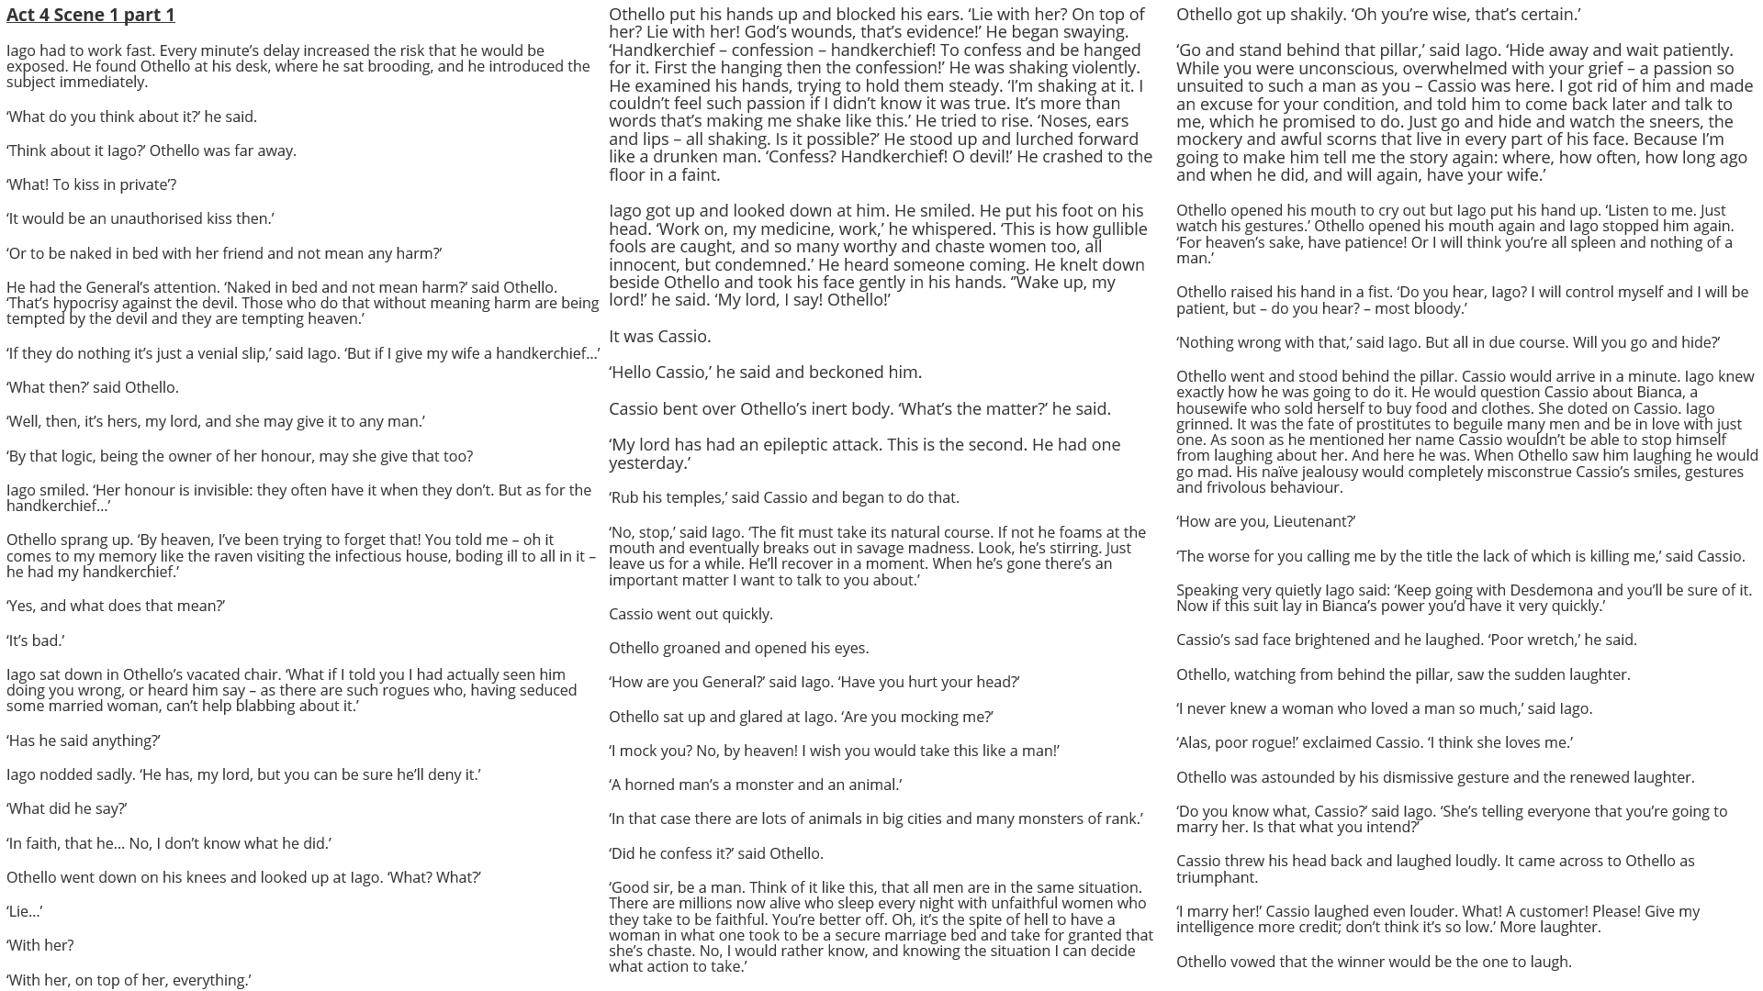

Slide 4
How does Shakespeare make this a memorable moment in the play?
One thing Shakespeare does to make this a memorable moment in the play is…
A quote that supports this would be…
This quote demonstrates my point because…
Another thing Shakespeare does to make this a memorable moment in the play is…
A quote that supports this would be…
This quote supports what I am saying because…

