Slide 3
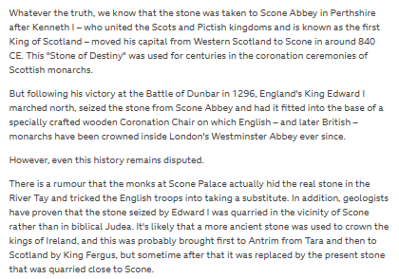

Slide 4
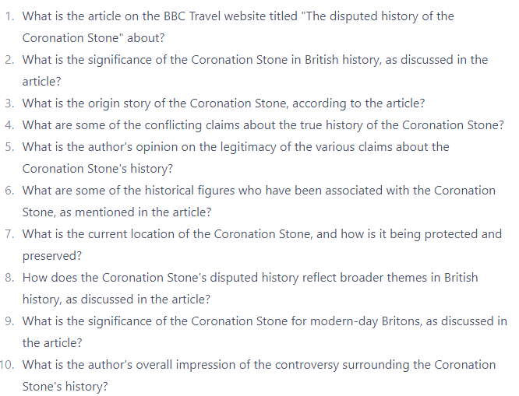
1. Summarise the article in no more than one paragraph.

