Slide 1
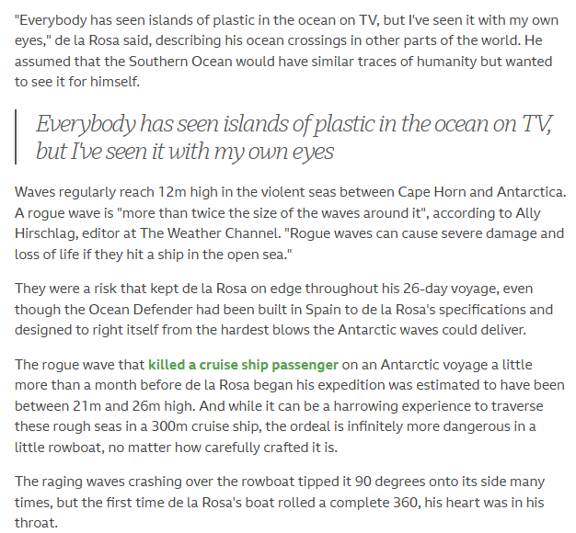
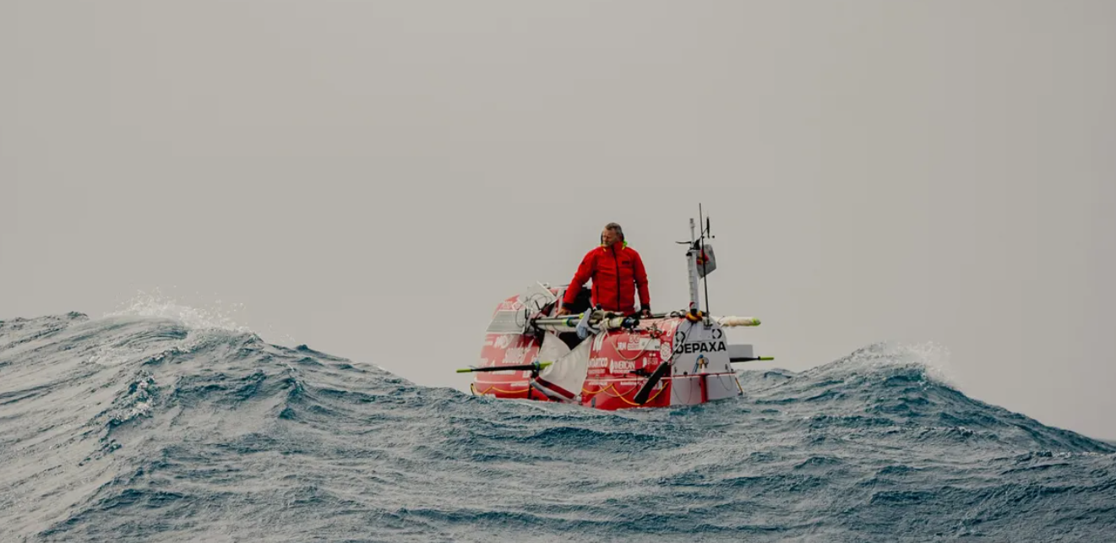
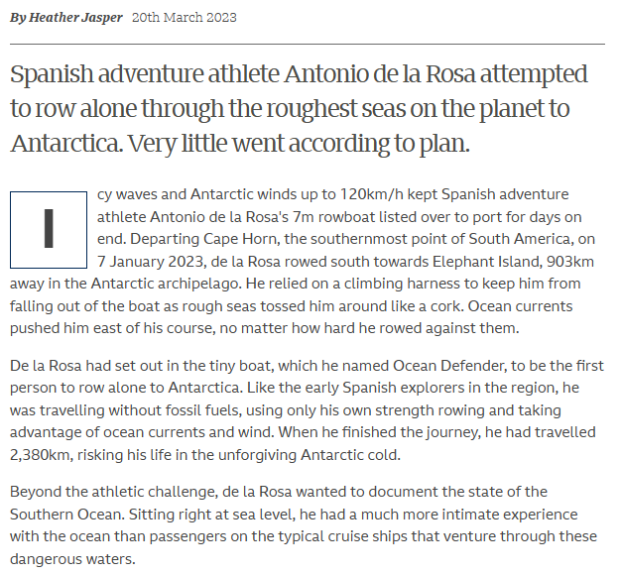

Slide 2
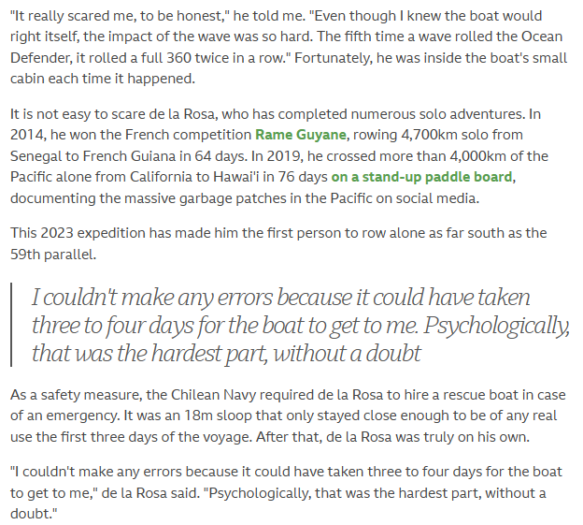
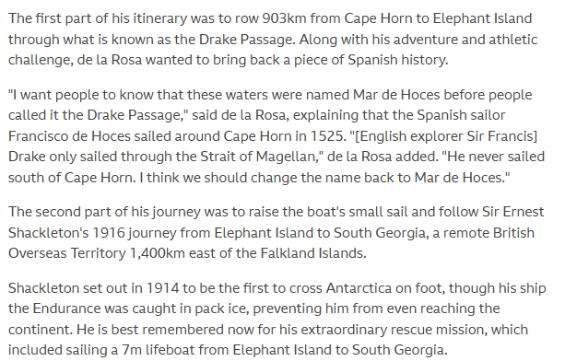
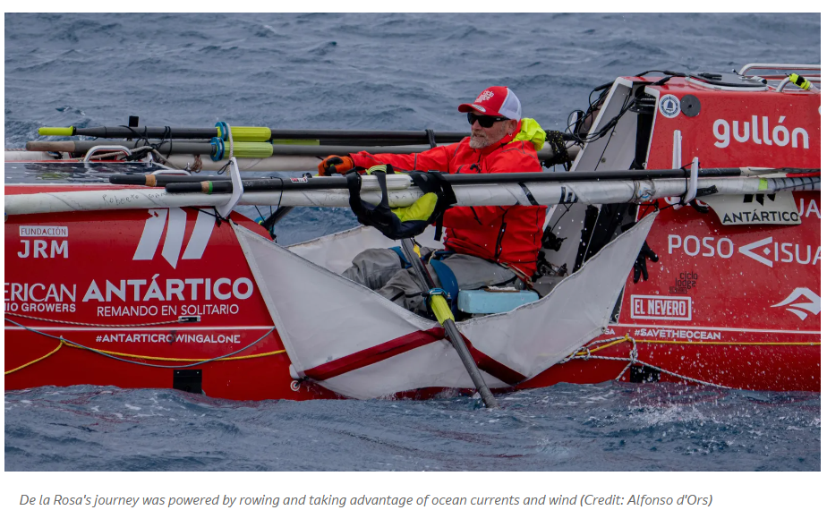

Slide 3
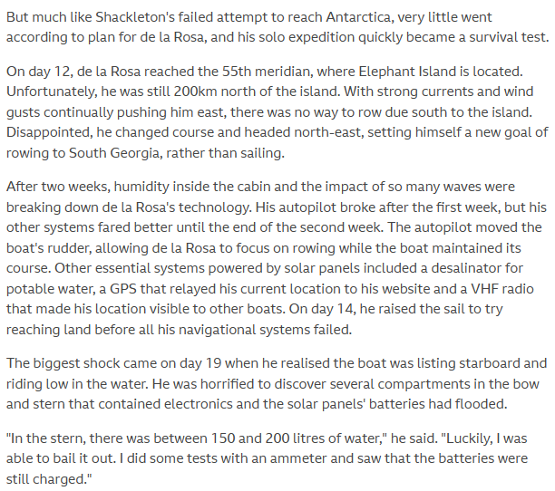
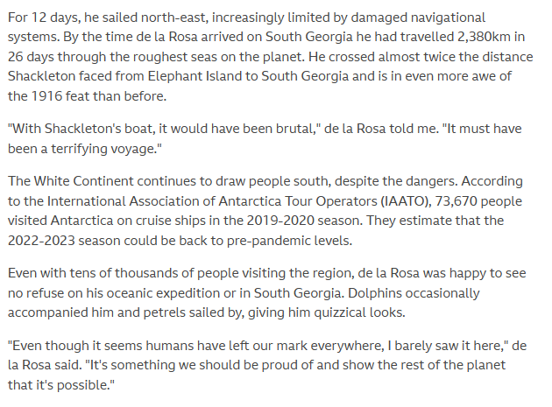
What is the main subject of the article?
2. What makes the journey to Antarctica unique?
3. What is the purpose of the route described in the article?
4. How long does the journey take?
5. What are the challenges faced by travelers on the route to Antarctica?
6. What are the benefits of taking this route to Antarctica?
7. How do the experiences of different travelers differ on the journey to Antarctica?
8. What role do the natural surroundings play in the journey to Antarctica?
9. What impact does the journey to Antarctica have on the environment?
10. What advice would you give to someone planning to take this route to Antarctica?
11. If you could go on a journey to any other remote location in the world, where would you go and why?

