Slide 1
What’s going in the rest of Act 4 Scene 1?

Slide 2
Act 4 Scene 1 part 2
‘The monkey has spread the rumours herself. She flatters herself. She does it out of self love, not because of any promise I made her.’
Iago unobtrusively drew Cassio closer to the pillar behind which Othello was hiding so that he could hear the rest of the conversation.
‘She was here just now,’ said Cassio. ‘She haunts me wherever I go. The other day I was at the beach, talking to some Venetians, and the toy comes along and, by this hand, starts hugging and kissing me.’ Othello tried to digest that.
‘And holds on to me and sighs and cries and pulls at me,’ said Cassio, still laughing. Othello filled in the rest – her dragging him to their bedroom. He was going to feed Cassio’s nose to the dogs.
‘Well, I’ll have to get rid of her,’ said Cassio. There was shouting and scuffling and the door burst open and Bianca came running in, followed by a guard.
Iago waved the guard away as she ran towards them.
‘What do you think you’re doing, stalking me like this?’ said Cassio.
‘Let the devil and his mother stalk you,’ she shouted. ‘What did you mean by giving me that handkerchief? I was a real fool to take it. A likely story that you found it in your bedroom and not know who left it there. This is a gift from some hussy, and I must take the embroidery out. Here!’ She threw the handkerchief at him. ‘Give it to your mistress, whoever gave it to you. I’m not taking the embroidery out.’
Cassio caught her in his arms. ‘Come on, my sweet Bianca. He held her close to him. ‘Come on, come on now.’ Othello recognised the handkerchief but stayed where he was. Bianca responded to Cassio’s kiss then struggled free. ‘If you’d like to come to supper tonight you may,’ she said. ‘If not, come when you like.’
‘After her, after her,’ said Iago.
‘Yes, I must,’ said Cassio. ‘Or she’ll shout it out in the streets.’
‘Will you go to her for supper?’
‘I suppose so.’
‘Well I may bump into you. I need to talk to you.’
‘Please come.’ Cassio paused at the door. ‘Will you?’
‘Go on. Say no more.’
Othello came out from behind the pillar. He clenched his fists. ‘How shall I murder him, Iago?’
‘Did you see how he laughed at his vice?’ said Iago.
‘Oh Iago!’
‘And did you see the handkerchief?’
‘Was that mine?’
‘Yours, by this hand! And to see how he values the foolish woman, your wife: she gave it to him and he has given it to his whore.’
‘I want him killed slowly.’ Othello sank down at his desk and put his head on it. ‘A fine woman, a beautiful woman, a sweet woman,’ he moaned.
Iago put his hand on the General’s shoulder. ‘No, you must forget that,’
he said.
Othello looked up at him. His eyes were wet. ‘Yes, let her rot and die and be damned tonight because she’ll not live beyond that. No, my heart has turned to stone.’ He beat his chest. ‘I strike it and it hurts my hand.’ He put his head on the desk again. ‘Oh, there’s not a sweeter creature in the world. She could lie at the side of an emperor and tell him what to do.’
‘No,’ said Iago. ‘That’s not your way.’
‘Hang her!’ Othello rallied for a moment then sank down again. ‘I’m only saying what she is. So delicate with her needle, such an admirable musician. Oh, she could sing the savageness out of a bear. Such high intelligence, so creative.’
‘She’s the worse for all that,’ said Iago.
‘Oh, a thousand thousand times! But then, so gentle.’
‘Yes, too gentle.’
‘No, that’s certain!’ Othello shook his head. ‘But yet, the pity of it, Iago.
Oh, Iago, the pity of it, Iago!’
‘If you’re going to be so foolish about her crime just go ahead and give her permission because if it’s not your business it’s no-one else’s.’
‘I will chop her into pieces of meat!’ said Othello. ‘Cuckold me!’
‘Oh it’s so foul of her,’ said Iago.
‘With my officer!’
‘That’s even fouler.’
‘Get me some poison tonight, Iago. I won’t delay in case her body and beauty make me change my mind. Tonight, Iago.’
‘Don’t do it with poison. Strangle her in bed – the very bed she’s contaminated.’
Othello gripped Iago’s sleeves. ‘Good. Good! The justice of it is appropriate. Very good!’
‘And as for Cassio, let me deal with him. You will hear more by midnight.’
‘Excellent.’
There was a loud fanfare from the castle’s trumpeters.
‘What’s that?’ said Othello
‘Something from Venice, I’ll bet,’ said Iago. He went to the door. There were people coming along the corridor. He turned back to Othello: ‘It’s Lodovico, come from the Duke, and see, your wife is with him.’
‘God save you, worthy General!’ exclaimed Lodovico and shook Othello’s hand vigorously.
Othello tried a smile. ‘With all my heart, Sir.’
Lodovico handed him a letter. ‘The Duke and senators of Venice greet you.’
Othello opened the letter and started reading it. The others chatted as they waited for him.
‘And what’s the news, good cousin Lodovico?’ said Desdemona.
‘I’m very glad to see you, signor,’ said Iago. ‘Welcome to Cyprus.’
‘Thank you,’ said Lodovico. ‘How is Lieutenant Cassio?’
‘Lives, Sir,’ said Iago.
‘Cousin,’ said Desdemona. ‘He and my lord have sadly fallen out. But you’ll make that all well.’
‘Are you sure of that?’ said Othello suddenly.
‘My Lord?’ said Desdemona.
Othello ignored her. His lips moved as he read. ‘ ‘This you must not fail to do, if you…’ he muttered.
Lodovico laughed. ‘He wasn’t talking to you. He’s engrossed in the letter. Has there been a quarrel between my lord and Cassio?’
‘A most unfortunate one. I would do a lot to bring them together for the sake of the love I have for Cassio.’
‘Fire and brimstone!’ roared Othello.

Slide 3
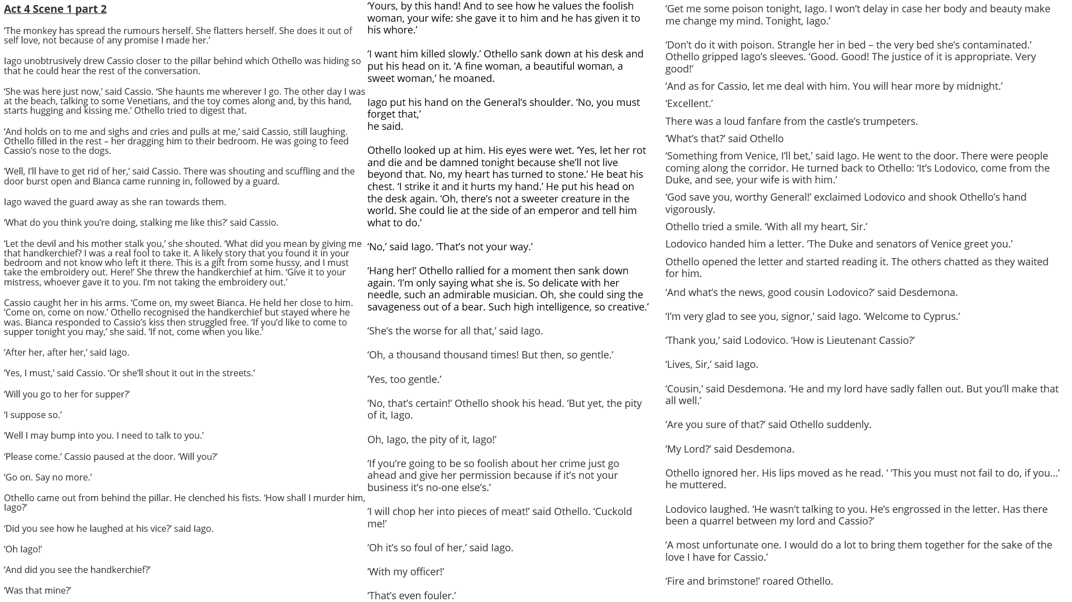

Slide 4
How does Shakespeare make this a memorable moment in the play?
One thing Shakespeare does to make this a memorable moment in the play is…
A quote that supports this would be…
This quote demonstrates my point because…
Another thing Shakespeare does to make this a memorable moment in the play is…
A quote that supports this would be…
This quote supports what I am saying because…

