Slide 1
What’s going at the end of Act 4 Scene 1?

Slide 2
Act 4 Scene 1 part 3
Desdemona looked shocked. ‘My lord?’ she said.
He threw the letter down and came up to Desdemona. ‘Are you wise?’ he said.
Desdemona appealed to Emilia: ‘What? Is he angry?’
‘Perhaps the letter has upset him,’ said Lodovico. ‘I believe they’re recalling him, replacing him with Cassio.’
Desdemona smiled excitedly. ‘I’m so happy about that,’ she exclaimed.
Othello glared at her. ‘Really!’ he said.
‘My Lord?’
‘I’m happy for you then,’ said Othello.
Desdemona caught the pain on his features and took his arm.
‘Why, sweet Othello,’ she said.
He shook her off roughly. ‘Devil!’ he shouted, lifted his hand and struck her hard in the face.
They all watched, shocked, as she looked up at his angry face with tears in her eyes. ‘I haven’t deserved this,’ she said.
Lodovico found his voice. My lord,’ he said. ‘Even if I were to swear that I saw this with my own eyes no-one in Venice would believe it. It’s too much. Apologise to her. She’s crying.’
Othello turned and gave him a hard look. ‘Oh devil, devil,’ he said. ‘If the whole earth were flooded with woman’s tears, each drop would be a crocodile tear.’ He turned his head toward Desdemona. ‘Out of my sight!’ he snapped.
‘I won’t offend you by staying,’ she said and began walking fast to the door.
Lodovico stared after her. ‘She’s an obedient lady,’ he said. ‘I beg of you, call her back.’
‘Mistress!’ said Othello.
She stopped and turned. ‘My lord?’
‘What do you want her for, Sir?’ said Othello.
‘Who I?’ said Lodovico.
‘Yes. You wanted me to make her turn. Sir, she can turn, and turn, and leave again, and turn again. And she can weep, Sir, weep. And she’s obedient, as you say, obedient – very obedient.’ His tone was bitter. He shook his finger at Desdemona. ‘You carry on with your tears.’
Then to Lodovico: ‘Concerning this, Sir,’ and then to Desdemona again: ‘Oh well counterfeited passion!’ To everyone: ‘I am commanded home,’ and to Desdemona, shouting: ‘Get away, I’ll send for you presently.’ To Lodovico: ‘Sir, I obey the mandate and will return to Venice.’ He saw Desdemona stop at the door and shouted after her: ‘Go, vanish!’
She almost ran. Othello tried to speak calmly but his breath was laboured. ‘Cassio will take my place. And, Sir, I invite you to supper with me tonight. You are welcome, Sir, to Cyprus.’ He turned abruptly and strode off. He lifted his head to the heavens and roared: ‘Goats and monkeys!’
Iago was silent as Lodovico paced for a moment then swung round to him.
‘Is this the noble Moor, whom our full senate call unmatchable? Is this the temperament that couldn’t be shaken by emotion? Whose solid virtue couldn’t be affected by anything? ‘
‘He is much changed,’ said Iago.
‘Is his mind stable? Has he gone mad?’
‘This is what he’s like. I wouldn’t dare to breathe my judgment about what he’s capable of. If he’s not what he should be I wish to heaven he were.’
‘What! To strike his wife!’
‘Yes, that was bad. But I wish I could feel that that violence would prove the worst thing he could do.’
‘Is this what he’s usually like? Or did the letters stir his blood and create this fault in him?’
‘Sadly, it would be disloyal of me to speak of what I have seen and known. You watch him and he will reveal himself so that I won’t have to tell you. Just follow him and see how he behaves.’
Lodovico shook his head sadly. ‘I regret to say that I’m disappointed in him.’

Slide 3
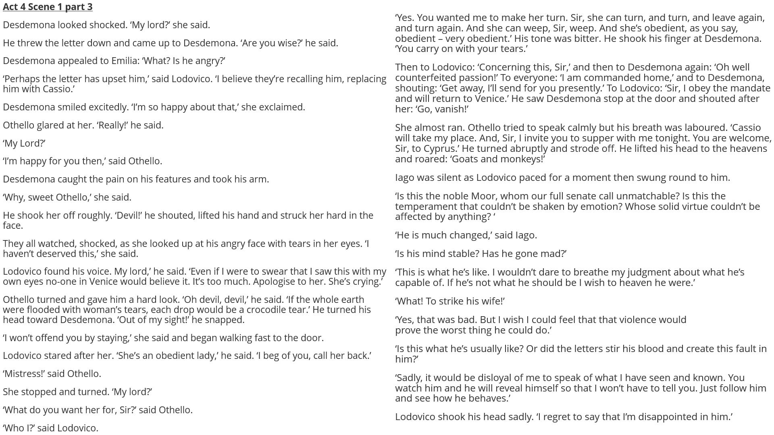

Slide 4
How does Shakespeare make this a memorable moment in the play?
One thing Shakespeare does to make this a memorable moment in the play is…
A quote that supports this would be…
This quote demonstrates my point because…
Another thing Shakespeare does to make this a memorable moment in the play is…
A quote that supports this would be…
This quote supports what I am saying because…

