Slide 1
What’s going at the end of Act 4 Scene 2?

Slide 2
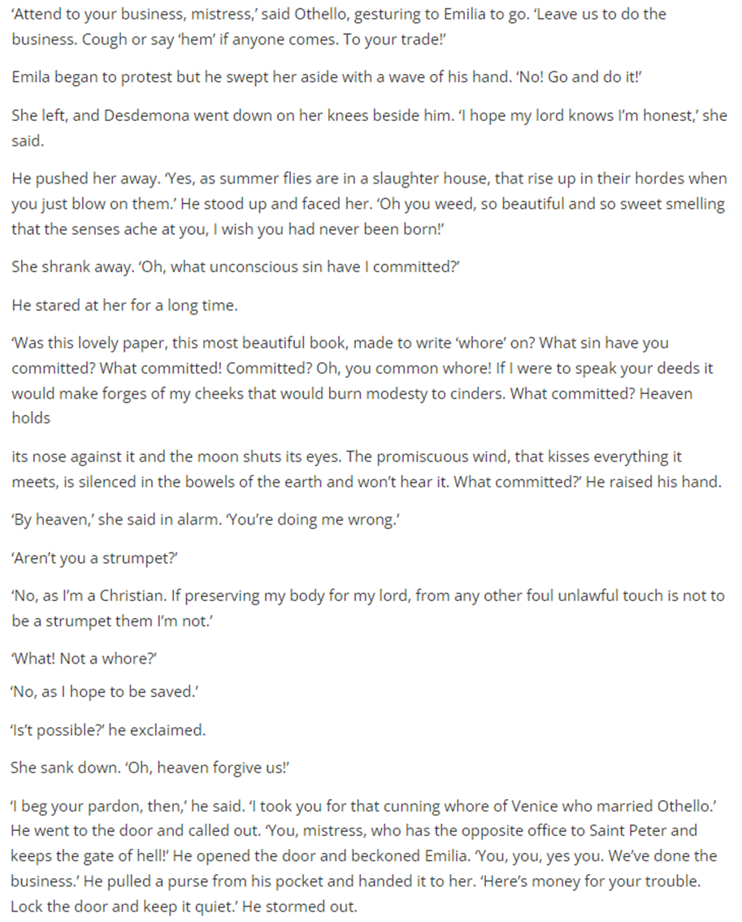
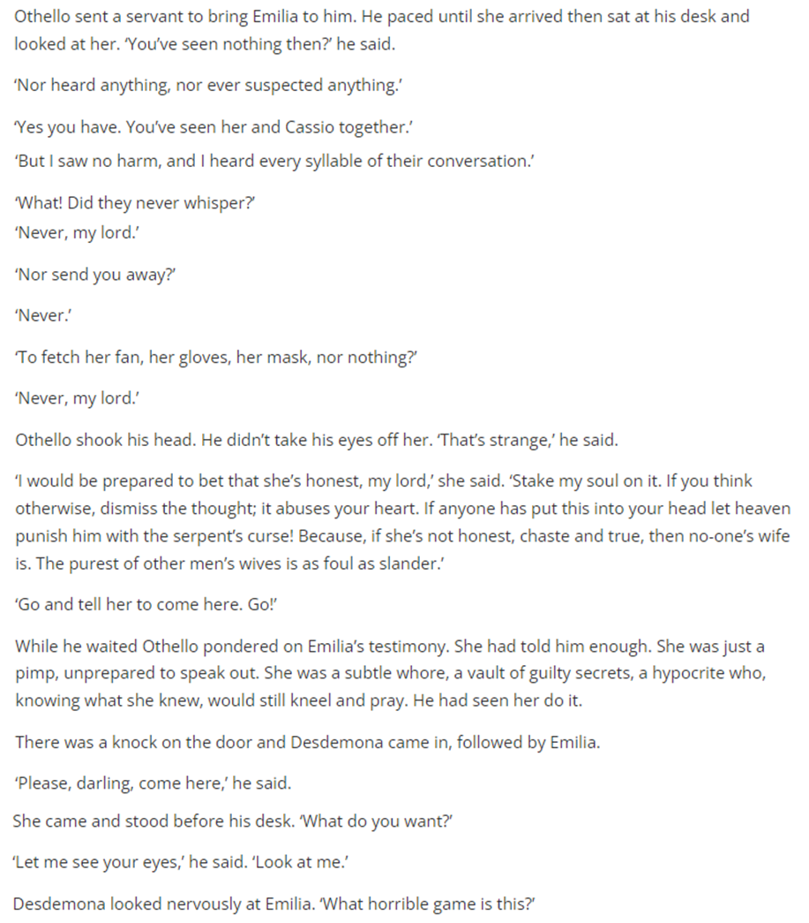
Act 4 Scene 2 part 1

Slide 3
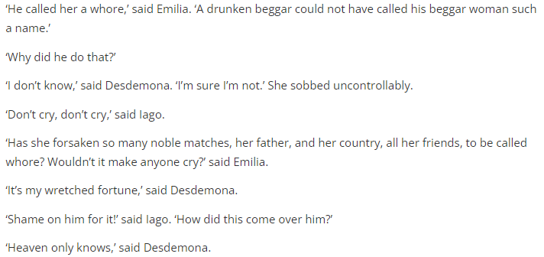
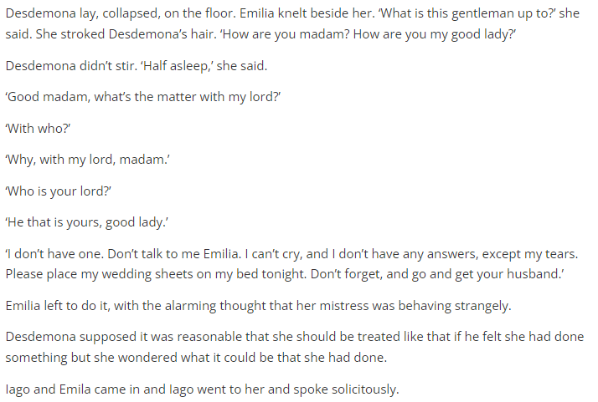
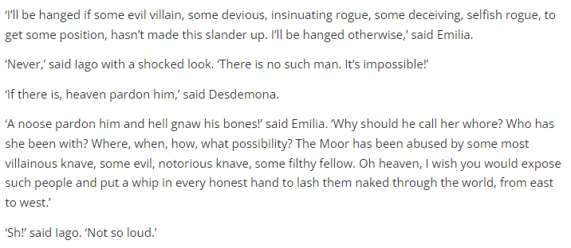
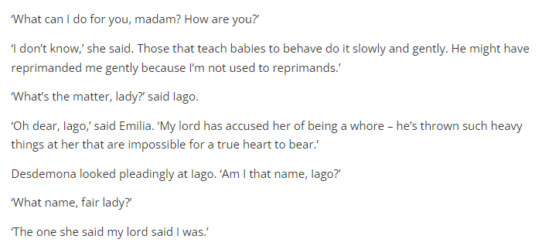
Act 4 Scene 2 part 2

Slide 4
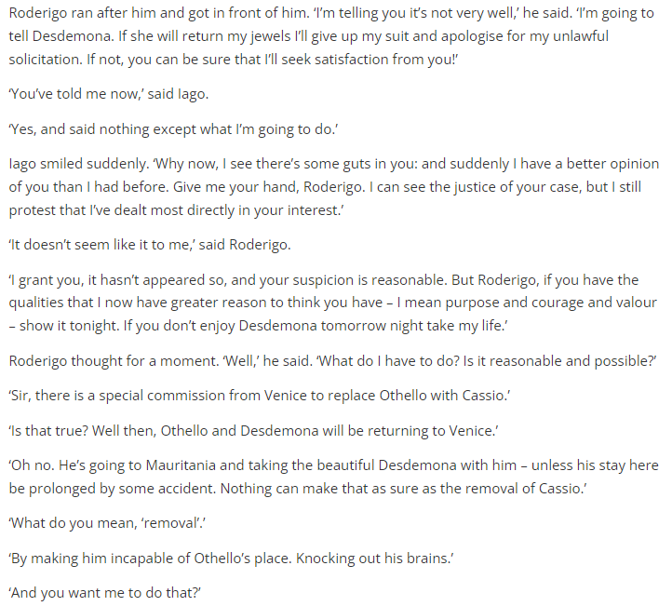
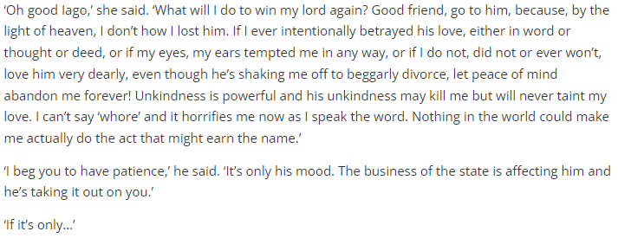
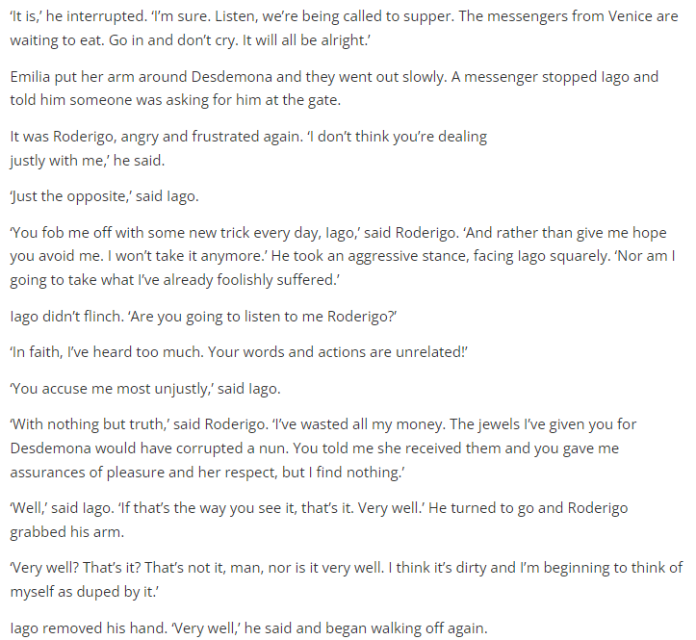
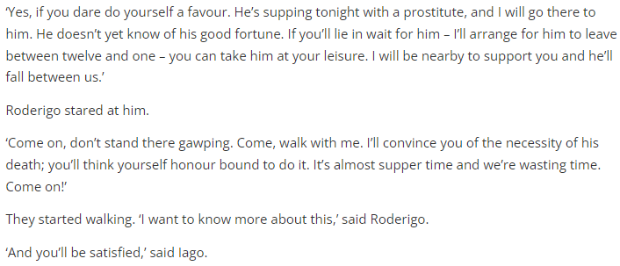
Act 4 Scene 2 part 3

Slide 5
How does Shakespeare make Act 4 Scene 2 a memorable moment in the play?
One thing Shakespeare does to make this scene memorable moment in the play is… (AO4)
A quote that supports this would be… (AO1)
This quote demonstrates my point because… (AO2)
This is interesting in relation to the rest of the play because… (AO3)

Slide 6
How does Shakespeare characterize Desdemona throughout the play?
Shakespeare characterizes Desdemona as…
A quote that supports this is…
This is a good quote to illustrate my point because..
Another way Shakespeare characterizes Desdemona is…
A quote to support this is…
This quote supports what I am trying to say here because…

Slide 7
Use this handout to improve your ‘characterization of Desdemona answer

