Slide 1
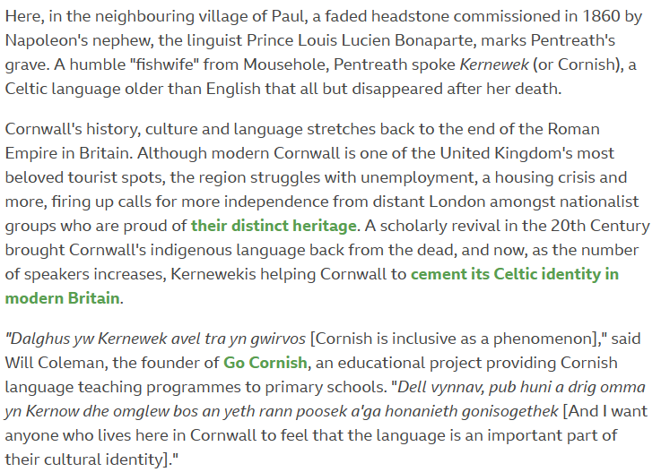
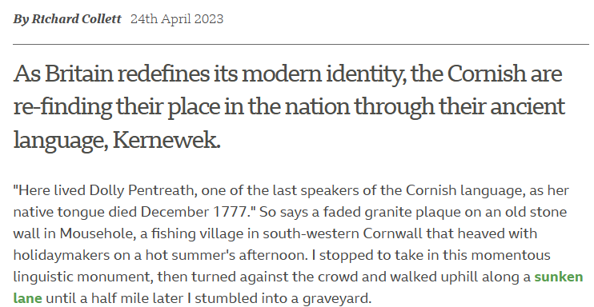

Slide 2
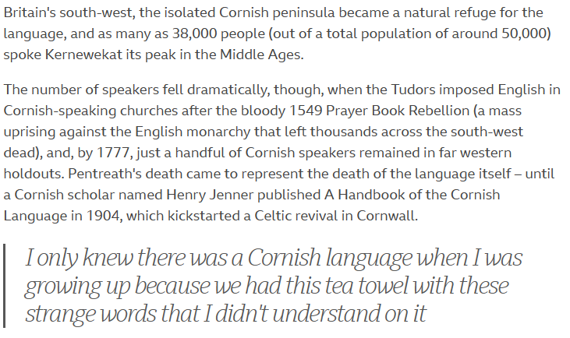
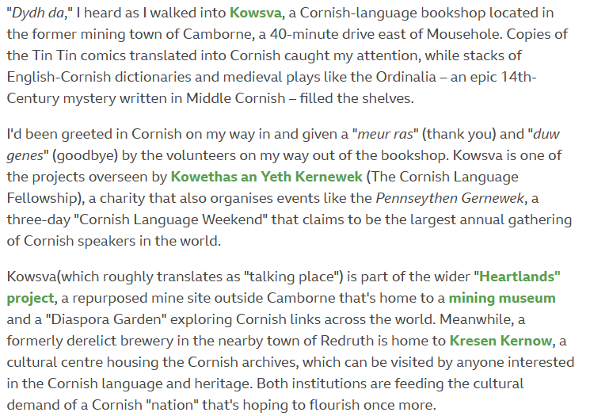

Slide 3
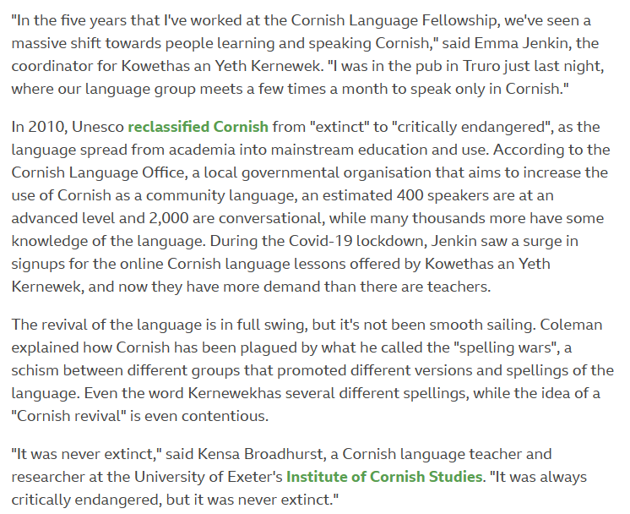
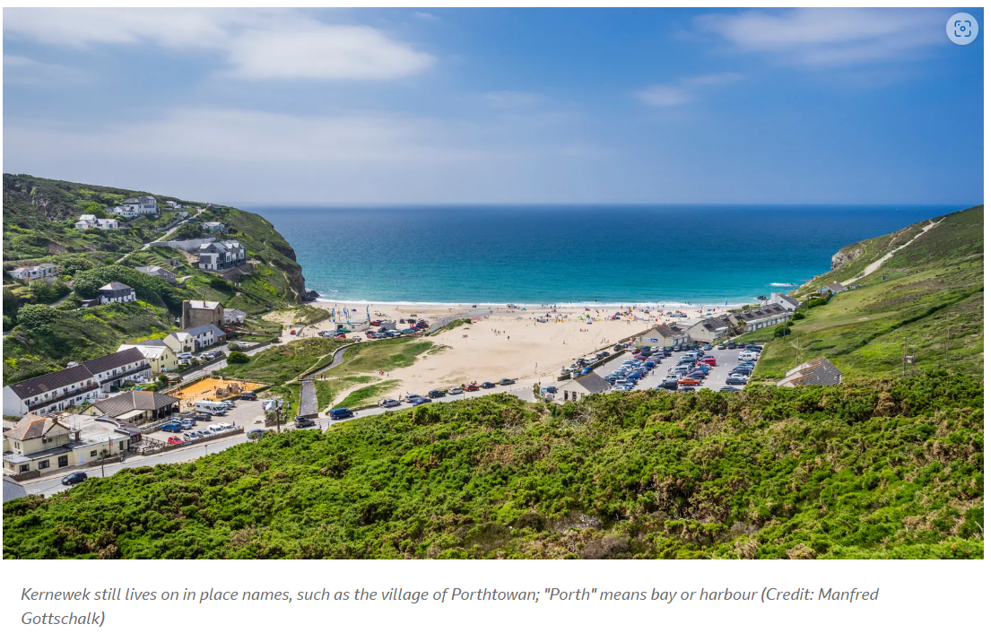
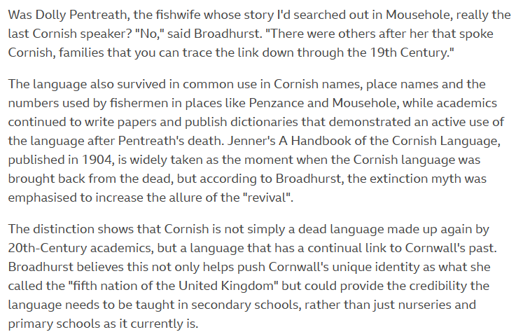

Slide 4
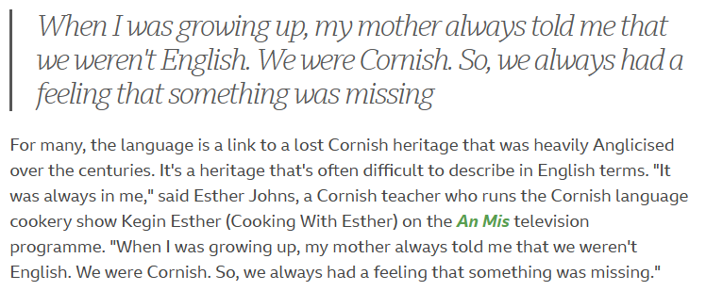
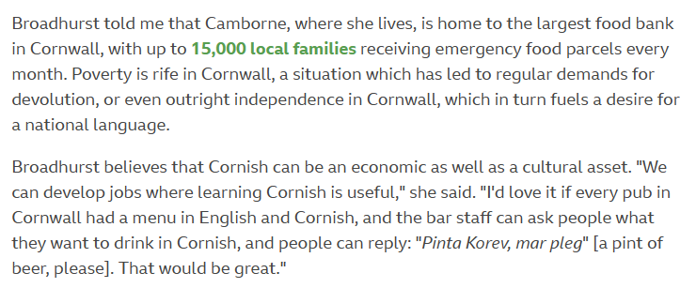
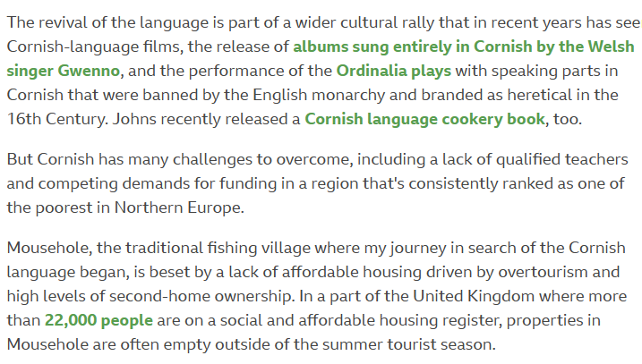
1. What is the indigenous language being revived in Cornwall?
2. How many people in Cornwall speak the indigenous language today?
3. What were the historical reasons for the decline of the Cornish language?
4. What measures are being taken by the Cornish government to revive the Cornish language?
5. How has the revival of the Cornish language impacted tourism in Cornwall?
6. In what ways is the Cornish language connected to the region's cultural identity?
7. What is the role of the Cornish Language Partnership in promoting the Cornish language?
8. How does the revival of the Cornish language fit into the broader context of language revitalization movements worldwide?
9. What challenges does the Cornish language face in the modern world?
10. What can other regions and countries learn from the Cornish language revival experience?
11. What is the tone of the article "Why Cornwall is resurrecting its indigenous language"?
12. How does the author convey the importance of preserving endangered languages in the article?
13. What are some of the benefits of preserving endangered languages?
14. has the Cornish language been received by the wider English-speaking population in Cornwall?
15. What role do community groups play in the revival of the Cornish language?
16. How does the Cornish language connect the people of Cornwall to their history and heritage?
17. What are some of the challenges facing language revitalization efforts in Cornwall and elsewhere?
18. What is the role of technology in language revitalization efforts?
19. What is the significance of language in shaping cultural identity?
20. How can individuals support language revitalization efforts in their own communities?

