Slide 1
What’s going at the end of Act 4 Scene 2?

Slide 2
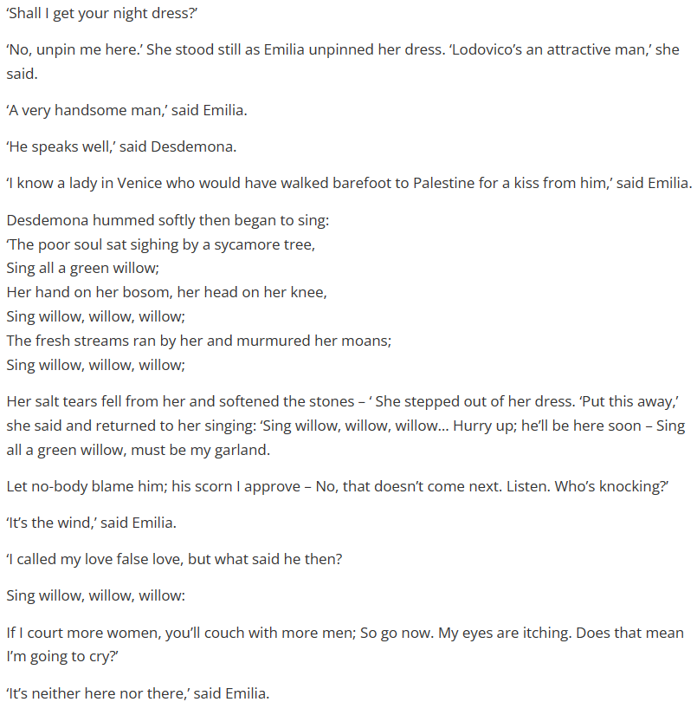
Act 4 Scene 3 part 1

Slide 3
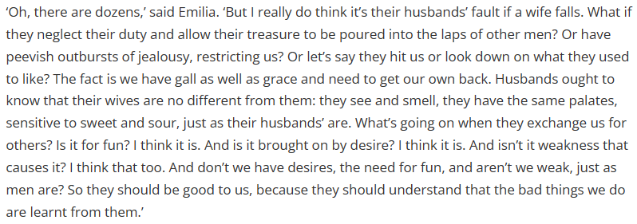
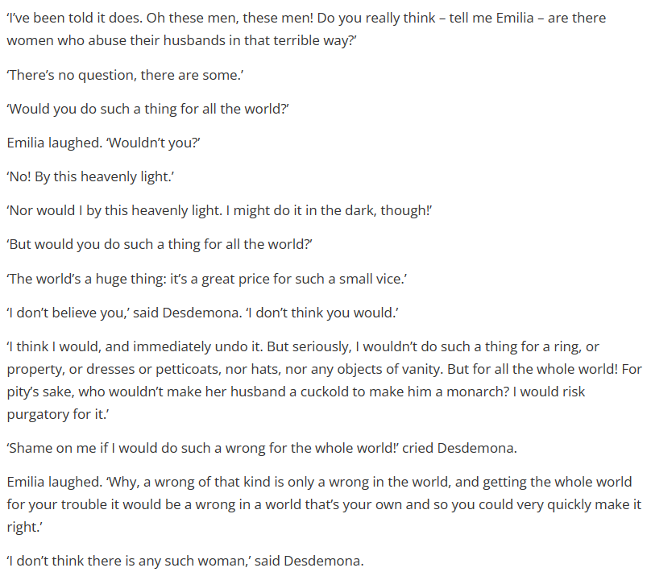
Act 4 Scene 3 part 2

Slide 4
How does Shakespeare make this a memorable moment in the play?
One thing Shakespeare does to make this a memorable moment in the play is…
A quote that supports this would be…
This quote demonstrates my point because…
This is interesting in relation to the rest of the play because…
From a structural point of view, this part of the play is similar / different to the rest of the play because…

Slide 5
How does Shakespeare characterize Othello throughout the play?
Shakespeare characterizes Desdemona as…
A quote that supports this is…
This is a good quote to illustrate my point because..
Another way Shakespeare characterizes Desdemona is…
A quote to support this is…
This quote supports what I am trying to say here because…

Slide 6
Use this handout to improve your ‘characterization of Othello’ answer

