Slide 1
What’s going at the end of Act 5 Scene 1?

Slide 2
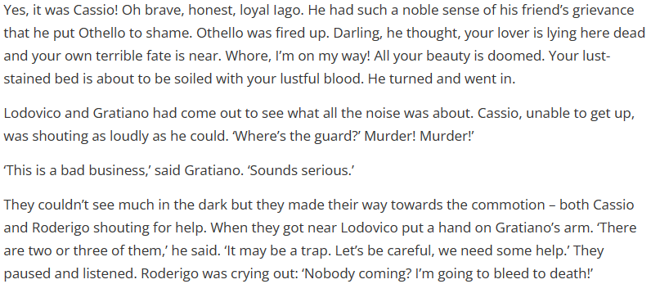
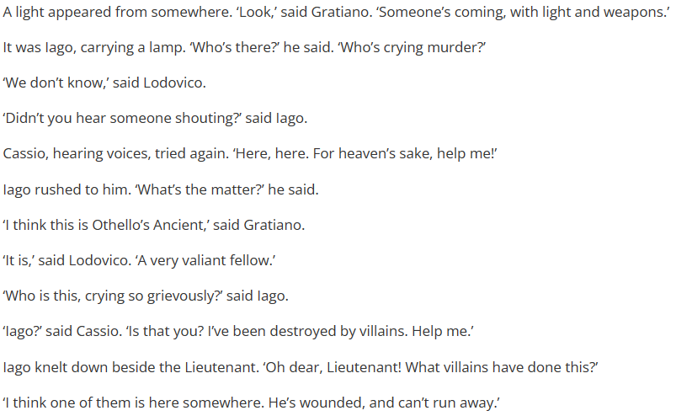
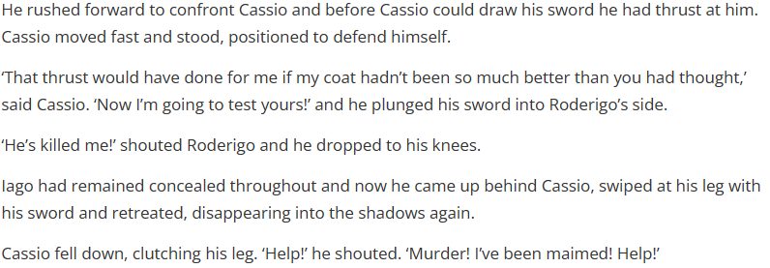
Act 5 Scene 1 part 1

Slide 3
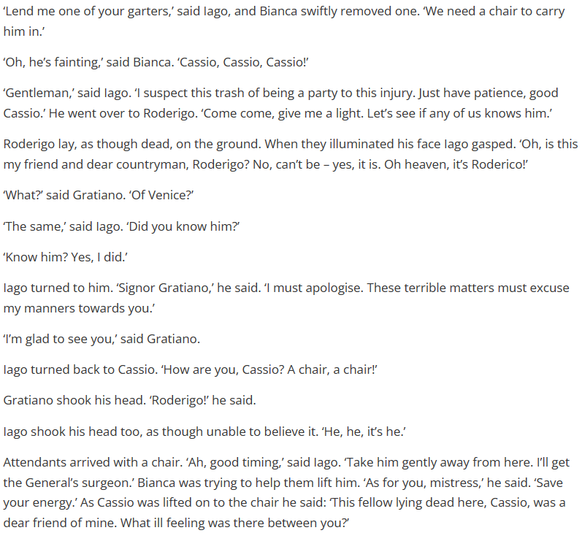
Act 5 Scene 1 part 2

Slide 4
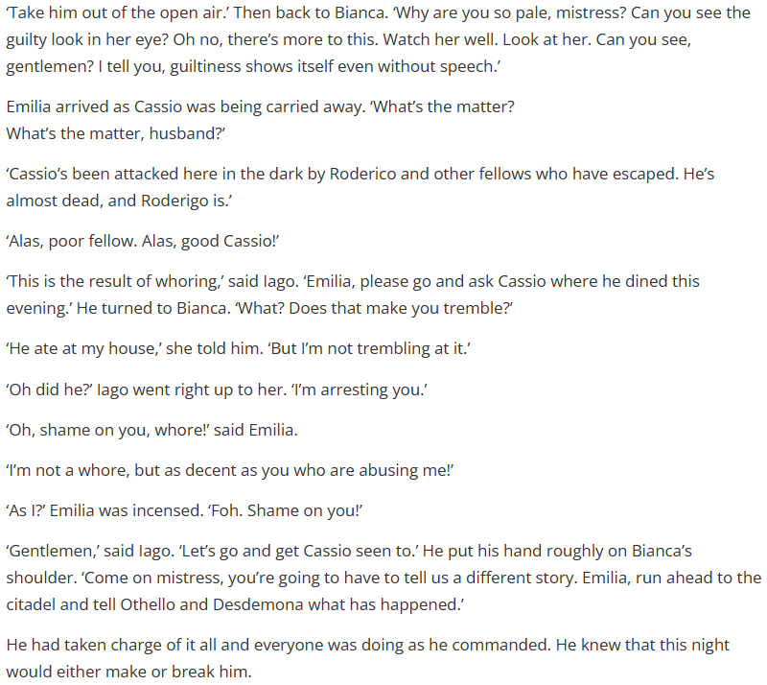
Act 5 Scene 1 part 3

Slide 5
How does Shakespeare make this a memorable moment in the play?
One thing Shakespeare does to make this a memorable moment in the play is…
A quote that supports this would be…
This quote demonstrates my point because…
This is interesting in relation to the rest of the play because…
From a structural point of view, this part of the play is similar different to the rest of the play because…

Slide 6
How does Shakespeare characterize Iago throughout the play?
Shakespeare characterizes Iago as…
A quote that supports this is…
This is a good quote to illustrate my point because..
Another way Shakespeare characterizes Iago is…
A quote to support this is…
This quote supports what I am trying to say here because…

Slide 7
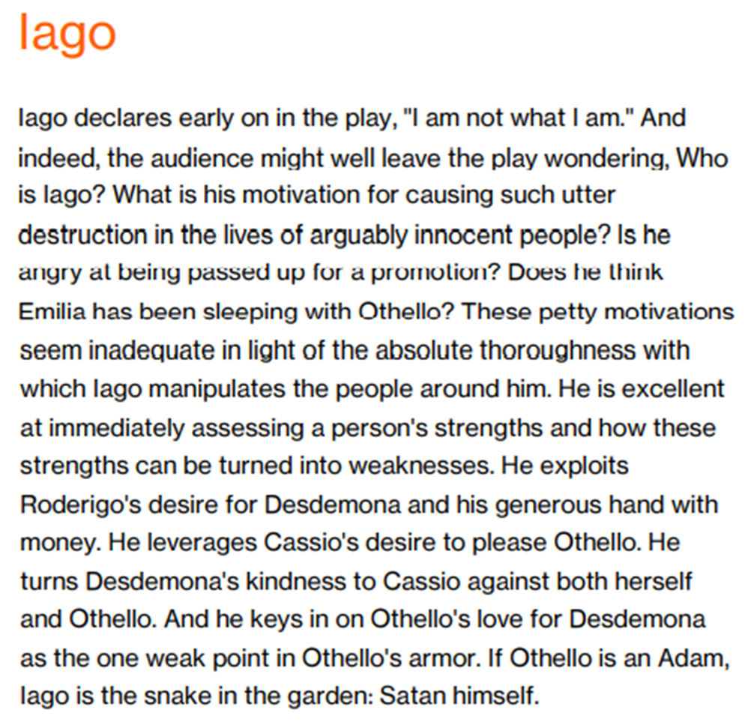
Use this handout to improve your ‘characterization of Iago’ answer

Slide 10
