Slide 1
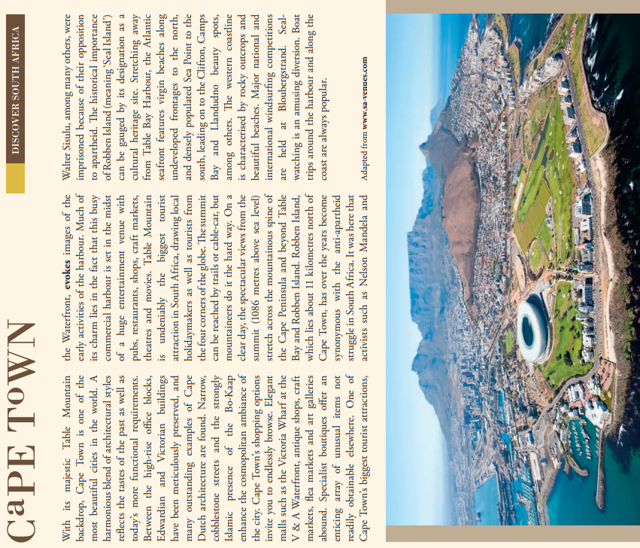
Read and highlight key information in the text.
On the article itself, mark where you would divide it into paragraphs.
Explain why you chose to put paragraph breaks in the places that you did.
Imagine you are a travel writer. Pick one word from each of the paragraphs you have created and then give a synonym for each one.
In full sentences, summarise the attractions that Cape Town has for visitors according to the passage.
Does this article make you want to visit Cape Town? Explain why / not.

Slide 2
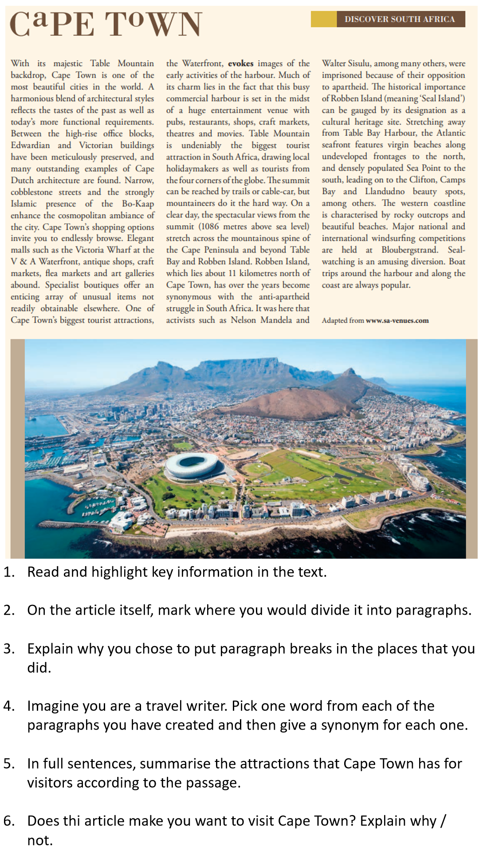

Slide 3
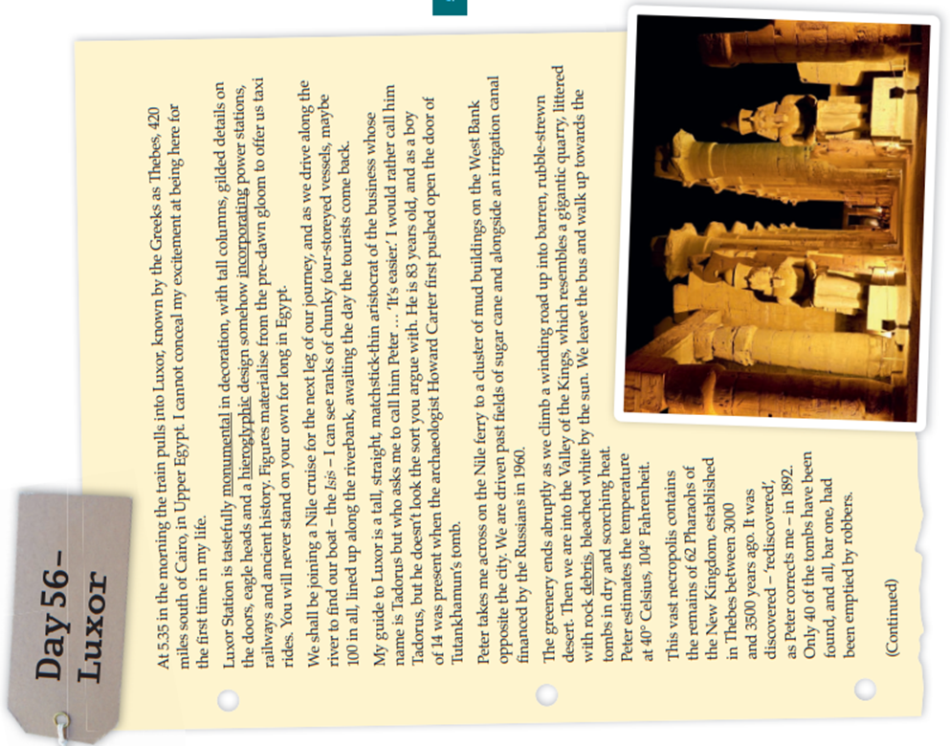
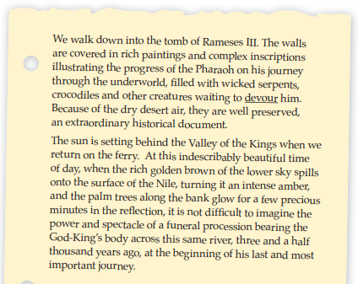
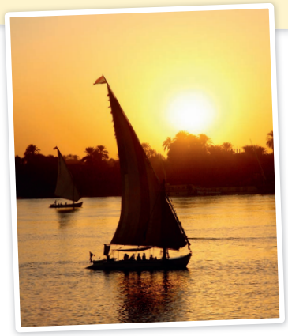

Slide 4
