Slide 1
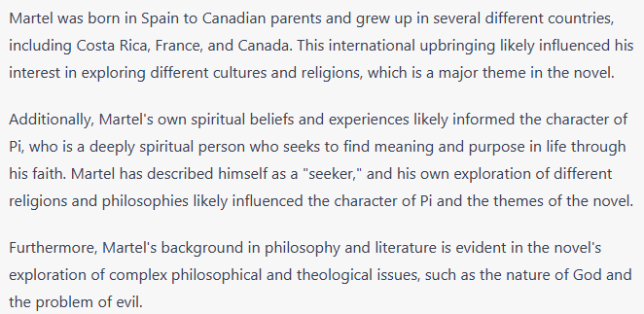
How are Yann Martel’s upbringing and background important to the novel?

Slide 2
Explain how Yann Martel’s background and upbringing are important to the novel.

Slide 3
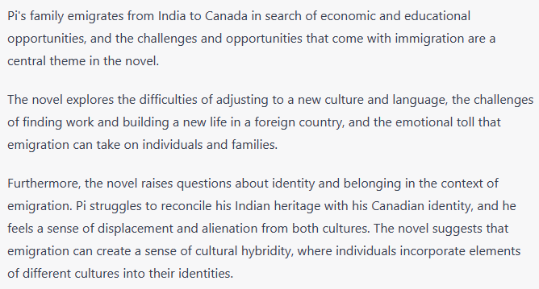
How is emigration important to Life of Pi?

Slide 4
Explain how emigration is important to the novel.

Slide 5
Recap questions
1. What Hindu themes appear in the novel?
2. What Muslim Themes appear in the novel?
3. What Christian themes appear in the novel?
4. What is the point of religion in the novel more generally?
5. Why is Yann Martel’s background and upbringing an important pieve of context for anyone reading the novel?
6. How is emigration a key theme in the novel?

Slide 6
Reading, following, active listening to the author’s note. As I read, write down any questions you have.

Slide 7
Written task
Explain the story behind how Life of Pi came to be written.
Feel free to refer to the author’s note for information.

