Slide 1
Quick quiz
Shakespeare is respected because he is good at the technique known as c_________.
Shakespeare is renowned for how he uses L________ effectively.
Shakespeare wrote 38 plays, across a range of genres, for example: t__________, c__________ and h_________.
Shakespeare is famous for his i_________ on later authors and popular culture nowadays.
Shakespeare actually came up with a lot of the i_____ that people nowadays like to use, for example; “Break the ice” and “Heart of gold”.
Characterization
Language
Tragedies, comedies and histories
influence
idioms

Slide 2
Quick quiz
How many theatres were there in London by the end of the Elizabethan Age?
Elizabethan society was known as the Great Chain of Being, with Elizabeth at the top, Nobles below her, the Gentry in level below and final the commoners. This is an example of a h___________.
Elizabethan times were known as a Golden Age, partly because there was an increase in S_________ of L_________.
Culture could flourish during Shakespeare’s time, since England was at p____ for the majority of Elizabeth’s reign.
A lot of what was important to Elizabethan society is e_________ in Shakespeare’s plays.
Four
2. Hierarchy
3. Standards of Living
4. peace
5. evident

Slide 3
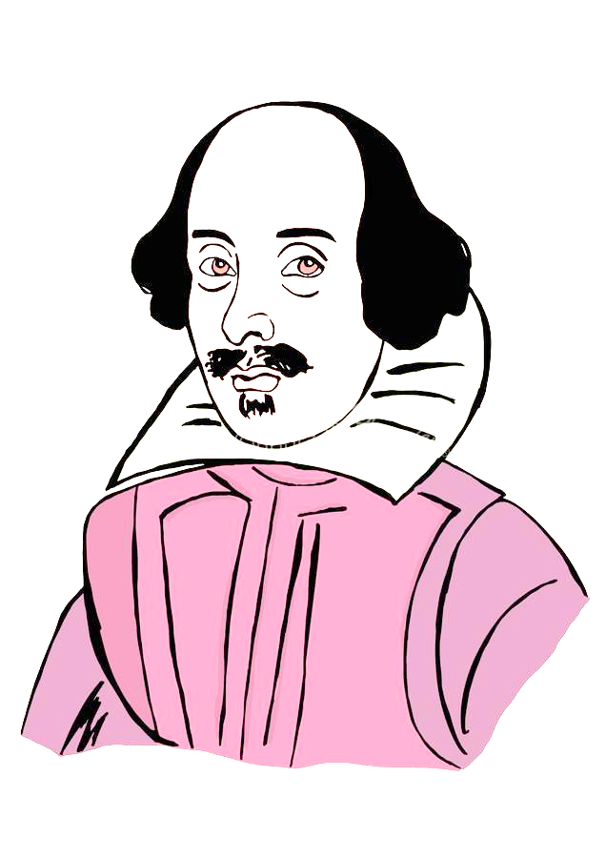
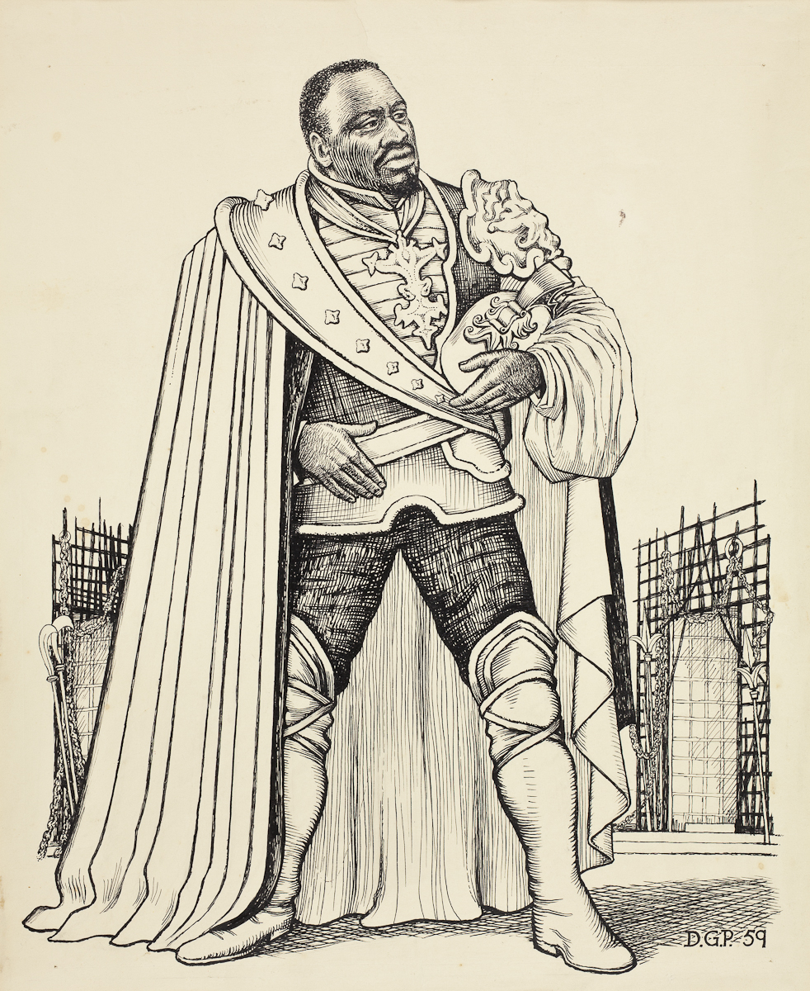
What is Othello about?
Monday, September 12, 2022
Good Progress | Excellent Progress
Describe the storyline of Othello | Explain how the development of the storyline demonstrates tragedy.

Slide 4
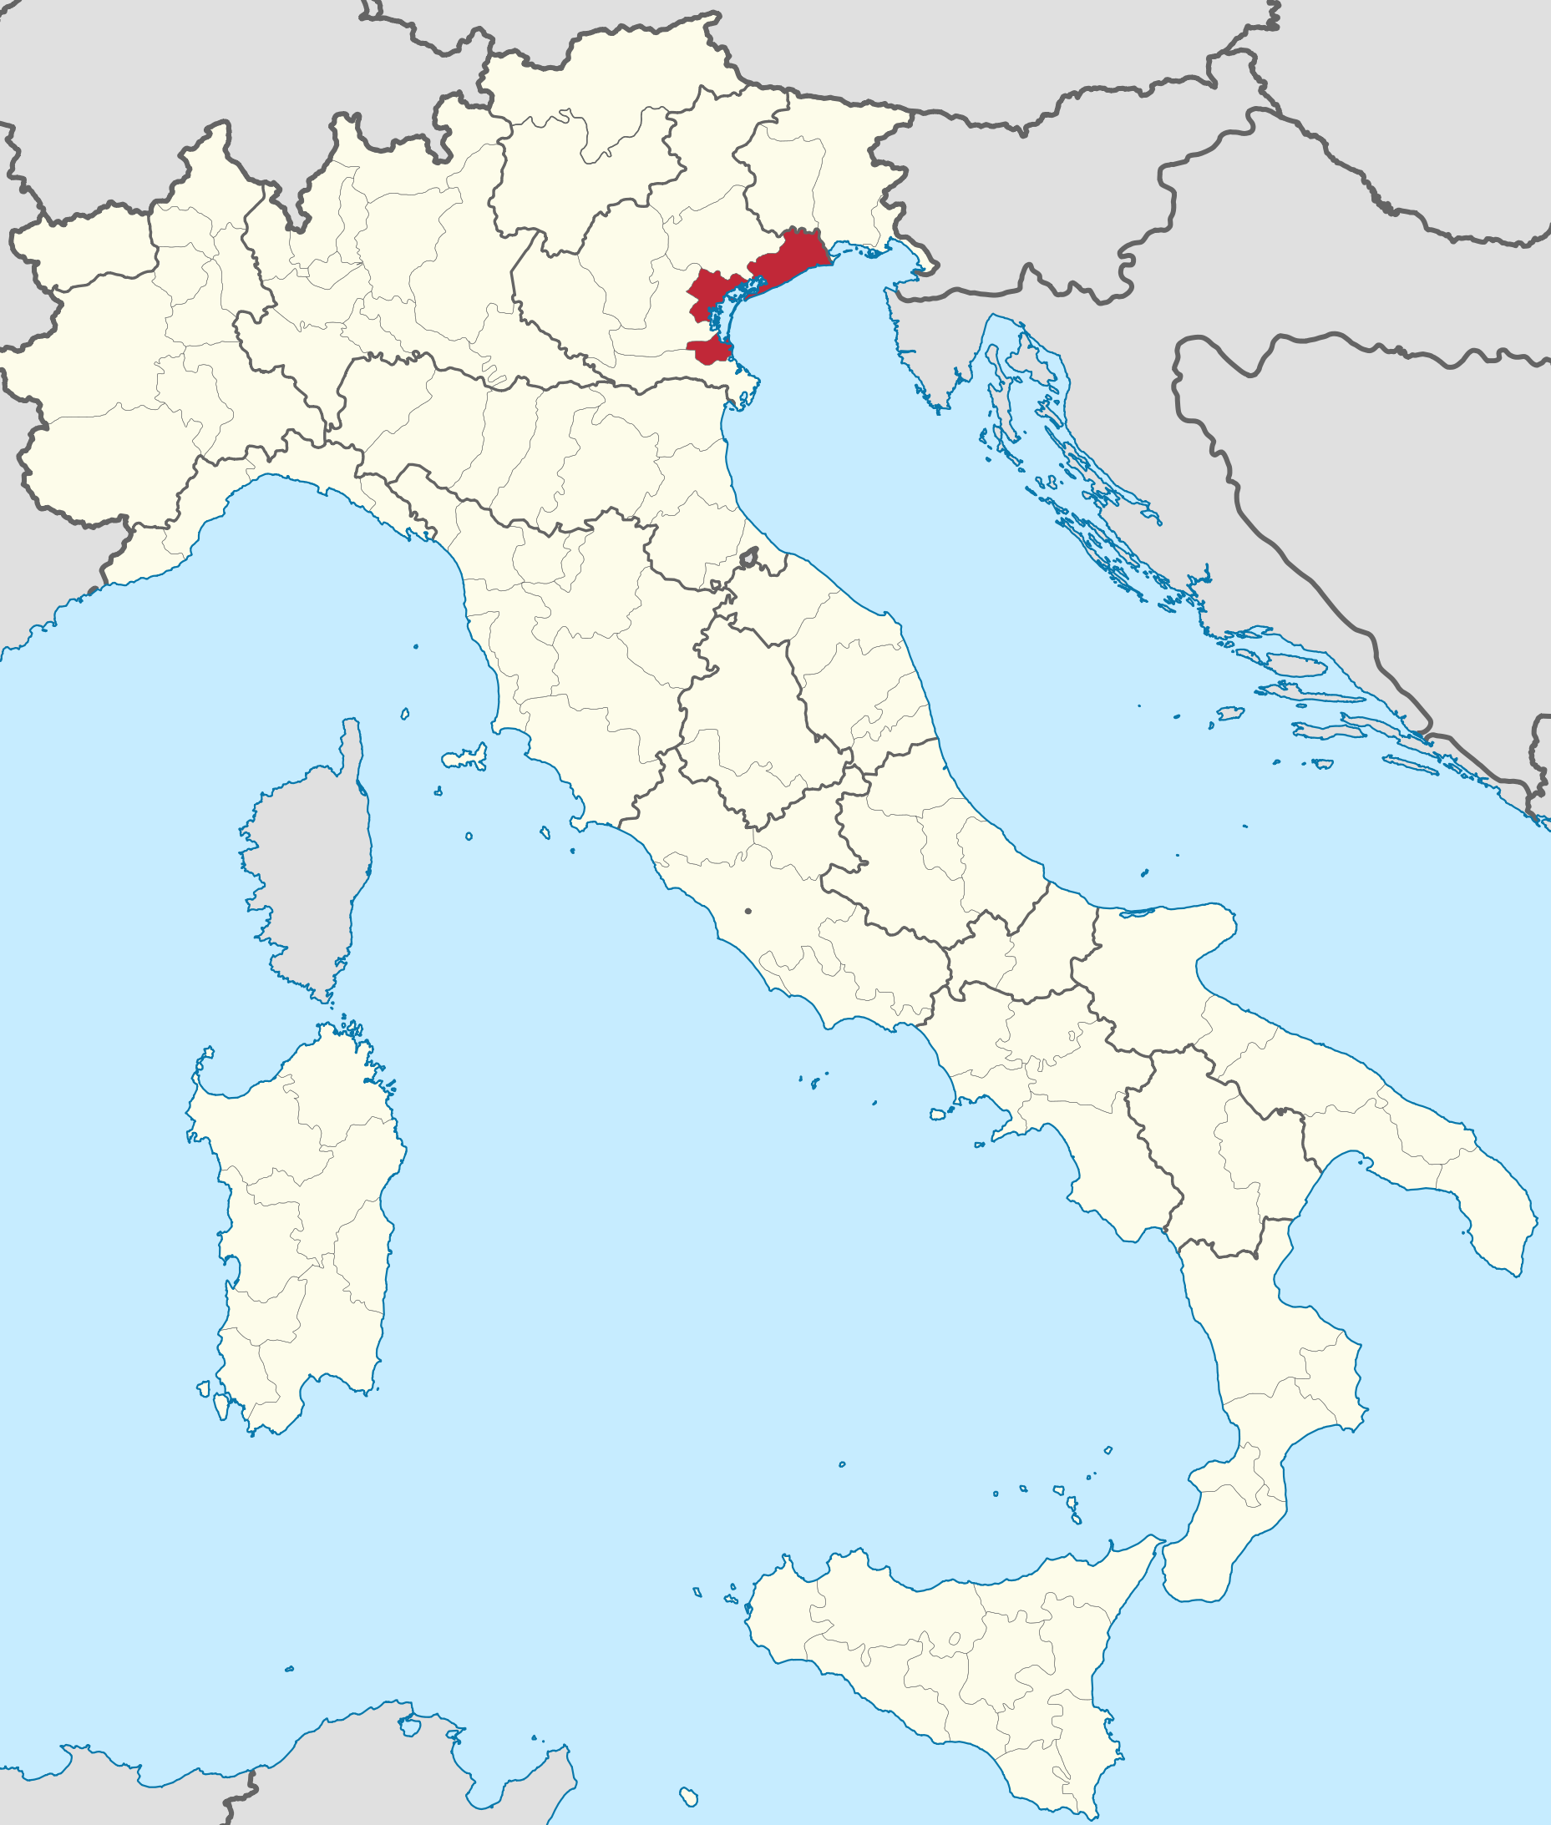
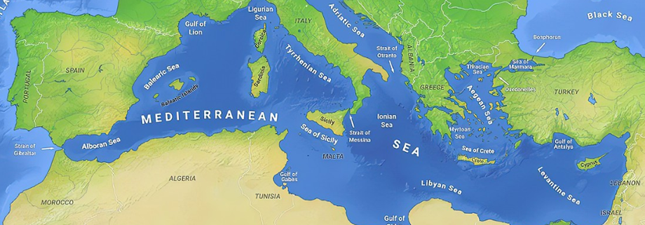
What’s the play’s full name?
The Tragedy of Othello, the Moor of Venice

Slide 5
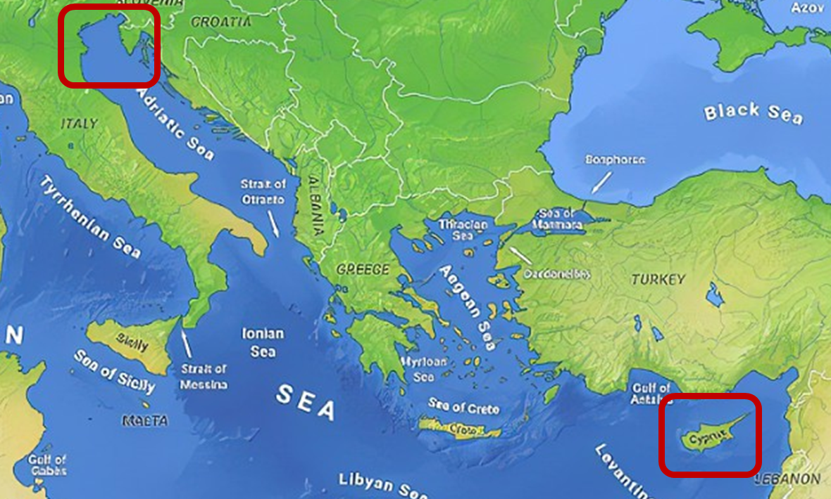
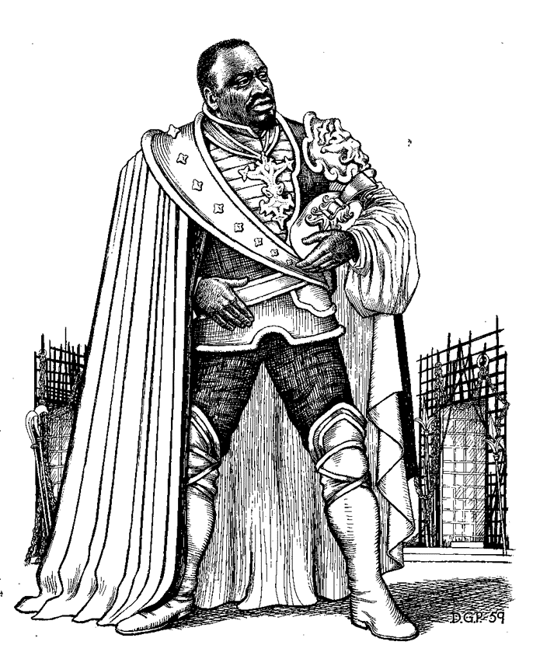
Who is Othello?
An Italian man of African descent (a Moor).
From Venice.
A general in the Venetian army.
Leading the Venetian defence of the Island of Cyprus, which belongs to Venice.

Slide 6
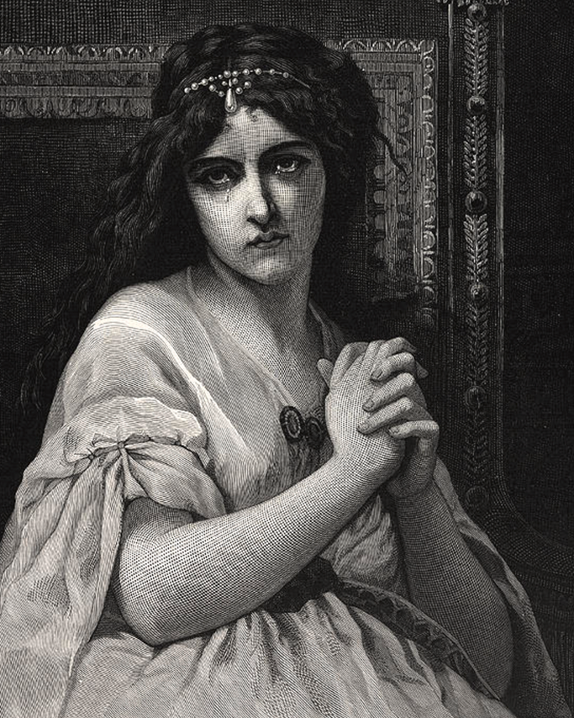
Who is Desdemona?
Othello’s wife (recently married).
Known for her beauty and the rich family she belongs to in Venice.
Her father was unhappy with the marriage.
Why do you think this might be?
Othello will end up murdering her, convinced she is having an affair (she isn’t).
Why do you think this play is known as a tragedy?

Slide 7
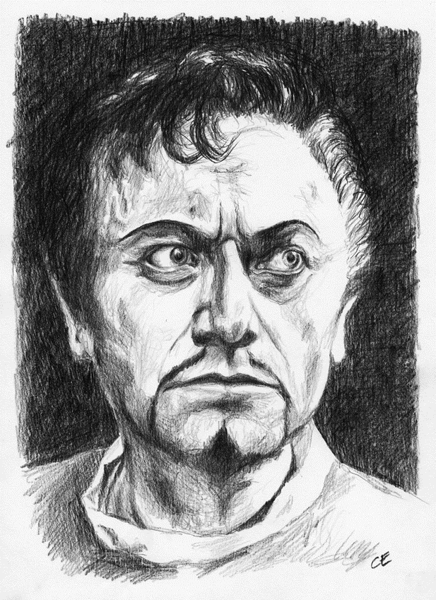
Who is Iago?
Othello’s lieutenant for the last few years.
Is angry that he does not get promoted. Instead, Othello promoted his other lieutenant, Michael Cassio.
Iago’s wife (Emilia) is a close friend / servant of Othello’s wife, Desdemona.
Iago convinces Othello that Desdemona is having an affair with Michael Cassio, ending in Othello murdering her.
Why might this be significant?

Slide 8
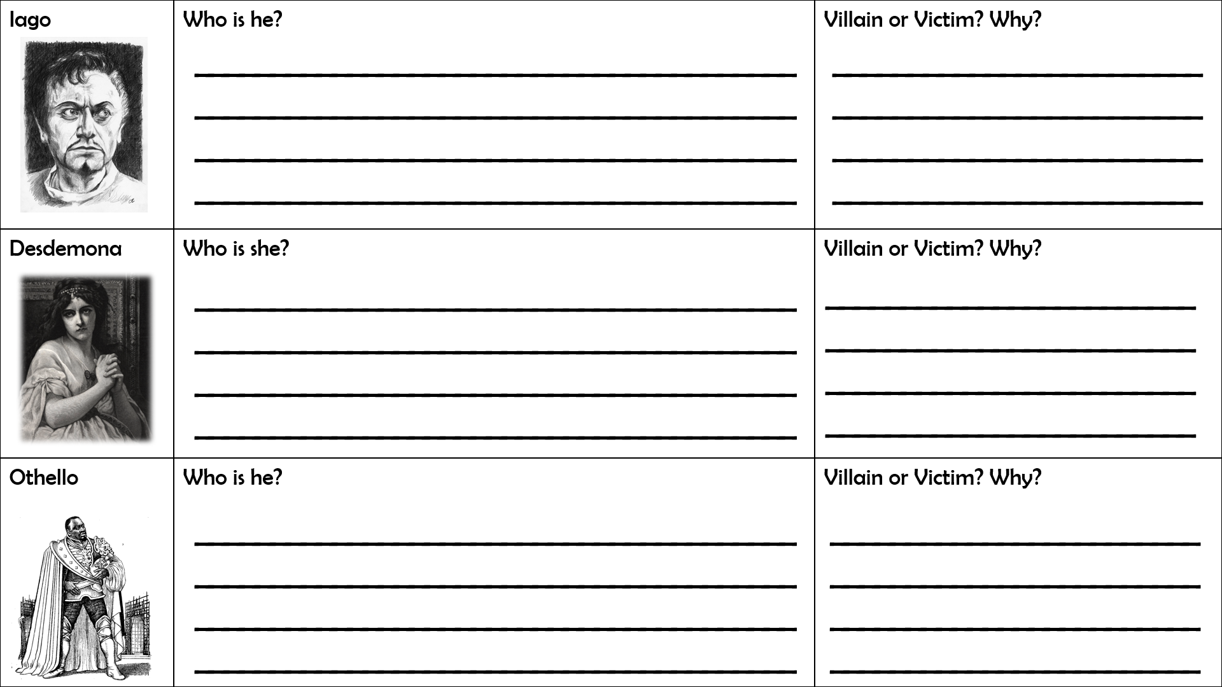
Worksheet task
Using all the information we have been talking about, complete each section of the worksheet.
Start with Iago, then move on to Desdemona, and finish with Othello.
Stuck? Just ask ☺

Slide 9
Written task
Explain what it means when a play is described as a tragedy.
A tragic play is a play where…
Explain why Othello is a good example of a tragedy.
Othello is a good example of a tragedy because…

Slide 10
Quick quiz
Shakespeare is respected because he is good at the technique known as c_________.
Shakespeare is renowned for how he uses L________ effectively.
Shakespeare wrote 38 plays, across a range of genres, for example: t__________, c__________ and h_________.
Shakespeare is famous for his i_________ on later authors and popular culture nowadays.
Shakespeare actually came up with a lot of the i_____ that people nowadays like to use, for example; “Break the ice” and “Heart of gold”.
Characterization
Language
Tragedies, comedies and histories
influence
idioms

Slide 11
Quick quiz
How many theatres were there in London by the end of the Elizabethan Age?
Elizabethan society was known as the Great Chain of Being, with Elizabeth at the top, Nobles below her, the Gentry in level below and final the commoners. This is an example of a h___________.
Elizabethan times were known as a Golden Age, partly because there was an increase in S_________ of L_________.
Culture could flourish during Shakespeare’s time, since England was at p____ for the majority of Elizabeth’s reign.
A lot of what was important to Elizabethan society is e_________ in Shakespeare’s plays.
Four
2. Hierarchy
3. Standards of Living
4. peace
5. evident

Slide 12
What is Othello about?
Monday, September 12, 2022
Good Progress | Excellent Progress
Describe the storyline of Othello | Explain how the development of the storyline demonstrates tragedy.

