Slide 1
What’s going at the end of Act 5 Scene 2?

Slide 2
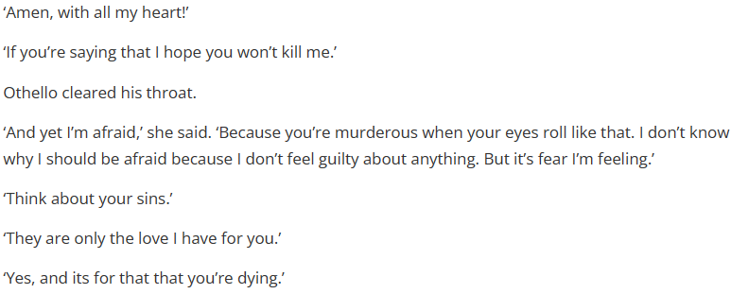
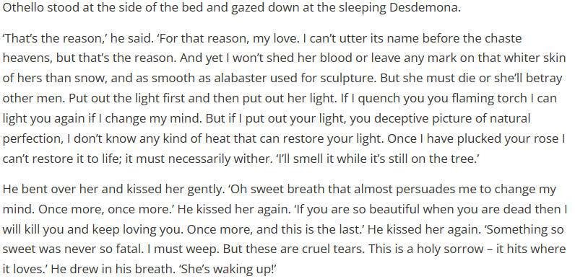
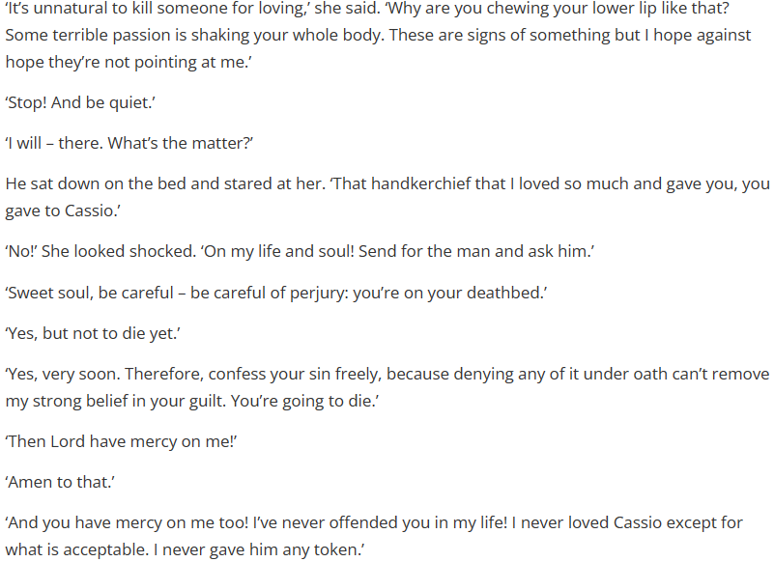
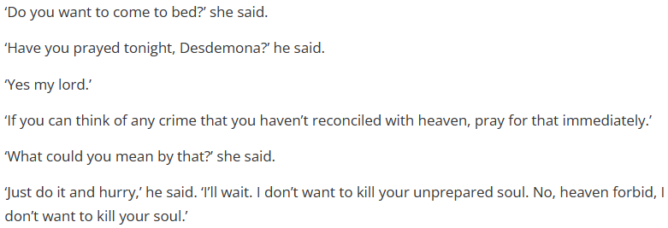
Act 5 Scene 2 part 1

Slide 3
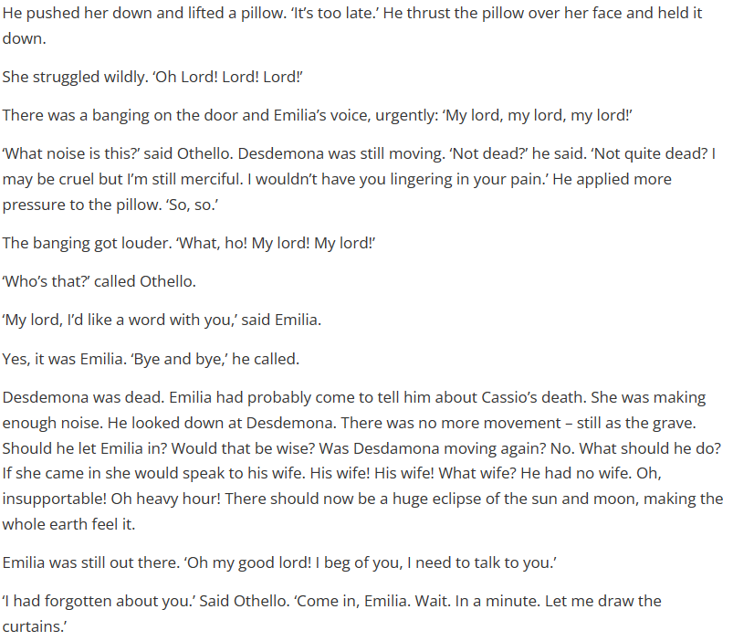
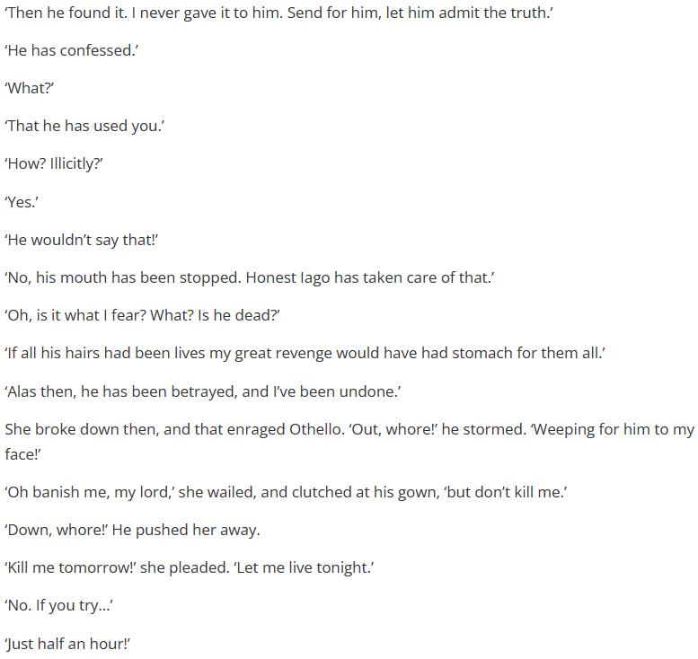
Act 5 Scene 2 part 2

Slide 4
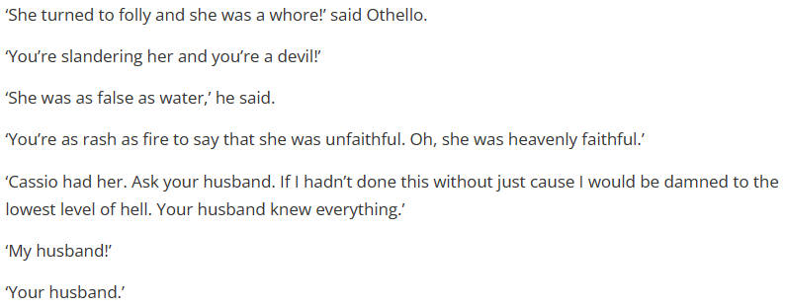
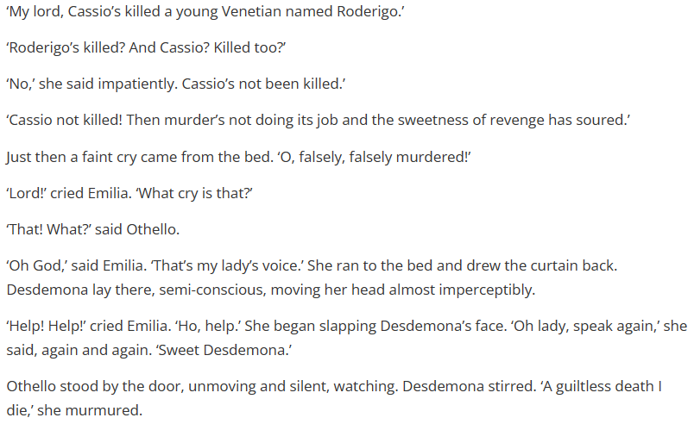
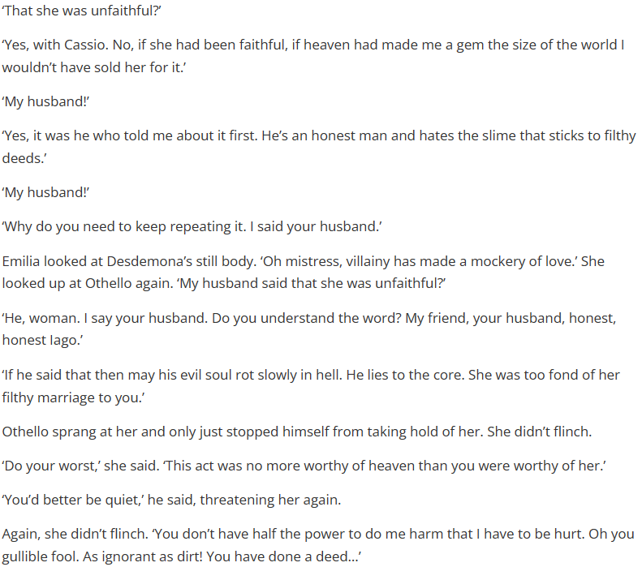
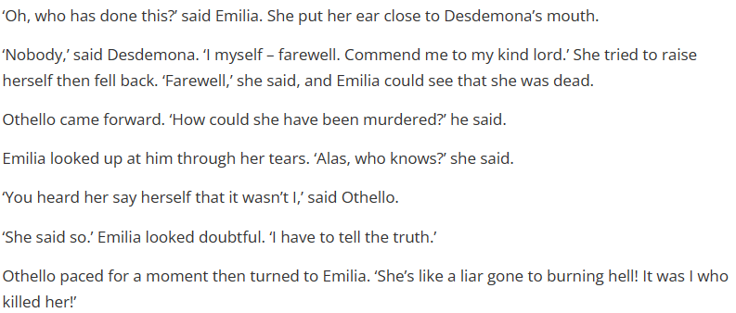
Act 5 Scene 2 part 3

Slide 5
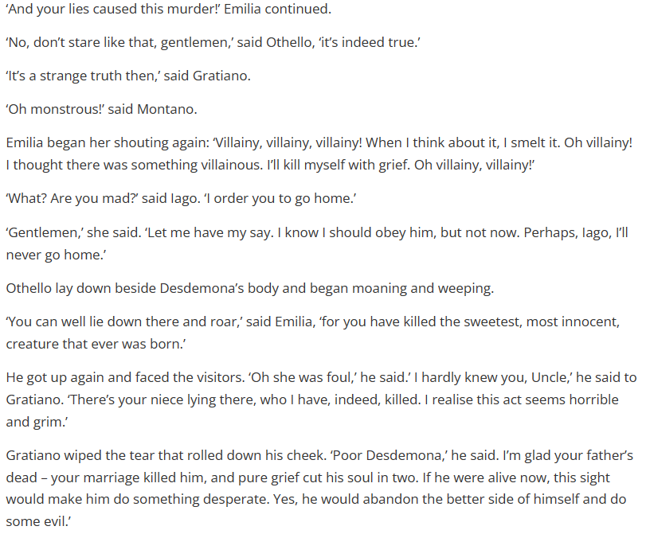
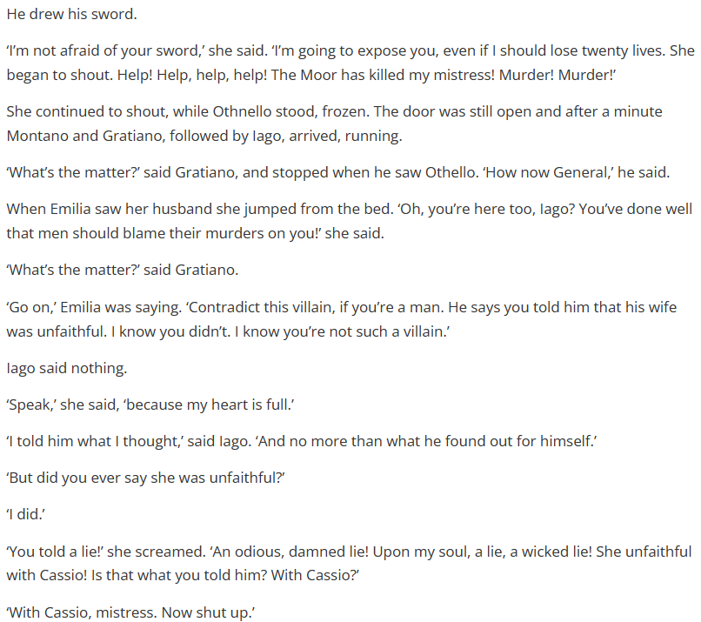
Act 5 Scene 2 part 4

Slide 6
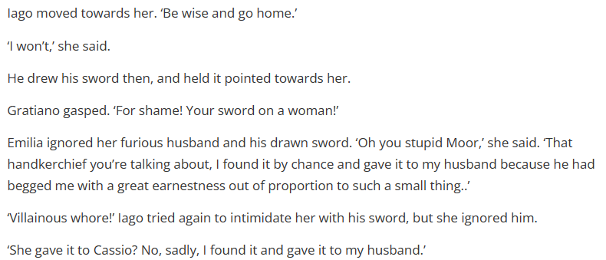
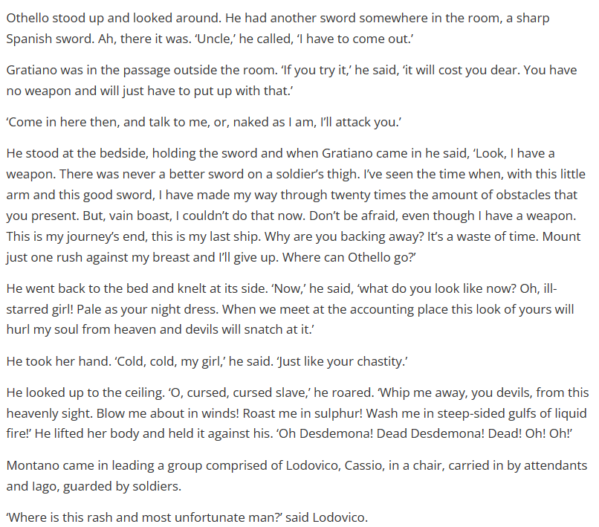

Slide 7
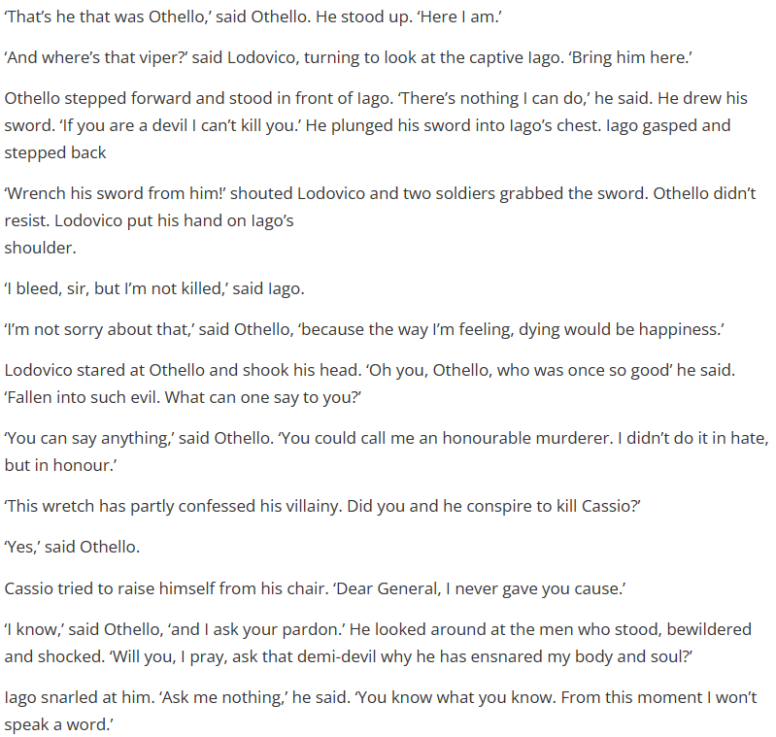
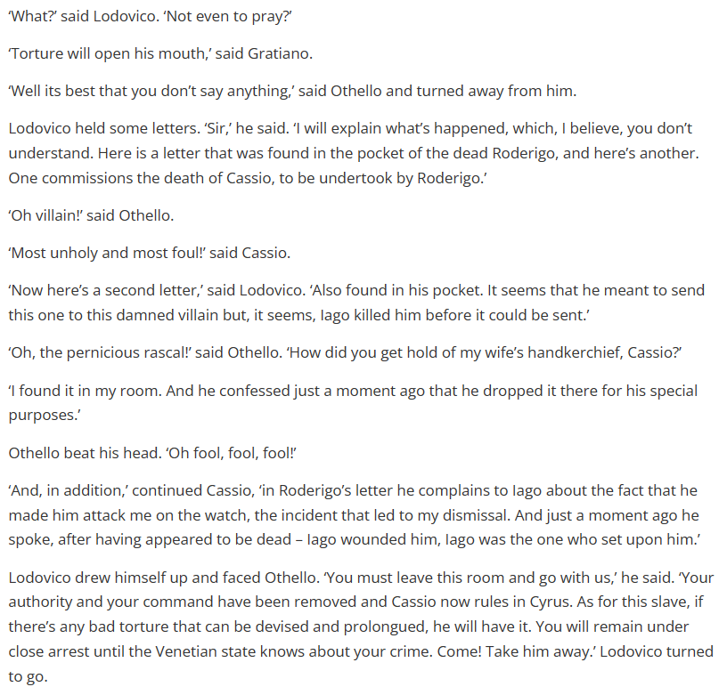

Slide 8
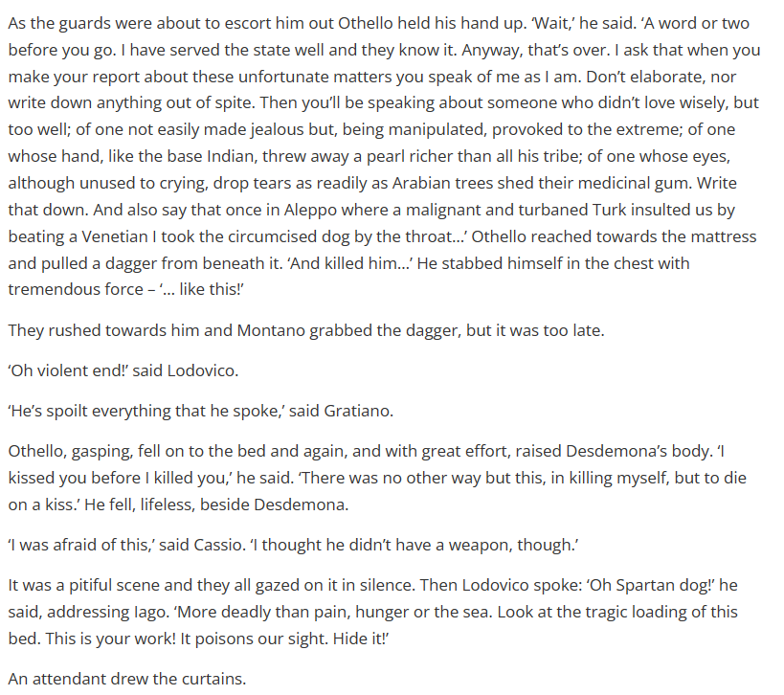

Slide 9
How does Shakespeare make this a memorable moment in the play?
One thing Shakespeare does to make this a memorable moment in the play is…
A quote that supports this would be…
This quote demonstrates my point because…
Another thing Shakespeare does to make this a memorable moment in the play is…
A quote that supports this would be…
This quote supports what I am saying because…

Slide 10
Shakespeare creates a powerful and memorable final scene in "Othello" by using a combination of dramatic irony, tragic irony, and powerful imagery. The audience knows that Othello has been manipulated by Iago and that he is about to kill his innocent wife, Desdemona. This creates a sense of tension and anticipation. The imagery of Othello suffocating Desdemona with a pillow is also very powerful and creates a lasting impression. Additionally, Othello's final speech, in which he acknowledges his own tragic flaws and recognizes the horror of what he has done, adds depth to the character and makes the scene even more poignant.
Dramatic irony: The audience knows that Iago has been manipulating Othello and lying to him about his wife's infidelity, while Othello believes Iago and becomes convinced that Desdemona is unfaithful. This creates a sense of dramatic irony, as the audience knows the truth and is aware of the tragic events that are about to unfold, while Othello is not.
Tragic irony: Othello's belief in Iago's lies ultimately leads to his own downfall and the death of Desdemona. This is a form of tragic irony, as Othello's own actions and beliefs are what ultimately lead to his tragic end.
Powerful imagery: The scene in which Othello suffocates Desdemona with a pillow is a very powerful image that leaves a lasting impression on the audience. The use of a pillow, an object associated with comfort and sleep, to commit the murder, emphasizes the horror of the act.
Othello's final speech: Othello's final speech, in which he acknowledges his own tragic flaws and recognizes the horror of what he has done, adds depth to the character and makes the scene even more poignant. He speaks of his "free and open nature" which was "easily impressed" and that has led him to commit such a tragic act. He express remorse and regret and his last words are "I kissed thee ere I killed thee: no way but this, Killing myself, to die upon a kiss" which creates an emotional impact on the audience.
Shakespeare creates a powerful and memorable final scene in "Othello" by using a combination of dramatic irony, tragic irony, and powerful imagery. The audience knows that Othello has been manipulated by Iago and that he is about to kill his innocent wife, Desdemona. This creates a sense of tension and anticipation. The imagery of Othello suffocating Desdemona with a pillow is also very powerful and creates a lasting impression. Additionally, Othello's final speech, in which he acknowledges his own tragic flaws and recognizes the horror of what he has done, adds depth to the character and makes the scene even more poignant.
Dramatic irony: The audience knows that Iago has been manipulating Othello and lying to him about his wife's infidelity, while Othello believes Iago and becomes convinced that Desdemona is unfaithful. This creates a sense of dramatic irony, as the audience knows the truth and is aware of the tragic events that are about to unfold, while Othello is not.
Tragic irony: Othello's belief in Iago's lies ultimately leads to his own downfall and the death of Desdemona. This is a form of tragic irony, as Othello's own actions and beliefs are what ultimately lead to his tragic end.
Powerful imagery: The scene in which Othello suffocates Desdemona with a pillow is a very powerful image that leaves a lasting impression on the audience. The use of a pillow, an object associated with comfort and sleep, to commit the murder, emphasizes the horror of the act.
Othello's final speech: Othello's final speech, in which he acknowledges his own tragic flaws and recognizes the horror of what he has done, adds depth to the character and makes the scene even more poignant. He speaks of his "free and open nature" which was "easily impressed" and that has led him to commit such a tragic act. He express remorse and regret and his last words are "I kissed thee ere I killed thee: no way but this, Killing myself, to die upon a kiss" which creates an emotional impact on the audience.

Slide 11
How does Shakespeare characterize Cassio throughout the play?
Shakespeare characterizes Iago as…
A quote that supports this is…
This is a good quote to illustrate my point because..
Another way Shakespeare characterizes Iago is…
A quote to support this is…
This quote supports what I am trying to say here because…

Slide 12
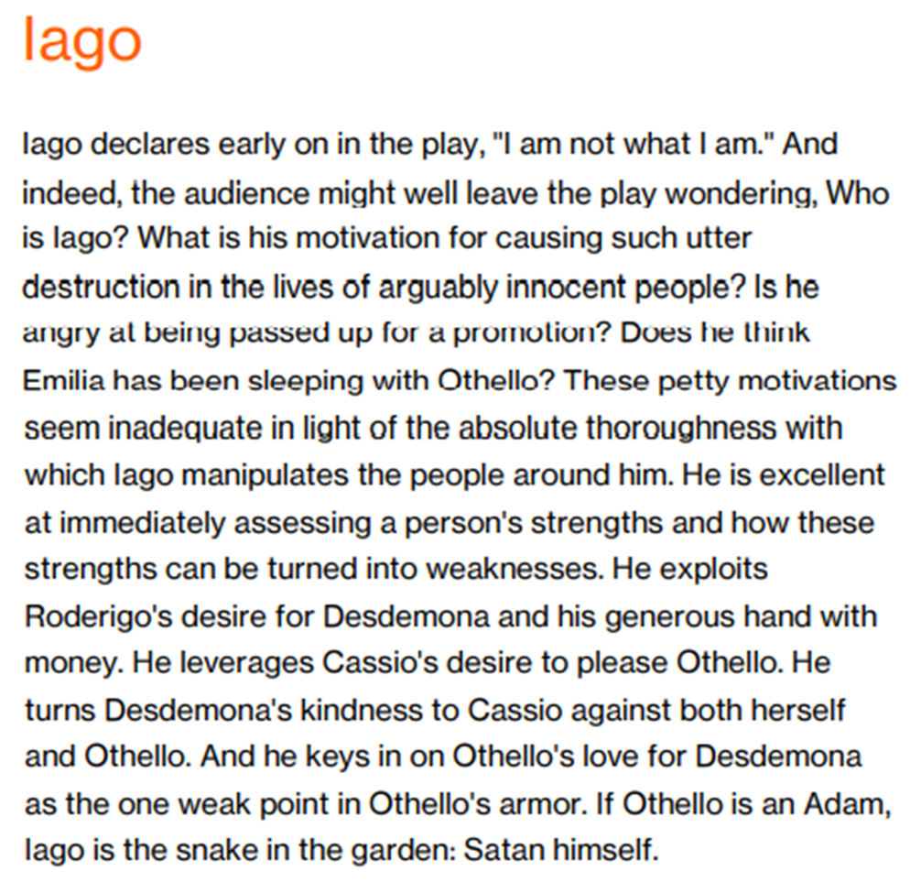
Use this handout to improve your ‘characterization of Iago’ answer

