Slide 1
How does the theme of jealousy permeate the play?

Slide 2
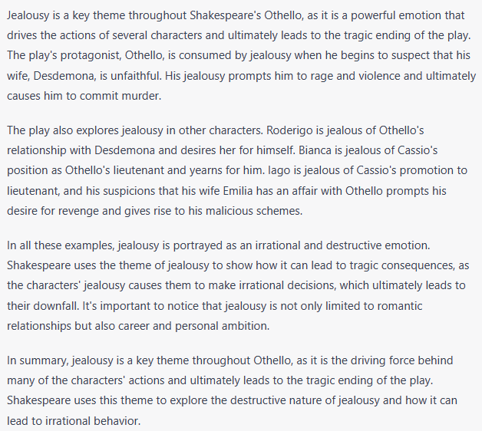
What is the primary emotion that drives the actions of several characters in Othello?
How does Othello's jealousy manifest itself?
Who is Roderigo jealous of and what does he desire?
What does Iago feel jealousy about and what is his motivation for his malicious schemes?
How does jealousy lead to irrational behavior in the characters?
How does the theme of jealousy in the play contribute to the tragic ending?
Is jealousy only limited to romantic relationships in the play or is it also portrayed in career and personal ambition? Give examples for each from the play.
How Shakespeare explore the destructive nature of jealousy?

Slide 3
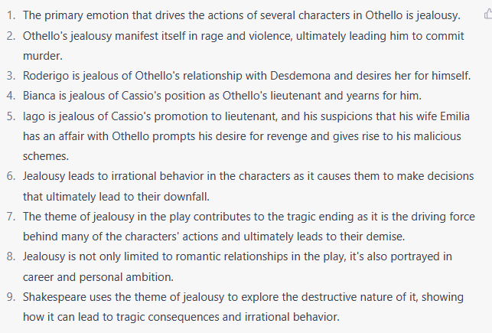
Answers Correct in Green

Slide 4
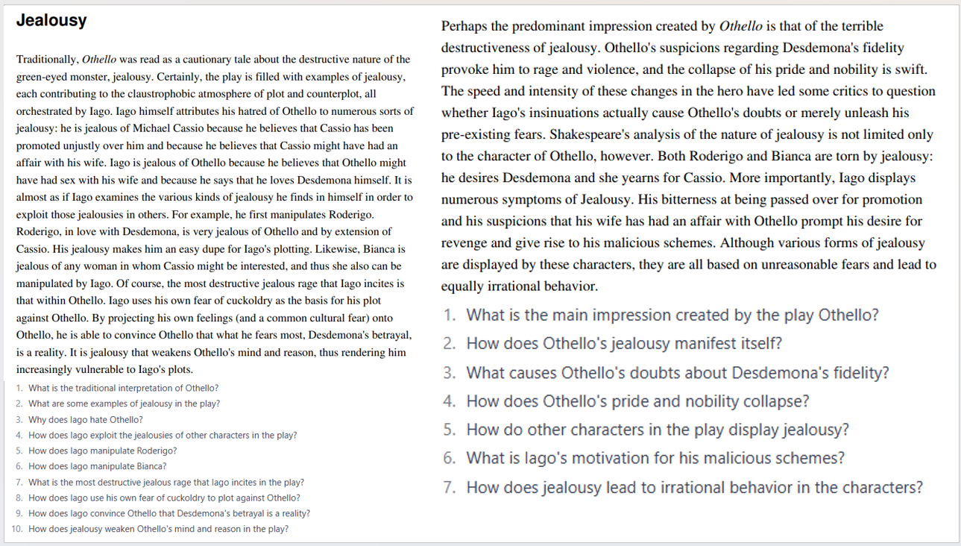
Comprehension task
Read the text
Highlight key info
Answer the questions below the text.

Slide 5
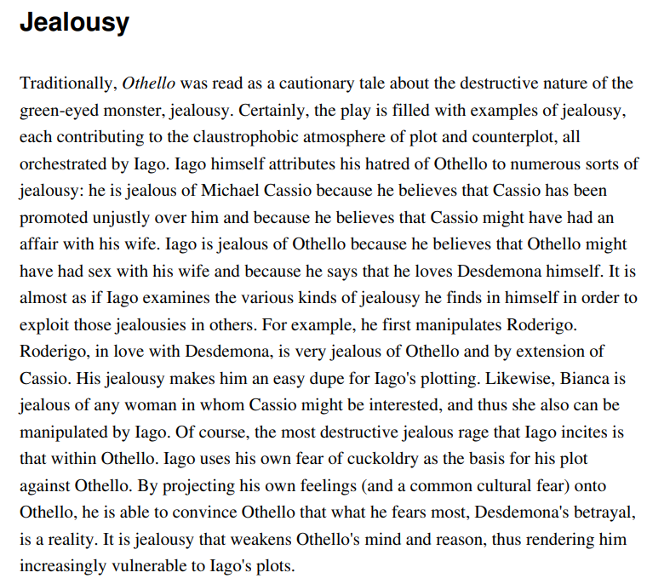
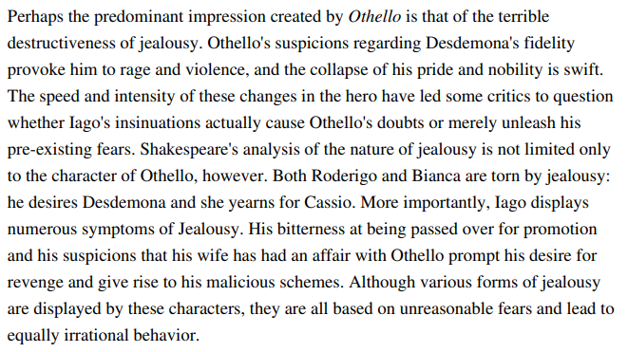
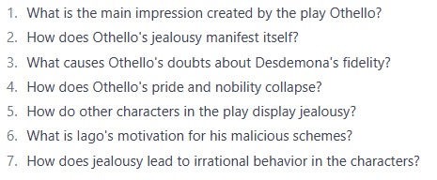
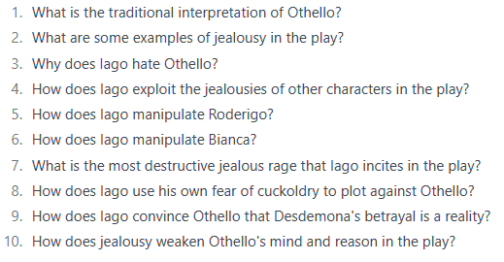

Slide 6
Jealousy extension Tasks
Find a scene that exhibits jealousy.
1
Find a quote that exhibits jealousy.
2
Explain how jealousy permeates the play.
3

