Slide 1
Othello revision

Slide 2
“Iago has many motives for his actions, but none of them are clear.”
How far do you agree with this view?

Slide 3
Use the below answer to improve yours in green.
Intro:
In Shakespeare's tragedy Othello, the character of Iago is often regarded as one of the most enigmatic and complex villains in literature. While some argue that Iago's motives are not clear, others believe that his motives can be discerned through careful analysis of the text. In this essay, we will explore both sides of the argument, considering the evidence from the play to evaluate the clarity of Iago's motives.
Disagree:
On one hand, there are clear indications within the play that suggest Iago possesses a multitude of motives. He openly admits his resentment towards Othello for promoting Cassio over him, establishing jealousy as a primary motive. Iago's soliloquies provide further insight into his motivations, revealing his bitterness, desire for revenge, and his belief that Othello has slept with his wife, Emilia. These personal grievances can be seen as driving forces behind Iago's plot against Othello.
Moreover, Iago's racist attitudes towards Othello, referring to him as "an old black ram" and "the devil," suggest that he also harbors deep-seated racial prejudice. This prejudice could be another motivating factor for Iago, as he aims to undermine Othello's position and tarnish his reputation by exploiting racial stereotypes and instigating doubt in the minds of others.
Agree:
On the other hand, some argue that Iago's motives remain ambiguous throughout the play. Although he provides reasons for his actions, his true intentions and the extent to which they are genuine remain elusive. Iago is known for his skillful manipulation and deceit, often presenting contradictory explanations for his behavior. This ambiguity contributes to the complex and enigmatic nature of his character, leaving room for interpretation.
Additionally, Iago's ability to adapt his motives to different situations and characters suggests a level of opportunism and cunning rather than a single, clear motive. His interactions with various characters, such as Roderigo and Cassio, showcase his talent for exploiting their weaknesses and using them as pawns in his grand scheme. This versatility further blurs the clarity of his motives.
Conclusion:
Overall, taking into account the various arguments presented, it is evident that Iago's motives in Othello are indeed multifaceted, with both clear and unclear aspects. While jealousy, revenge, racial prejudice, and a desire for power and control can be identified as driving forces behind his actions, his true intentions and the extent to which these motives are genuine remain open to interpretation. Shakespeare intentionally crafted Iago as a complex character, challenging the audience to delve deeper into the psyche of this malevolent manipulator.

Slide 4
The perfect answer?
AO1: show detailed knowledge of the content of literary texts, supported by reference to the text
Throughout the essay, I have demonstrated a solid understanding of the play Othello and its central character, Iago. I have referenced specific examples from the text to support my arguments, such as Iago's soliloquies, his racist attitudes towards Othello, and his manipulation of other characters. These references showcase a detailed knowledge of the play's content.
AO2: understand the meanings of literary texts and their contexts, and explore texts beyond surface meaning to show deeper awareness of ideas and attitudes
I have delved beyond the surface meaning of the text by exploring the complex motivations of Iago. I have analyzed the various ideas and attitudes presented in the play, including jealousy, revenge, racial prejudice, and the destructive power of manipulation. By considering the context of the play and its societal implications, I have shown a deeper awareness of the themes and subtext within Othello.
AO3: recognise and appreciate ways in which writers use language, structure, and form to create and shape meanings and effects
I have acknowledged the ways in which Shakespeare uses language, structure, and form to develop the character of Iago and convey his motives. I have highlighted the use of soliloquies to provide insight into Iago's thoughts, as well as his derogatory language towards Othello to emphasize racial prejudice. By recognizing these linguistic and structural choices, I have appreciated the intentional creation and shaping of meaning and effects within the play.
AO4: communicate a sensitive and informed personal response
I have expressed a personal response to the topic, acknowledging the complexities of Iago's character and motivations. My response reflects sensitivity towards the nuances and intricacies of the play, considering both sides of the argument while reaching a reasoned judgment. While the response is personal, it is also informed by the evidence and analysis presented throughout the essay.

Slide 5
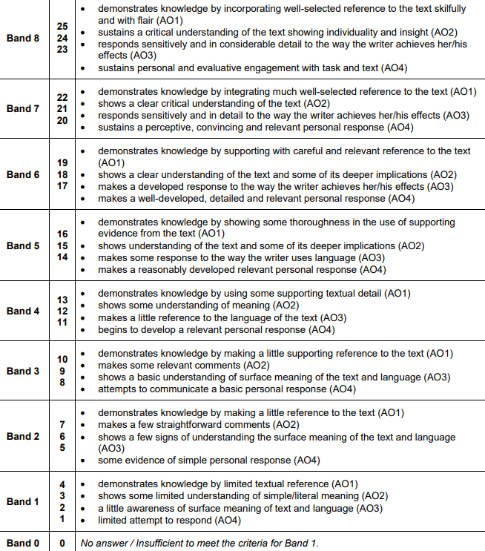
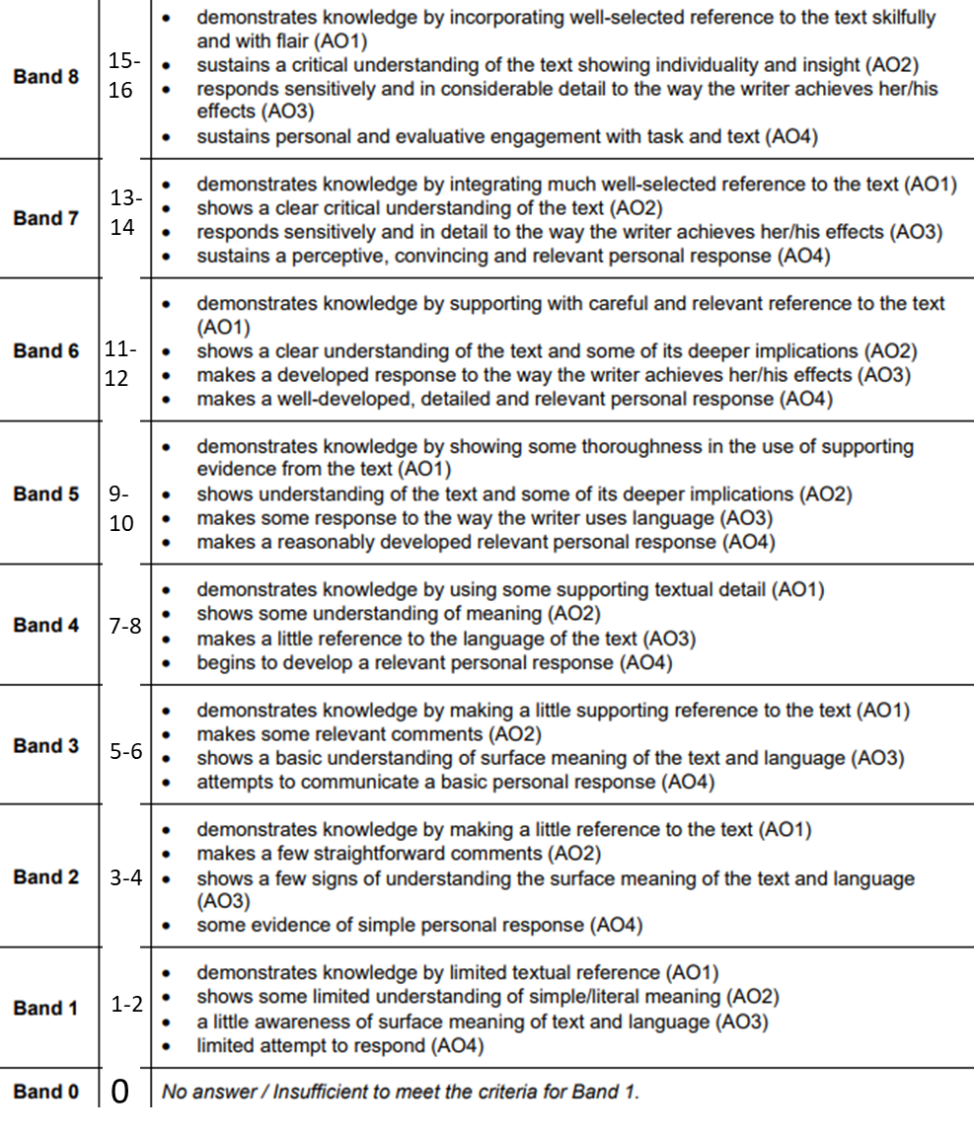
15-
16
13-
14
11-
12
9-
10
7-8
5-6
3-4
1-2
0

