Slide 1
Read Chapters 1, 2 and 3

Slide 2
Life of Pi is a good example of autofiction

Slide 6
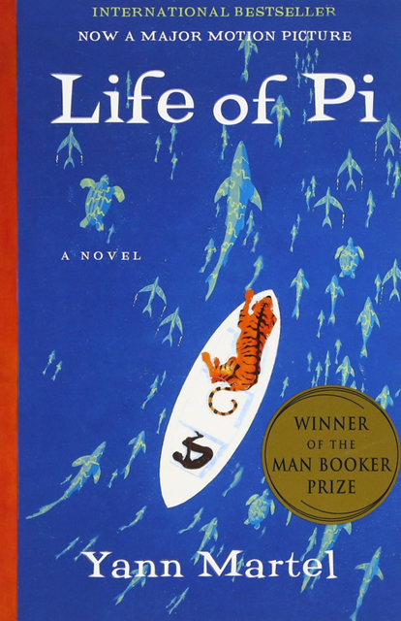
Final thoughts
After reading what you have done so far, what are your thoughts on the novel?
Likes? Dislikes? Points of interest?
Is it meeting or falling short of your expectations so far? Why?

Slide 8
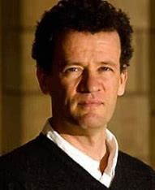

Slide 9
In your opinion, how has Yann Martel’s life influenced Life of Pi?

