Slide 1
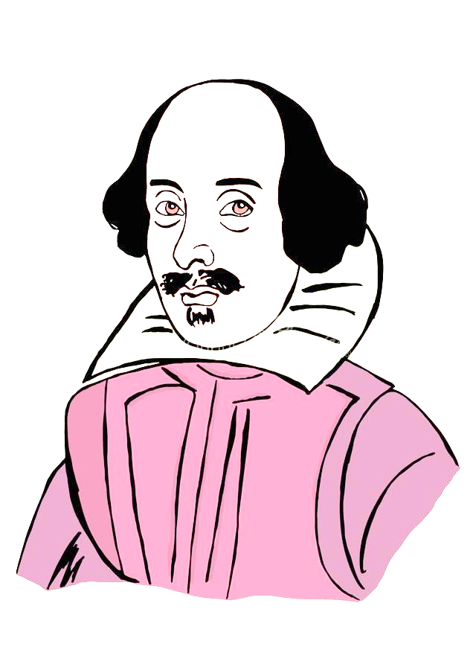
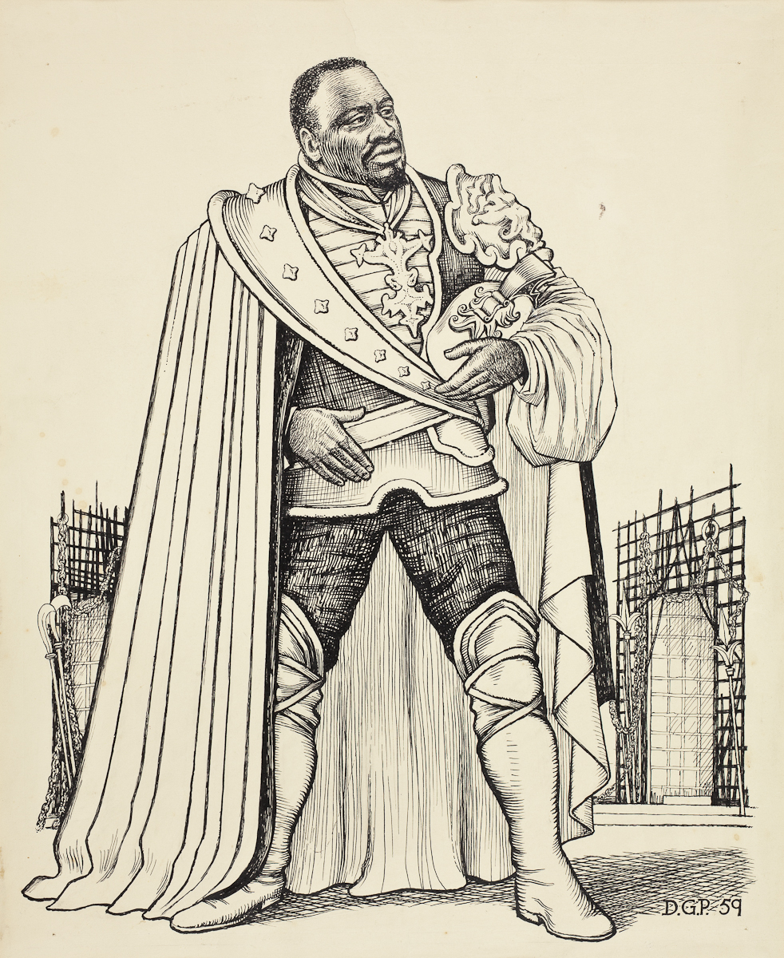
What happens in Act 1 of Othello?
Monday, September 12, 2022
Good Progress | Excellent Progress
Describe the key features of Othello Act I | Explain how Act I fits with the typical plot structure of a Shakespearean Tragedy.

Slide 2
Quick quiz
Shakespeare is respected because he is good at the technique known as c_________.
Shakespeare is renowned for how he uses L________ effectively.
How many theatres were there in London by the end of the Elizabethan Age?
Shakespeare is famous for his i_________ on later authors and popular culture nowadays.
Culture could flourish during Shakespeare’s time, since England was at p____ for the majority of Elizabeth’s reign.
Characterization
Language
Four
influence
5. Peace

Slide 3
Quick quiz
Who are the main three characters in the play?
Who is the protagonist of the play?
Who is the antagonist of the play?
Who could we say for sure is defintely a tragic victim in the play?
What is the name of the man that got promotion, making Iago angry because he felt he deserved he promotion instead?
Othello, Desdemona and Iago
Othello
Iago
Desdemona
5. Michael Cassio

Slide 4
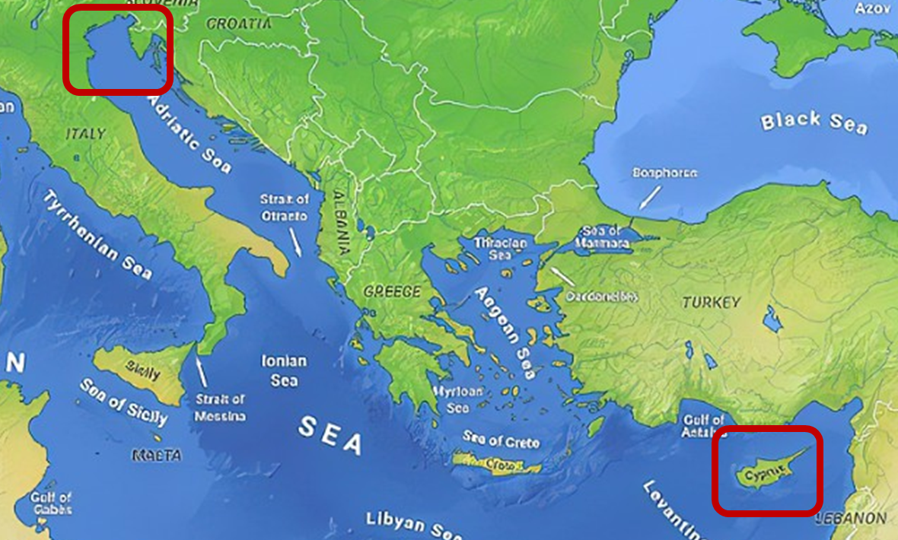
What’s the situation?

Slide 5
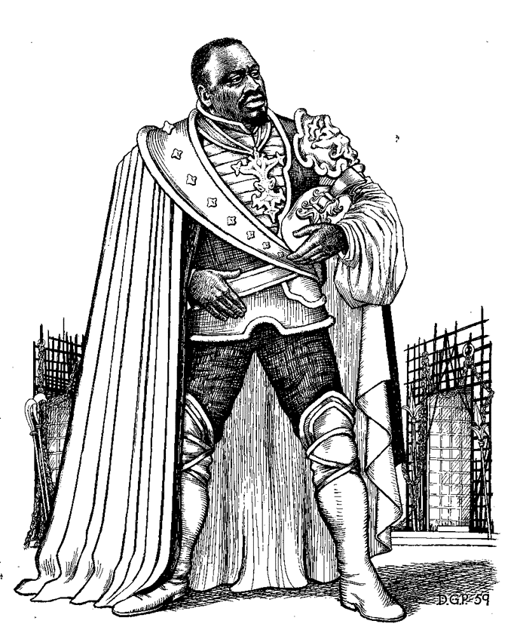
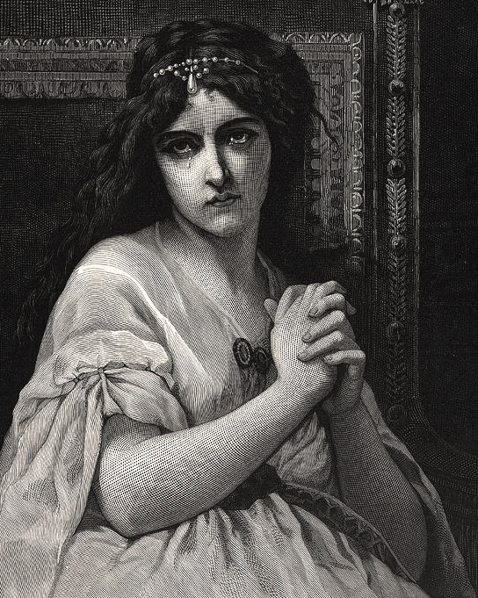
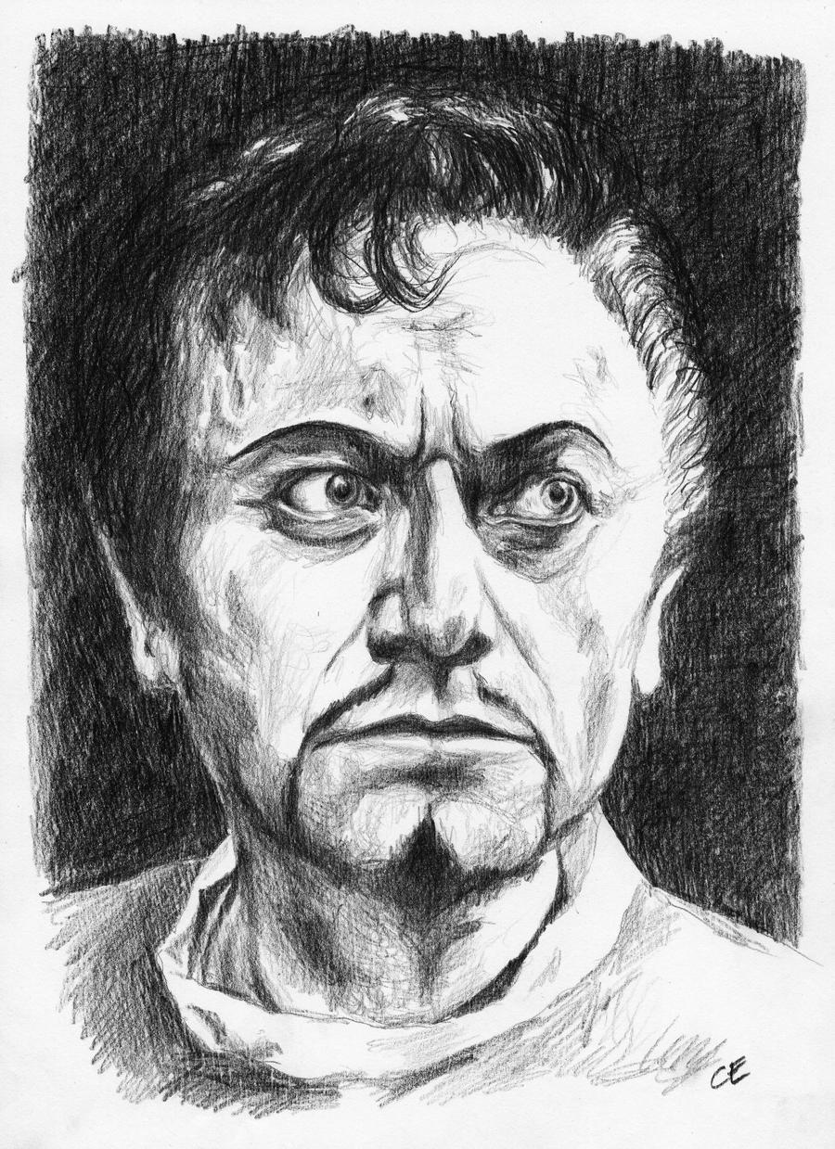

Slide 6
Act I
The curtains open and the audience catches sight of a street in Venice. Iago is there, accompanied by a man who seems angry with him.
His name is Roderigo and he is upset because he has just found out that Othello ran off with Desdemona to marry her. Roderigo was secretly in love with Desdemona and claims Iago kept it a secret from him because he is so loyal to Othello.
Iago replies that actually, he hates Othello for not promoting him and promoting Michael Cassio instead. Iago claims Cassio only knows how to win battles by reading about them in books, not from first-hand experience of fighting and killing like he himself has.
Iago and Roderigo go to Desdemona’s home to tell her father, Brabantio, about the fact she ran off to marry Othello.
Brabantio is furious when he hears Iago’s message, but Iago sneaks off before Brabantio sees him, so that it will never get back to Othello that he was the one who told Desdemona’s father what was going on. Brabantio and Roderigo then go off in search of Othello and Desdemona.
The action then switches to Othello, who is in the process of being told by Cassio that the Duke of Venice has ordered him to sail to Cyprus to defend it from the Turks.
Brabantio though has heard of Othello’s location and barges in with Roderigo ready for a fight.
He is outraged that Desdemona has chosen Othello to marry instead of someone more important, richer and of better social status.
He claims that Othello used supernatural powers to bewitch and trick Desdemona into falling in love with him.
Othello though is calm in his reply and tells Desdemona’s father that they fell in love when Othello came to visit and stay with
Brabantio previously.
Othello then hears that the Duke of Venice is insistent that he leave for Cyprus that night, meaning he would have to leave Desdemona at home with her father for her protection.
Brabantio though forbids Desdemona from coming home with him, meaning Othello comes up with a plan for his friend Iago to accompany Desdemona to Cyprus some time later.
Act I ends with Iago formalizing his plan to destroy Othello by convincing him that Desdemona is having an affair with Cassio.

Slide 7
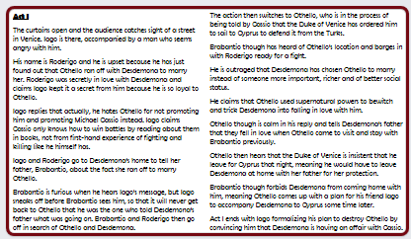
Reading the summary of Act I

Slide 8
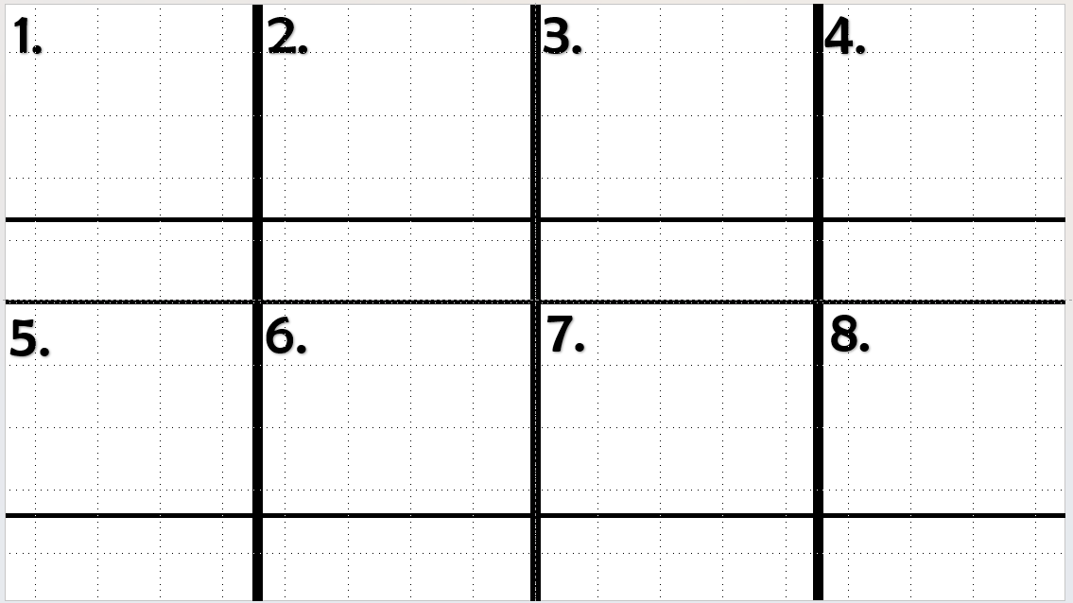
Use the Act I sheet we have read through to create a storyboard.
EXT: What do you think of Brabantio? Why?
What do you think of Roderigo? Why?

Slide 9
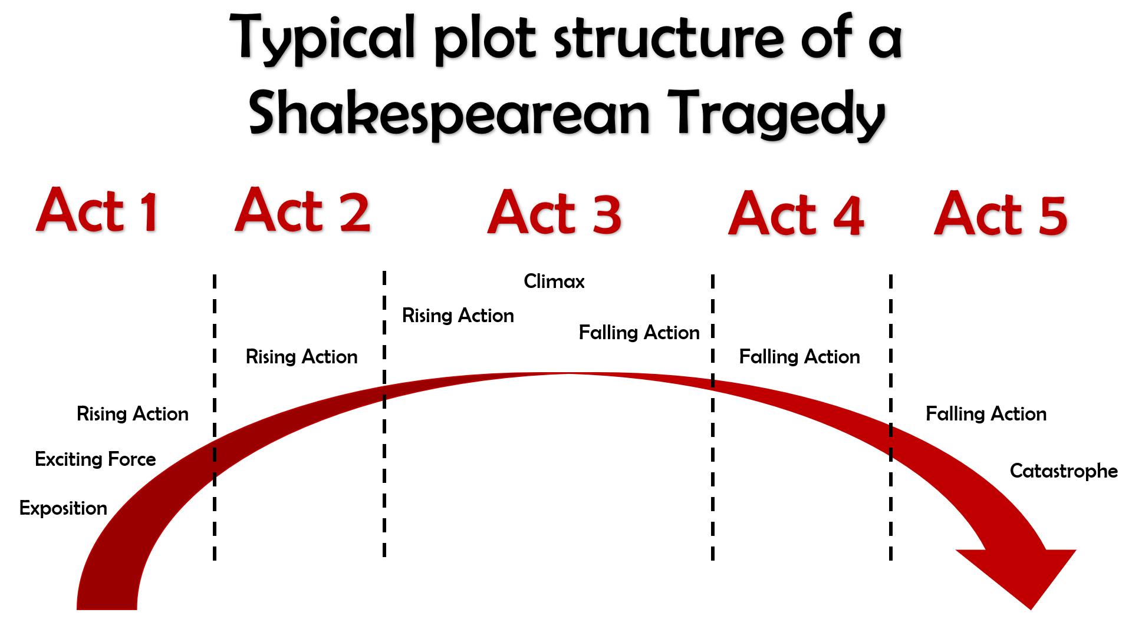
What kinds of things would we expect to see in Act 1?

Slide 10
Quick quiz
Shakespeare is respected because he is good at the technique known as c_________.
Shakespeare is renowned for how he uses L________ effectively.
How many theatres were there in London by the end of the Elizabethan Age?
Shakespeare is famous for his i_________ on later authors and popular culture nowadays.
Culture could flourish during Shakespeare’s time, since England was at p____ for the majority of Elizabeth’s reign.
Characterization
Language
Four
influence
5. Peace

Slide 11
Quick quiz
Who are the main three characters in the play?
Who is the protagonist of the play?
Who is the antagonist of the play?
Who could we say for sure is definitely a tragic victim in the play?
What is the name of the man that got promotion, making Iago angry because he felt he deserved he promotion instead?
Othello, Desdemona and Iago
Othello
Iago
Desdemona
5. Michael Cassio

Slide 12
What happens in Act 1 of Othello?
Monday, September 12, 2022
Good Progress | Excellent Progress
Describe the key features of Othello Act I | Explain how Act I fits with the typical plot structure of a Shakespearean Tragedy.

