Slide 1
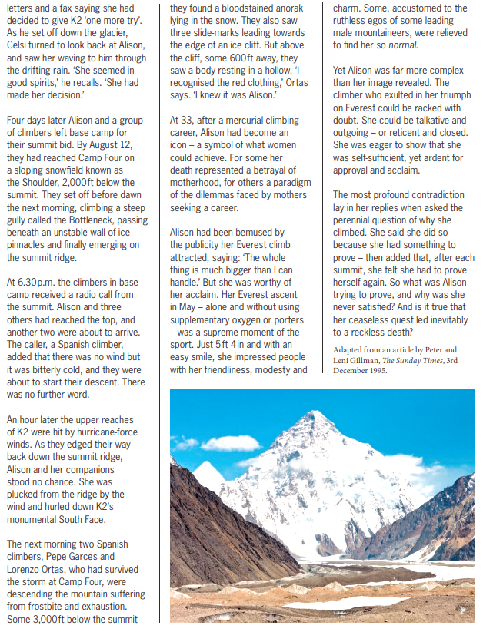
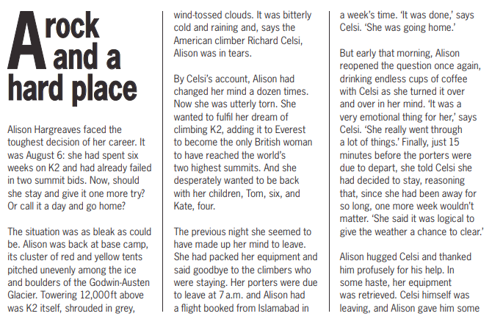
1.
2.
Read and highlight the key information from the passage below.
3.
Explain whether you think “A rock and a hard place” is a good title for this article or not. Explain why.
4.
Read and highlight the ‘key point’ box at the top of the other side of this page.

