Slide 1
Recap
What’s the name of the book that Yann Martel took ‘the spark of life’ from?
Who wrote it?
How is it different from Life of Pi?
What is maya in Hinduism?
How is it relevant to Life of Pi?
Can we trust the author’s note to be 100% true?
What does that make us think about the rest of the novel?

Slide 2
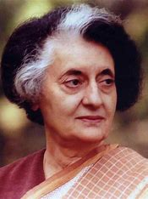
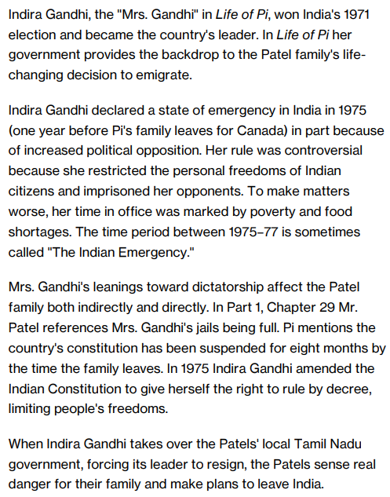
Why were Pi and his family leaving India?

Slide 3
How is Pi portrayed by Yann Martel in chapters 1 and 2?
Write a few paragraphs and quote from the text.
Yann Martel portrays Pi as…. A quote that supports this is… this suggests he is… because…
AO1: UNDERSTAND THE CONTENT OF THE TEXT.
You demonstrate your knowledge of what the novel is about and its deeper meanings. You use TEXTUAL REFERENCES, including QUOTATIONS, to support and illustrate your interpretations.
AO2: Understanding of characters, relationships and themes.
AO3: UNDERSTANDING OF THE author’s INTENTIONS AND METHODS.
You demonstrate an understanding of WHY the write wrote the novel and HOW he uses language to achieve his intentions. You ANALYSE language and structure closely.
AO4: YOU OFFER A PERSONAL RESPONSE TO THE novel.
You engage with the text and OFFER AN OPINION on it sometimes directly (answering questions such as ‘What do you think?’, ‘What are
your feelings about…?’) and sometimes by implication (answering questions such as ‘Explore the ways in which…’)

Slide 4
What do you think these quotes really mean?
1
2
3
I love Canada. I miss the heat of India, the food, the house lizards on the walls, the musicals on the silver screen….but I love Canada.
When you´ve suffered a great deal in life, each additional pain is both unbearable and trifling. My life is like a memento mori painting from European art: there is always a grinning skull at my side to remind me of the folly of human ambition.
Richard Parker has stayed with me. I´ve never forgotten him. Dare I say I miss him? I do. I miss him. I see him in my dreams. They are nightmares mostly, but nightmares tinged with love.
Challenge: Which writing devices do you notice and what is their effect?
Similes, metaphors, personification, anthropomorphism, zoomorphism, adjectives, adverbs, verbs, semantic fields, different sentence types, punctuation, foreshadowing, pathetic fallacy, oxymoron, juxtaposition, symbolism

Slide 5
Design a new front cover
Shipwreck and survival at sea
Tiger
Other animals
Zoo
Pi’s family
Pondicherry
The man in the Indian coffee shop
Religion
Emigration
Try and ensure as many as possible of these things are included in your new front cover.
Notes:
Video link: https://www.youtube.com/watch?v=b0AHmqyjRIc

Slide 6
Find this quote in the novel
“Fresh off the boat, are you?” I blanched…..He had no idea how deeply those words wounded me. They were like nails being driven into my flesh.”
What’s the significance of this quote?

Slide 7
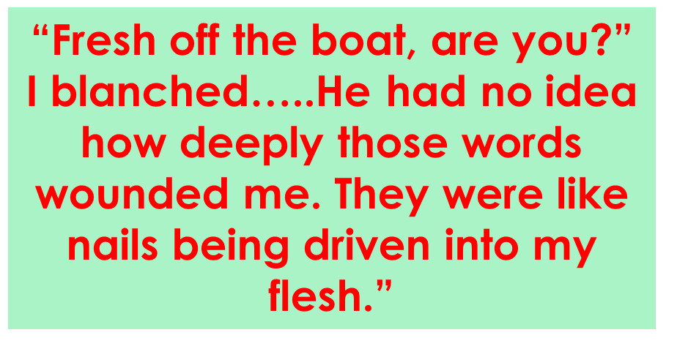
Improve your answer…
Pi, like most people, wants to feel welcome in his community.
The waiter's comment implies he doesn't belong, even in a restaurant that serves food connected to his heritage. The comment may also have a racist undertone, mocking Pi's immigrant status.
Pi is also ashamed of his past savagery on an actual boat, "a level of savagery I never imagined possible," and he is self-conscious about eating with his hands. His fingers become "dirty" and "like criminals caught in the act."
When he looks at the knife and fork, he's negotiating cultural differences but also figuring out how to exist again in the civilized world after his transformative experiences.
He has to relearn many rituals, such as drinking from a water tap.

Slide 8
Recap
What’s the name of the book that Yann Martel took ‘the spark of life’ from?
Who wrote it?
How is it different from Life of Pi?
What is maya in Hinduism?
How is it relevant to Life of Pi?
Can we trust the author’s note to be 100% true?
What does that make us think about the rest of the novel?

