Slide 1
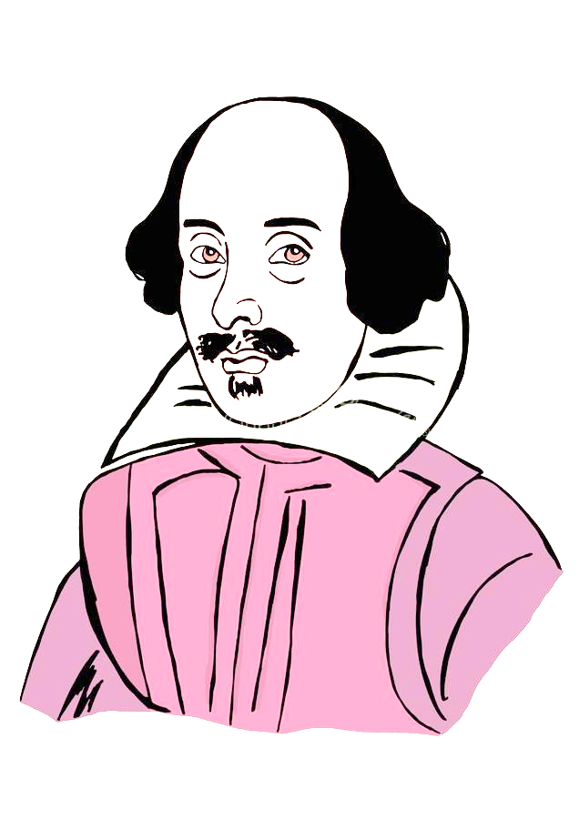
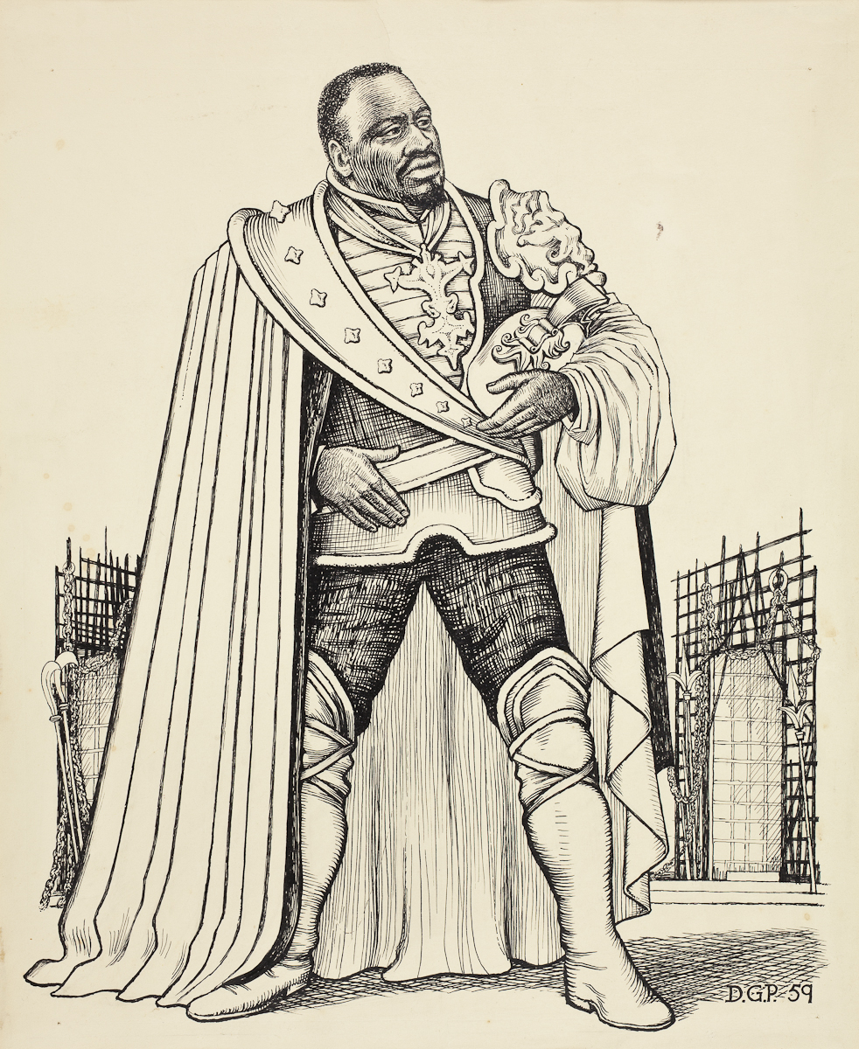
What’s going on at the beginning of Act 1 Scene 1?
Sunday, September 11, 2022
Good Progress | Excellent Progress
Describe the key features of the beginning of the play. | Explain how what we are seeing fits with Shakespeare’s typical tragic arc.

Slide 2
Quick quiz
Who are the main three characters in the play?
Who is the antagonist of the play?
What is his wife’s name?
Who could we say for sure is definitely a tragic victim in the play?
An average Elizabethan would have been more c_______ than racist when encountering a Moor like Othello.
Othello, Desdemona and Iago
Iago
Emilia
Desdemona
5. C

Slide 3
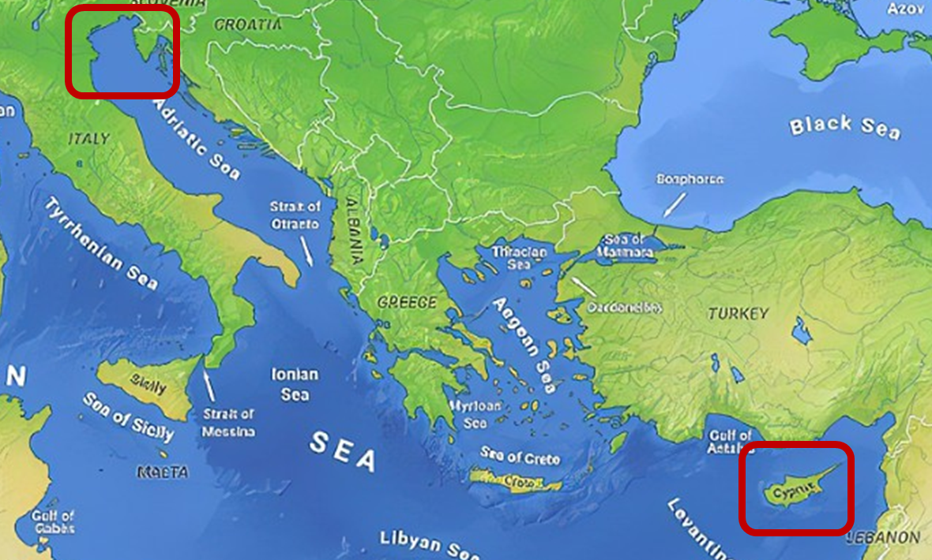
What’s the situation?

Slide 4
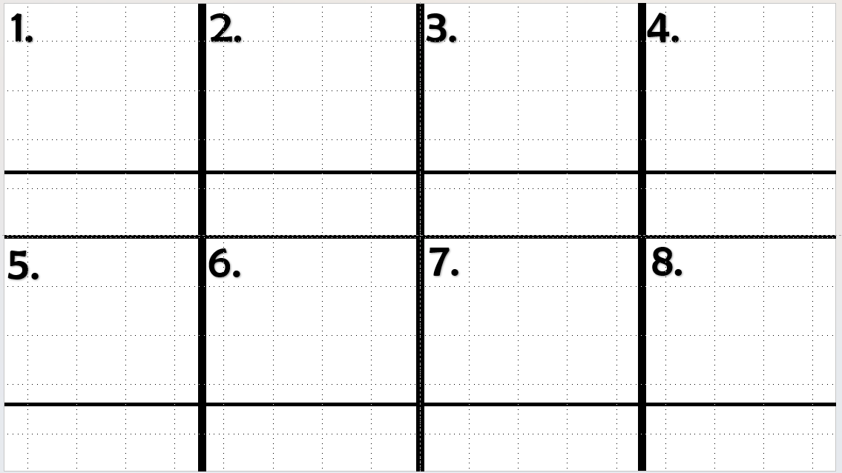
Use the Act I sheet we have read through to create a storyboard.
EXT: What do you think of Brabantio? Why?
What do you think of Roderigo? Why?

Slide 5
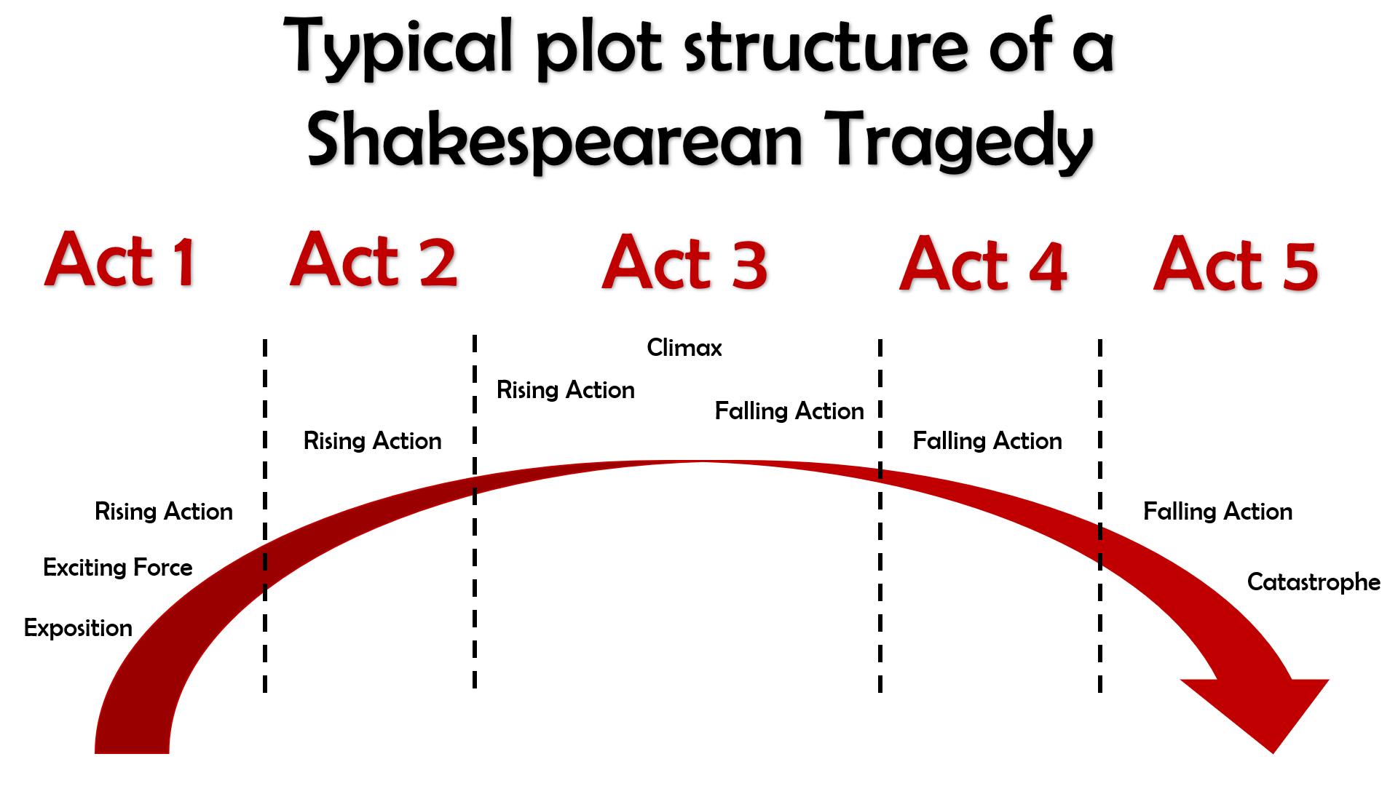
What kinds of things would we expect to see in Act 1?

Slide 6
Act I
The curtains open and the audience catches sight of a street in Venice. Iago is there, accompanied by a man who seems angry with him.
His name is Roderigo and he is upset because he has just found out that Othello ran off with Desdemona to marry her. Roderigo was secretly in love with Desdemona and claims Iago kept it a secret from him because he is so loyal to Othello.
Iago replies that actually, he hates Othello for not promoting him and promoting Michael Cassio instead. Iago claims Cassio only knows how to win battles by reading about them in books, not from first-hand experience of fighting and killing like he himself has.
Iago and Roderigo go to Desdemona’s home to tell her father, Brabantio, about the fact she ran off to marry Othello.
Brabantio is furious when he hears Iago’s message, but Iago sneaks off before Brabantio sees him, so that it will never get back to Othello that he was the one who told Desdemona’s father what was going on. Brabantio and Roderigo then go off in search of Othello and Desdemona.
The action then switches to Othello, who is in the process of being told by Cassio that the Duke of Venice has ordered him to sail to Cyprus to defend it from the Turks.
Brabantio though has heard of Othello’s location and barges in with Roderigo ready for a fight.
He is outraged that Desdemona has chosen Othello to marry instead of someone more important, richer and of better social status.
He claims that Othello used supernatural powers to bewitch and trick Desdemona into falling in love with him.
Othello though is calm in his reply and tells Desdemona’s father that they fell in love when Othello came to visit and stay with
Brabantio previously.
Othello then hears that the Duke of Venice is insistent that he leave for Cyprus that night, meaning he would have to leave Desdemona at home with her father for her protection.
Brabantio though forbids Desdemona from coming home with him, meaning Othello comes up with a plan for his friend Iago to accompany Desdemona to Cyprus some time later.
Act I ends with Iago formalizing his plan to destroy Othello by convincing him that Desdemona is having an affair with Cassio.

Slide 7
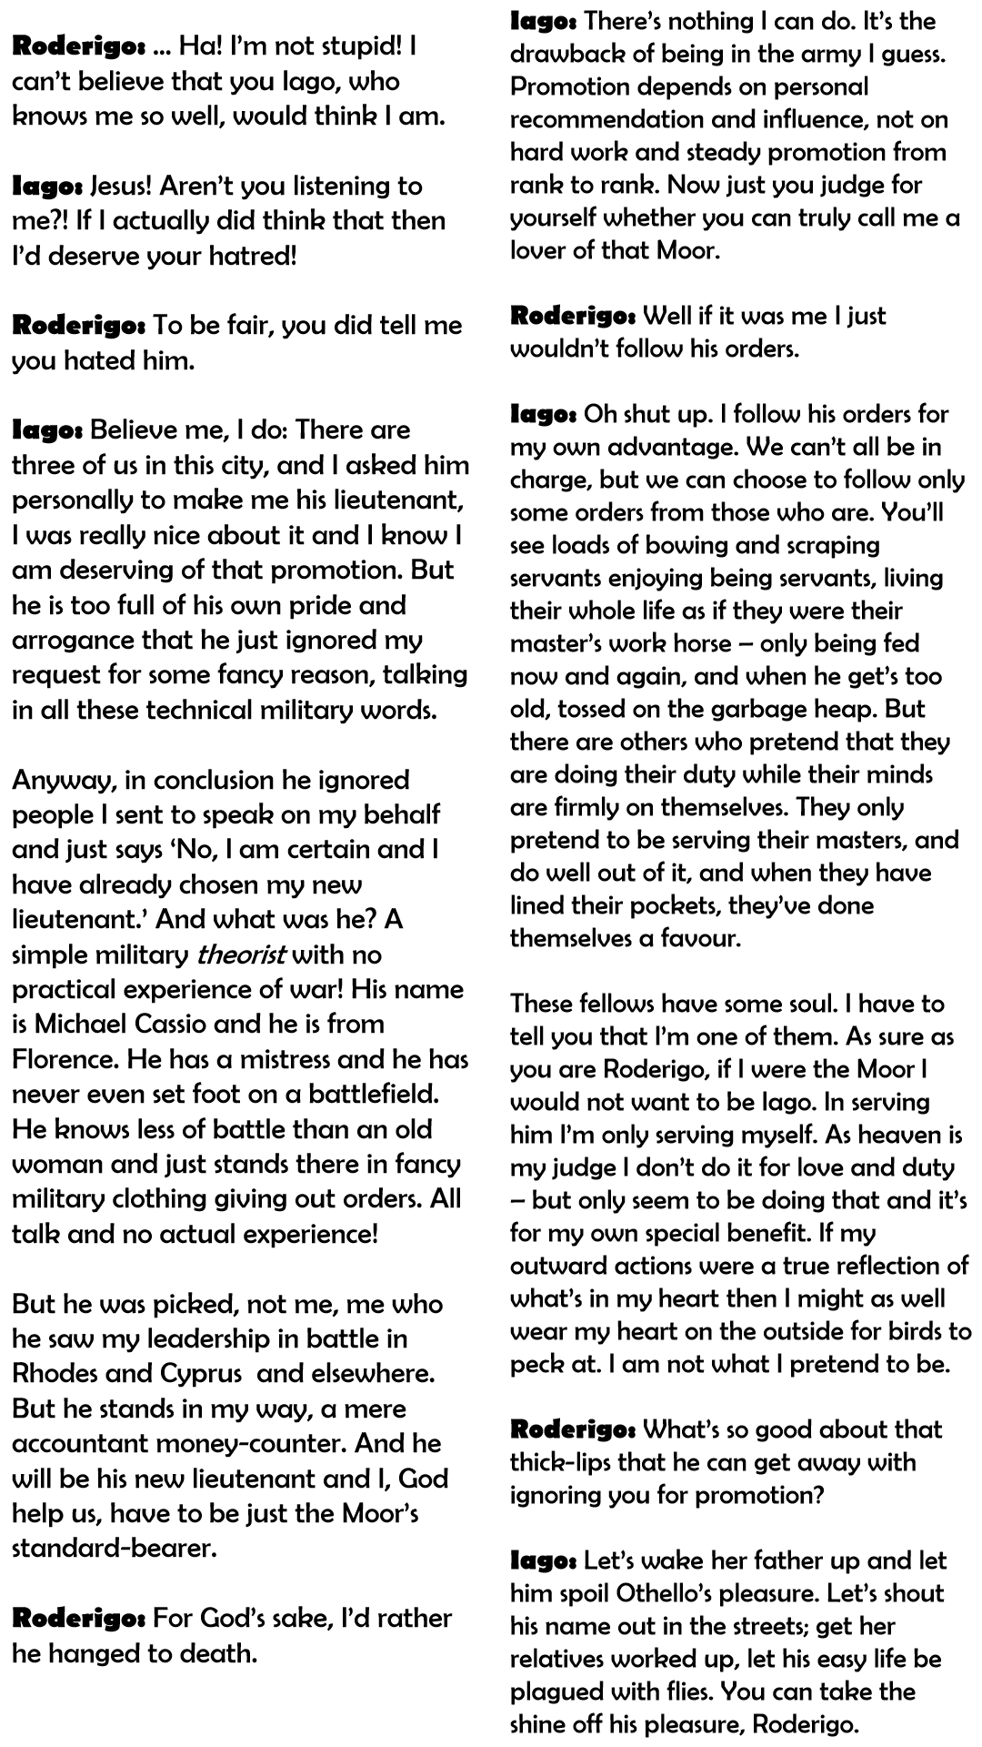
The first half of Act 1 Scene 1
1. Let’s read through and talk about various aspects of what’s going on.
2. Let’s read the Shakespearean version and see if you can follow what’s going on.
EXT: What’s your opinion of Iago in this scene and why?
EXT EXT: What role in the narrative is Roderigo playing here? How do you know?

Slide 8
Iago: There’s nothing I can do. It’s the drawback of being in the army I guess. Promotion depends on personal recommendation and influence, not on hard work and steady promotion from rank to rank. Now just you judge for yourself whether you can truly call me a lover of that Moor.
Roderigo: Well if it was me I just wouldn’t follow his orders.
Iago: Oh shut up. I follow his orders for my own advantage. We can’t all be in charge, but we can choose to follow only some orders from those who are. You’ll see loads of bowing and scraping servants enjoying being servants, living their whole life as if they were their master’s work horse – only being fed now and again, and when he get’s too old, tossed on the garbage heap. But there are others who pretend that they are doing their duty while their minds are firmly on themselves. They only pretend to be serving their masters, and do well out of it, and when they have lined their pockets, they’ve done themselves a favour.
These fellows have some soul. I have to tell you that I’m one of them. As sure as you are Roderigo, if I were the Moor I would not want to be Iago. In serving him I’m only serving myself. As heaven is my judge I don’t do it for love and duty – but only seem to be doing that and it’s for my own special benefit. If my outward actions were a true reflection of what’s in my heart then I might as well wear my heart on the outside for birds to peck at. I am not what I pretend to be.
Roderigo: What’s so good about that thick-lips that he can get away with ignoring you for promotion?
Iago: Let’s wake her father up and let him spoil Othello’s pleasure. Let’s shout his name out in the streets; get her relatives worked up, let his easy life be plagued with flies. You can take the shine off his pleasure, Roderigo.
Roderigo: … Ha! I’m not stupid! I can’t believe that you Iago, who knows me so well, would think I am.
Iago: Jesus! Aren’t you listening to me?! If I actually did think that then I’d deserve your hatred!
Roderigo: To be fair, you did tell me you hated him.
Iago: Believe me, I do: There are three of us in this city, and I asked him personally to make me his lieutenant, I was really nice about it and I know I am deserving of that promotion. But he is too full of his own pride and arrogance that he just ignored my request for some fancy reason, talking in all these technical military words.
Anyway, in conclusion he ignored people I sent to speak on my behalf and just says ‘No, I am certain and I have already chosen my new lieutenant.’ And what was he? A simple military theorist with no practical experience of war! His name is Michael Cassio and he is from Florence. He has a mistress and he has never even set foot on a battlefield. He knows less of battle than an old woman and just stands there in fancy military clothing giving out orders. All talk and no actual experience!
But he was picked, not me, me who he saw my leadership in battle in Rhodes and Cyprus and elsewhere. But he stands in my way, a mere accountant money-counter. And he will be his new lieutenant and I, God help us, have to be just the Moor’s standard-bearer.
Roderigo: For God’s sake, I’d rather he hanged to death.

Slide 9
Quick quiz
Shakespeare is respected because he is good at the technique known as c_________.
Shakespeare is renowned for how he uses L________ effectively.
How many theatres were there in London by the end of the Elizabethan Age?
Shakespeare is famous for his i_________ on later authors and popular culture nowadays.
Culture could flourish during Shakespeare’s time, since England was at p____ for the majority of Elizabeth’s reign.
Characterization
Language
Four
influence
5. Peace

Slide 10
Quick quiz
Who are the main three characters in the play?
Who is the antagonist of the play?
What is his wife’s name?
Who could we say for sure is definitely a tragic victim in the play?
Who sends Othello to Cyprus?
Othello, Desdemona and Iago
Iago
Emilia
Desdemona
5. Duke / Governor of Venice.

Slide 11
What’s going on in the opening scene of Othello?
Sunday, September 11, 2022
Good Progress | Excellent Progress
Describe the key features of the beginning of the play. | Explain how what we are seeing fits with Shakespeare’s typical tragic arc.

