Slide 1
1. Finish your answer: How does Yann Martel present the character of Pi in Chapter Three?
2.. Use the below answer to improve yours in green.
Martel emphasizes the significance of Pi´s name throughout Chapter Three in an attempt to convey the complexities of his character.
This is evidenced by the line: ´I was named after a swimming pool.´
The short, declarative sentence establishes Pi´s link to water right from the beginning of the novel. Through Pi´s first-person narration, Martel gradually recounts Pi´s voyage across the ocean to Canada. Furthermore, Pi also is an irrational mathematical symbol used to calculate distance in a circle. It could be used to convey how pi is difficult to comprehend, just like the protagonist.
This makes the reader feel curious- it hooks them to find out more about the narrator. An air of mystery sounds Pi and his name leaves them asking questions about the main events and themes of the novel.
Pi also holds religious connotations; it is a letter in the Greek alphabet which is linked to alpha and omega, two terms used repeatedly by Martel. Not only do they refer to the ´beginning´ and ´end of the journey´ but they might also imply that some creatures are more dominant than others. This might be interpreted as foreshadowing; Martel establishes that Pi´s journey will be one of moral and spiritual discovery.
3. How could this paragraph be improved?
4. Now answer: How does Martel present the theme of racism in ´Life of Pi?´ - similar style answer to the one you have just done – including quotes + explanation.
Notes:
Pi
Piscine Molitor Patel’s preferred moniker is more than just a shortened version of his given name. Indeed, the word Pi carries a host of relevant associations. It is a letter in the Greek alphabet that also contains alpha and omega, terms used in the book to denote dominant and submissive creatures. Pi is also an irrational mathematical number, used to calculate distance in a circle. Often shortened to 3.14, pi has so many decimal places that the human mind can’t accurately comprehend it, just as, the book argues, some realities are too difficult or troubling to face. These associations establish the character Pi as more than just a realistic protagonist; he also is an allegorical figure with multiple layers of meanin

Slide 2
Finish your answer: How does Martel present the theme of racism in ´Life of Pi?´?
(Similar style answer to the one you have just done – including quotes + explanation)
2.. Use the below answer to improve yours in green.
Pi is hurt by the racism he faces as an immigrant in Canada.
“Fresh off the boat, are you?” I blanched…..He had no idea how deeply those words wounded me. They were like nails being driven into my flesh.”
The simile conveys how cutting and hurtful the words of the waiter are as he fails to conform to the behaviour expected at the restaurant. The verb ´blanched´ also conveys a physical reaction to the waiter´s question- ´blanched´ means to ´go pale´ which could convey Pi´s embarrassment but could also imply that he feels out of place amongst other Canadian citizens.
This makes the reader feel pathos for Pi as he has to learn the new expectations of a culture that is unknown to him.
Martel implies that moving from one country to another is extremely challenging- a difficult journey where one feels forced to adopt to the habits and routines of a new community.
3. How could this paragraph be improved?
4. Complete any outstanding green pen corrections / improvements in your Lit and Lang books.
EXT:
Continue reading Life of Pi from where you have read up to so far.
Notes:
Pi
Piscine Molitor Patel’s preferred moniker is more than just a shortened version of his given name. Indeed, the word Pi carries a host of relevant associations. It is a letter in the Greek alphabet that also contains alpha and omega, terms used in the book to denote dominant and submissive creatures. Pi is also an irrational mathematical number, used to calculate distance in a circle. Often shortened to 3.14, pi has so many decimal places that the human mind can’t accurately comprehend it, just as, the book argues, some realities are too difficult or troubling to face. These associations establish the character Pi as more than just a realistic protagonist; he also is an allegorical figure with multiple layers of meanin

Slide 3
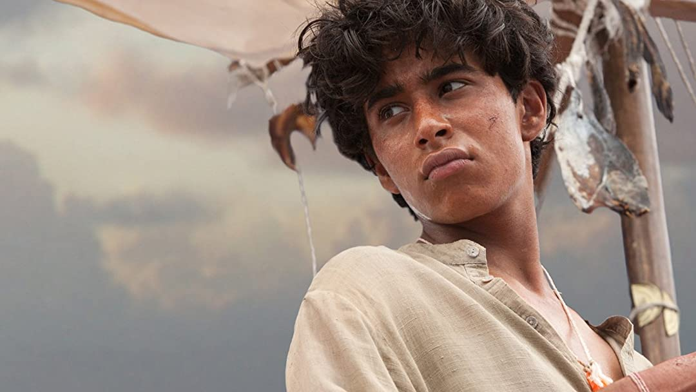
How does Yann Martel create a gripping opening to his novel ´Life of Pi?´
Success Criteria:
Write a point about Pi.
Include a key quotation as evidence.
Analyse your quotation, commenting on writing devices.
Think about the effect on the reader.
MAKE A LINK to context.
Use the below to help you answer the question above.
Point: The writer uses/employs…………………….to create a gripping/exciting/intriguing/ interesting opening to his novel ´Life of Pi.´
Evidence: This is evidenced/highlighted/ implied/ suggested by…….
Analysis: The (insert writing device)……………….. Try to say three things about the quotation.
Effect: This makes the reader feel……
Context: Martel attempts to……..
Notes:
Pi
Piscine Molitor Patel’s preferred moniker is more than just a shortened version of his given name. Indeed, the word Pi carries a host of relevant associations. It is a letter in the Greek alphabet that also contains alpha and omega, terms used in the book to denote dominant and submissive creatures. Pi is also an irrational mathematical number, used to calculate distance in a circle. Often shortened to 3.14, pi has so many decimal places that the human mind can’t accurately comprehend it, just as, the book argues, some realities are too difficult or troubling to face. These associations establish the character Pi as more than just a realistic protagonist; he also is an allegorical figure with multiple layers of meanin

