Slide 1
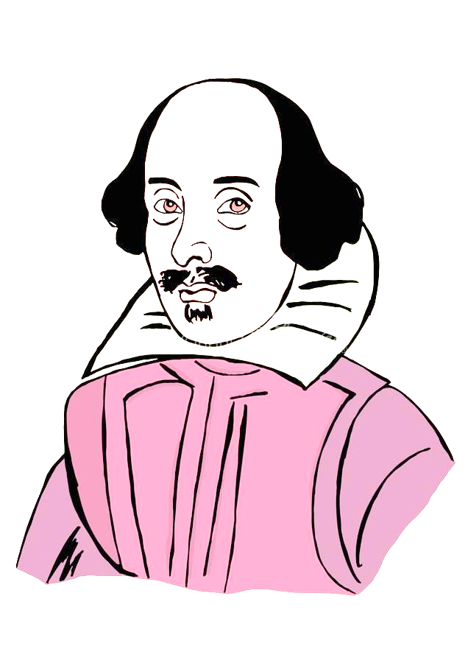
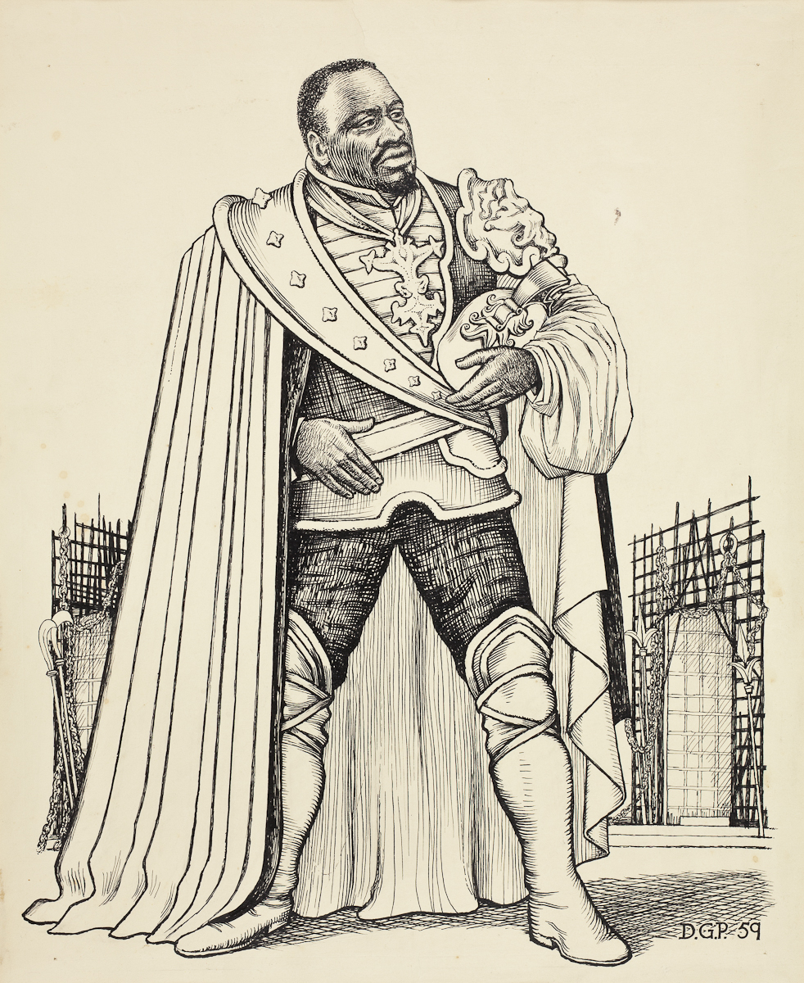
What’s going on in the middle of Act 1 Scene 1?
Sunday, September 11, 2022
Good Progress | Excellent Progress
Describe the key features of the beginning of the play. | Explain how what we are seeing fits with Shakespeare’s typical tragic arc.

Slide 2
Quick quiz
Shakespeare is respected because he is good at the technique known as c_________.
Which character at the beginning of Scene 1 is overtly racist?
Which character at the beginning of Scene 1 is more subtle in the way they talk about Othello’s race?
Shakespeare is famous for his i_________ on later authors and popular culture nowadays.
Culture could flourish during Shakespeare’s time, since England was at p____ for the majority of Elizabeth’s reign.
Characterization
Roderigo
Iago
influence
5. Peace

Slide 3
Quick quiz
Who are the main three characters in the play?
Who is the antagonist of the play?
What is his wife’s name?
Who could we say for sure is definitely a tragic victim in the play?
An average Elizabethan would have been more c_______ than racist when encountering a Moor like Othello.
Othello, Desdemona and Iago
Iago
Emilia
Desdemona
5. Curious

Slide 4
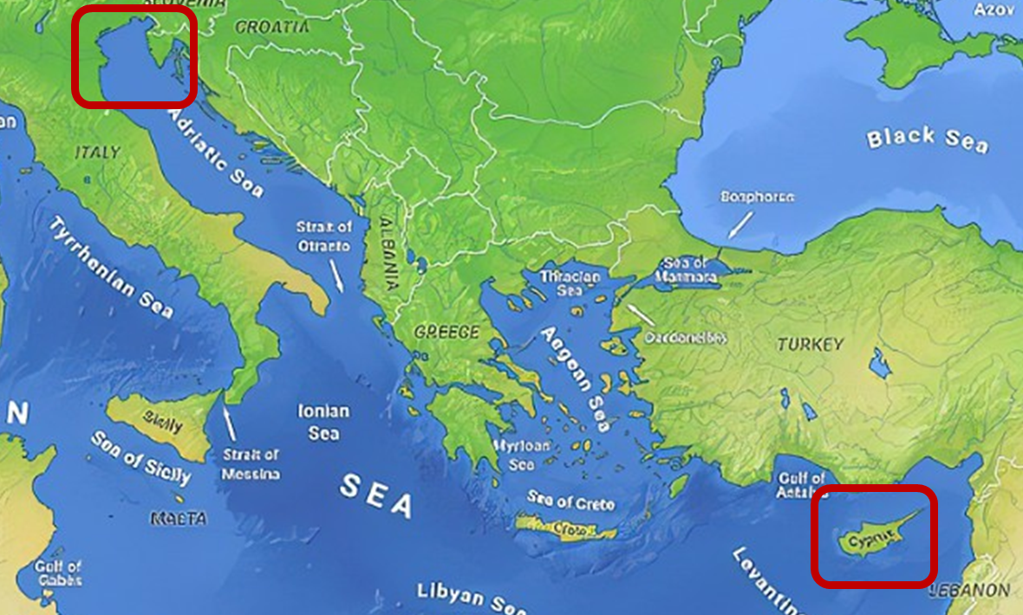
What’s the situation?

Slide 5
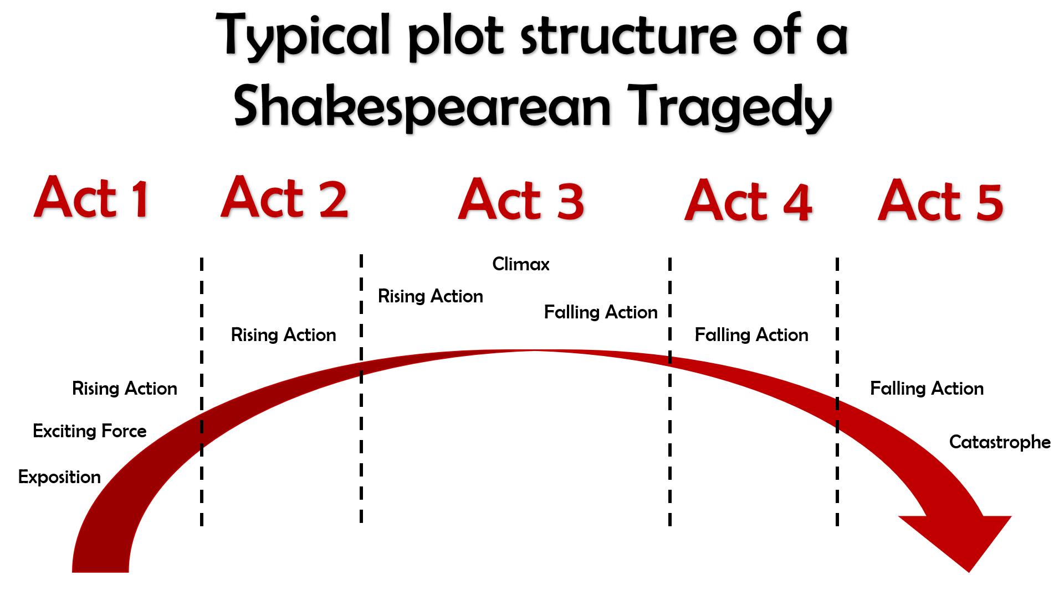
What kinds of things would we expect to see in Act 1?

Slide 6
Act I
The curtains open and the audience catches sight of a street in Venice. Iago is there, accompanied by a man who seems angry with him.
His name is Roderigo and he is upset because he has just found out that Othello ran off with Desdemona to marry her. Roderigo was secretly in love with Desdemona and claims Iago kept it a secret from him because he is so loyal to Othello.
Iago replies that actually, he hates Othello for not promoting him and promoting Michael Cassio instead. Iago claims Cassio only knows how to win battles by reading about them in books, not from first-hand experience of fighting and killing like he himself has.
Iago and Roderigo go to Desdemona’s home to tell her father, Brabantio, about the fact she ran off to marry Othello.
Brabantio is furious when he hears Iago’s message, but Iago sneaks off before Brabantio sees him, so that it will never get back to Othello that he was the one who told Desdemona’s father what was going on. Brabantio and Roderigo then go off in search of Othello and Desdemona.
The action then switches to Othello, who is in the process of being told by Cassio that the Duke of Venice has ordered him to sail to Cyprus to defend it from the Turks.
Brabantio though has heard of Othello’s location and barges in with Roderigo ready for a fight.
He is outraged that Desdemona has chosen Othello to marry instead of someone more important, richer and of better social status.
He claims that Othello used supernatural powers to bewitch and trick Desdemona into falling in love with him.
Othello though is calm in his reply and tells Desdemona’s father that they fell in love when Othello came to visit and stay with
Brabantio previously.
Othello then hears that the Duke of Venice is insistent that he leave for Cyprus that night, meaning he would have to leave Desdemona at home with her father for her protection.
Brabantio though forbids Desdemona from coming home with him, meaning Othello comes up with a plan for his friend Iago to accompany Desdemona to Cyprus some time later.
Act I ends with Iago formalizing his plan to destroy Othello by convincing him that Desdemona is having an affair with Cassio.

Slide 7
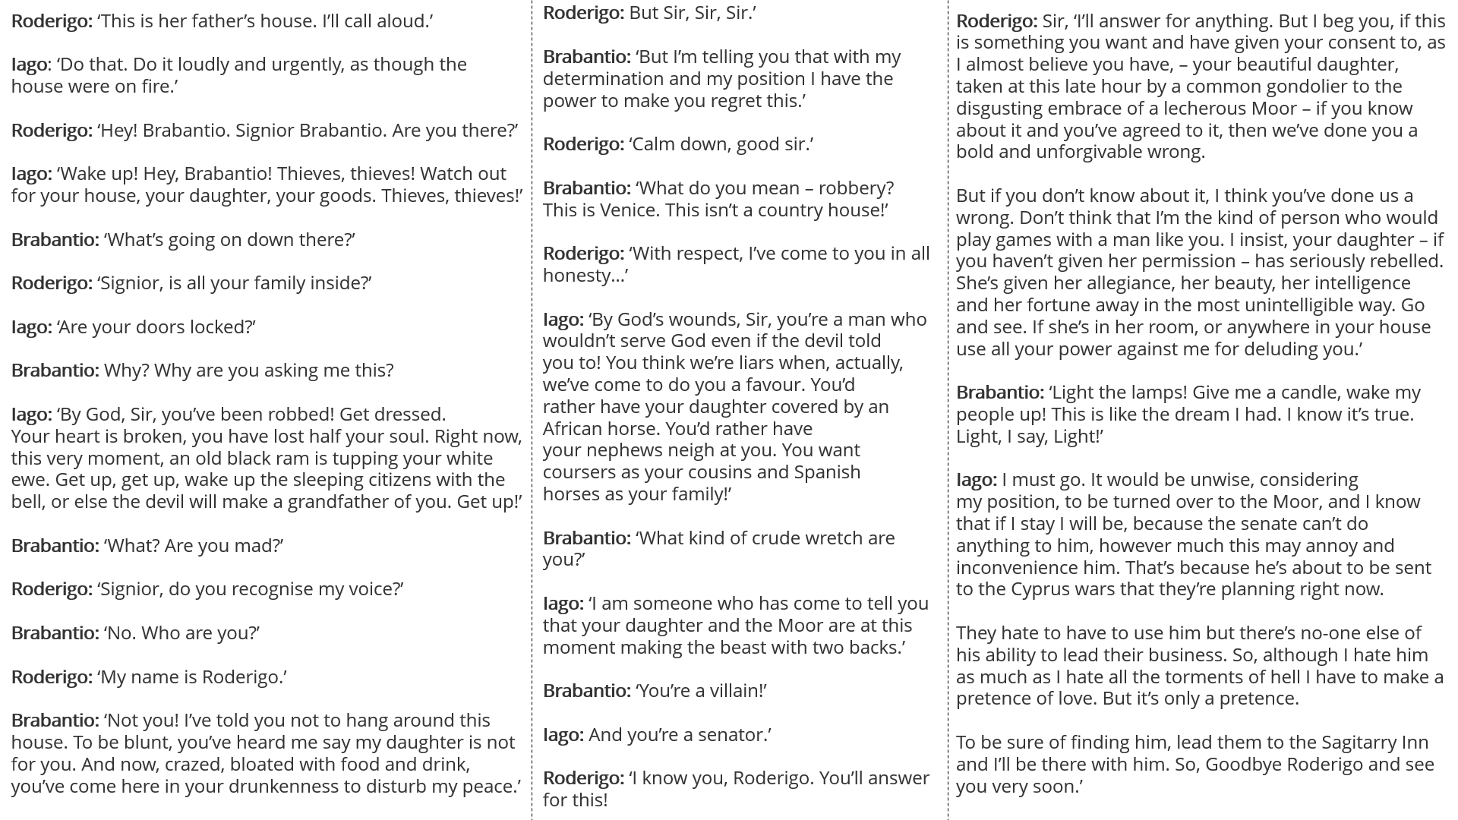
The middle part of Act 1 Scene 1
Stick the sheet in the middle of a double page so you can annotate around it.
As we read through, highlight any words you aren’t sure the meaning of.
At the end, ask me for definitions and annotate your sheet.
We will annotate the passage together.
We will read this part of Act 1 Scene 1 in the original Shakespeare.

Slide 8
Roderigo: But Sir, Sir, Sir.’
Brabantio: ‘But I’m telling you that with my determination and my position I have the power to make you regret this.’
Roderigo: ‘Calm down, good sir.’
Brabantio: ‘What do you mean – robbery? This is Venice. This isn’t a country house!’
Roderigo: ‘With respect, I’ve come to you in all honesty…’
Iago: ‘By God’s wounds, Sir, you’re a man who wouldn’t serve God even if the devil told you to! You think we’re liars when, actually, we’ve come to do you a favour. You’d rather have your daughter covered by an African horse. You’d rather have your nephews neigh at you. You want coursers as your cousins and Spanish horses as your family!’
Brabantio: ‘What kind of crude wretch are you?’
Iago: ‘I am someone who has come to tell you that your daughter and the Moor are at this moment making the beast with two backs.’
Brabantio: ‘You’re a villain!’
Iago: And you’re a senator.’
Roderigo: ‘I know you, Roderigo. You’ll answer for this!
Roderigo: ‘This is her father’s house. I’ll call aloud.’
Iago: ‘Do that. Do it loudly and urgently, as though the house were on fire.’
Roderigo: ‘Hey! Brabantio. Signior Brabantio. Are you there?’
Iago: ‘Wake up! Hey, Brabantio! Thieves, thieves! Watch out for your house, your daughter, your goods. Thieves, thieves!’
Brabantio: ‘What’s going on down there?’
Roderigo: ‘Signior, is all your family inside?’
Iago: ‘Are your doors locked?’
Brabantio: Why? Why are you asking me this?
Iago: ‘By God, Sir, you’ve been robbed! Get dressed. Your heart is broken, you have lost half your soul. Right now, this very moment, an old black ram is tupping your white ewe. Get up, get up, wake up the sleeping citizens with the bell, or else the devil will make a grandfather of you. Get up!’
Brabantio: ‘What? Are you mad?’
Roderigo: ‘Signior, do you recognise my voice?’
Brabantio: ‘No. Who are you?’
Roderigo: ‘My name is Roderigo.’
Brabantio: ‘Not you! I’ve told you not to hang around this house. To be blunt, you’ve heard me say my daughter is not for you. And now, crazed, bloated with food and drink, you’ve come here in your drunkenness to disturb my peace.’
Roderigo: Sir, ‘I’ll answer for anything. But I beg you, if this is something you want and have given your consent to, as I almost believe you have, – your beautiful daughter, taken at this late hour by a common gondolier to the disgusting embrace of a lecherous Moor – if you know about it and you’ve agreed to it, then we’ve done you a bold and unforgivable wrong.
But if you don’t know about it, I think you’ve done us a wrong. Don’t think that I’m the kind of person who would play games with a man like you. I insist, your daughter – if you haven’t given her permission – has seriously rebelled. She’s given her allegiance, her beauty, her intelligence and her fortune away in the most unintelligible way. Go and see. If she’s in her room, or anywhere in your house use all your power against me for deluding you.’
Brabantio: ‘Light the lamps! Give me a candle, wake my people up! This is like the dream I had. I know it’s true. Light, I say, Light!’
Iago: I must go. It would be unwise, considering my position, to be turned over to the Moor, and I know that if I stay I will be, because the senate can’t do anything to him, however much this may annoy and inconvenience him. That’s because he’s about to be sent to the Cyprus wars that they’re planning right now.
They hate to have to use him but there’s no-one else of his ability to lead their business. So, although I hate him as much as I hate all the torments of hell I have to make a pretence of love. But it’s only a pretence.
To be sure of finding him, lead them to the Sagitarry Inn and I’ll be there with him. So, Goodbye Roderigo and see you very soon.’

Slide 9
What kinds of things would we expect to see in Act 1?

Slide 10
Quick quiz
Shakespeare is respected because he is good at the technique known as c_________.
Which character at the beginning of Scene 1 is overtly racist?
Which character at the beginning of Scene 1 is more subtle in the way they talk about Othello’s race?
Shakespeare is famous for his i_________ on later authors and popular culture nowadays.
Culture could flourish during Shakespeare’s time, since England was at p____ for the majority of Elizabeth’s reign.
Characterization
Roderigo
Iago
influence
5. Peace

Slide 11
Quick quiz
Who are the main three characters in the play?
Who is the antagonist of the play?
What is his wife’s name?
Who could we say for sure is definitely a tragic victim in the play?
An average Elizabethan would have been more c_______ than racist when encountering a Moor like Othello.
Othello, Desdemona and Iago
Iago
Emilia
Desdemona
5. Curious

Slide 12
What’s going on in the middle of Act 1 Scene 1?
Sunday, September 11, 2022
Good Progress | Excellent Progress
Describe the key features of the beginning of the play. | Explain how what we are seeing fits with Shakespeare’s typical tragic arc.

