Slide 2
…..

Slide 3
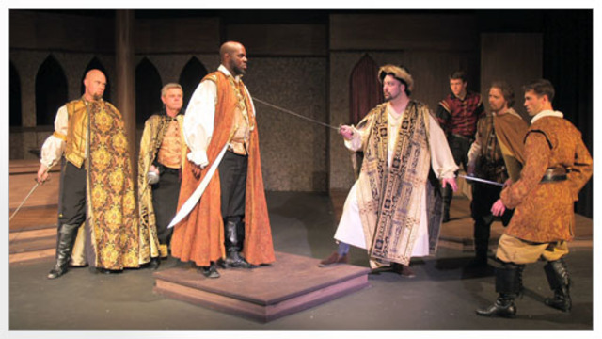

Slide 4
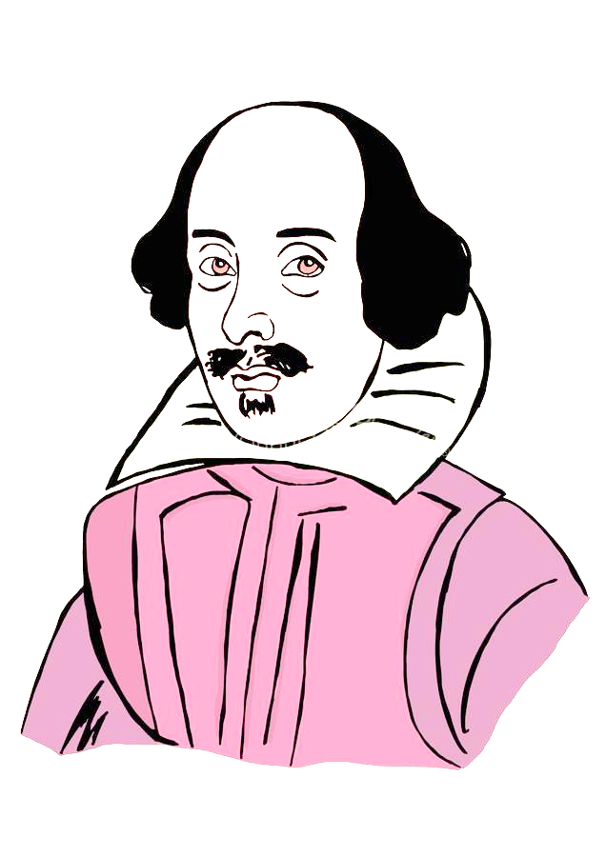
What’s going on in Scene 2 of Othello?
Monday, September 12, 2022
Good Progress | Excellent Progress
Describe the key features of Act 1 Scene 2 | Explain how what we are seeing fits with Shakespeare’s typical tragic arc.

Slide 6
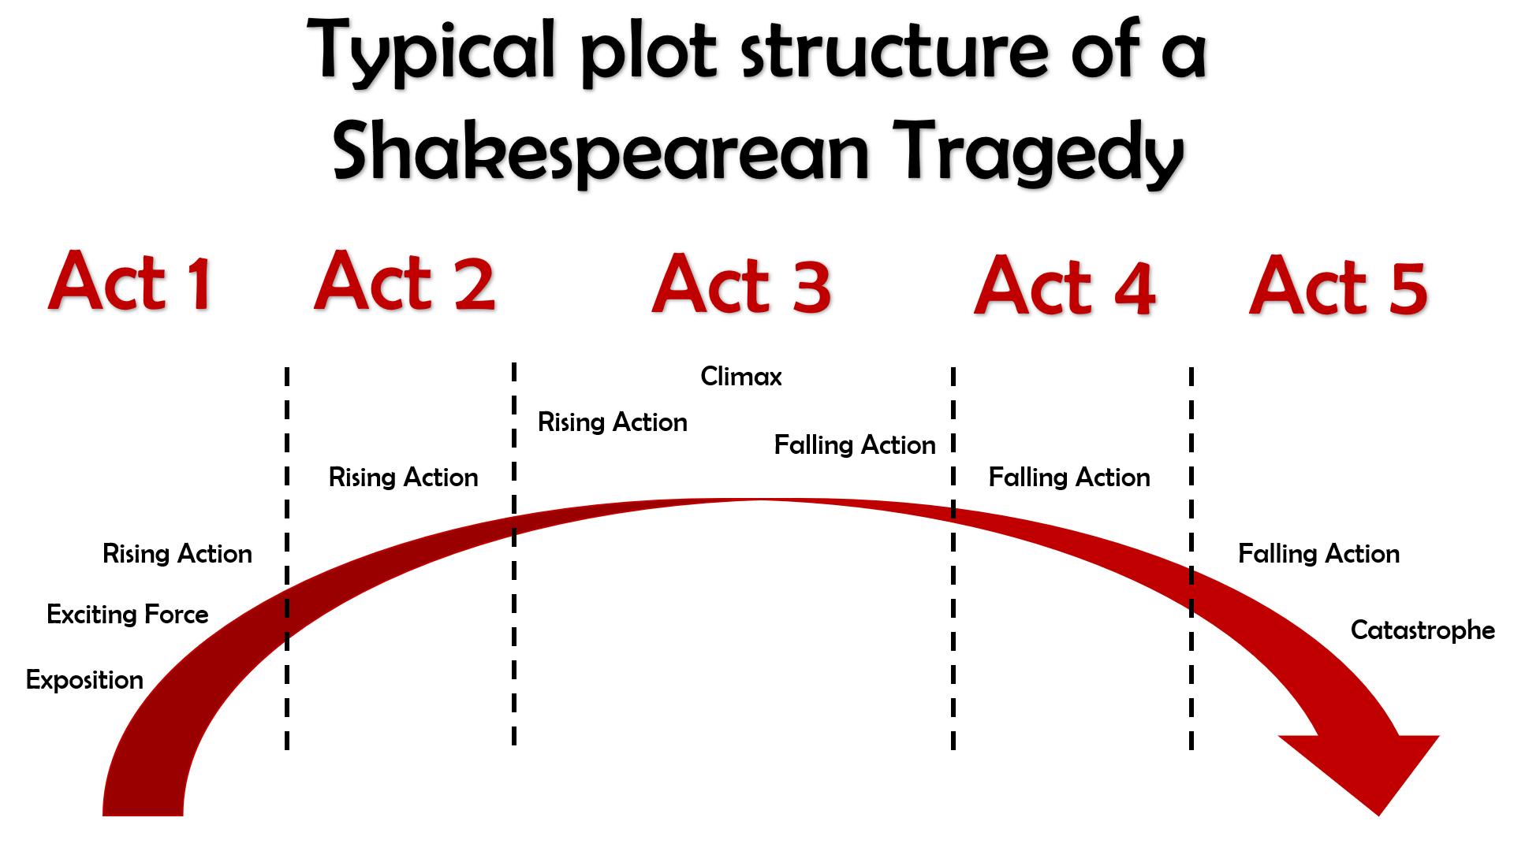
What kinds of things would we expect to see in Act 1?

Slide 7
Act I
The curtains open and the audience catches sight of a street in Venice. Iago is there, accompanied by a man who seems angry with him.
His name is Roderigo and he is upset because he has just found out that Othello ran off with Desdemona to marry her. Roderigo was secretly in love with Desdemona and claims Iago kept it a secret from him because he is so loyal to Othello.
Iago replies that actually, he hates Othello for not promoting him and promoting Michael Cassio instead. Iago claims Cassio only knows how to win battles by reading about them in books, not from first-hand experience of fighting and killing like he himself has.
Iago and Roderigo go to Desdemona’s home to tell her father, Brabantio, about the fact she ran off to marry Othello.
Brabantio is furious when he hears Iago’s message, but Iago sneaks off before Brabantio sees him, so that it will never get back to Othello that he was the one who told Desdemona’s father what was going on. Brabantio and Roderigo then go off in search of Othello and Desdemona.
The action then switches to Othello, who is in the process of being told by Cassio that the Duke of Venice has ordered him to sail to Cyprus to defend it from the Turks.
Brabantio though has heard of Othello’s location and barges in with Roderigo ready for a fight.
He is outraged that Desdemona has chosen Othello to marry instead of someone more important, richer and of better social status.
He claims that Othello used supernatural powers to bewitch and trick Desdemona into falling in love with him.
Othello though is calm in his reply and tells Desdemona’s father that they fell in love when Othello came to visit and stay with
Brabantio previously.
Othello then hears that the Duke of Venice is insistent that he leave for Cyprus that night, meaning he would have to leave Desdemona at home with her father for her protection.
Brabantio though forbids Desdemona from coming home with him, meaning Othello comes up with a plan for his friend Iago to accompany Desdemona to Cyprus some time later.
Act I ends with Iago formalizing his plan to destroy Othello by convincing him that Desdemona is having an affair with Cassio.

Slide 8
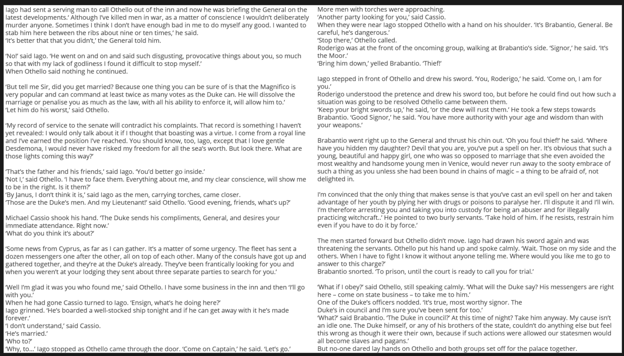
Act 1 Scene 2
Stick the sheet in the middle of a double page so you can annotate around it.
As we read through, highlight any words you aren’t sure the meaning of.
At the end, ask me for definitions and annotate your sheet.
We will annotate the passage together.
We will read this part of Act 1 Scene 2 in the original Shakespeare.

Slide 9
Iago had sent a serving man to call Othello out of the inn and now he was briefing the General on the latest developments.‘ Although I’ve killed men in war, as a matter of conscience I wouldn’t deliberately murder anyone. Sometimes I think I don’t have enough bad in me to do myself any good. I wanted to stab him here between the ribs about nine or ten times,’ he said.
‘It’s better that that you didn’t,’ the General told him.
‘No!’ said Iago. ‘He went on and on and said such disgusting, provocative things about you, so much so that with my lack of godliness I found it difficult to stop myself.’
When Othello said nothing he continued.
‘But tell me Sir, did you get married? Because one thing you can be sure of is that the Magnifico is very popular and can command at least twice as many votes as the Duke can. He will dissolve the marriage or penalise you as much as the law, with all his ability to enforce it, will allow him to.’
‘Let him do his worst,’ said Othello.
‘My record of service to the senate will contradict his complaints. That record is something I haven’t yet revealed: I would only talk about it if I thought that boasting was a virtue. I come from a royal line and I’ve earned the position I’ve reached. You should know, too, Iago, except that I love gentle Desdemona, I would never have risked my freedom for all the sea’s worth. But look there. What are those lights coming this way?’
‘That’s the father and his friends,’ said Iago. ‘You’d better go inside.’
‘Not I,’ said Othello. ‘I have to face them. Everything about me, and my clear conscience, will show me to be in the right. Is it them?’
‘By Janus, I don‘t think it is,’ said Iago as the men, carrying torches, came closer.
‘Those are the Duke’s men. And my Lieutenant!’ said Othello. ‘Good evening, friends, what’s up?’
Michael Cassio shook his hand. ‘The Duke sends his compliments, General, and desires your immediate attendance. Right now.’
‘What do you think it’s about?’
‘Some news from Cyprus, as far as I can gather. It’s a matter of some urgency. The fleet has sent a dozen messengers one after the other, all on top of each other. Many of the consuls have got up and gathered together, and they’re at the Duke’s already. They’ve been frantically looking for you and when you weren’t at your lodging they sent about three separate parties to search for you.’
‘Well I’m glad it was you who found me,’ said Othello. I have some business in the inn and then ‘I’ll go with you.’
When he had gone Cassio turned to Iago. ‘Ensign, what’s he doing here?’
Iago grinned. ‘He’s boarded a well-stocked ship tonight and if he can get away with it he’s made forever.’
‘I don’t understand,’ said Cassio.
‘He’s married.’
‘Who to?’
‘Why, to…’ Iago stopped as Othello came through the door. ‘Come on Captain,’ he said. ‘Let’s go.’
More men with torches were approaching.
‘Another party looking for you,’ said Cassio.
When they were near Iago stopped Othello with a hand on his shoulder. ‘It’s Brabantio, General. Be careful, he’s dangerous.’
‘Stop there,’ Othello called.
Roderigo was at the front of the oncoming group, walking at Brabantio’s side. ‘Signor,’ he said. ‘It’s the Moor.’
‘Bring him down,’ yelled Brabantio. ‘Thief!’
Iago stepped in front of Othello and drew his sword. ‘You, Roderigo,’ he said. ‘Come on, I am for you.’
Roderigo understood the pretence and drew his sword too, but before he could find out how such a situation was going to be resolved Othello came between them.
‘Keep your bright swords up,’ he said, ‘or the dew will rust them.’ He took a few steps towards Brabantio. ‘Good Signor,’ he said. ‘You have more authority with your age and wisdom than with your weapons.’
Brabantio went right up to the General and thrust his chin out. ‘Oh you foul thief!’ he said. ‘Where have you hidden my daughter? Devil that you are, you’ve put a spell on her. It’s obvious that such a young, beautiful and happy girl, one who was so opposed to marriage that she even avoided the most wealthy and handsome young men in Venice, would never run away to the sooty embrace of such a thing as you unless she had been bound in chains of magic – a thing to be afraid of, not delighted in.
I’m convinced that the only thing that makes sense is that you’ve cast an evil spell on her and taken advantage of her youth by plying her with drugs or poisons to paralyse her. I’ll dispute it and I’ll win. I’m therefore arresting you and taking you into custody for being an abuser and for illegally practicing witchcraft..’ He pointed to two burly servants. ‘Take hold of him. If he resists, restrain him even if you have to do it by force.’
The men started forward but Othello didn’t move. Iago had drawn his sword again and was threatening the servants. Othello put his hand up and spoke calmly. ‘Wait. Those on my side and the others. When I have to fight I know it without anyone telling me. Where would you like me to go to answer to this charge?’
Brabantio snorted. ‘To prison, until the court is ready to call you for trial.’
‘What if I obey?’ said Othello, still speaking calmly. ‘What will the Duke say? His messengers are right here – come on state business – to take me to him.’
One of the Duke’s officers nodded. ‘It’s true, most worthy signor. The Duke’s in council and I’m sure you’ve been sent for too.’
‘What?’ said Brabantio. ‘The Duke in council?’ At this time of night? Take him anyway. My cause isn’t an idle one. The Duke himself, or any of his brothers of the state, couldn’t do anything else but feel this wrong as though it were their own, because if such actions were allowed our statesmen would all become slaves and pagans.’
But no-one dared lay hands on Othello and both groups set off for the palace together.

Slide 11
Iago features heavily in the play’s exposition. For example…
Iago and Roderigo are responsible for the play’s exciting force. For example…
A good example of rising action in Act 1 is when… This counts as rising action because…

Slide 12
Quick quiz
Shakespeare is respected because he is good at the technique known as c_________.
Which character at the beginning of Scene 1 is overtly racist?
Which character at the beginning of Scene 1 is more subtle in the way they talk about Othello’s race?
Shakespeare is famous for his i_________ on later authors and popular culture nowadays.
Culture could flourish during Shakespeare’s time, since England was at p____ for the majority of Elizabeth’s reign.
Characterization
Roderigo
Iago
influence
5. Peace

Slide 13
Quick quiz
Who are the main three characters in the play?
Who is the antagonist of the play?
What is his wife’s name?
Who could we say for sure is definitely a tragic victim in the play?
An average Elizabethan would have been more c_______ than racist when encountering a Moor like Othello.
Othello, Desdemona and Iago
Iago
Emilia
Desdemona
5. Curious

Slide 14
What’s going on in Scene 2 of Othello?
Monday, September 12, 2022
Good Progress | Excellent Progress
Describe the key features of Act 1 Scene 2 | Explain how what we are seeing fits with Shakespeare’s typical tragic arc.

