Slide 1
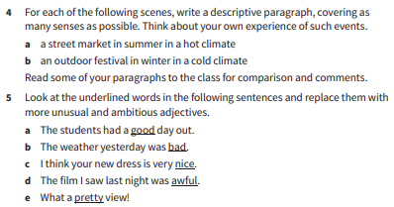
1a. Read and highlight the key information in the Key Point and Task Tip boxes on this page.
3a. Read and highlight the important points in the ‘Key point’ and ‘Task tip’ boxes.

Slide 3
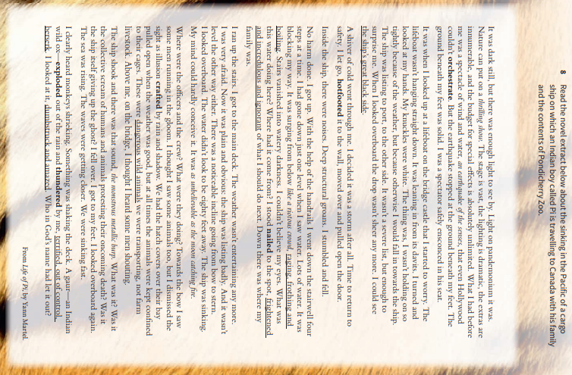
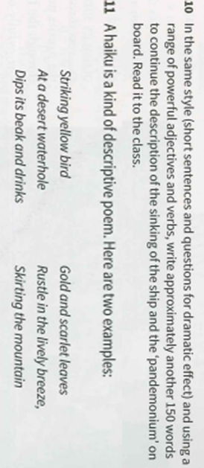

Slide 4
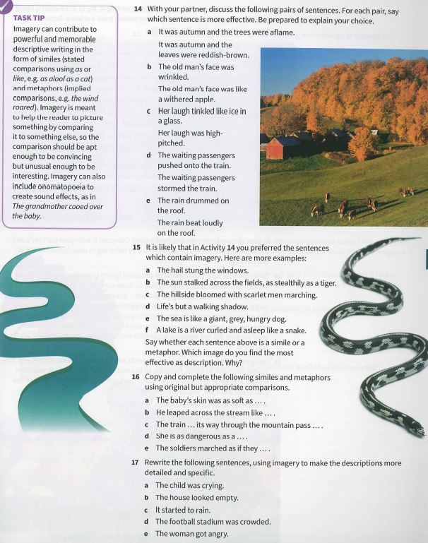
Look at
and

