Slide 1
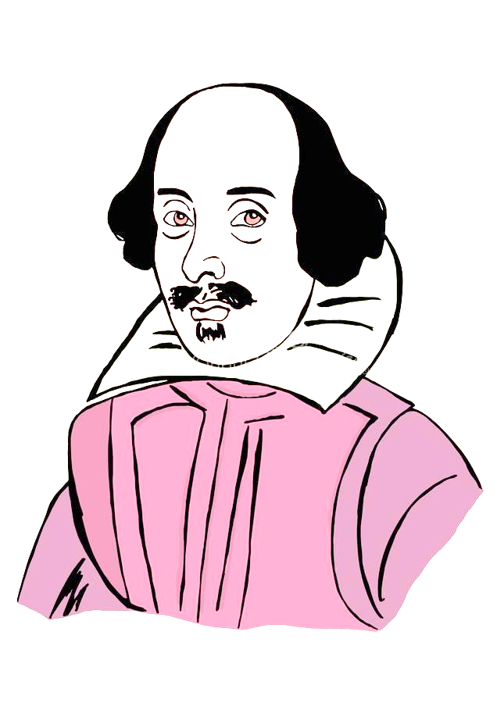
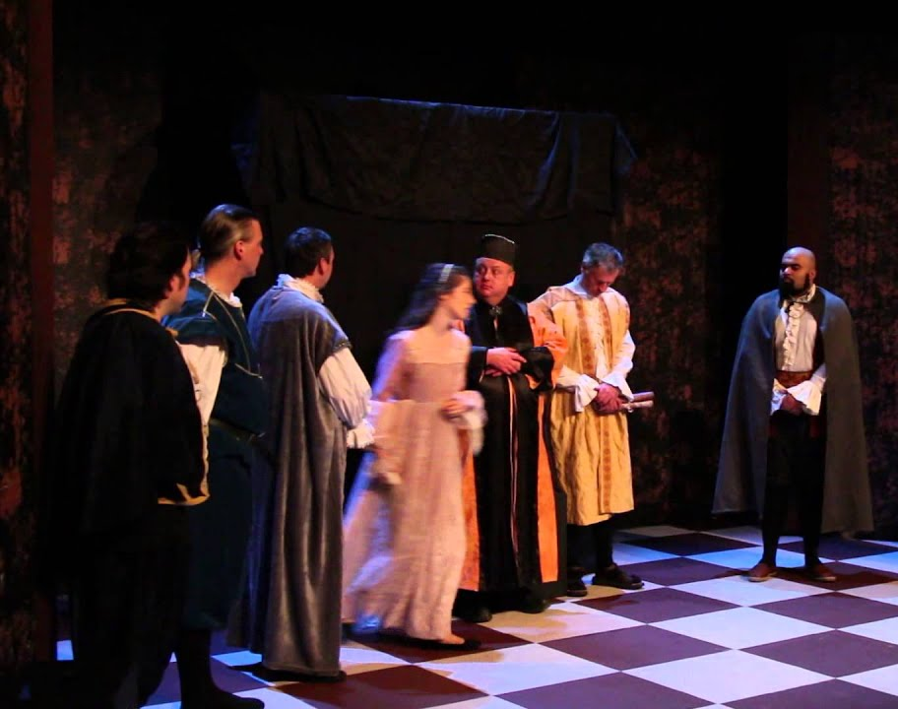
Finishing Act 1 Scene 3 of Othello
Monday, September 19, 2022
Good Progress | Excellent Progress
Describe the key features of the end Act 1 Scene 3 | Explain how what we are seeing fits with Shakespeare’s typical tragic arc.

Slide 2
Starter task…
Summarise the story so far in exactly 57 words.

Slide 5
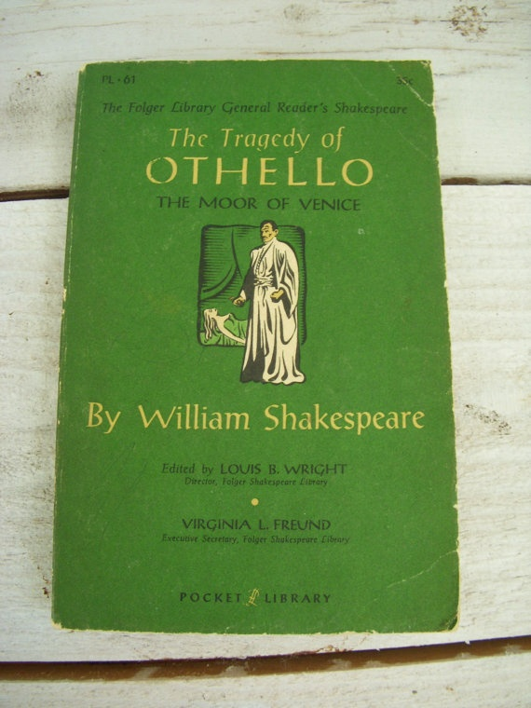
Reading Scene 3 of Othello…
Let’s finish reading and annotating Act 1, Scene 3 in modern English.
Let’s read Act 1 Scene 3 in Shakespearean language.

Slide 7
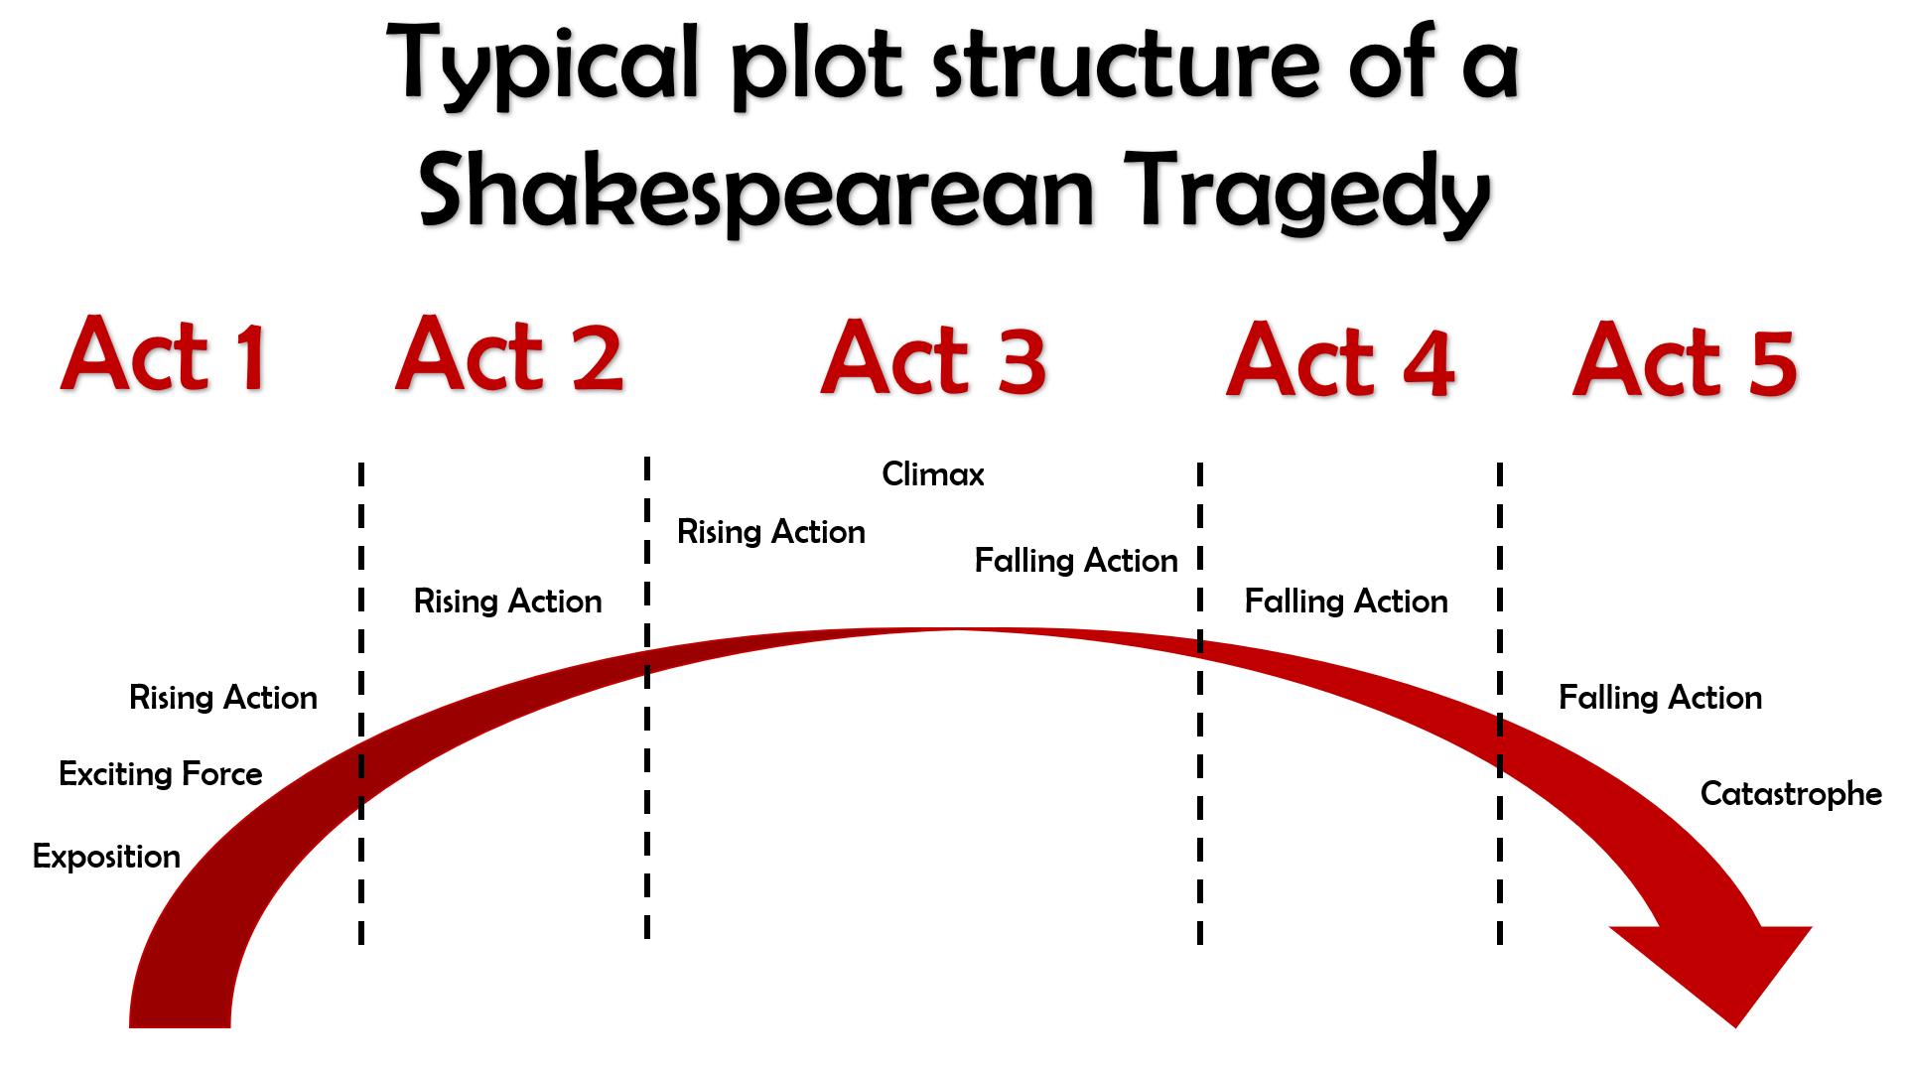
Give an example of exposition, exciting force and rising action.

Slide 8
Act I
The curtains open and the audience catches sight of a street in Venice. Iago is there, accompanied by a man who seems angry with him.
His name is Roderigo and he is upset because he has just found out that Othello ran off with Desdemona to marry her. Roderigo was secretly in love with Desdemona and claims Iago kept it a secret from him because he is so loyal to Othello.
Iago replies that actually, he hates Othello for not promoting him and promoting Michael Cassio instead. Iago claims Cassio only knows how to win battles by reading about them in books, not from first-hand experience of fighting and killing like he himself has.
Iago and Roderigo go to Desdemona’s home to tell her father, Brabantio, about the fact she ran off to marry Othello.
Brabantio is furious when he hears Iago’s message, but Iago sneaks off before Brabantio sees him, so that it will never get back to Othello that he was the one who told Desdemona’s father what was going on. Brabantio and Roderigo then go off in search of Othello and Desdemona.
The action then switches to Othello, who is in the process of being told by Cassio that the Duke of Venice has ordered him to sail to Cyprus to defend it from the Turks.
Brabantio though has heard of Othello’s location and barges in with Roderigo ready for a fight.
He is outraged that Desdemona has chosen Othello to marry instead of someone more important, richer and of better social status.
He claims that Othello used supernatural powers to bewitch and trick Desdemona into falling in love with him.
Othello though is calm in his reply and tells Desdemona’s father that they fell in love when Othello came to visit and stay with
Brabantio previously.
Othello then hears that the Duke of Venice is insistent that he leave for Cyprus that night, meaning he would have to leave Desdemona at home with her father for her protection.
Brabantio though forbids Desdemona from coming home with him, meaning Othello comes up with a plan for his friend Iago to accompany Desdemona to Cyprus some time later.
Act I ends with Iago formalizing his plan to destroy Othello by convincing him that Desdemona is having an affair with Cassio.

Slide 9
‘Desdemona loved listening too. Every now and then her household duties would drag her away but she came back as soon as she could and listened hungrily. Seeing that, one day I chose a convenient time to talk to her and she begged me to tell her the parts of the story that she had missed. I agreed, and found that she often wept when I spoke of some distressing episode in my youth.
When I had told the full story she responded with a world of sighs. She exclaimed that it was a strange story, a very strange story, that it was sad, very sad. She wished that she hadn’t heard it, but she wished that she had been a man so that she could have had such adventures. She thanked me and told me that if I had a friend who loved her I should teach him how to tell my story and that would win her heart. On that hint I spoke out. She loved me for the dangers I had experienced and I loved her for pitying them. That is the only witchcraft I have used.’
The door was opened again and Desdemona stood there.
‘There she is,’ said Othello, as Iago led her forward to stand before the Duke. ‘Let her tell you.’ The Duke waved to Desdemona to be seated. He turned to Brabantio. ‘I think this story would win my daughter too,’ he said ‘Good Brabantio, why don’t you make the best of a bad job? Broken weapons are better than bare hands in battle.’
‘Please,’ said Brabantio, ‘listen to her. If she tells you that she takes half the blame for this then I’ll accept it.’ He drew his chair closer to Desdemona’s. ‘Come here, my darling,’ he said, taking her hand. ‘Can you see the person to whom you most owe obedience in this room?’
Desdemona gently removed her hand from his and stood up. ‘My noble father,’ she began. ‘I have a divided loyalty.’ Then she took his hand again. ‘I’m indebted to you for my life and education, and both my life and my education have taught me to respect you. I am still your daughter and I still have a duty to you.’ She turned and smiled at Othello and took his hand too. ‘But this is my husband,’ she said. ‘And just as my mother assumed a duty to you, putting you before her father, I have done the same, giving my duty to the Moor.’
‘God be with you then,’ said Brabantio. ‘I give up. If you don’t mind, Your Grace, let’s get on with state affairs.’ He wiped a tear from his cheek. ‘I’d rather adopt a child than have my own. Come here, Moor,’ he said.
He placed Desdemona’s hand in Othello’s and spoke in a businesslike way. ‘I give you with all my heart that which if you didn’t have it already, I would with all my heart have kept from you.’ Then to Desdemona: ‘As for you, Precious, I’m really glad I don’t have any other children because this would have made me so strict that I would have immobilised them with wooden blocks on their legs.’ He sat down. ‘I’ve finished, my Lord.’ The Duke pulled himself up and drew a line under the matter with a final word, telling them that he agreed with Brabantio that as there was nothing anyone could do about it there was no point in bearing grudges: that would just make matters worse. To harbour grudges was the way to the destruction of one’s own life.
When he had finished Brabantio nodded. ‘I suggest, with respect, that we get on with the affairs of state.’ The Duke cleared his throat and looked around at the assembled senators. ‘The Turks, heavily armed, are making towards Cyprus.
Othello, you have the best knowledge of the defences of Cyprus, and although we have a very effective man there, everyone knows that you’re more suitable. You must therefore accept that you have to interrupt your new condition with this more difficult and public expedition.’
Othello nodded his agreement. ‘The tyranny of habit, esteemed Senators, has made the hard and uncomfortable couch of war a soft bed for me. I acknowledge the prompt and natural liking I have for the hardness of war, and I accept this mission against the Ottomites. I ask, therefore, that you will offer my wife an appropriate place to live – some place that would suit her position.’
‘At her father’s perhaps,’ said the Duke.
‘I don’t want that,’ said Brabantio.
‘Neither do I,’ said Othello.
‘Nor I,’ said Desdemona. ‘I don’t want to live there, where my father could be hurt by my presence. My gracious Duke, listen to my idea and see if you can agree to it.’
‘What do you want?’ said the Duke. ‘Tell me.’
‘I’ve shown the whole world that, in spite of the problems it’s caused, I love the Moor enough to live with him. My heart is his entirely. I became aware of Othello’s qualities and dedicated my soul and my future to him. So, dear Senators, if I were to be left behind while he goes to war, I would be deprived of all the things I love him for and it would be very hard for me to be without him. Let me go with him.’
‘Give her your permission,’ said Othello. ‘Heaven knows, I’m not asking because I want to satisfy my appetite, not at all for my own desires – those youthful things having faded, – but to be generous to her wishes. And heaven forbid that you should think that I would neglect this serious and important business if she were with me. No, when the light pleasures of love dull my professional faculties, when my mind is distracted by sexual dalliance, then it’s time for housewives to make a saucepan of my brain and for my reputation to be eroded.’
The Duke nodded his approval. ‘Decide between yourselves whether she should stay or go. But this business is urgent and we must move fast. You must leave tonight.’
‘Tonight?’ Desdemona was taken aback.
‘Yes, tonight.’
‘Of course,’ said Othello. The Duke got up. ‘We’ll meet again at nine in the morning. Othello, leave an officer here and he’ll bring your orders to you, along with other matters of business that concern you.’

Slide 10
‘My ensign, my Lord,’ said Othello. ‘He’s honest and trustworthy. He can bring my wife and anything else your grace may want to send to me.’
‘So be it,’ said the Duke. ‘Good night to everyone. And Brabantio, if virtue is anything to go by, your son-in-law is far more fair than black.’
The senators wished Othello luck and one of them told him to take care of Desdemona. Brabantio stopped him as he was leaving. ‘Watch out for her, Moor, if you have eyes to see,’ he said. ‘She has deceived her father and may deceive you too.’
‘I would stake my life on her fidelity,’ Othello told him, and the two men parted as the Duke and senators left. ‘Honest Iago,’ said Othello. ‘I’m leaving my Desdemona in your care. Your wife can look after her. Bring them both to Cyprus in the best comfort you can manage. Come Desdemona, I’ve got just one hour to spend with you and to prepare. We must hurry.’
When they had gone Roderigo, who had watched everything with dismay, shook his head. ‘Iago?’
‘What, my dear friend?’
‘What do you think I should do?’
‘Go to bed and sleep, of course.’
‘I’m going to drown myself.’ Iago laughed. ‘You silly man. If you do that I’ll never respect you again!’
Roderigo slumped down and put his head in his hands. ‘It would be silly to live when life is such a torment,’ he said. ‘Death would be the best medicine right now.’
‘How wrong can you be?’ said Iago.
I’ve lived for twenty-eight years and ever since the time I could tell the difference between a good and a bad act I’ve never met anyone who could properly value himself. I would rather be a baboon than a man who would drown himself for the love of a whore.’
‘What should I do then? I confess that it’s shameful to be so foolish but there’s nothing I can do about it.’
‘Rubbish! What we can do, how we are, is up to ourselves. Our bodies are our gardens and our wills are gardeners. If we plant nettles or sow lettuce, whether we cultivate hyssop or weed out thyme, plant all one kind of herb or dilute it with many kinds, let it become sterile or fertilise it with hard work, all this depends on what we want to do. If the balance of our lives didn’t have a weight of reason to set against those weights of sensuality, the blood and natural bad that we have in our natures would take us to the most preposterous depths. But we do have reason to cool our raging emotions, our carnal desires and our unbridled lusts, which I take this – that you call love – to be.’
Roderigo looked up at him pathetically and shook his head slowly. ‘It can’t be.’
Iago laughed and pulled him to his feet. ‘It’s nothing more than a lust of the blood and a self indulgence of your will. Come on, be a man. Drown yourself? Drown cats and puppies. I have declared myself your friend and I tell you that I’m committed to your cause. I could never advise you better than I do now. Put some money in your purse and follow these wars. Disguise yourself, get a false beard.
Go on, put money in your purse. It’s impossible that Desdemona could continue her love for the Moor for long.
Put money in your purse. Nor could he love her for long. It was begun badly and you will see a separation. But put money in your purse. These Moors are changeable. Fill your purse with money. The food that is now as delicious as carob cobs to him will soon be as bitter tasting as crab apples. She will soon want someone young. When she’s had enough of his body she will see her mistake.
So put money in your purse. If you want to damn yourself do it in a more subtle way than drowning. Make as much money as you can. If a sanctimonious manner and a feeble vow between a barbarian and a vulnerable Venetian isn’t too hard for my intelligence and all the evil I can muster, you’ll enjoy her yet, so therefore make money. To hell with drowning yourself. It’s totally out of the question. You would be better off being hanged for realising your dream than being drowned and not having her.’
Roderigo’s hopefulness showed in his face. ‘If I depend on you will you do it for me?’
‘You can rely on me,’ said Iago. ‘Go and make money. I’ve often told you and I tell you again and again: I hate the Moor. My cause is deeply felt and yours has as much value. Let’s work together in our revenge against him. If you can cuckold him you’ll be getting pleasure and I’ll have some fun. There are a lot of things we can do, and which we will do. About turn. Go and get your money. We’ll talk again tomorrow. Good bye.’
‘Where will we meet in the morning?’
‘At my lodging.’
‘I’ll be there.’
‘Yes. Goodbye.’ Roderigo walked to the door and Iago called after him. ‘Roderigo!’ Roderigo turned. ‘What?’
‘No more talk of drowning, do you hear?’
‘I’ve changed my mind.’
‘Fine. Good bye. Put enough money in your purse.’
‘I’ll sell all my land,’ said Roderigo as he left. Iago waited a moment and then began walking home. He smiled grimly. As usual he was getting money out of fools. As if he would lower himself to spend time with such a pathetic individual unless he was having some fun and getting money out of it as well. As he walked he felt his hatred of the Moor well up. And he had heard that the Moor had been with his wife Emilia. He didn’t know whether it was true but he would take that hint of suspicion as a fact. He stood in high regard with the General and that would help his purpose. He began to plan his revenge. Cassio was a good looking man. He thought about that.
How could he get Cassio’s position of Lieutenant and get his revenge on the Moor at the same time? How?…How?… A strategy was developing in his mind. After a while, when they were settled in, be would make Othello think that Cassio was too familiar with Desdemona. Cassio was a handsome man with the charm and personality that could easily make women unfaithful. On the other hand the Moor had an open and trusting nature, thinking men are honest when they only seem to be so, and could be led by the nose as easily as a donkey.
Just as he got to his door he realised that he had his plan. It was born. He realised, too, that he had deliberately chosen evil.

Slide 11
Quick quiz
Shakespeare is respected because he is good at the technique known as c_________.
Which character at the beginning of Scene 1 is overtly racist?
Which character at the beginning of Scene 1 is more subtle in the way they talk about Othello’s race?
Shakespeare is famous for his i_________ on later authors and popular culture nowadays.
Culture could flourish during Shakespeare’s time, since England was at p____ for the majority of Elizabeth’s reign.
Characterization
Roderigo
Iago
influence
5. Peace

Slide 12
Quick quiz
Who are the main three characters in the play?
Who is the antagonist of the play?
What is his wife’s name?
Who could we say for sure is definitely a tragic victim in the play?
An average Elizabethan would have been more c_______ than racist when encountering a Moor like Othello.
Othello, Desdemona and Iago
Iago
Emilia
Desdemona
5. Curious

Slide 13
Finishing Act 1 Scene 3 of Othello
Monday, September 19, 2022
Good Progress | Excellent Progress
Describe the key features of the end Act 1 Scene 3 | Explain how what we are seeing fits with Shakespeare’s typical tragic arc.

